Slide 1
State Steering Team Meeting
March 12, 2021
www.osymigrant.org

Slide 2
Agenda
Welcome and Introductions - Doug Boline
Questions from States:
Counseling service(s) and how it is counted in MSIX - Zach Taylor (SC) and Emily Hoffman (MA)
Data/Forms Package – Marty Jacobson (META)
TST Work Group Reports
Onboarding Process- What We Have Learned
Margarita Munoz (GA) and Emily Salinas (IN)
At-Risk Secondary Student Profile Discussion
Marty Jacobson
Materials for Summer Programs
Breakout Discussion
How are states going to use iSOSY materials in the summer of 2021?
What support do you need as you implement summer services?
Mentoring Plan for new states or states with new state directors - Marty Jacobson
TST Training and Coaching Institute
TBD May 2021
Final GOSOSY State Profile Reports
Fall 2021 meeting dates
www.osymigrant.org

Slide 3
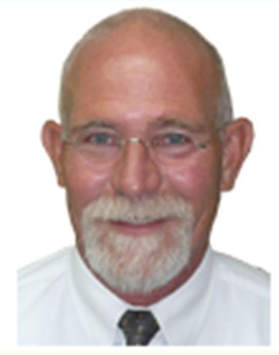
Instructional Services
for OSY and Secondary Youth
Doug Boline
Kansas Migrant Education MEP State Director
www.osymigrant.org

Slide 4
iSOSY Objectives
Objective 1: Each year, 70% of migratory OSY and secondary youth at-risk of dropping out who participate in iSOSY instructional support will demonstrate 5% growth on iSOSY curriculum-based assessments.
iSOSY lessons with curriculum-based assessments include life skills lessons, personal wellness lessons, reading and math lessons, some of the English lessons, and others that are in development.
TST and evaluator will work on a glossary of terms and local data collection tools.
www.osymigrant.org

Slide 5
iSOSY Objectives
Objective 2: By the end of Year 3, iSOSY States will support 144 migratory youth (average increase of 3 per state over baseline) to obtain an HSED or regular high school diploma.
This Objective is cumulative over three years.
We want to know about migratory youth who achieve this with assistance from MEP instructional services.
www.osymigrant.org

Slide 6
iSOSY Objectives
Objective 3: By the end of Years 2 and 3, 80% of staff participating in iSOSY professional development (PD) will increase knowledge and understanding of strategies to promote graduation and attainment of postsecondary credentials appropriate for the needs of their students.
We will be measuring this directly in Year 2 after new professional development has been created and implemented.
We will still collect results of professional development provided in Year 1 via the staff training survey.
www.osymigrant.org

Slide 7
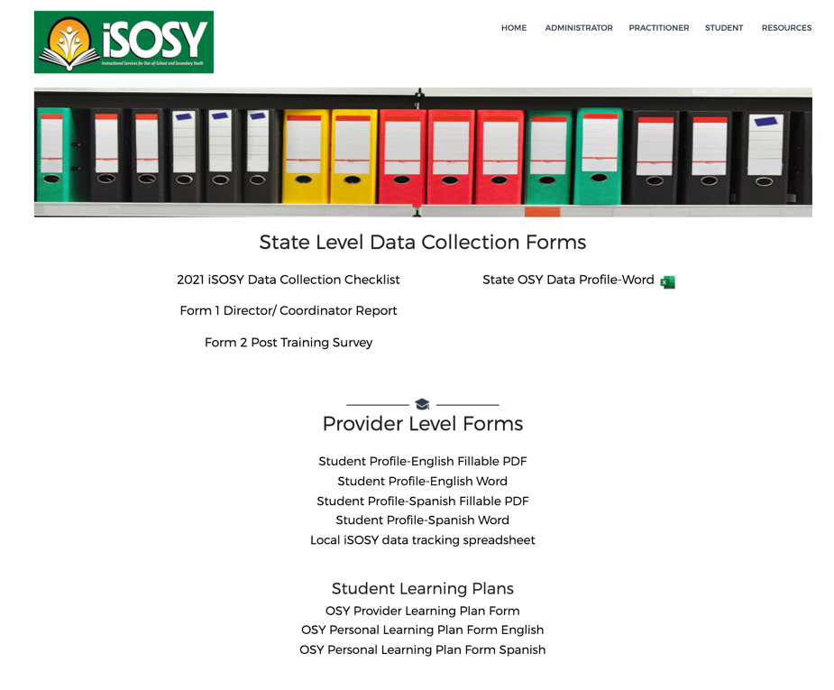
Data Collection Forms
State Level Forms:
Checklist
Form 1 (Director/Coordinator Report)
Form 2 (Post Training Survey)
State OSY Profile Summary
Provider Level Forms:
OSY Student Profile
Learning Plan
Local Data Collection Spreadsheet
www.osymigrant.org

Slide 8
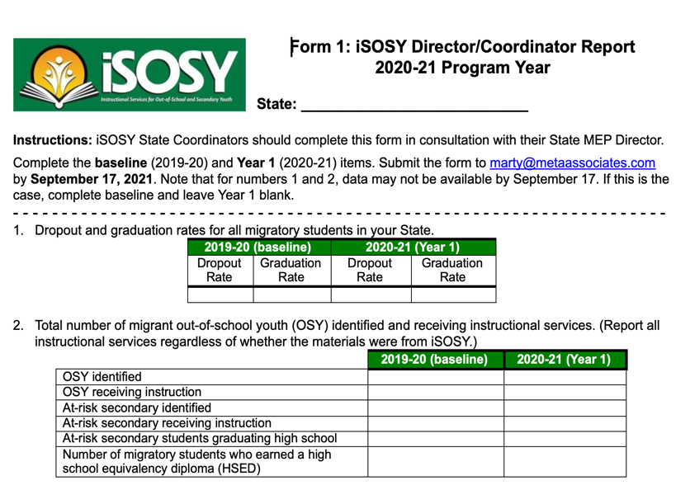
Form 1: Items 1 and 2
For the graduation rates and dropout rates, report baseline data if Year 1 data is not available by September 17, 2021.
For item 2, use the same definitions for identification of students and provision of services as is used for the CSPR. When we ask about instruction for this one, we are asking about ANY instruction provided, whether associated with iSOSY or not.
At-risk secondary students are generally students identified as PFS in grades 9-12. However, states have the option of expanding this definition.
www.osymigrant.org

Slide 9
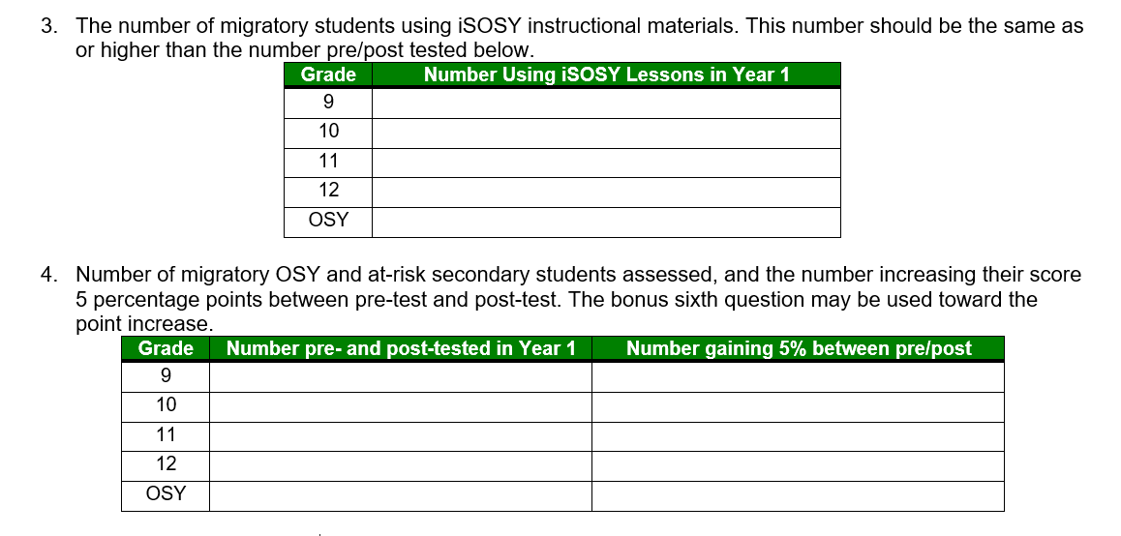
Form 1: Items 3 and 4
Item 3: Count the number of students by grade receiving instruction with iSOSY lessons in Year 1 (2020-21, same dates as the MEP reporting period). Count students receiving instruction even if they did not do a pre-/post-test. You may wish to use the Local Data Collection Worksheet to collect from local projects.
Item 4: Count only students with both a pre-test and a post-test score in the first column, and count the number gaining 5% (usually any gain) in the second column. If a student earned 100% on both the pre- and the post-test, leave that student out of both counts.
www.osymigrant.org

Slide 10
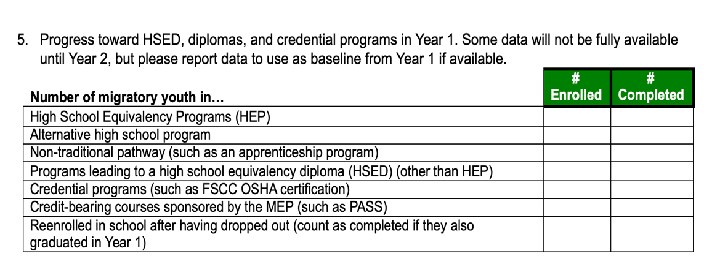
Form 1: Item 5
Item 5: Not required in Year 1 but will be required in Year 2. Not all sites/states will have students enrolled in all areas, but the goal is to have students enrolled in one or more areas by the end of Year 2.
www.osymigrant.org

Slide 11
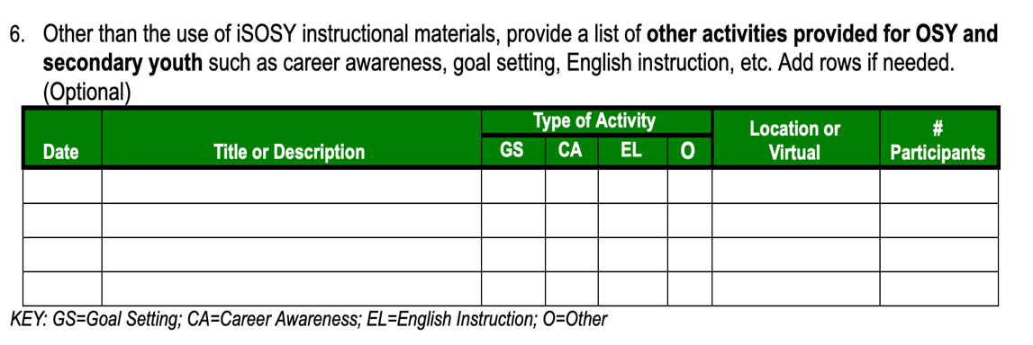
Form 1: Item 6
Item 6: Not required. What special projects were implemented in Year 1 with OSY and secondary youth? Examples include leadership activities, college/university site visits, virtual conferences, goal setting workshops, career fairs, etc.
www.osymigrant.org

Slide 12
Form 1: Item 7
Item 7: List local or statewide training provided. Do NOT include webinars conducted by iSOSY. We already have that information. (If staff only attended national training, you may leave the table blank.)
www.osymigrant.org

Slide 13
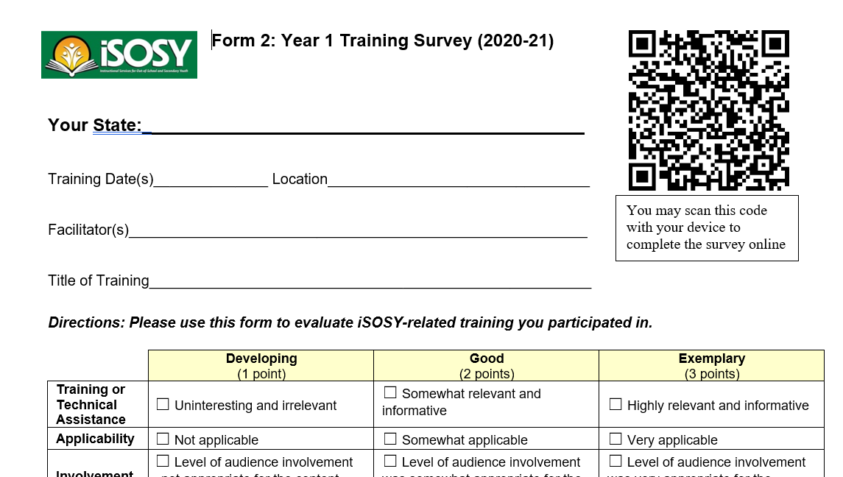
Form 2
Use the training survey after each local or state training provided that included iSOSY content.
You may have participants complete the Word document, write on paper, or use the survey link.
www.osymigrant.org

Slide 14
Form 1: Item 8
Item 8: List the number of students who completed a learning plan in the first column, and the number who made any amount of progress on the plan in the second column. You may use the iSOSY learning plan or another learning plan your state is implementing. You may also use a modified version of the iSOSY learning plan.
www.osymigrant.org

Slide 15
Data Collection from Local Projects
www.osymigrant.org

Slide 16
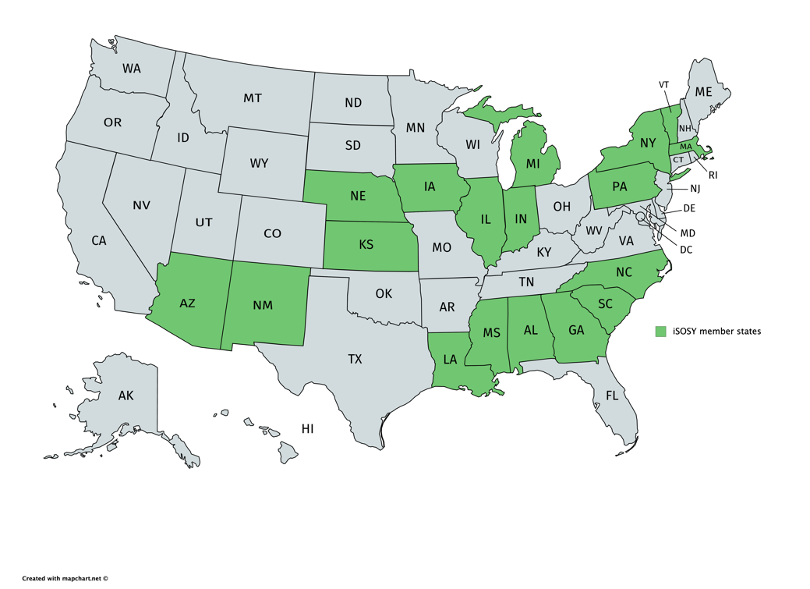
iSOSY Onboarding
10 states
participating
3 meetings
to date
Topics include:
-State responsibilities
-Data reporting
-Use of materials
-Website function
-FAQs
www.osymigrant.org

Slide 17
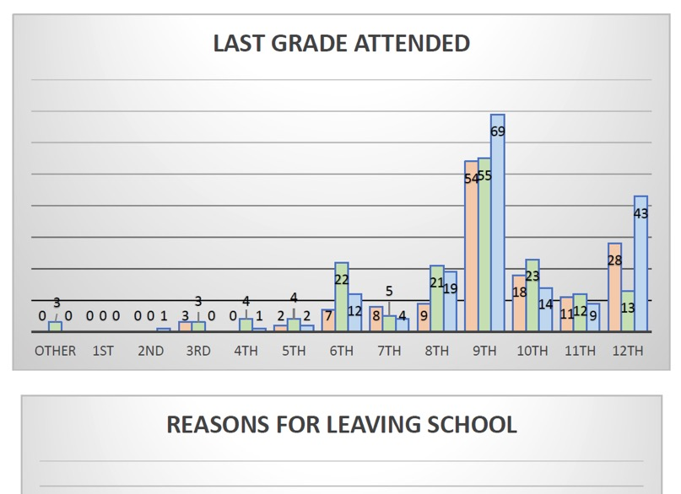
At-Risk Secondary Student Profile
We have plans in place for doing OSY Profiles to produce needs data for states (see graphic to the right).
We proposed something similar for at-risk secondary students.
Which states currently collect PFS risk factors for all secondary students?
If you don’t currently collect this information, would it be something you would want to begin collecting for 2021-22?
www.osymigrant.org

Slide 18
Mentoring Committee
Members:
FII indicators: 1.2
1.2 Establish iSOSY mentors and mentoring plan for technical assistance with serving OSY and at-risk secondary students, designing summer services, helping students along pathways, establishing programs for students, identifying at-risk students.
Tracie Kalic (lead- iSOSY)
Joyce Bishop (AL)
Emily Hoffman (MA)
Michelle Williams (MI)
Odilia Coffta (NY)
Hunter Ogletree (NC)
Zachary Taylor (SC)
www.osymigrant.org

Slide 19
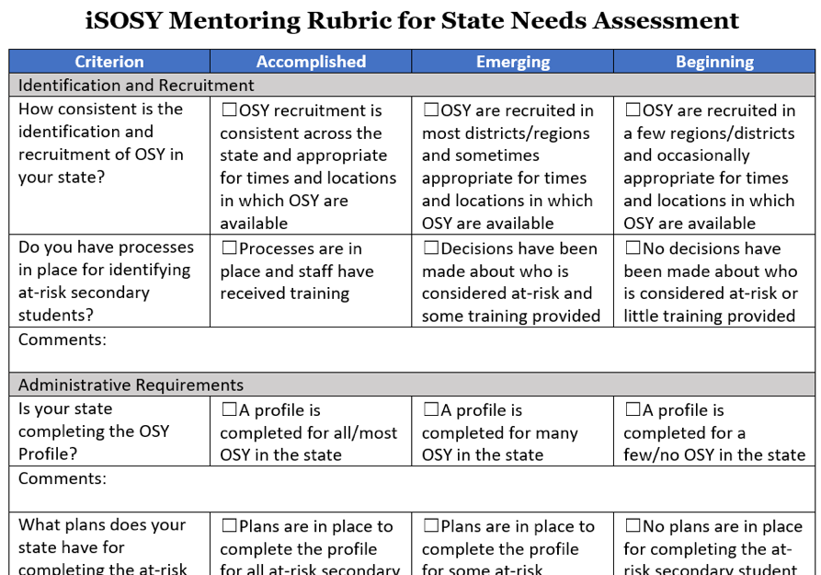
Mentoring Plan
Mentoring rubric will be completed by the end of Year 1 with new states and new directors (and anyone else who wants to participate).
During the fall SST meeting we will look at the top areas where assistance is needed.
We will choose mentors for those areas.
Mentors will prepare a short 20-30 minute talk on the area and present virtually with 30-40 minutes of time for questions and discussion.
Anyone who wishes to participate in the discussion may do so and set up time with the mentor for follow-up.
www.osymigrant.org

Slide 20
Materials for Summer Piloting
Suicide Prevention training module
COVID-19 lesson
English for Daily Life
iSOSY Website 101 webinar
Preparing for College (revised)
Secondary At-Risk Profile (pilot)
www.osymigrant.org

Slide 21
Breakout Discussion
How are states going to use iSOSY materials in the summer of 2021?
What support do you need as you implement summer services?
www.osymigrant.org

Slide 22
TST Work Groups
Curriculum
FII indicators: 1.5
1.5 Prepare initial catalog of lessons for wide array of academic backgrounds and identify assessment and instructional materials appropriate for various pathways and methods of instruction including asynchronous, synchronous, and summer.
Finalize English for Daily Life revisions and lesson plans.
Review English Language Screener feedback and make recommendations for revisions.
Develop Life Skills lesson on COVID-19.
Members:
Brenda Pessin (lead- iSOSY)
Laurie Stewart (LA)
Veronica Hill (NE)
C. Hope Derry (NC)
Wilson Kendrick (MS)
Lori Potutschnig (PA)
www.osymigrant.org

Slide 23
TST Work Groups
Technology and Student Portal
Travis Williamson (lead - NY)
Emily Salinas (IN)
Andy Wallace (IN)
Michelle Mattson (MI)
Iggy Campos (NM)
Sarah Braun-Hamilton (VT)
Members:
FII indicators: 1.11 and 1.12
1.11 Plan and design student portal with resources that can be used with and without instructional support and options for synchronous and asynchronous instruction.
1.12 Create a plan and processes for transferring Learning Plans state to state.
www.osymigrant.org

Slide 24
TST Work Groups
Pathways
FII indicators: 1.6, 1.7, 1.8, and 1.14
1.6 Develop Pathways Guide to HSED and credentials that includes information about prerequisite skills and assessments (instructor version).
1.7 Prepare guide for students on a pathway to HSED exams that includes information about benefits of an HSED, resources, and direction to instruction.
1.8 Prepare guide for students on a pathway to credential programs that includes benefits of various programs (including FSCC programs), resources, and direction to instruction.
1.14 Develop training materials/webinars on pathways to HSED and credentials.
Members:
Emily Hoffman (lead-MA)
Janet Reynolds (KS)
John Farrell (KS)
Bruce Lack (MI)
Hunter Ogletree (NC)
www.osymigrant.org

Slide 25
TST Work Groups
Career Awareness and Goal Setting
Members:
FII indicators: 1.9
1.9 Develop goal setting and career awareness materials (include materials to assess progress or attainment of lesson objectives).
Emily Williams (lead- SC)
Joyce Bishop (AL)
Merriam Massey (AZ)
Lizy Garcia Ramirez (IL)
Mary Speyrer (LA)
Shantella Singleton (PA)
www.osymigrant.org

Slide 26
TST Work Groups
Personal Wellness
FII indicators: 1.10 and 1.17
1.10 Develop materials to enhance personal wellness (include materials to assess progress or attainment of lesson objectives).
1.17 Develop training materials regarding impact of trauma.
Members:
Lysandra Alexander
(lead- PA)
Lora Thomas (iSOSY)
Susana Das Neves (IL)
Valeria Peña (IA)
www.osymigrant.org

Slide 27
TST Work Groups
Professional Learning
FII indicators: 1.16
1.16 Develop training materials for distance education (how to use virtual learning tools for students and service providers).
Members:
Sabrina Rivera-Pineda (lead- GA)
April Roberts (GA)
Odilia Coffta (NY)
April Dameron (IA)
www.osymigrant.org

Slide 28
At-Risk Secondary Students
Who are at-risk secondary students?
States have an option on how to define this. Here are two possible definitions:
Migratory students in grades 9-12 who are priority for services (PFS)
Migratory students in grades 9-12 who meet the at-risk definitions your state has outlined for PFS (but not necessarily the move within 1-year period part)
www.osymigrant.org

Slide 29
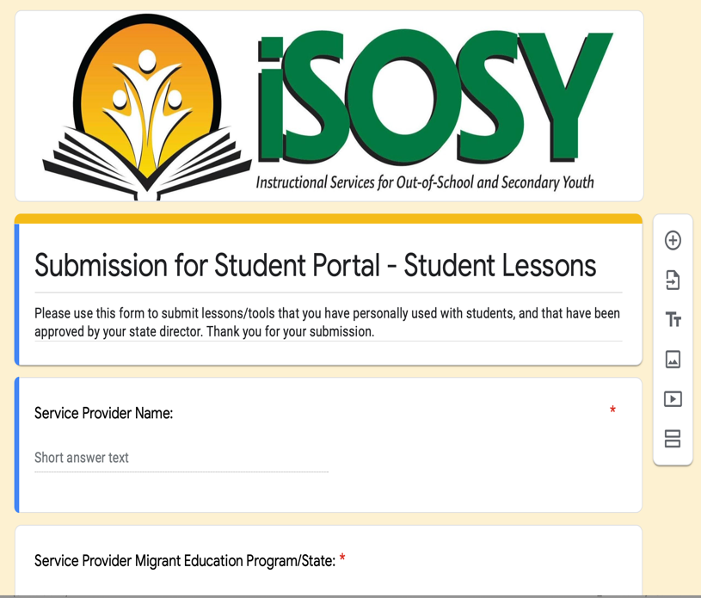
Submissions for
Student Portal Lessons
Committee:
Tracie Kalic - lead
Brenda Pessin (iSOSY consultant)
C. Hope Derry (NC)
Travis Williamson (NY)
Sarah Braun-Hamilton (VT)
www.osymigrant.org

Slide 30
PILOT - Submissions for
Student Portal Lessons
FIVE states will pilot the lesson submission project.
A letter, lesson plan template, and link to Google Form will go out at end of March.
Committee will vet the submissions for inclusion on the Student Portal.
Process will be finalized and shared with all states.
www.osymigrant.org

Slide 31
TST Training and Coaching Institute
Work groups will develop training materials ahead of the Institute.
Model use of instructional materials
Opportunities for practice and coaching
Date: Late May 2021
www.osymigrant.org

Slide 32
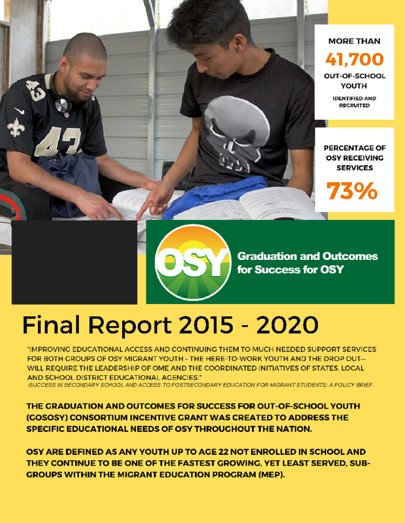
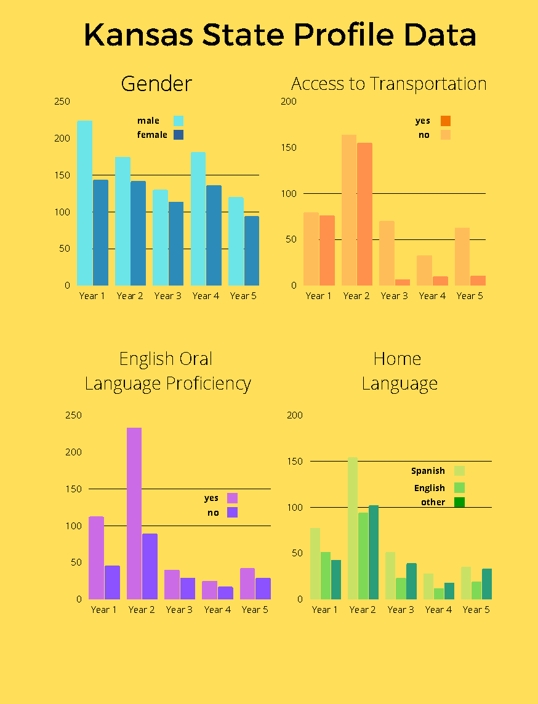
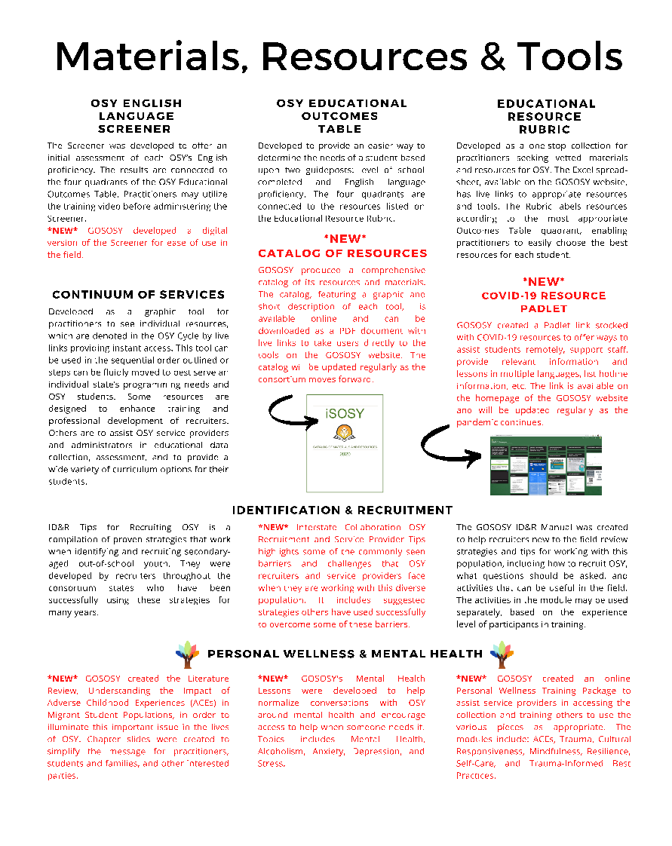
Final GOSOSY State Reports
Your State
Data
More
www.osymigrant.org

Slide 33
Upcoming Meetings
iSOSY Presentation at ADM March 23, 2021
TST Training and Coaching Institute Late May 2021
IMEC Meeting October 2021
Next SST meeting
www.osymigrant.org

