Slide 1
iSOSY Personal Wellness
Adverse Childhood Experiences (ACEs)
Presenter, title, organization
www.osymigrant.org
Notes:
Welcome to the recorded version of iSOSY’s training on Adverse Childhood Experiences, or ACEs.
An understanding of Adverse Childhood Experiences is vital to anyone seeking an understanding of the effects of trauma in students’ lives and how to offer trauma-informed care.
This module focuses on common responses that occur in reaction to ACEs when an individual’s coping abilities are overwhelmed as they experience an adverse event or series of events.
ACEs appear in many forms and can affect brain development, behavior, and learning. These effects convey life-long implications for health.
Childhood trauma is not something one just “gets over” as one ages. The repeated stress of abuse, neglect, and family members struggling with mental health or substance abuse issues has real, tangible effects on the development of the brain.
These effects unfold across a lifetime, exposing those who have experienced high levels of trauma to the risk of chronic physical health issues, depression, and other mental health struggles.

Slide 2
Adverse Childhood Experiences (ACEs)
Today you will learn to:
Understand the importance of resilience in the lives of migratory students affected by ACEs.
Understand the role that ACEs plays in the lives of migratory students and families.
Learn to use the ACEs Questionnaire to determine personal ACEs scores.
www.osymigrant.org
Notes:
Today we will:
Understand the importance of ACEs in the lives of migratory students and families.
Learn to use the ACEs Questionnaire to determine personal ACEs scores.

Slide 3
Adverse Childhood Experiences (ACEs)
Today you will learn to:
Access the ACEs Literature Review and accompanying slide presentations on the iSOSY website as tools to help others understand ACEs.
Determine the appropriate resources to connect with when helping others determine their ACEs score and any resulting mental/emotional/physical health issues.
www.osymigrant.org
Notes:
We will also:
Access the ACEs Literature Review and accompanying slide presentations on the iSOSY website as tools to help others understand ACEs.
Determine the appropriate resources to connect with when helping others determine their ACEs score and any resulting mental, emotional or physical health issues.

Slide 4
Adverse Childhood Experiences (ACEs)
What are ACEs?
ACEs =Adverse Childhood Experiences
These are traumatic or stress-inducing experiences that happen before adulthood and affect brain chemistry, especially with prolonged exposure.
Having a score of four (4) or more ACEs has been linked to developing alcoholism, drug abuse, depression, and chronic illness in adulthood.
Let’s take a look at the different types of ACEs.
www.osymigrant.org
Notes:
You may have heard of ACEs when reading and learning about stress and anxiety.
ACEs stands for Adverse Childhood Experiences.
These prolonged adverse experiences during childhood can create toxic stress which may negatively impact brain development.
Studies prove that children who experience multiple adverse experiences are at risk to later develop health problems that include drug and alcohol abuse, depression, and chronic illness.

Slide 5
Adverse Childhood Experiences (ACEs)
ACEs
categories
Notes:
ACEs are divided into three categories:
Abuse
Neglect
Family/household dysfunction
Abuse includes physical, emotional, or sexual abuse.
Neglect may mean physical or emotional neglect.
Household dysfunction includes a family member’s incarceration, a caregiver’s mental illness or substance abuse, or a family member – usually a mother – treated violently.
As stated before, an individual with a score of four or more ACEs has a higher risk of developing alcoholism, drug abuse, depression, and chronic illness in adulthood.
Let’s take a look at the ACEs Questionnaire as a tool to help each individual determine their personal ACEs score.

Slide 6
Adverse Childhood Experiences (ACEs)
ACEs Questionnaire
Take the ACEs Questionnaire.
Think about yourself or someone you love.
There is no need to share the results.
Did someone in your life make a difference in improving outcomes?
Notes:
The objective of this activity is to discover our own personal ACEs score so that we may better explain to others the process of using the ACEs Questionnaire.
Self-knowledge is the first step toward recognizing the effects of ACEs on a personal level and realizing the need to develop strategies that help to cope, calm, and heal.
You should have a hard copy of the ACEs Questionnaire in front of you.
Take the time you need to review the list of questions and answer honestly. You will not be sharing your answers. This exercise if for your own private benefit.
--PAUSE—
Now that you have answered the questions, you will simply add up the points (1 for each “yes” answer) to determine your own personal ACEs score.
Take a few more moments for quiet reflection.
Did you realize anything that you were not expecting?
--PAUSE—
Are you surprised at your final score?
--PAUSE—
Do you believe your own ACEs score influences your level of personal well-being?
--PAUSE—

Slide 7
Adverse Childhood Experiences (ACEs)
Effects of ACEs Beyond Childhood
www.osymigrant.org
Notes:
This video does a very good job of illustrating how Adverse Childhood Experiences can result in challenges during adulthood.
Childhood abuse can have far-reaching effects.
From insecurities to intimacy issues, from not daring to trust people to difficulties making friends, the effects of childhood abuse can show in any area of your life.
Let’s watch the video “7 Ways Childhood Trauma Follow You into Adulthood”
--PLAY VIDEO—
Let’s review the seven ways childhood trauma can follow you into adulthood:
1. You do not remember your younger years.
2. You find yourself in toxic relationships.
3. You feel like you do not deserve love at all.
4. You develop passive aggressiveness.
5. Negative self-talk is amplified.
6. You ride an emotional rollercoaster.
7. You do not know who you are.
Now let’s consider:
Do we know students who express these behaviors?
--PAUSE—
How can we educate students regarding these lasting impacts?
--PAUSE—

Slide 8
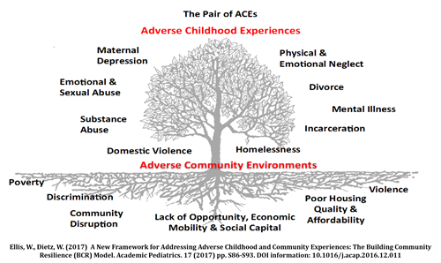
Adverse Childhood Experiences (ACEs)
ACEs
on the Surface and Beneath
Notes:
So we have discussed the different categories of ACEs and how those experiences may stay with us into adulthood…now let’s dig a little deeper.
The types of ACEs we talked about are all on the surface.
However, it is important as well to look at the root causes that put children at risk of experiencing ACEs in the first place.
These root causes have to do with the environment, specifically the communities where children grow up, as well as circumstances.
These are:
Poverty
Discrimination
Community disruption
Lack of opportunity, economic mobility, and social capital
Poor housing quality and affordability
Violence
A lot of these underlying causes are very common to the migratory student population.

Slide 9
Adverse Childhood Experiences (ACEs)
www.osymigrant.org
Notes:
This next slide features a graphic from the Centers for Disease Control (known as the CDC) that illustrates the lasting, lifelong impacts of ACEs.
The areas of impact are:
Injury
Mental health
Maternal health
Infectious diseases, such as STDs
Chronic diseases, such as cancer and diabetes
Risky behaviors, such as drug and alcohol abuse
And opportunities, such as education attainment

Slide 10
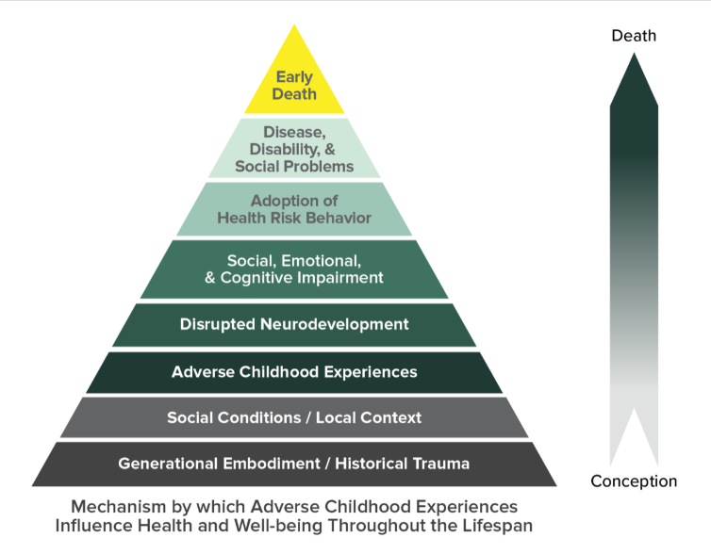
Adverse Childhood Experiences (ACEs)
ACEs
Pyramid
Notes:
The ACEs Pyramid represents the life course model of the ACEs Study, illustrating how ACEs can influence an individual from conception until death.
ACEs can lead to impaired neurodevelopment, which in turn can lead to social-emotional and cognitive adaptations. These adaptations may result in elevated risk factors for major causes of disease, disability, social problems, and early death.
The arrow shows how Adverse Childhood Experiences can progressively lead to those risk factors for health and social consequences higher up the pyramid.

Slide 11
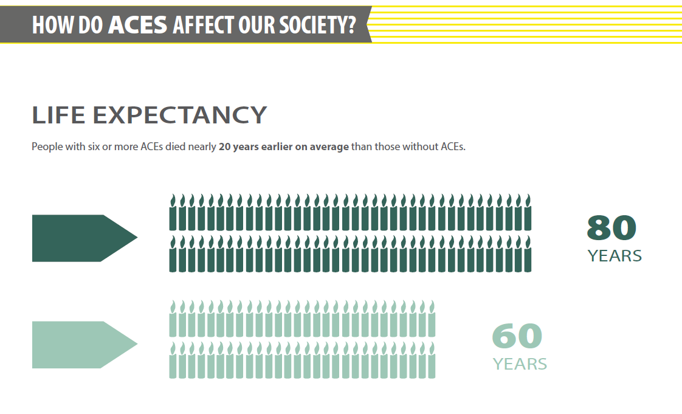
Adverse Childhood Experiences (ACEs)
ACEs Life Expectancy
Notes:
As you can see by this graphic, life expectancy is severely affected by ACEs. People with a score of six or higher die, on average, more than 20 years earlier.

Slide 12
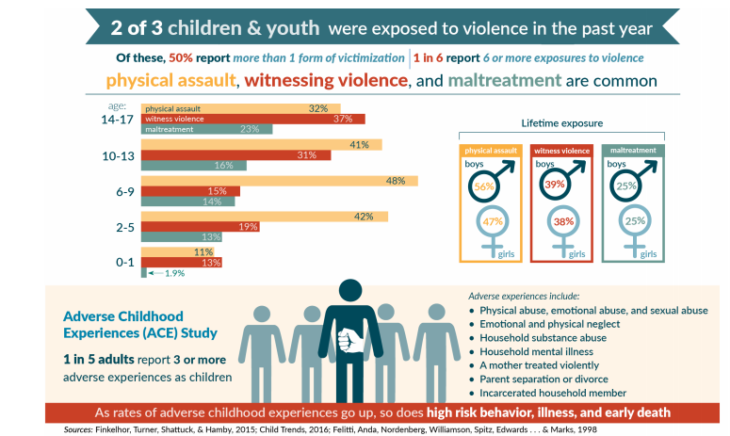
Adverse Childhood Experiences (ACEs)
Prevalence of Childhood Trauma
Notes:
The fact is that ACEs are pervasive.
According to the ACEs study, two out of three children were exposed to violence and one in five adults report a score of 3 or more.

Slide 13
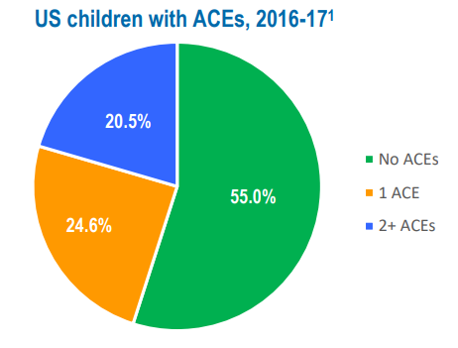
Adverse Childhood Experiences (ACEs)
https://www.cahmi.org/wp-content/uploads/2019/06/CAHMI-State-Fact-Sheet-National.pdf
www.osymigrant.org
Notes:
According to the 2019 National Fact Sheet from the Child and Adolescent Health Measurement Initiative (CAHMI), over 45% of American children and 66% of adults have been exposed to at least one Adverse Childhood Experience—such as physical or emotional neglect or abuse; living with someone with a drug, alcohol, or serious mental health problem; the death of a parent; or being exposed to violence or discrimination in the home or community.
More than one in five children have a score of 2+ ACEs.
Breakthrough neurobiological sciences explain the link between ACEs exposure levels and markedly higher rates of chronic physical illnesses; mental, emotional, and behavioral health problems; and lowered quality of life and life expectancy.
However, hope lies in the realization that methods to prevent and heal the legacy and effects of trauma from ACEs are available. Additional iSOSY Personal Wellness modules focus in depth on the concepts of resilience and trauma-informed best practices for service providers.

Slide 14
Adverse Childhood Experiences (ACEs)
May contribute to ACEs for the migratory student:
Leaving homeland or home-base
Frequent moves
Immigration status (fear of parents being deported, being left behind)
Reasons for migrating (fleeing trauma)
Living situation (poverty, homelessness)
www.osymigrant.org
Notes:
These are some specific examples of what our migratory students in particular may experience that can cause long-term stress and lead to the lifetime effects of ACEs.
What other prolonged adverse experiences do your students face?

Slide 15
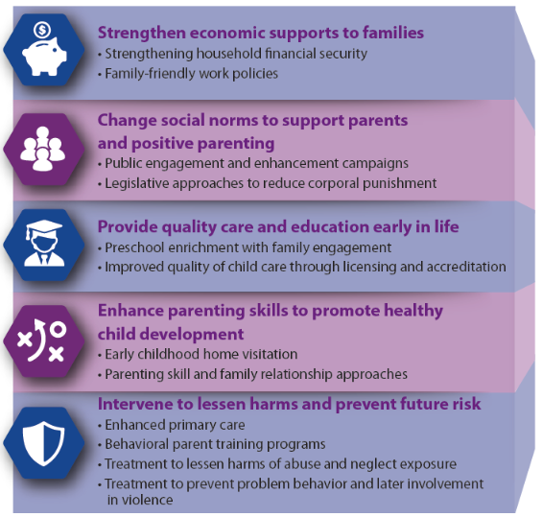
Adverse Childhood Experiences (ACEs)
The Effects of ACEs
Can be Prevented
Notes:
ACEs can be prevented if we provide support to the parents and communities that have some of the risks mentioned earlier.
Some ways we can help are:
Providing economic opportunities
Parenting help
Access to early childhood programs
Access to physical and mental health resources

Slide 16
Adverse Childhood Experiences (ACEs)
www.osymigrant.org
Notes:
There are a number of ways that parents, caregivers, teachers, and other service providers may be able to help students who have experienced traumatic stress, therefore mitigating the ill effects of those experiences.
As mentioned earlier, supportive relationships make a difference.
That means you.
Resilience skills can be taught to our students. The next video is a good illustration of that.

Slide 17
Adverse Childhood Experiences (ACEs)
Moving
from
ACEs
to
Resilience
www.osymigrant.org
Notes:
Watch video: https://www.youtube.com/watch?v=-pnhFmdz-ig
Let’s watch the video “Moving from ACEs to Resilience”.
You can see the students in the video have been taught ways to move past adversity through resilience strategies.
As mentioned before, iSOSY’s Personal Wellness Module 4 covers the concept of resilience in more detail.

Slide 18
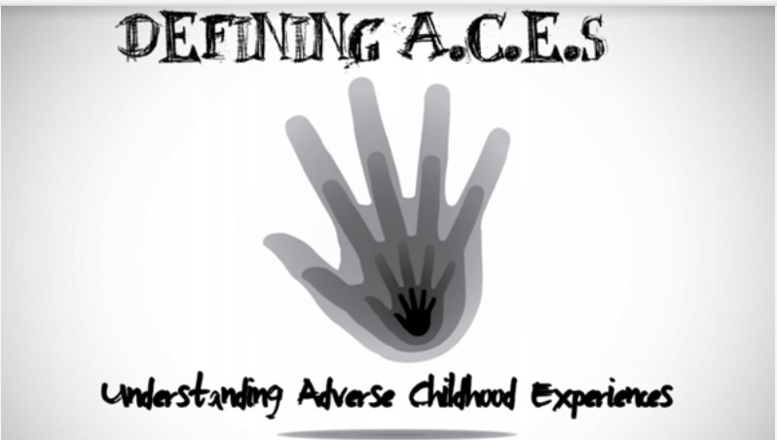
Adverse Childhood Experiences (ACEs)
ACEs Resources on the iSOSY Website
www.osymigrant.org
Notes:
There are numerous resources about ACEs on the iSOSY website: http://www.osymigrant.org/Newsite/educat/ACES.html
These resources provide the background of the original study, how it applies to OSY and migratory students, as well as strategies to address the effects of ACEs in those populations.
The resources also introduce the intriguing concept of epigenetics, whereby trauma can actually change a person’s DNA and pass down those effects to future children.
The ACEs Literature Review is broken down into easy-to-digest slide shows that cover the important concepts in the following chapters:
Defining ACEs
Original ACEs study history
Epigenetics Explanation
ACEs in the Migrant Population
Understanding the Effect of Trauma on OSY
Strategies for Helping Students with ACEs
You may explore these resources by using both our Jigsaw or Scavenger Hunt Activities.

Slide 19
Adverse Childhood Experiences (ACEs)
Explore the ACEs Literature Review -
Jigsaw Activity
www.osymigrant.org
Notes:
For the Jigsaw Activity, divide into groups and review each of the chapters:
Defining ACEs
The History of the Original ACEs Study History
Epigenetics Explanation
ACEs in Migrant Population
Understanding the Effects of Trauma
Strategies for Helping Students with ACEs
ACEs and the Power of Resilience
Strategies for Helping OSY with ACEs
After a period of time, come back together to share what you learned with the group:
What did we learn about ACEs?
--PAUSE--
How can you use this information to improve services for students?
--PAUSE--
What do you want to change about your approach to services now that you have learned about ACEs?
--PAUSE--

Slide 20
Adverse Childhood Experiences (ACEs)
Explore the ACEs Literature Review -
Scavenger Hunt Activity
?
?
?
?
?
www.osymigrant.org
Notes:
For the Scavenger Hunt Activity, have access to a hard copy or electronic version of the
Literature Review Scavenger Hunt Handout.
Pause the video and take some time to look through the documents for the answers.
Then review the answers as a whole group.

Slide 21
Adverse Childhood Experiences (ACEs)
Please use the link to fill out an evaluation. Thank you!
www.osymigrant.org
Notes:
We appreciate your time and attention to this presentation about the importance of ACEs in the lives of migratory students. Your honest feedback is vital to our focus and efforts as iSOSY continues to move forward in the area of personal wellness and mental health. Please take just a moment to use the QR code on the screen to access a brief evaluation. Thank you.

Slide 22
Adverse Childhood Experiences (ACEs)
Presenter name
Email
Phone
www.osymigrant.org
Notes:
Thank you so much for your time and attention. Any questions/comments?

