Slide 1
State Steering Team Meeting
January 17-18, 2019
Montgomery, AL
www.osymigrant.org

Slide 2
Member States
Alabama
Florida
Georgia
Illinois
Iowa
Kansas
Kentucky
Massachusetts
Mississippi
Nebraska
New Hampshire
New Jersey
New York
North Carolina
Pennsylvania
South Carolina
Tennessee
Vermont
www.osymigrant.org

Slide 3
Partner States
Alaska
Arkansas
California
Colorado
Idaho
Maryland
Minnesota
Missouri
Montana
Oregon
Washington
Wisconsin
www.osymigrant.org

Slide 4
Welcome and Introductions
Welcome and Introductions
Doug Boline, KS MEP State Director
www.osymigrant.org

Slide 5
Agenda – Day 1
Welcome and Introductions
Welcome to Alabama
Overview of agenda and expectations for meeting
Discussion of TST Work Groups tasks and processes
OSY Engagement and Relationship Building
Curriculum and Material Development
Goal Setting and OSY Learning Plans
Professional Development
Interstate Collaboration
Mental Health/Trauma
Literature Review
Dissemination Event Evaluation results
Review of the Annual Performance Report results
Year 4 extension work items and changes to the FII
Year 4 changes to performance measures
Data collection for Year 4
LUNCH
Strategic Planning Process and expectations
Planning for a new CIG competition

Slide 6
Welcome to Alabama and the AL MEP
Cyndi Townley
Peggy Haveard
Joyce Bishop
www.osymigrant.org

Slide 7
Expectations of Our Time Together
Discuss reorganized work groups, their assignments, alignment with FII, and their progress
Evaluate Dissemination Event
Review APR data and objectives for Year 4
Discuss GOSOSY Work Plan and work group assignments
Learn about next CIG competition and OME priorities
Strategize and plan for next CIG
www.osymigrant.org

Slide 8
Technical Support Team
Expectations
Membership
State Director expectations
Requirements
2-3 meetings per year
Conference calls
Work assignments
Team Lead meeting
Collaboration and coordination across groups
Work Norms
Be fully committed to the work and demonstrate this commitment by meeting agreed upon deadlines, participating/attending meetings and calls until outcomes/goals are fully met.
Leave each meeting with tangible products/achievements synthesizing our meeting outcomes.
Use included reflection time to promote spontaneous, creative discussion.
www.osymigrant.org
Notes:
Purpose- responsibilites
Who to send?
Mentoring Pilot- World Education
Tracie will ask MA, TN, VT, GA, and CA
Mental Health-- KS
Goal Setting – TOT Work Group – Sonja Williams (lead)—Ernesto?
PD- Develop training to certified and non-certified staff – Jessica Castaneda (Lead)
ID&R – in collaboration with IRRC—Jennifer Almeda (lead)
Develop web-accessible lessons- Material Development—Bob Lynch and Brenda Pessin-- leads
With support and guidance from World Ed – Andy Nash
OSY Learning Plan—Emily Hoffman
With Steve Quonn

Slide 9
Reorganization of TST Work Groups
Work Groups:
OSY Engagement and Relationship Building
Curriculum and Material Development
Professional Development
Interstate Collaboration
Goal Setting and Learning Plans
Mental Health/Trauma
Literature Review
www.osymigrant.org

Slide 10
OSY Engagement and Relationship Building
Members: Emily Hoffman (lead), Rachel Beech, Joyce Bishop
FII 1.1f/2.2c
This group will develop list of research-based promising practices for reaching OSY and building relationships with them. The group will continue to research mentoring and develop a list of promising practices.
The group will offer presentation on that research at April 2019 TST meeting and will use feedback to create list of 8 - 10 best ideas. Those final ideas will be combined with current GOSOSY mentoring toolkit materials to create a new mentorship guide.
www.osymigrant.org

Slide 11
Curriculum and Material Development
Members: Brenda Pessin (lead), Jessica Castañeda, Peggy Haveard, Rachel Wright Junio
FII 3.1a
This group will continue to improve ELL lesson currently in draft. It will be simplified and focus on vocabulary with an audio component and translation capabilities for multiple languages. There will be games for practice and imbedded videos. The first lesson will establish a template for future lessons. (by April 2019 TST meeting)
The group will create a rubric for the lessons to explain how to adapt to different situations
The group will create a catalog of resources that will expand/improve on the current Educational Resource Rubric; it may include a searchable format.
www.osymigrant.org

Slide 12
Professional Development
Members: Joan Geraci (lead), Odilia Coffta, April Dameron, Veronica Hill, Sabrina Rivera-Pineda
FII 2.1c
This group will develop a Prezi on Growth Mindset that will be printable (as a PDF). One version will be for practitioners and another for students. (To be completed by April 2019 TST meeting.)
The group will also develop two additional PD modules including OSY with Limited Schooling and Introduction to OSY.
www.osymigrant.org

Slide 13
Interstate Collaboration
Members: Deke Showman (lead), Margot Di Salvo, Monika Lorinczova, Barbie Patch, Travis Williamson
FII 2.2a-2.2b
This group will create a survey (sent in January 2019) to collect best practices from each state.
The group will host quarterly networking meetings with staff from the following groups: HEP, CAMP, GOSOSY, IRRC, PI, Migrant Health, and non-member states. The meetings will be recorded and archived for continual access. (beginning in March 2019)
The group will create an online forum to collect the best practices and allow sharing/discussion.
Will include a mentoring pilot to share information between all CIGs.
The group intends to create an up-to-date directory of MEPs.
www.osymigrant.org

Slide 14
GOSOSY Member State Resource Survey
Interstate Collaboration Work Group
Includes information about state needs related to:
OSY services
Recruitment
Current practices
Most-used languages
Answers will be compiled and shared in online forum available to all states.
www.osymigrant.org

Slide 15
Goal Setting and Learning Plans
Members: Sarah Braun Hamilton (lead), Eugenia Luna, Justyn Settles, Emily Williams
FII 1.2a-1.3d/ 1.1 b
This group will finalize Goal Setting materials and Learning Plans by April 2019 TST meeting and create training once materials are finalized.
The group intends to create a “goal setting frame” that could be used with any lesson.
The group will work with the Interstate Collaboration Work Group around the idea of portability and transferability of Learning Plans.
www.osymigrant.org

Slide 16
Mental Health/Trauma
Members: Lora Thomas (lead), Lysandra Alexander, Susanna Bartee, John Farrell
FII 1.1d/2.2d/3.1b
The group will create a Needs Assessment survey addressing the topic for national MEP audience and send to all MEP contacts from Dissemination Event and other consortia.
The group will create staff development, including training in the Mental Health First Aid program (hoping to include as part of April 2019 TST)
The group will host a focus group presentation at NASDME (May 2019) to present the findings from the Needs Assessment survey and will include fact sheets concerning the stigma surrounding and myths about mental health issues.
The group will create a white paper after collecting feedback and additional data at NASDME.
The group intends to create a vetted list of national/state/local tools and resources for staff.

Slide 17
GOSOSY Student Mental Health/ACEs Survey
Mental Health/Trauma Work Group
Includes information about state needs related to:
Mental health needs in migrant student population
Training needs for statewide staff
Barriers to mental health services
Use of GOSOSY Mental Health Life Skill Lessons
Access to appropriate and available resources
Answers will be used to inform next grant application and future materials.
www.osymigrant.org

Slide 18
Lit Review
Member: Jessica Castañeda
FII 1.1 g
Will create literature review focusing on preventing drop outs in the migrant student community. (for April TST meeting)
www.osymigrant.org

Slide 19
Agenda- Day 2
8:30 am
Strategic planning wrap up
Key Features
State Responsibilities
Submission Process
Discuss structure of Technical Support Team
Future Meetings
www.osymigrant.org

Slide 20
TST Structure and Work Discussion Questions
1. How should the TST be structured to achieve its objectives in the next CIG? One member per state? Multiple members?
2. How well do the TST Work Groups represent the organization’s membership as a whole?
3. What are the ideal qualities for TST WG members and team leads?
4. How much time is reasonable to expect each TST WG member to devote to achieving WG goals and objectives?
5. What is the best way to communicate TST efforts and achievements to the SST? Entire organization?
www.osymigrant.org

Slide 21
Navigating the Materials and Resources on the GOSOSY Website
www.osymigrant.org

Slide 22
Google Analytics
October 15th 2018 to January 7th, 2019
GOSOSY Site
www.osymigrant.org

Slide 23
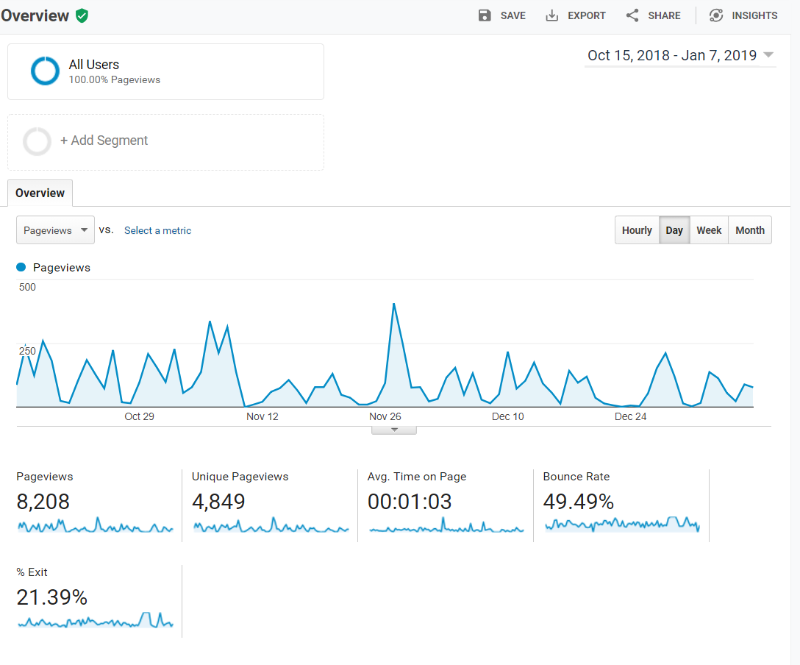
Site Audience Overview

Slide 24
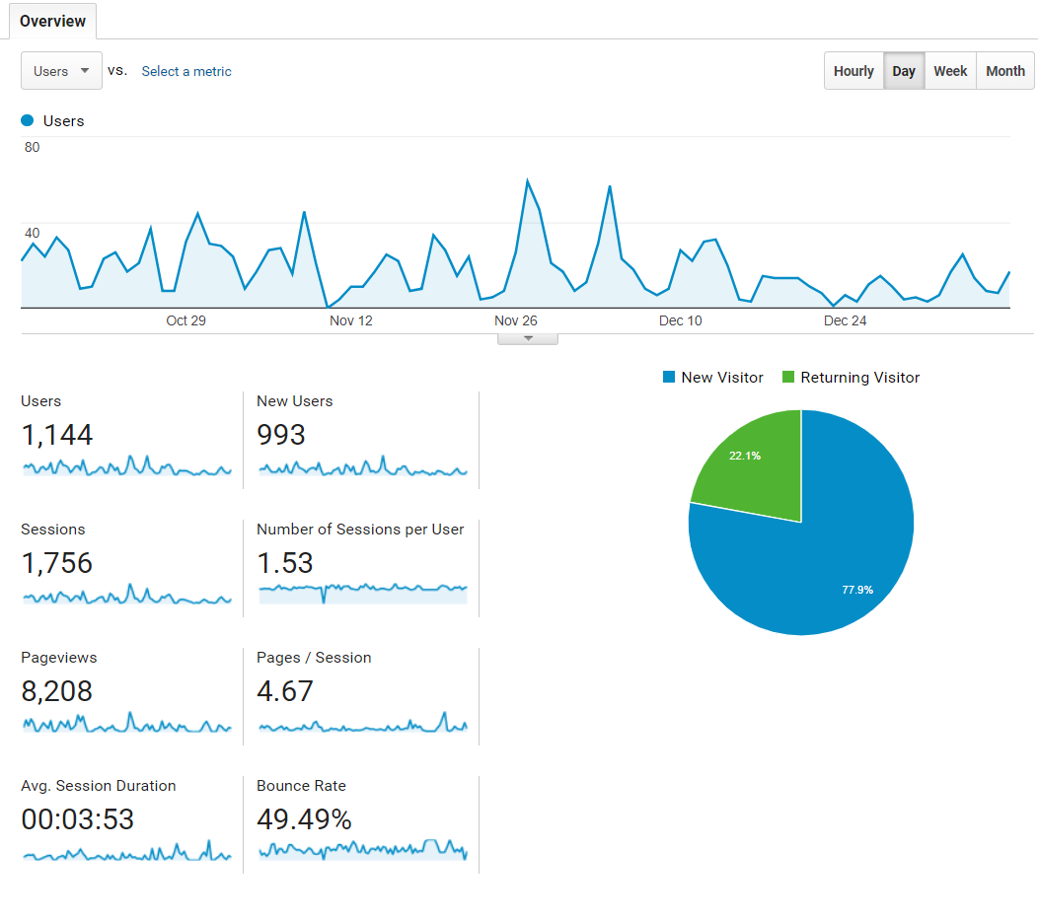
Overview of Sessions & Users
www.osymigrant.org

Slide 25
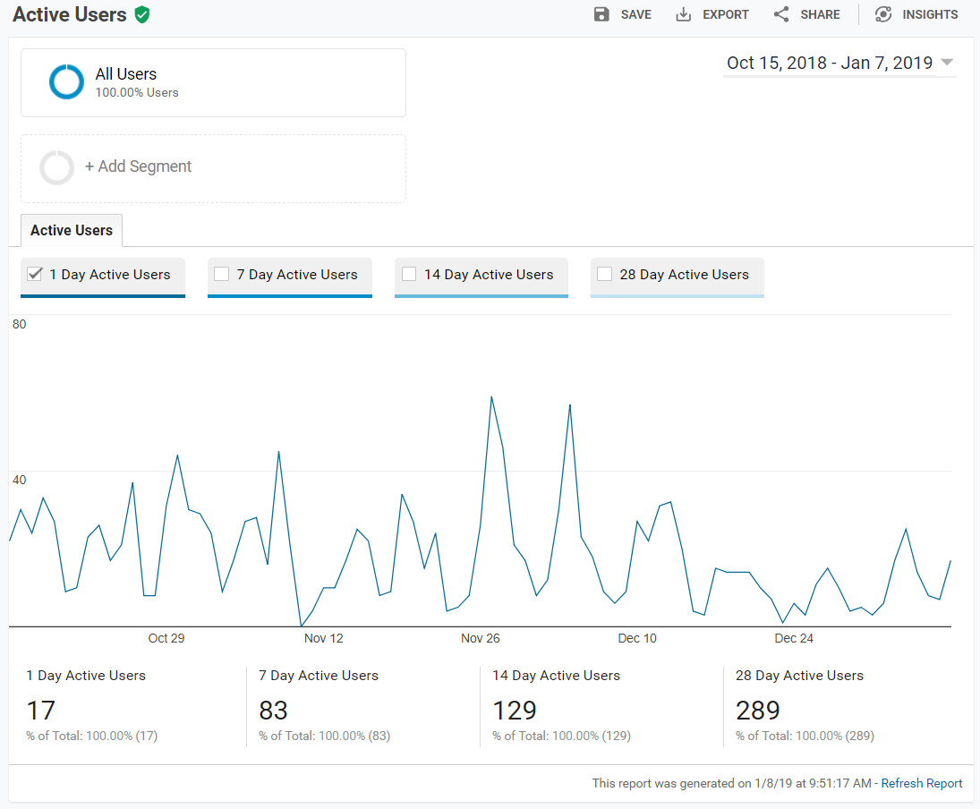
Active Users

Slide 26
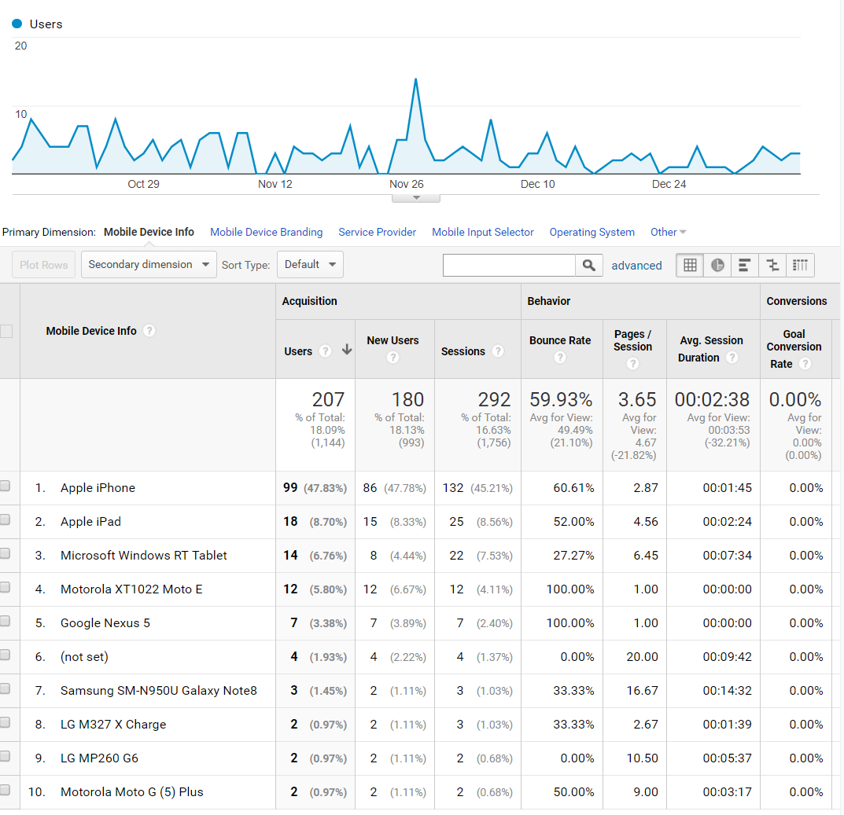
What devices are users using?

Slide 27
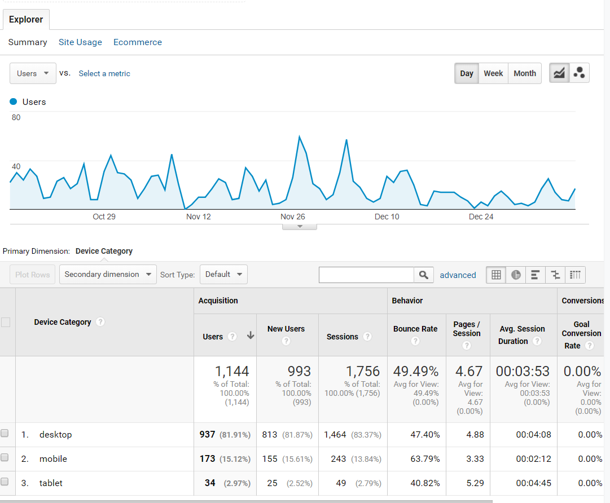
Desktop is still the favorite…

Slide 28
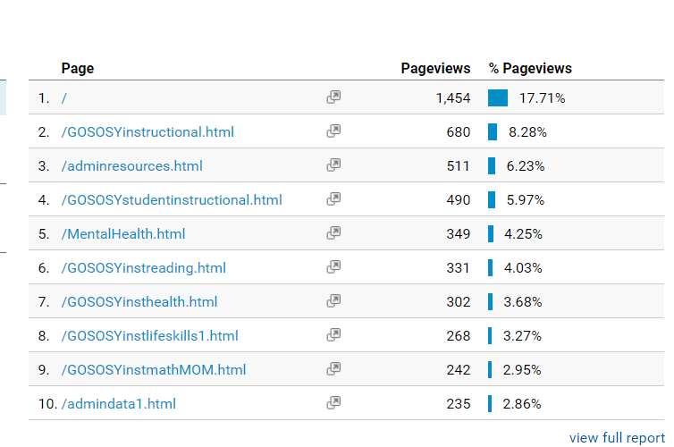
Where they are going on the site - top 10 pages

Slide 29
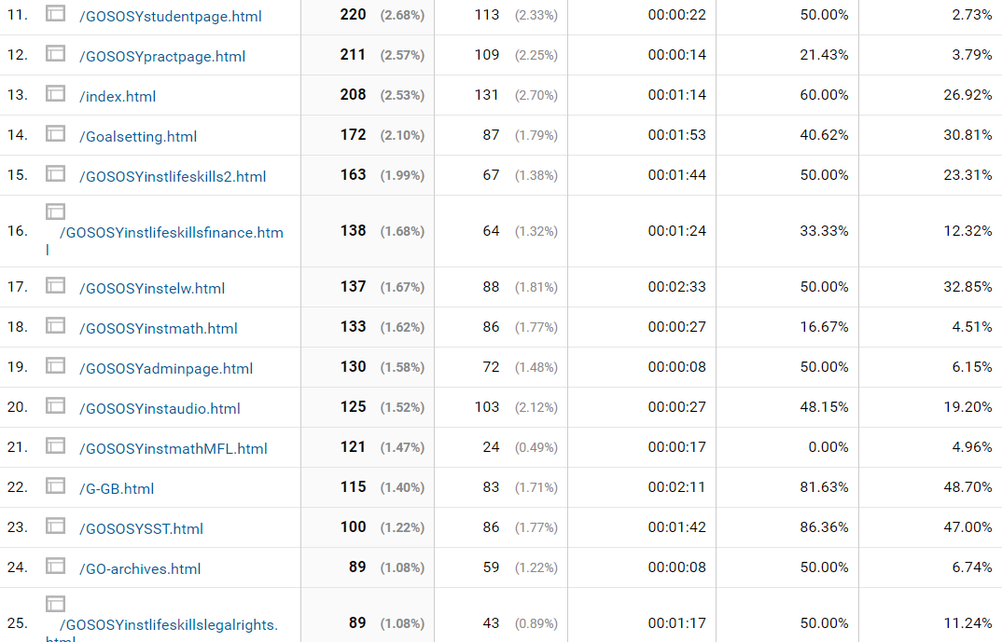
# 11 is still the student page

Slide 30
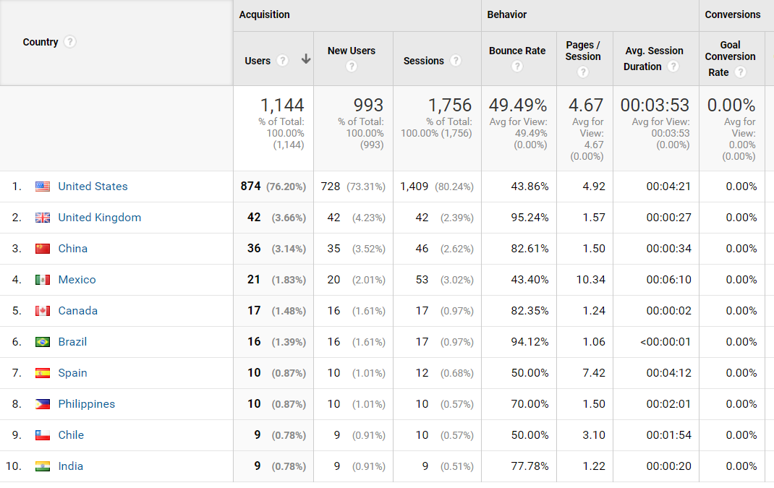
Countries our users are from

Slide 31
Website Usage
4946 unique visitors
9857 unique sessions
46,970 page views
www.osymigrant.org

Slide 32
NASDME Presentations
Proposal Submission
Creating Trauma-Informed Care and Education of Migrant Students
MEP and HEP: Partnering for Migrant Student Success
Presenters
Deadline and due dates
www.osymigrant.org

Slide 33
Future Meeting Dates
State Steering Team Meeting dates
October 2019 at IMEC Symposium
TST Meeting Dates:
April 8-10, 2019
April 8: Mental Health TOT
April 9-10 TST Meeting
Location: Omaha, NE
www.osymigrant.org

