Slide 1
State Steering Team Meeting
March 14, 2022
www.osymigrant.org
Notes:
Welcome to our fall State Steering Team meeting—

Slide 2
Agenda
Welcome and Introductions
Work Group Reports
Introduction to the Student Portal—Travis Williamson and Andy Wallace
Google Analytics
Pilot Reviews, Pilot Process, and What States Are Piloting
Annual Performance Report and State Data
iSOSY Evaluation Requirements for Year 2
Dissemination of Materials—Virtual or Other Format
OSHA Course Overview and Success Story
iSOSY End of Year 1 Report-- Tracie
Breakout Activity
Share successful examples of the following:
Recruitment of OSY/Secondary Youth at risk of dropping out
Service to OSY/Secondary Youth at risk of dropping out
Materials used
Innovative approaches
NASDME proposals
Future Meeting Dates
www.osymigrant.org
Notes:
Walk through agenda—
Today we will be hearing from a number of individuals about new projects as well as updates to the current work and future plans from our work groups.
The Technical Support Team has done a tremendous job this part year– through the difficulties of remote work– they, as you will see, have accomplished a great deal.

Slide 3
Meeting Materials
https://drive.google.com/drive/folders/1NptJQ9YjvBGxb_QT70e_PS2IQTbiS-Ke?usp=sharing
www.osymigrant.org

Slide 4
TST Work Group Reports
Personal Wellness
Pathways
Career Awareness
Professional Development
Curriculum and Material Development
Student Portal
www.osymigrant.org

Slide 5
Personal Wellness
Personal wellness is finding a greater well-being through positively connecting the mind and body. In a simpler sense, achieving personal wellness comes from maintaining a healthy and balanced lifestyle.
Purpose: Continuing to add and adapt the Personal Wellness Training Package.
Members:
Lysandra Alexander (PA) - Lead
Susana Das Neves (IL)
Mesha Patrick (AL)
Valeria Peña (IA)
Lora Thomas (iSOSY Consultant)
Notes:
This group had started as a mental health, but we decided to add the wholistic concept of Personal Wellness to include the mind and body connection.
This training package was created to address the broad concept of personal wellness, fully embracing the extensive research showing that mind and body are inextricably connected and therefore it is impossible to have good overall wellness without good mental health. We are continuing the effort and expanding it in iSOSY.
Members are:
Lysandra Alexander (PA) - Lead
Susana Das Neves (IL)
Mesha Patrick (AL)
Valeria Pena (IA)
Lora Thomas (iSOSY Consultant)

Slide 6
Personal Wellness
Personal Wellness Training Package
SEL: Responsible
Decision-Making
Suicide Prevention
Resilience
Trauma
Trauma-Informed
Best Practices
Self-Care
Mindfulness
Cultural
Responsiveness
ACEs
www.osymigrant.org
Notes:
Lysandra
In response to that research, the iSOSY Personal Wellness Work Group developed a Personal Wellness Training Package that is available on the iSOSY website. There are
currently seven modules featured. They include ACEs, Trauma, Cultural Responsiveness, Resilience, Mindfulness, Self-Care, and – the focus of today’s presentation –
Trauma-Informed Best Practices. As a side note, the 8th module is in development and will cover suicide prevention. We chose the symbol of a tree since it
encompasses the hopeful illustration of the importance of roots and growing. The Suicide Prevention module is the newest one.

Slide 7
Personal Wellness
Tasks:
Develop a new module for the Personal Wellness Training Package on Social-Emotional Learning, focusing on Responsible Decision-Making. Module includes:
PowerPoint with Notes
Facilitator’s Guide
Activities
Record PowerPoints for all modules.
Update the Resilience and Trauma modules.
www.osymigrant.org
Notes:
The main task this year was developing a module on social-emotional learning.

Slide 8
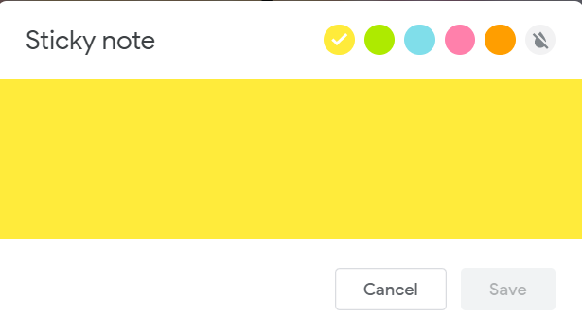
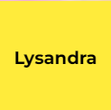
Activity: “Would You Rather?”
Head over to JamBoard for an interactive activity! (Link in chat)
Once there, place a sticky with your name on your choice.
www.osymigrant.org
Notes:
Lys
Explain and put link in chat
https://jamboard.google.com/d/1j5qjfTDhNl4d5dZTwvc2Om4xu9lOuT9QtgoR1yw54Pc/edit?usp=sharing

Slide 9
Pathways
Emily Hoffman (MA) – Lead
John Farrell (KS)
Janet Reynolds (KS)
Hunter Ogletree (NC)
www.osymigrant.org
Notes:
Lys
Explain and put link in chat
https://jamboard.google.com/d/1j5qjfTDhNl4d5dZTwvc2Om4xu9lOuT9QtgoR1yw54Pc/edit?usp=sharing

Slide 10
Pathways
FII Indicators
1.6 Develop Pathways Guide to HSED and credentials that includes information about prerequisite skills and assessments (instructor version).
1.7 Prepare guide for students on a pathway to HSED exams that includes information about benefits of an HSED, resources, and direction to instruction.
1.8 Prepare guide for students on a pathway to credential programs that includes benefits of various programs (including FSCC programs), resources, and direction to instruction.
1.14 Develop training materials/webinars on pathways to HSED and credentials.
We are developing these guides so that it can clearly/quickly help providers know these things:
What is it (really)?
Who is the student/youth this best works for?
What questions/conversations do I need to have with the youth to ensure best fit?
What program options (either referrals or direct service) are available?
www.osymigrant.org
Notes:
Lys
Explain and put link in chat
https://jamboard.google.com/d/1j5qjfTDhNl4d5dZTwvc2Om4xu9lOuT9QtgoR1yw54Pc/edit?usp=sharing

Slide 11
Pathways
HSED
INTRODUCTION TO HSED
What is it (general
HiSET + GED
Important Information re: taking the tests
Mobility
Documentation
Language
ACADEMIC EXPERIENCE
No/Early Elementary (K-2)
Elementary (3-5)
Middle School (6-8)
High School (9-12)
RESOURCES
Partner Agencies
iSOSY based resources
Free Academic resources
Paid Academic Resources
Miscellaneous
www.osymigrant.org
Notes:
Lys
Explain and put link in chat
https://jamboard.google.com/d/1j5qjfTDhNl4d5dZTwvc2Om4xu9lOuT9QtgoR1yw54Pc/edit?usp=sharing

Slide 12
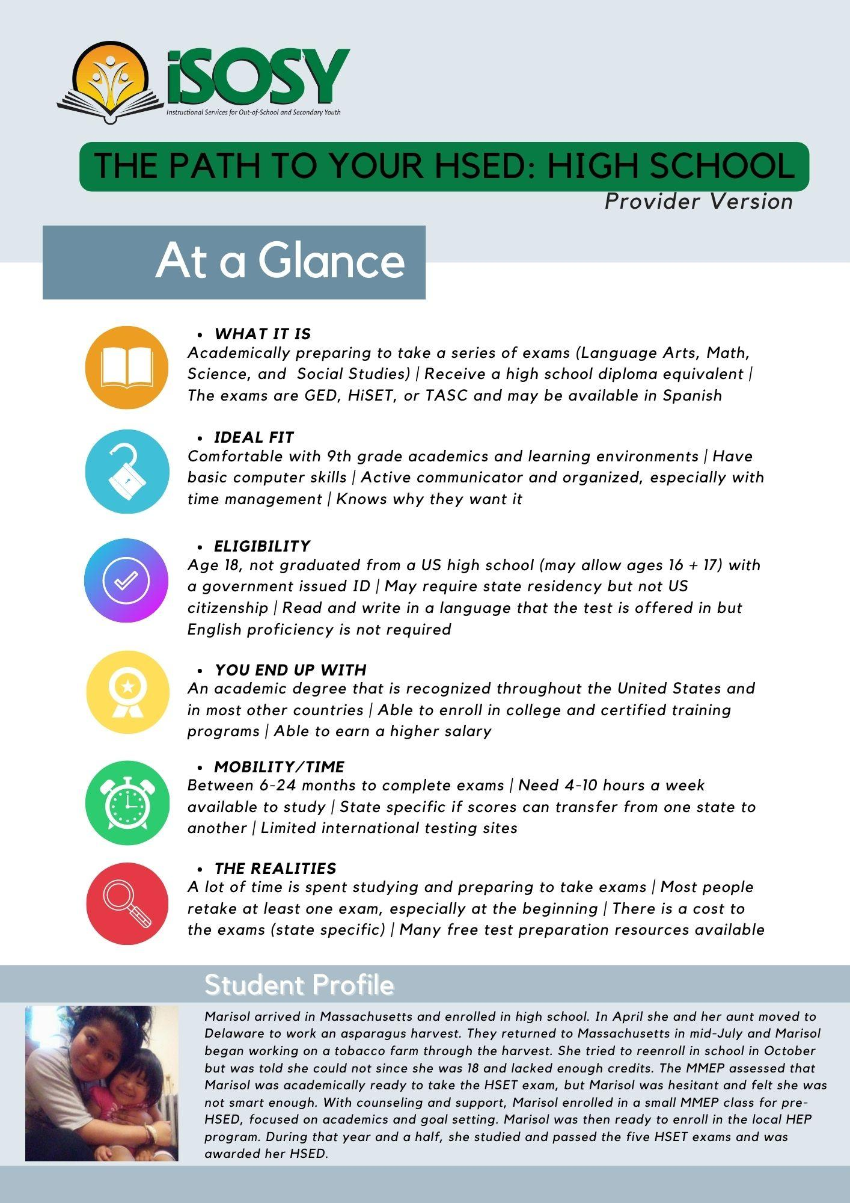
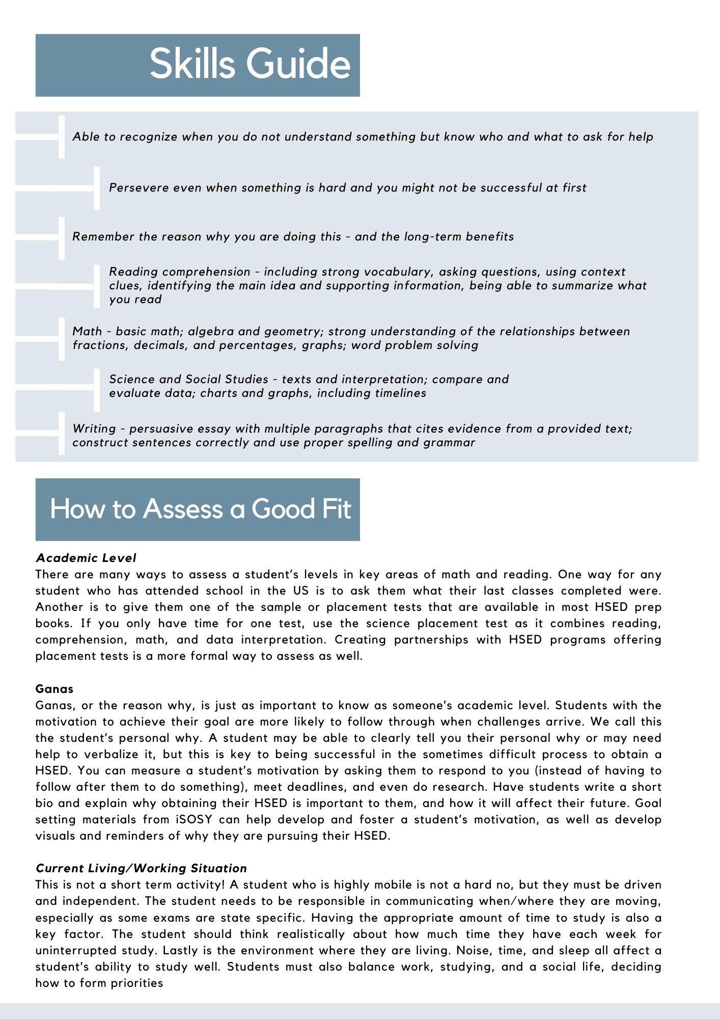
Pathways
HSED
www.osymigrant.org
Notes:
Lys
Explain and put link in chat
https://jamboard.google.com/d/1j5qjfTDhNl4d5dZTwvc2Om4xu9lOuT9QtgoR1yw54Pc/edit?usp=sharing

Slide 13
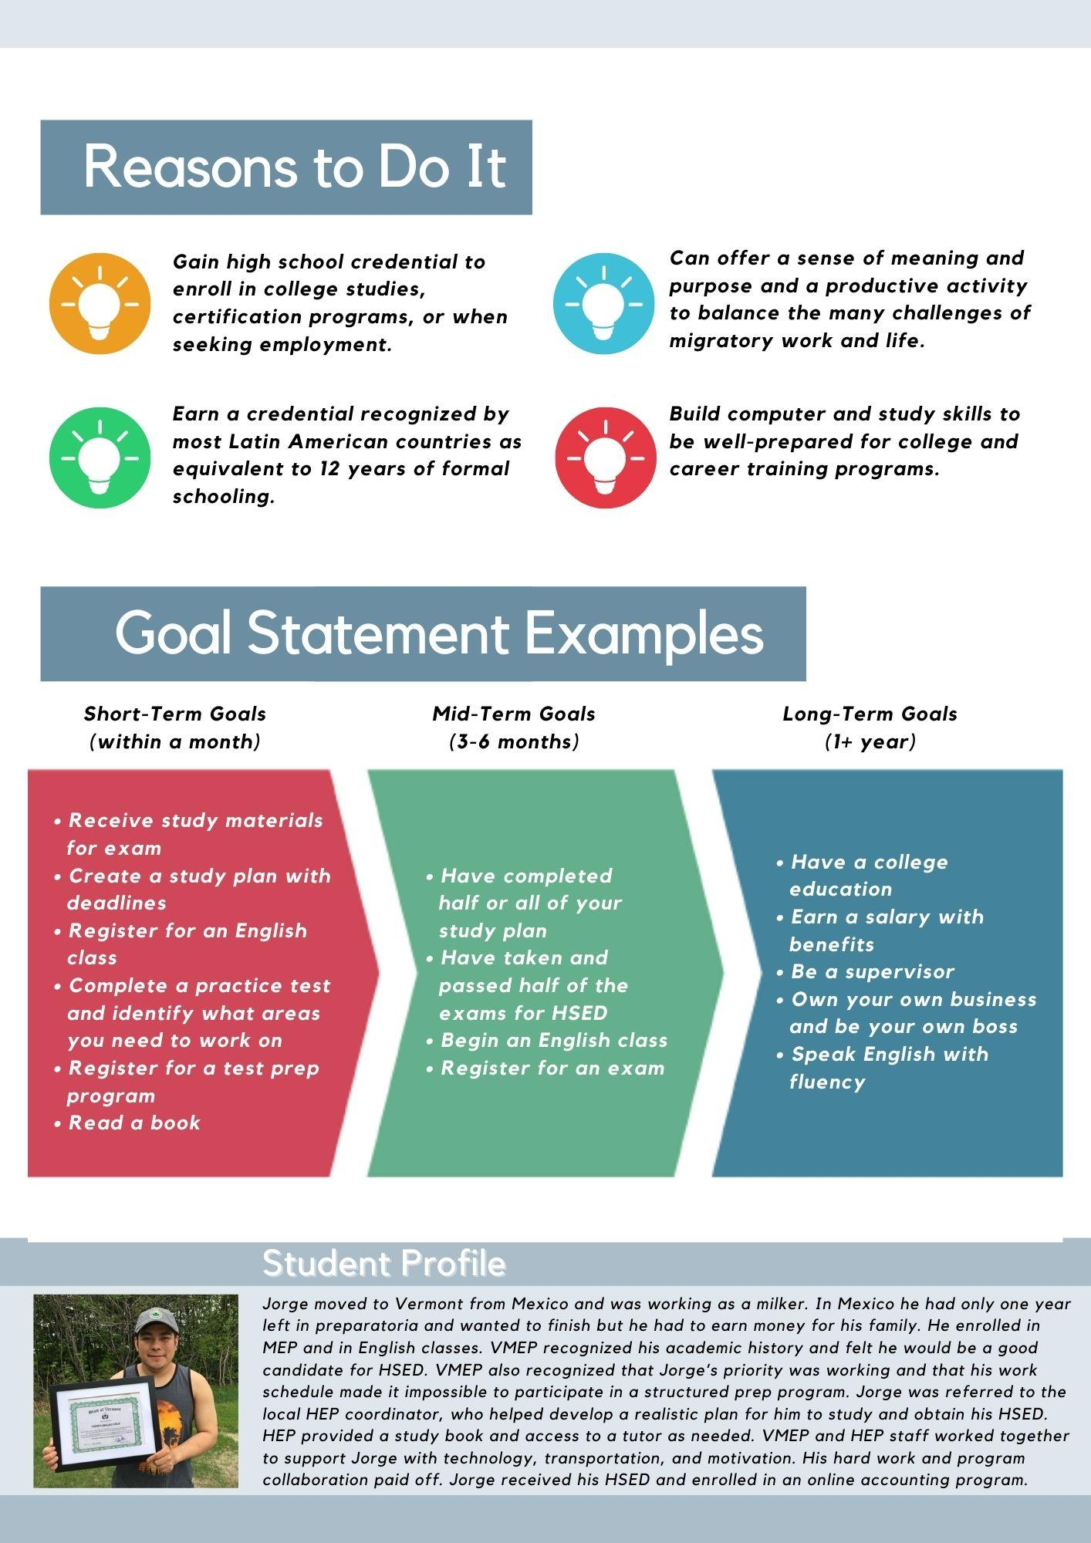
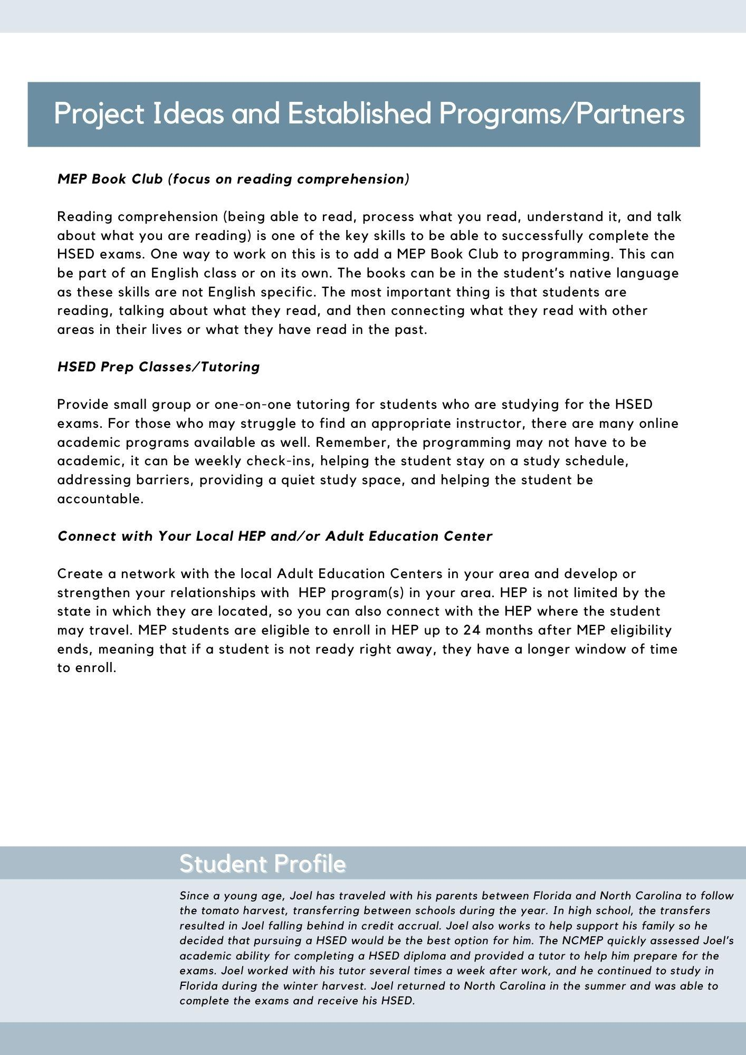
Pathways
HSED
www.osymigrant.org
Notes:
Lys
Explain and put link in chat
https://jamboard.google.com/d/1j5qjfTDhNl4d5dZTwvc2Om4xu9lOuT9QtgoR1yw54Pc/edit?usp=sharing

Slide 14
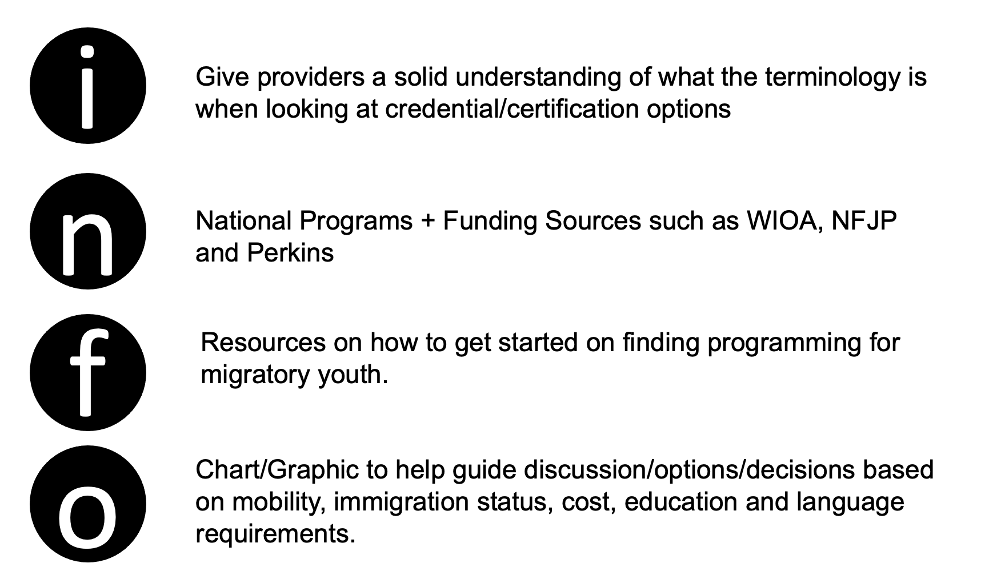
Pathways
CREDENTIALS
www.osymigrant.org
Notes:
Lys
Explain and put link in chat
https://jamboard.google.com/d/1j5qjfTDhNl4d5dZTwvc2Om4xu9lOuT9QtgoR1yw54Pc/edit?usp=sharing

Slide 15
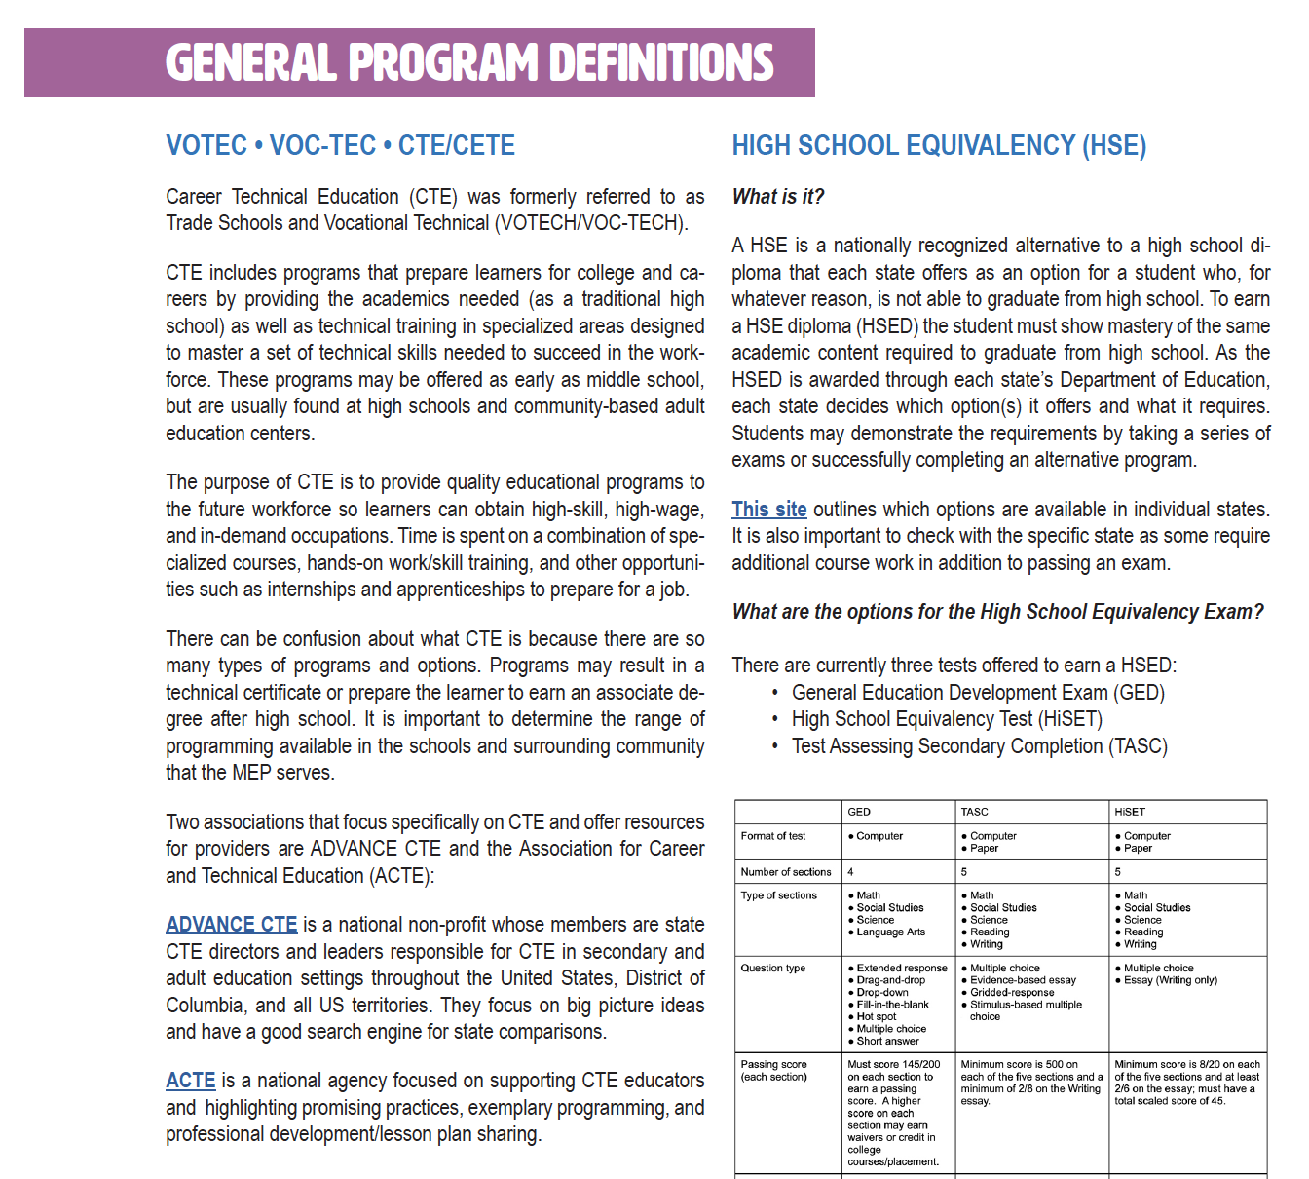
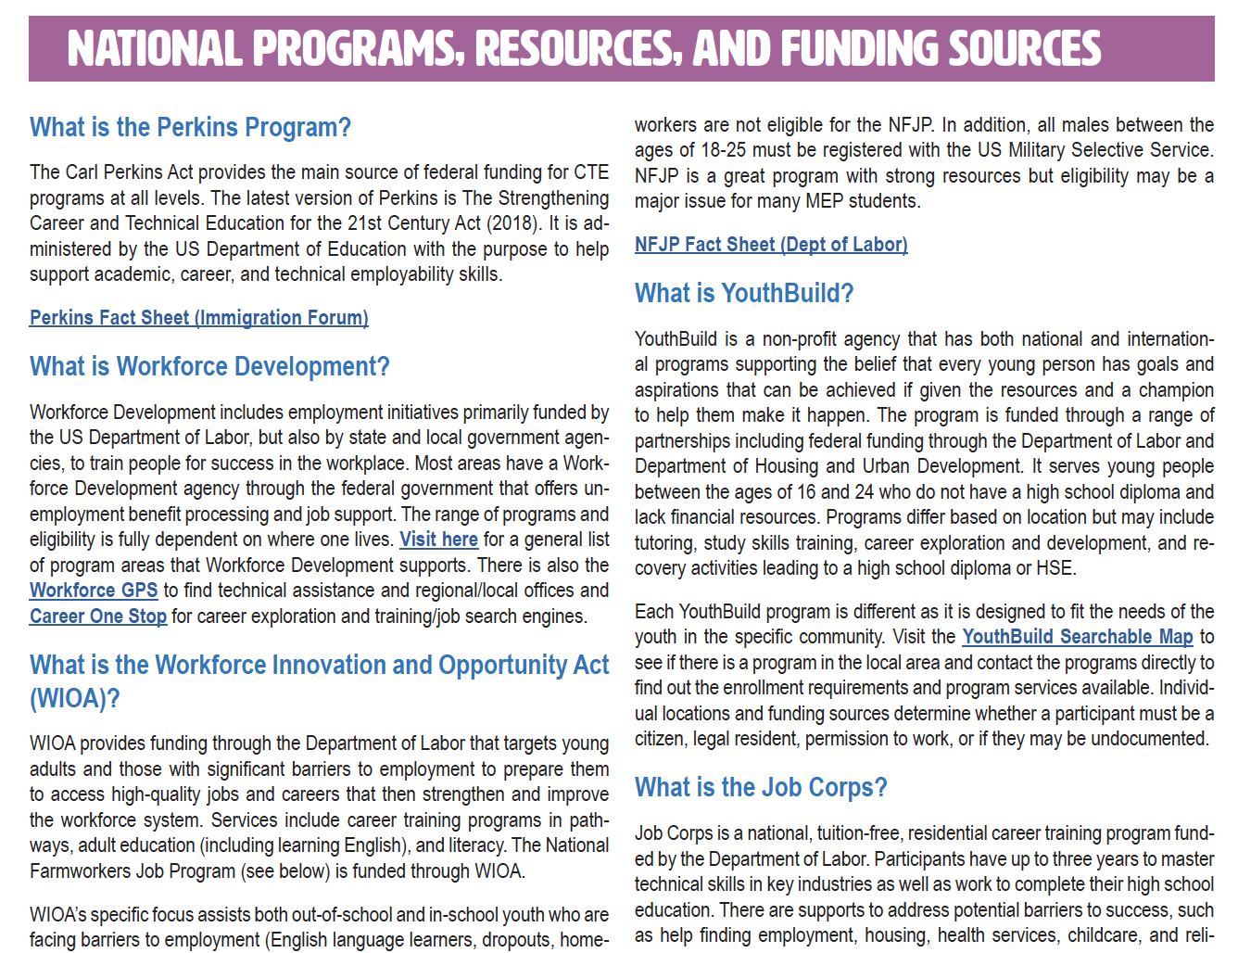
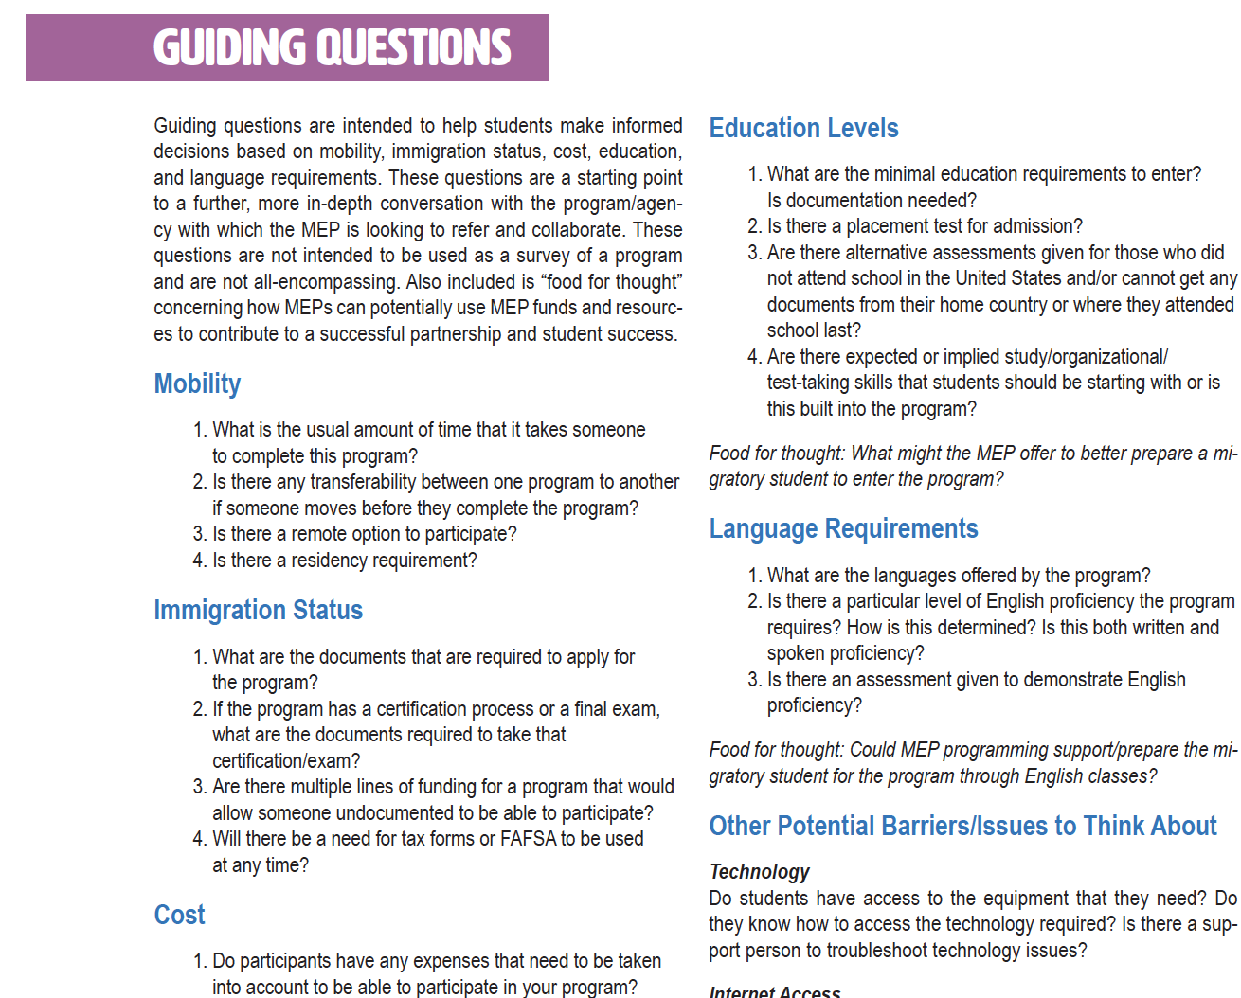
Pathways
CREDENTIALS
www.osymigrant.org
Notes:
Lys
Explain and put link in chat
https://jamboard.google.com/d/1j5qjfTDhNl4d5dZTwvc2Om4xu9lOuT9QtgoR1yw54Pc/edit?usp=sharing

Slide 16
Pathways
DEVELOPMENT OF:
INTRODUCTION TO ENTREPRENEURSHIP
DESIGNED FOR MIGRATORY YOUTH THAT IS
SELF PACED AND ON-LINE
CREDENTIALS
Provide students with a solid foundation of the role of entrepreneurs and entrepreneurship in the economy.
Develop an avenue to explore a perspective of innovation and entrepreneurism through case studies
Topics include: importance of business development for a healthy economy, basic economic ideas and their effect on new ventures and small business, entrepreneurial lifestyle, opportunity identification and innovation, overview of the process, business ownership, sustainability, and social media and marketing.
www.osymigrant.org
Notes:
Lys
Explain and put link in chat
https://jamboard.google.com/d/1j5qjfTDhNl4d5dZTwvc2Om4xu9lOuT9QtgoR1yw54Pc/edit?usp=sharing

Slide 17
Career Awareness & Goal Setting
Work Group Members
Emily Williams (SC) - Lead
Liz Garcia Ramirez (IL) Erika Guerrero (NE) Sally Meek (AL) Shantella Singleton (PA) Mary Speyer (LA)
www.osymigrant.org

Slide 18
Career Awareness & Goal Setting
Results from Year 1
Decided not to focus on Goal Setting materials
Already very well done
Not too much to improve
Do want to get more people using it!
Too many good, existing resources
focused on compiling a toolkit to help practitioners
Six (6) units with statements that correspond to resources to help explore topics
www.osymigrant.org

Slide 19
Career Awareness & Goal Setting
How would this toolkit work? (subject to changes after the pilot)
Each unit would have questions with a simple scale:
“How much do you agree with the statements?”: *not at all *a little *very much
Each question would then correspond to a resource link to explore that information.
This would give it a built in “assessment” for before and after.
www.osymigrant.org

Slide 20
Career Awareness & Goal Setting
Unit Themes
Self-Awareness
Goal Setting
Career Awareness
Financial Awareness
Education
Skills and Resources
This section is for students who have already identified a target field/career. Exception: They need help interviewing someone in a career they want to explore.
***If they score low on the questions/ statements for this section AND score low on career/self-awareness, they should be directed to those sections first. ***
www.osymigrant.org

Slide 21
Career Awareness & Goal Setting
Coming Up for the Rest of the Year
Training of Trainers at TST in May 2022
Make a semi-final outline to have states pilot during spring and summer 2022.
use for more than just OSY (at-risk and PFS secondary students)
use feedback to make a finalized toolkit
As always, the goal is to make something people can and will actually use.
Plan to design an anonymous survey to collect feedback.
minimum of 24 total surveys from six (6) states
Once the pilot is done:
offer recorded webinar about how to use the toolkit (ideally it is straight forward enough to not need a training)
www.osymigrant.org

Slide 22
Professional Development
Digital/Virtual Learning
April Dameron (IA) -Lead
Sabrina Rivera-Pineda (GA)
Odilia Coffta (NY)
April Roberts (GA)
www.osymigrant.org

Slide 23
Professional Development
Digital/Virtual Learning: Part 1
Introduction to Distance/Virtual Learning
What is digital learning?
Why might you consider providing services virtually?
Limitations
Things to consider
How to be successful with this option
www.osymigrant.org

Slide 24
Professional Development
What opinions do you hold about distance/virtual learning?
Virtual survey
Reveal bias one may hold about virtual learning and possible training needs to overcome barriers to offering distance/virtual learning.
Opportunity for problem solving that could be done with a service provider when faced with a challenging situation when trying to offer services to OSY/HS age students.
www.osymigrant.org

Slide 25
Professional Development
Distance/Virtual learning may be for you if…
Do you have a center where OSY/HS students attend?
Do you cover a large geographic area?
Do you cover the whole state?
Do you go to camps?
Does weather affect your ability to travel at certain times of the year?
www.osymigrant.org
Notes:
Just a short survey for service providers to determine if virtual learning may be beneficial.

Slide 26
Professional Development
Distance/Virtual Learning: Part 2
Preparing for College: How to Write an Essay
Virtual Tools
Screencastify
Zoom
Whiteboard
www.osymigrant.org
Notes:
Use hamburger activity drawn using whiteboard tool in zoom to help student learn the parts of an essay.

Slide 27
Professional Development
Distance/Virtual Learning: Part 3
Hybrid Lesson-
Using techniques from the Language Experience Approach
Art lesson from NY MEP
Materials given to OSY
Provide lesson using video enabled Social Media app, Zoom, etc.
www.osymigrant.org
Notes:
Language Experience Approach
Promoting reading and writing through personal experiences-Places value on a learner’s inherent life experiences, regardless of academic experiences.
You can use any practical topic you wish with this approach. Utilize iSOSY lessons- taking a child to the doctor, work, shopping, etc.

Slide 28
Professional Development
Future Plans…
Using Constant Contact -
Create a schedule to point people to training materials, resources, etc. on iSOSY website.
Share new resources as they are developed.
Create a database of iSOSY member experts on topics.
www.osymigrant.org
Notes:
Use Constant contact- to send out messages to utilize training materials, reminders for using materials on the website iSOSY
2 messages a month
Share videos that are being developed for Limited English
Go back through resources and check to make sure everything works, update, etc.
Share resources with iSOSY group each month that service providers can use to work with students using constant contact.
Idea: Make a list of everyone in iSOSY member states- who is a person that can help with certain topics, lessons, trainings, etc., who is the expert on certain resources- ex: Andy is an expert on google classroom. Go to Odilia if you are interested in NY’s Art projects, go to April R if you want to learn more about LEA, working with students in a hybrid model across the state with April D., etc.

Slide 29
Curriculum
Work Group Members
Brenda Pessin - Lead
C. Hope Derry (NC)
Veronica Hill (NE)
Wilson Kendrick (MS)
Erin Lamboi (IL)
Lori Potutschnig (PA)
Laurie Stewart (LA)
www.osymigrant.org

Slide 30
Curriculum
Lessons Recently Completed and Nearing Completion!
www.osymigrant.org
Notes:
We are excited to announce multiple resources have been developed this year.

Slide 31
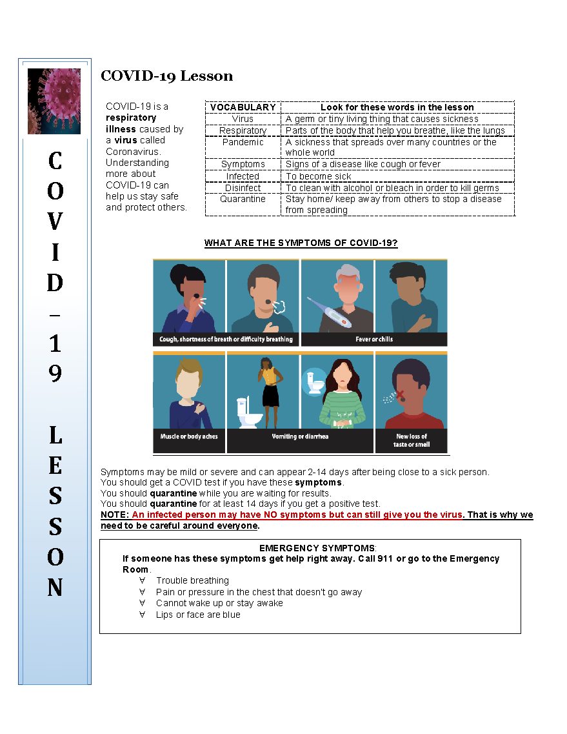
Curriculum
Content and graphics derived from CDC publications
Interactive videos and activities to promote student engagement
Contain pre- and post-assessments
Lesson #1 available in English and five languages:
Spanish
Keren
Nepali
Provider and student versions
PowerPoint and slideshow format with audio narration in English and Spanish
Arabic
Swahili
www.osymigrant.org

Slide 32
Curriculum
Lesson #1
Symptoms
Spread
Prevention
Quarantine
Lesson #2
Vaccine
Safety and Rights at Work
Booster and Testing
www.osymigrant.org
Notes:
Lesson #2 was developed in response to the changing science and information about vaccines and boosters.

Slide 33
Curriculum
NOTE to Instructors:
COVID-19 lessons are meant as a simple and general springboard for discussion of how to stay safe and healthy during the pandemic. As you go through the lessons with your students, please make sure to include information specific to your region and to include any recent CDC updates.
www.osymigrant.org
Notes:
Please note we want instructors who use the materials to understand the lessons are a starting point and springboard for helping our students stay safe.

Slide 34
Curriculum
Lessons Designed Specifically for
Out-of-School Youth
www.osymigrant.org
Notes:
Address the limited instructional time often the reality for OSY service providers
Practical and relevant to the needs and interests of OSY
Standard lesson plan template includes targeted basic vocabulary, interactive tools such as Quizlet, Edpuzzle and Quia, practice activities, pre- and post-assessments, as well as print handouts

Slide 35
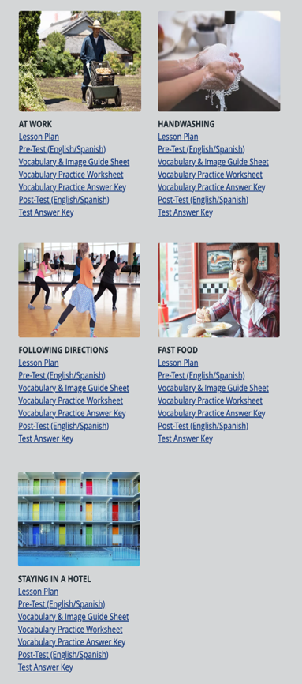
Curriculum
At Work
Hand Washing
Ordering Fast Food
Following Directions
Staying in a Hotel (2)
www.osymigrant.org

Slide 36
Curriculum
STAT Lesson Features
Standard Format
Lesson Plan
Targeted Vocabulary
Interactive Activities
Quizlet
Quia
EdPuzzle
Print and Virtual Worksheets
Videos
Pre- and Post-Tests and Answer Keys
www.osymigrant.org
Notes:
Standard lesson plan template includes targeted basic vocabulary, interactive tools, practice activities, worksheets, and pre-/post-tests
Best introduced by instructor
Will be available on the Student Portal for easy access and practice at the student’s convenience

Slide 37
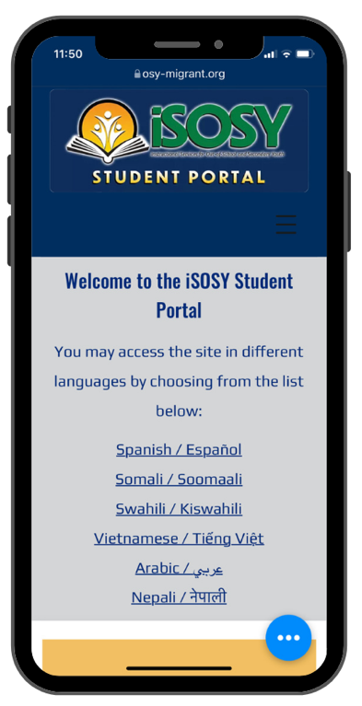
Student Portal &Technology Work Group Collaboration
Curriculum
Student Portal Vetting Committee comprised of members of both work groups
Conversion of STAT lessons into shorter, interactive experiences for direct access by students on the portal
Practice at the student’s convenience
Interaction with lessons when an in-person visit with an instructor is not possible
www.osymigrant.org

Slide 38
Student Portal & Technology
Student Portal & Technology Members:
Travis Williamson- NY
Andy Wallace- IN
Michelle Ervin- MIC
Cesar Duran- NE
Iggy Campos- NM
Sarah Braun-Hamilton- VT
www.osymigrant.org

Slide 39
Welcome to the iSOSY Student Portal!
Student Portal & Technology
The new iSOSY Student Portal serves as a hub to many resources intended for Out-of-School & Secondary Youth. Students with Wi-Fi/ internet capability now have 24/7 access to many engaging self-paced activities and educational materials. For students without access to the internet, they too can receive printed copies of the content; however, will not be able to partake in the interactive activities.
Now that the portal door has opened, lets take a closer look to what it includes!
www.osymigrant.org

Slide 40
What’s the Purpose of the Portal?
Student Portal & Technology
The purpose of the portal:
OSY & Secondary Youth with internet access will have 24/7 access to current iSOSY materials and other resources. Including other materials that supplement these branded iSOSY products .
Provide a collection of engaging interactive activities to keep the student wanting to expand with their learning.
Provide both live and recorded lessons with content based on focusing on students interests and needs.
Allow students to share their success and maintain connections when not always available.
www.osymigrant.org

Slide 41
Contents of the Portal?
Student Portal & Technology
When new iSOSY products are either created and/or submitted by member states, the portal will then be updated with these materials including any up-to-date COVID materials.
www.osymigrant.org

Slide 42
STAT Lessons
Student Portal & Technology
The student-based activities are designed using the content from the instructor-based lesson in order to keep the student engaged.
Interactive lessons include:
Matching
Quizlet & Quia
Edpuzzle
Crossword puzzles
Flipgrid and many more
www.osymigrant.org

Slide 43
COVID-19
Student Portal & Technology
All up-to-date COVID-19 materials will be readily available to students using many platforms in six languages. There is an informative video with which the student can check for understanding with various Edpuzzle questions.
COVID-19 materials and lessons are meant as a simple and general springboard for discussion of how to stay safe and healthy during the pandemic.
www.osymigrant.org

Slide 44
Live Lessons
Student Portal & Technology
We will be piloting our first live lesson at the end of April 2022.
The first lesson will include: smaller audience (we would like to invite ~3 OSY from each participating state.)
Welcome
Explain Objectives for these live lessons
Interactive polls throughout the lesson to gather for content for future live lessons
Beginner lesson on salutations/greetings including some everyday phrases
www.osymigrant.org

Slide 45
Google Classroom
Student Portal & Technology
Collected analytics from the OSY website to find the top five used topics. (Safety, Finance, Community, English for Everyday Life, and Health)
Developed interactive activities based on current iSOSY lessons and included supplemental resources to expand the student’s learning capacity.
www.osymigrant.org

Slide 46
Recorded Lessons & Resources
Student Portal & Technology
This section will be a collection of all created iSOSY materials and vetted Favorite Lesson submissions.
Also will include materials developed by other iSOSY workgroups (ex. Career Pathways, recent OSHA materials, digital literacy available apps).
It will also include past live recorded lessons if a student was unable to attend one in which they had interest.
www.osymigrant.org

Slide 47
Student Successes
Student Portal & Technology
In this section, we want to gather a plethora of success stories about our students.
Stories can be submitted by a recording of the student with each explaining how these materials have helped with their learning/life goals.
Students then can visit this section and hear affidavits of fellow students their age and see that they too can achieve success.
www.osymigrant.org

Slide 48
Have You Moved?
Student Portal & Technology
This button will direct the student to the IDRC referral page.
Questions?
www.osymigrant.org

Slide 49
Website Analytics
www.osymigrant.org

Slide 50
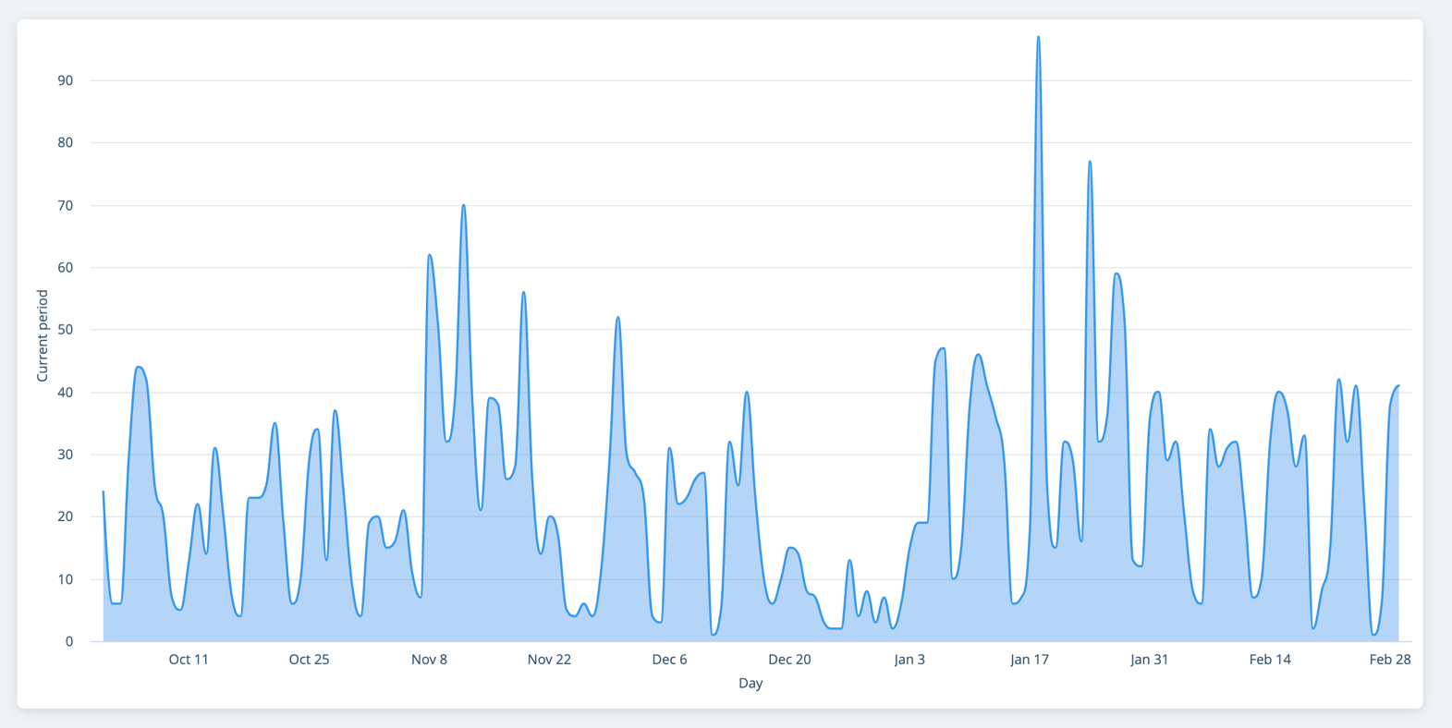
Website Analytics
iSOSY/IDRC Webinar
Mentor Meetings
TST Meeting
www.osymigrant.org

Slide 51
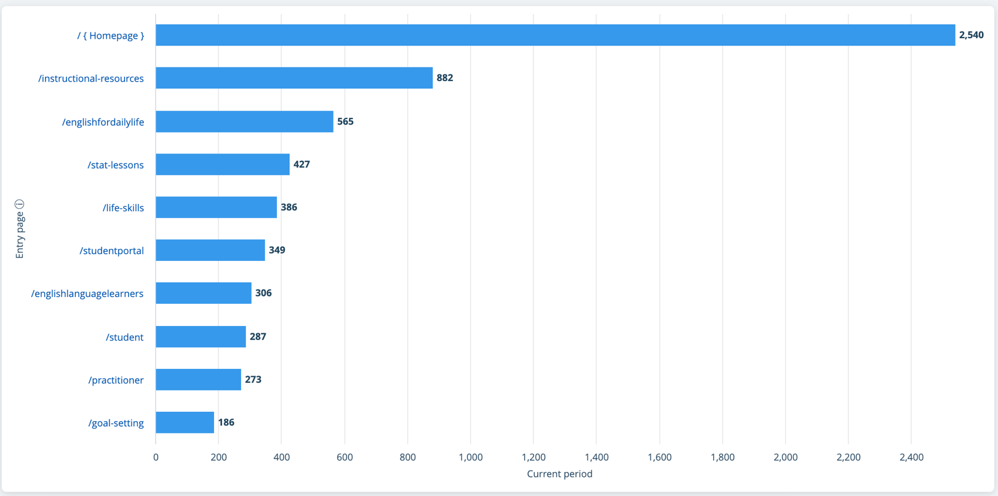
Website Analytics
www.osymigrant.org

Slide 52
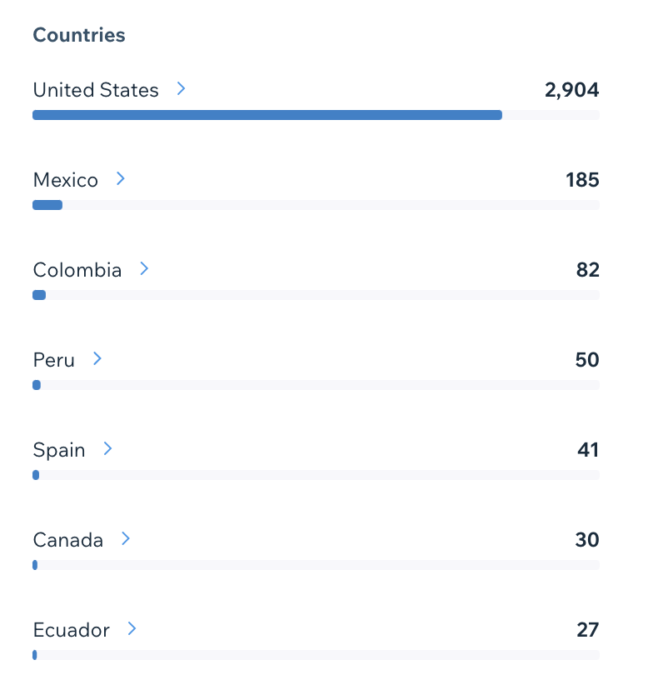
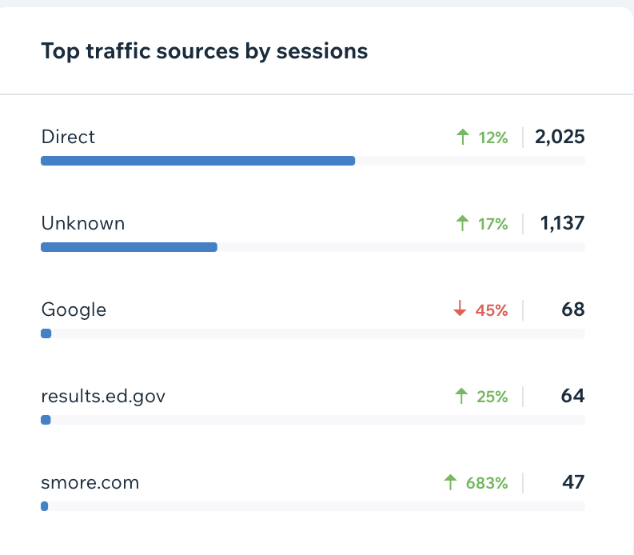
Website Analytics
www.osymigrant.org

Slide 53
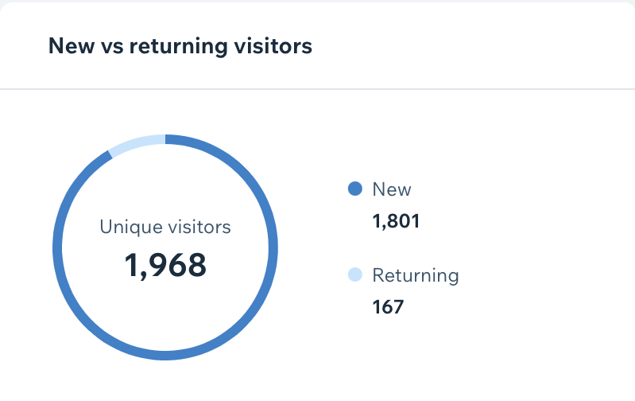
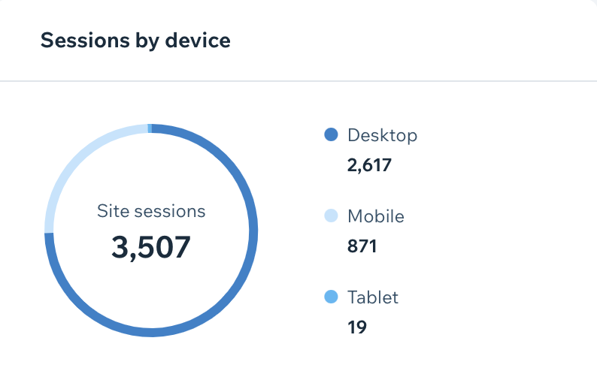
Website Analytics
www.osymigrant.org

Slide 54
Pilot Review Forms
www.osymigrant.org

Slide 55
Progression of Activities and Objectives
Develop
Pilot
Offer
Year 1: Development of new products and procedures
Year 2: Pilot test new products in at least 3 states and revise
Year 3: Offer new products consortium wide
Existing products (such as Learning Plans and Life Skills Lessons) should be used throughout all three years.
www.osymigrant.org

Slide 56
Pilot Procedures
Use products with students and/or MEP staff.
Each state should choose one or more products to pilot. Goal is to have 3-4 states piloting each product.
Conduct the pilot anytime up through 9/30/22.
Complete Form 3 and send to Marty with a CC to Tracie.
www.osymigrant.org

Slide 57
Year 2 Pilots
Product | States Piloting
1. STAT Lesson
2. Secondary student profile
3. Student Portal
4. Goal Setting and Career Awareness Toolkit
5. Personal Wellness materials
6. Live lessons
7. Pathways Guide
8. Website tour
www.osymigrant.org

Slide 58
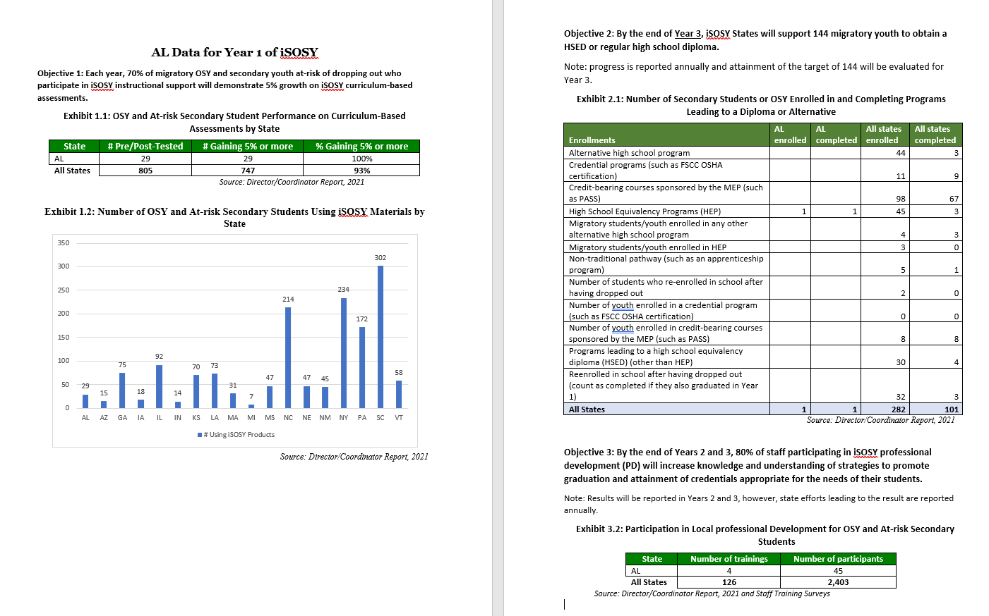
State Data by Objective
www.osymigrant.org

Slide 59
Year 2 Data Collection Review
www.osymigrant.org

Slide 60
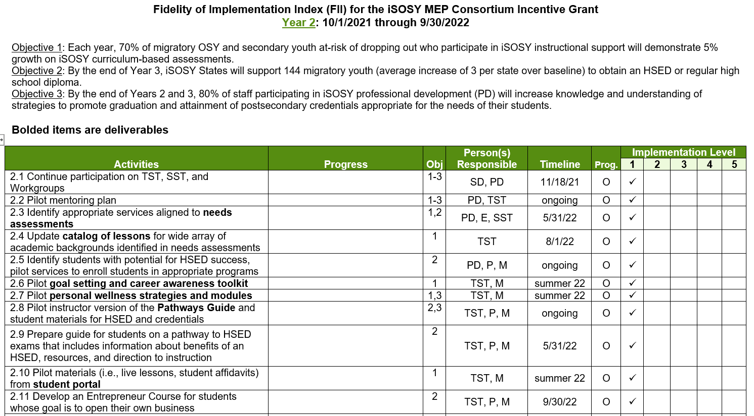
Year 2 FII Review
Fidelity of Implementation Index (FII)
Used to rate progress on activities we proposed
www.osymigrant.org

Slide 61
New to the FII
Materials developed in Year 1 are piloted in Year 2
Tracking HSED, credential, and graduation progress
Entrepreneur Course (added by the TST)
Digital literacy and distance education materials
Training for new materials
www.osymigrant.org

Slide 62
Data Collection Changes
Form 1: Director/Coordinator Report will remain largely the same with a few tweaks
Form 2: iSOSY Training Survey (tweaked)
Form 3: Pilot Review Form—we’ll work with the TST to identify specific questions for materials piloted
Form 4: Graduation, HSED, and credential support training survey (will be for select iSOSY webinars only to address Objective 2)
www.osymigrant.org

Slide 63
Form 1: Director/Coordinator
Complete once for each state.
Summarizes data collected regarding iSOSY services and activities.
What questions do you have?
www.osymigrant.org

Slide 64
Form 2: Staff Training Survey
Complete following training that includes iSOSY strategies or information.
You may submit these to the evaluator at any time.
File is available for download or you may use the online survey.
www.osymigrant.org

Slide 65
Form 3: Pilot Product Review
Will be customized for materials being piloted in Year 2 at the TST meeting.
You may submit these to the evaluator at any time.
All states should choose product(s) to pilot.
www.osymigrant.org

Slide 66
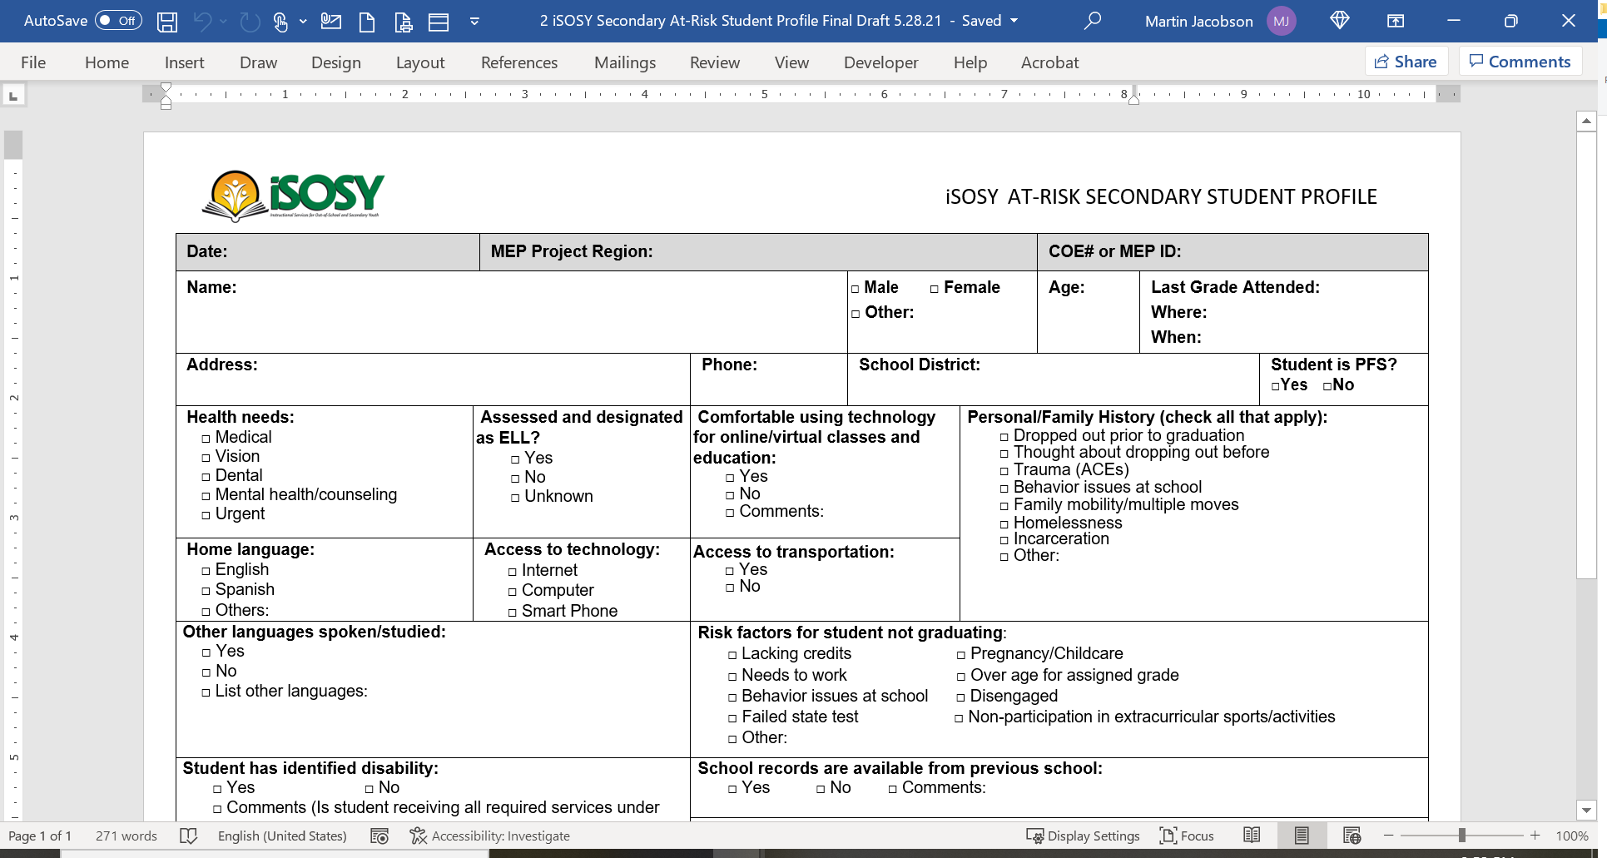
Profiles
OSY Profile and Summary
Used for CNAs in many states
Also used to guide material development and CIG proposals
Secondary student profile
The secondary student profile is a tool available to identify the needs of secondary students and help guide instructional staff toward appropriate materials for the student.
We will not be collecting data at the consortium level for this form. States may choose to use it for Comprehensive Needs Assessment or other state data collection.
www.osymigrant.org

Slide 67
Dissemination in Year 3
From the iSOSY proposal:
All CIGs are proposing a coordinated effort to disseminate products and strategies in Year 3 through in-person and/or virtual participation for all states (whether participating in a CIG or not). iSOSY will showcase activities, products, and strategies that have been useful in reaching project objectives.
www.osymigrant.org

Slide 68
iSOSY
iSOSY/Fort Scott Community College Collaboration
OSHA 10 General Industry
(Occupational Safety and Health Administration)
CAREERSAFE: THE NATIONAL YOUTH SAFETY INITIATIVE
www.osymigrant.org

Slide 69
iSOSY
CareerSafe is an OSHA-Authorized Online Outreach Training Provider.
Every student who successfully completes a CareerSafe OSHA 10-Hour course and passes with a 70% or higher will receive an OSHA 10-Hour Wallet Card as physical proof of the achievement.
www.osymigrant.org

Slide 70
iSOSY
COURSE OVERVIEW
Introduction to OSHA
Walking and Working Surfaces
Emergency Action Plans & Fire Protection
Avoiding Electrocution Hazards
Personal Protective Equipment (PPE)
Hazard Communication
Materials Handling, Storage, Use, Disposal
Machine Guarding
Industrial Hygiene
Bloodborne Pathogens
Ergonomics
Safe Driving Practices
Preventing Workplace Violence
Safety & Health Programs
www.osymigrant.org
Notes:
CareerSafe’s OSHA 10-Hour General Industry course consists of interactive topics discussing various safety tips and procedures one should follow in the workplace.
The General Industry course covers a wide range of topics that could be applied to any industry.

Slide 71
iSOSY
“The more we learn, the more we improve our lives.”
-Yessy, age 21, Kansas

Slide 72
Lessons Learned
Onboarding for Service Providers
Communication
Expectations of the course
Conduct meeting with service providers and students together
More frequent check-ins are needed
www.osymigrant.org

Slide 75
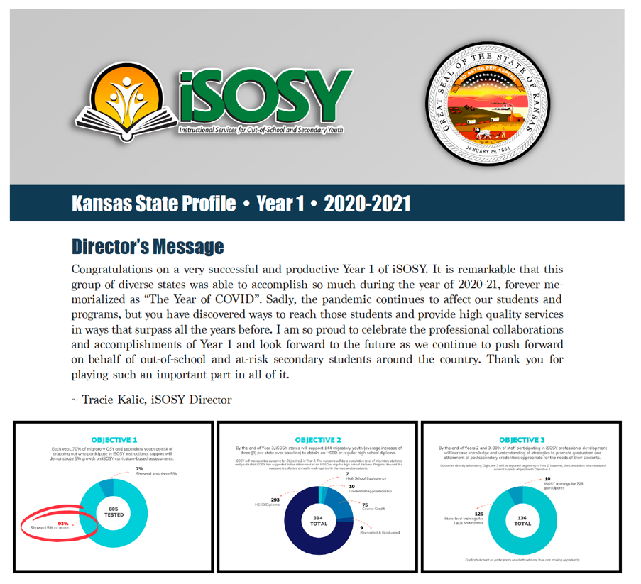
Year 1 State Profile Reports
www.osymigrant.org

Slide 76
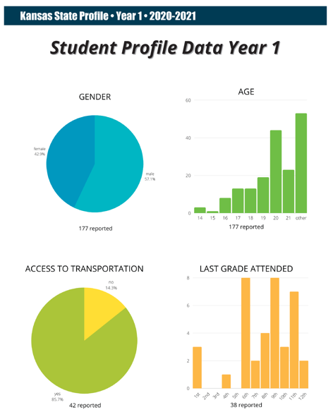
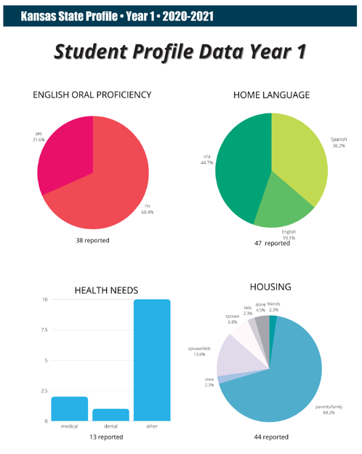
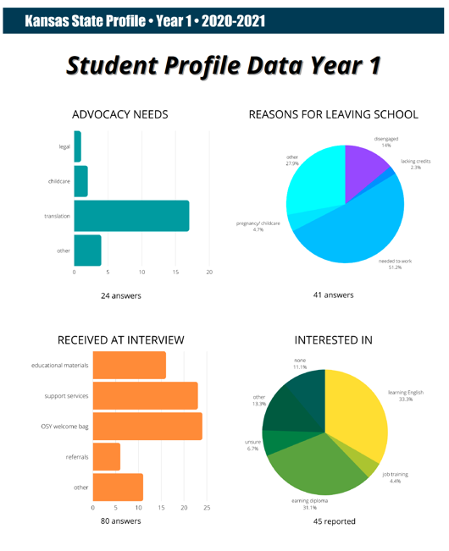
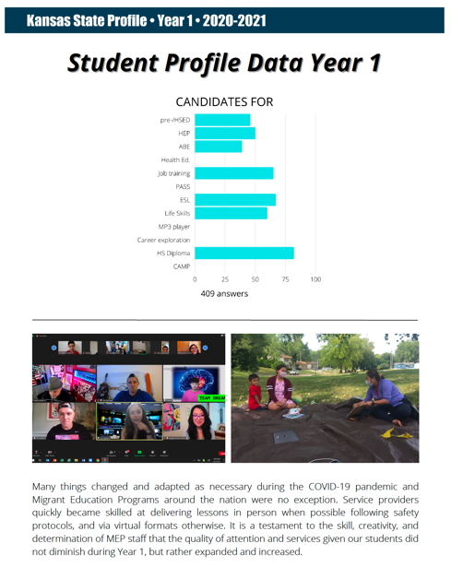
Year 1 State Profile Reports
www.osymigrant.org

Slide 77
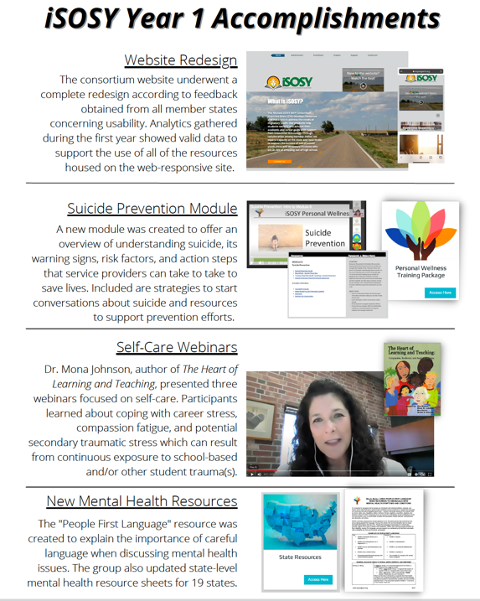
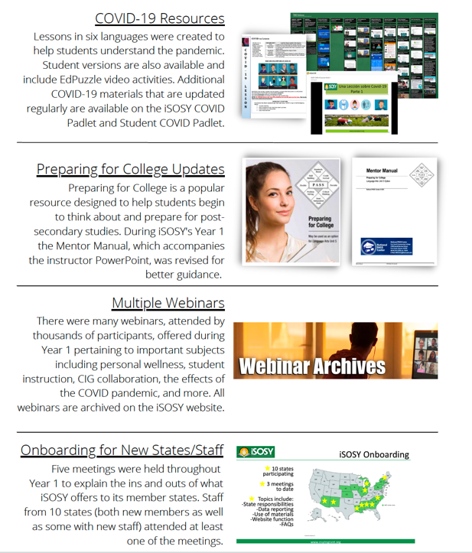
Year 1 State Profile Reports
www.osymigrant.org

Slide 78
Break Out Activity
Share successful examples of the following:
Recruitment of OSY/Secondary Youth at risk of dropping out
Service to OSY/Secondary Youth at risk of dropping out
Materials used
www.osymigrant.org

Slide 79
Upcoming Meetings and Other News
TST Meeting:
May 4-5, 2022
Chicago, IL
SST Meeting:
September 13, 2022 (before the IMEC Symposium)
Mentoring New or Interested States March 28, 2022
NASDME Proposals Accepted
Try Something New! Resources for Providing Services to OSY– Brenda Pessin and Veronica Hill
Suicide Prevention: Become Knowledgeable, Confident, and Start the Conversation– Lysandra Alexander and Lora Thomas
Come On In: iSOSY Opens New Student Portal– Travis Williamson and Andy Wallace
www.osymigrant.org

