Slide 1
State Steering Team Meeting
October 16, 2020
www.osymigrant.org

Slide 2
Agenda
Welcome and Introduction
Budget Approval (Rachel Beech)
Review objectives and Fidelity Implementation Index
Present draft data collection forms
Discuss “at risk” secondary students
Targeting Services
Direction for key activities and deliverables
Google Analytics
TST Work Groups and responsibilities (Tracie Kalic)
Upcoming meeting dates and times (Tracie Kalic)
New State Directors Follow Up Meetings
November 5 at 1:30 pm CST/2:30 pm EST/12:30 pm MST
Spring SST meeting TBD
Winter/Spring TST meetings TBD
Time for questions
Meeting Objectives
Become familiar with the iSOSY objectives and responsibilities.
Learn about data collection forms and due dates.
Discuss secondary at-risk students’ characteristics and needs.
Learn about key activities and deliverables
Understand the structure of iSOSY and the TST Work Groups.
Mark calendars for upcoming meetings.
www.osymigrant.org

Slide 3
iSOSY Objectives
Objective 2: By the end of Year 3, iSOSY States will support 144 migratory youth (average increase of 3 per state over baseline) to obtain an HSED or regular high school diploma.
This Objective is cumulative over three years.
We want to know about migratory youth who achieve this with assistance from MEP instructional services.
www.osymigrant.org

Slide 4
iSOSY Objectives
Objective 3: By the end of Years 2 and 3, 80% of staff participating in iSOSY professional development (PD) will increase knowledge and understanding of strategies to promote graduation and attainment of postsecondary credentials appropriate for the needs of their students.
We will be measuring this directly in Year 2 after new professional development has been created and implemented.
We will still collect results of professional development provided in Year 1 via the staff training survey.
www.osymigrant.org

Slide 5
FII Review
Fidelity of Implementation Index (FII)
Used to rate progress on activities we proposed
If there are any changes to language or items that you would like to suggest, now is the time.
www.osymigrant.org

Slide 6
Data Collection Forms
Data collection checklist
Form 1: Director/Coordinator Survey
Form 2: Staff Training Survey
www.osymigrant.org

Slide 7
Form 1: Director/Coordinator
Complete once for each state
Summarizes data collected regarding iSOSY services and activities
What questions do you have?
www.osymigrant.org

Slide 8
Form 2: Staff Training Survey
Complete following training that includes iSOSY strategies or information.
You may submit these to the evaluator at any time.
File is available for download or you may use the online survey.
www.osymigrant.org

Slide 9
Who are at-risk secondary students?
States have an option on how to define this. Here are two possible definitions.
Migratory students in grades 9-12 who are priority for services (PFS).
Migratory students in grades 9-12 who meet the at-risk definitions your state has outlined for PFS (but not necessarily the move within 1-year period part).
www.osymigrant.org

Slide 10
Which students should states serve?
Some states have very few OSY and some have very few at-risk secondary students.
iSOSY materials are designed for all OSY and/or at-risk secondary students.
We understand that states will have varying numbers/percentages in each group
Consider including OSY and at-risk secondary in your Comprehensive Needs Assessments (CNA) and Service Delivery Plan (SDP).
www.osymigrant.org

Slide 11
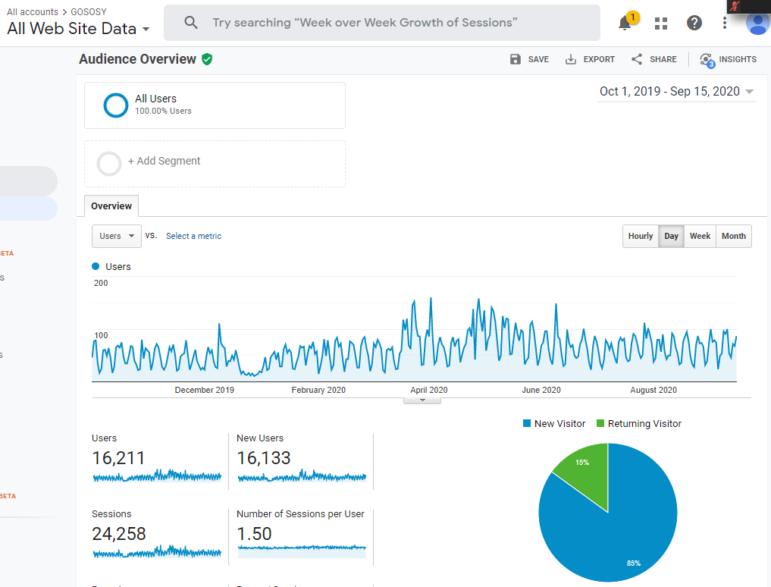
USERS
2019 to 2020
166% increase
www.osymigrant.org

Slide 12
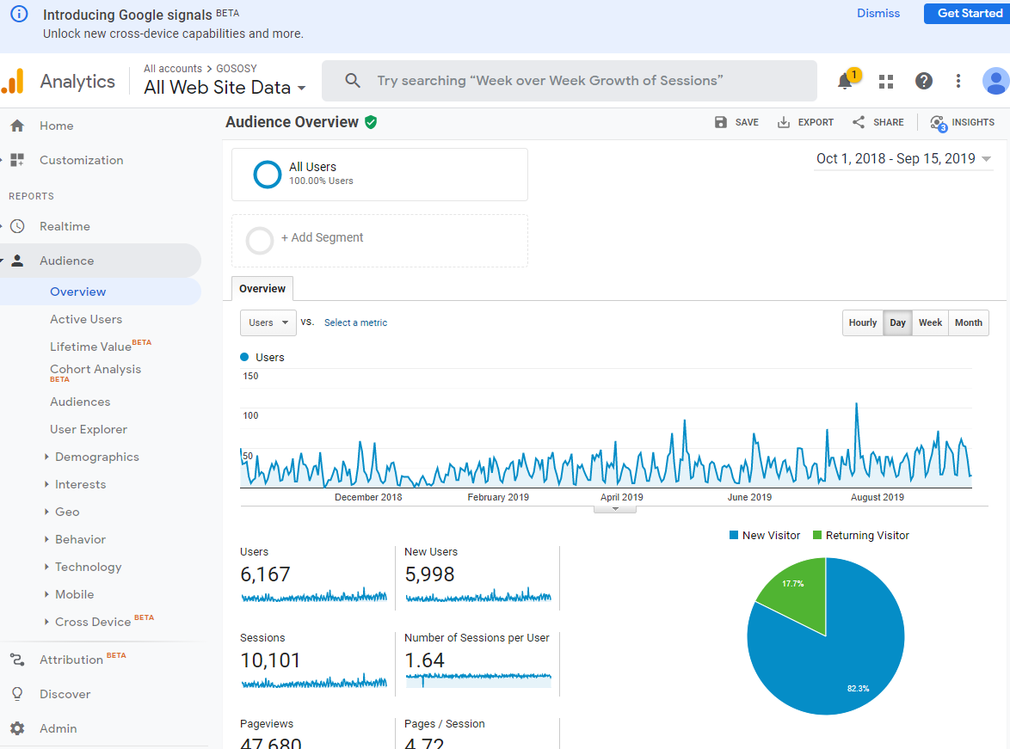
USERS
2018 - 2019
www.osymigrant.org

Slide 13
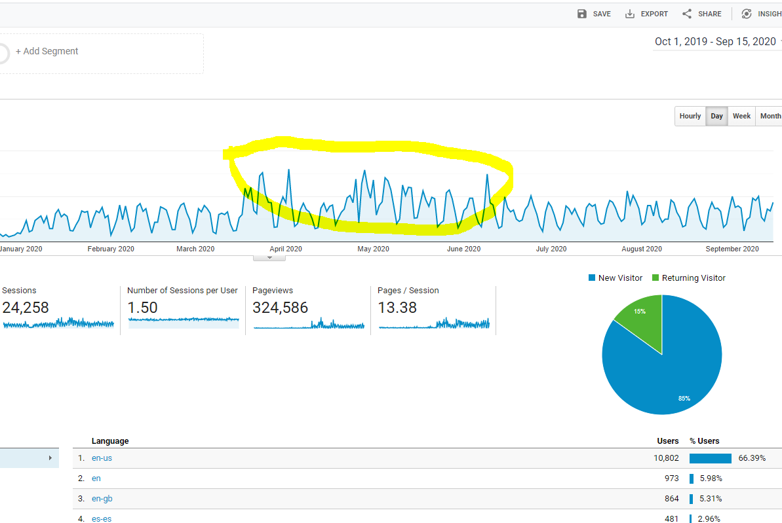
OVERVIEW
OF USAGE
CURRENT YEAR
www.osymigrant.org

Slide 14
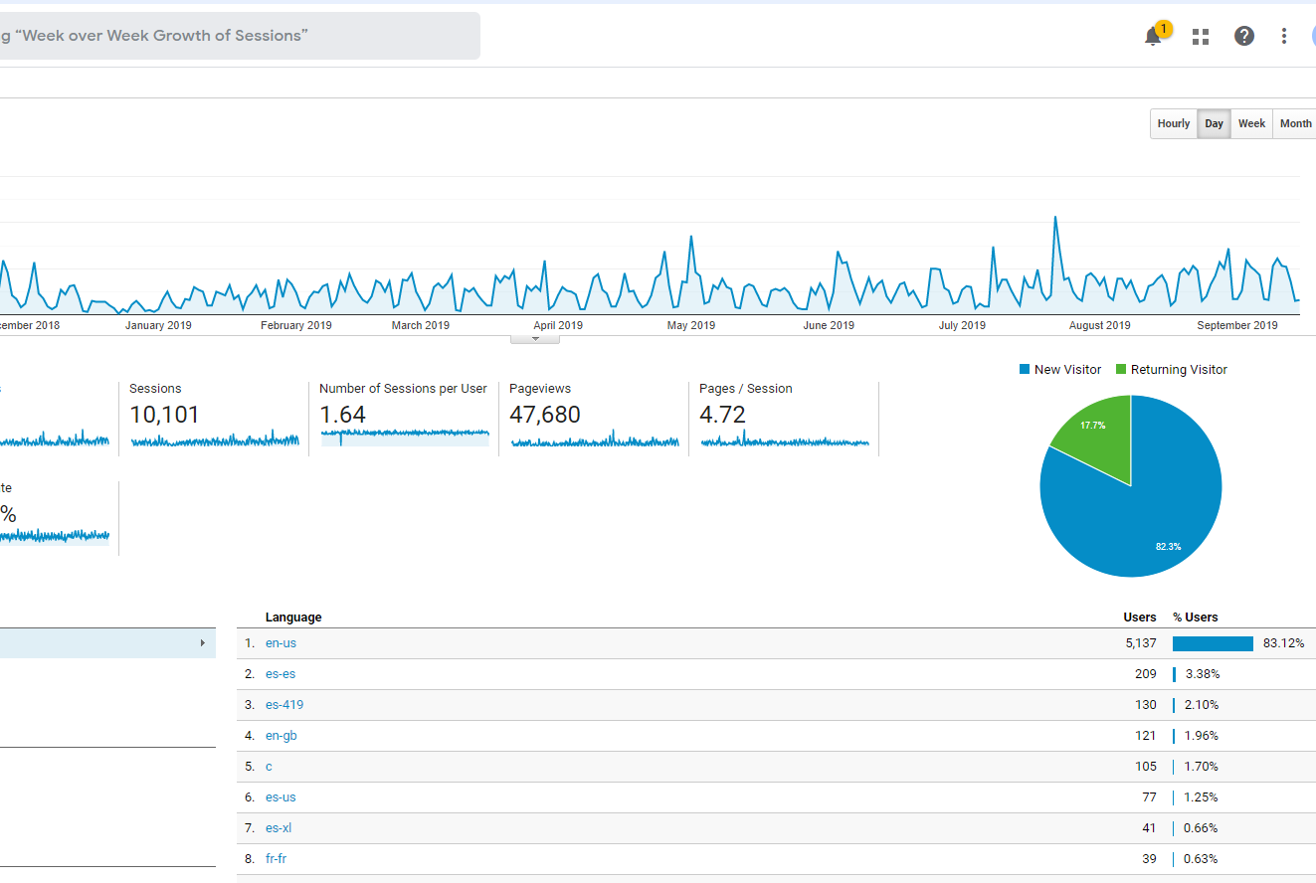
OVERVIEW
OF USAGE
LAST YEAR
www.osymigrant.org

Slide 15
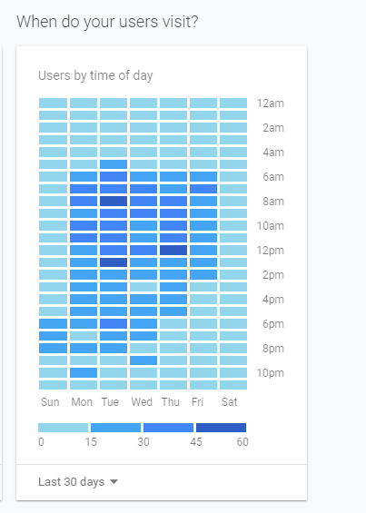
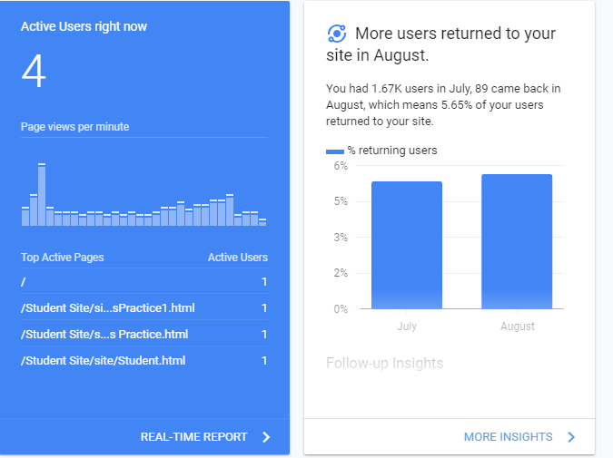
INSIGHTS
www.osymigrant.org

Slide 16
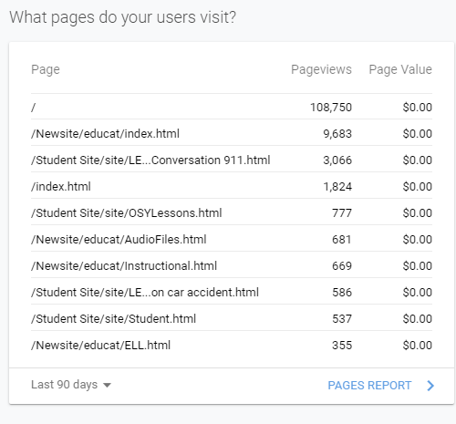
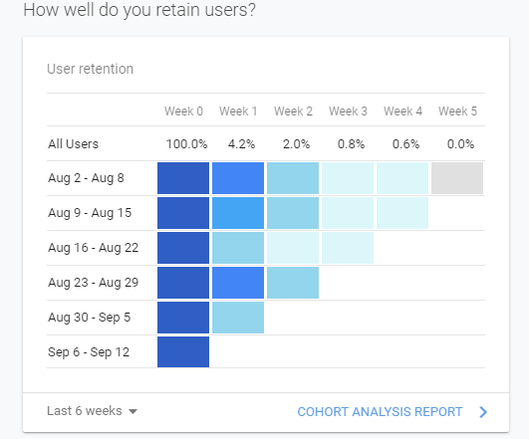
INSIGHTS
www.osymigrant.org

Slide 17
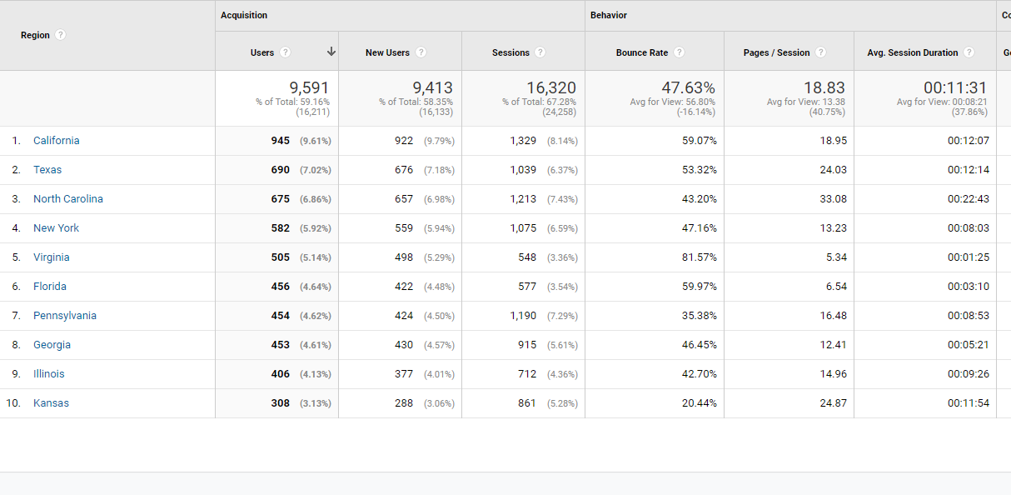
TOP STATE USAGE
OVER PAST YEAR
www.osymigrant.org

Slide 18
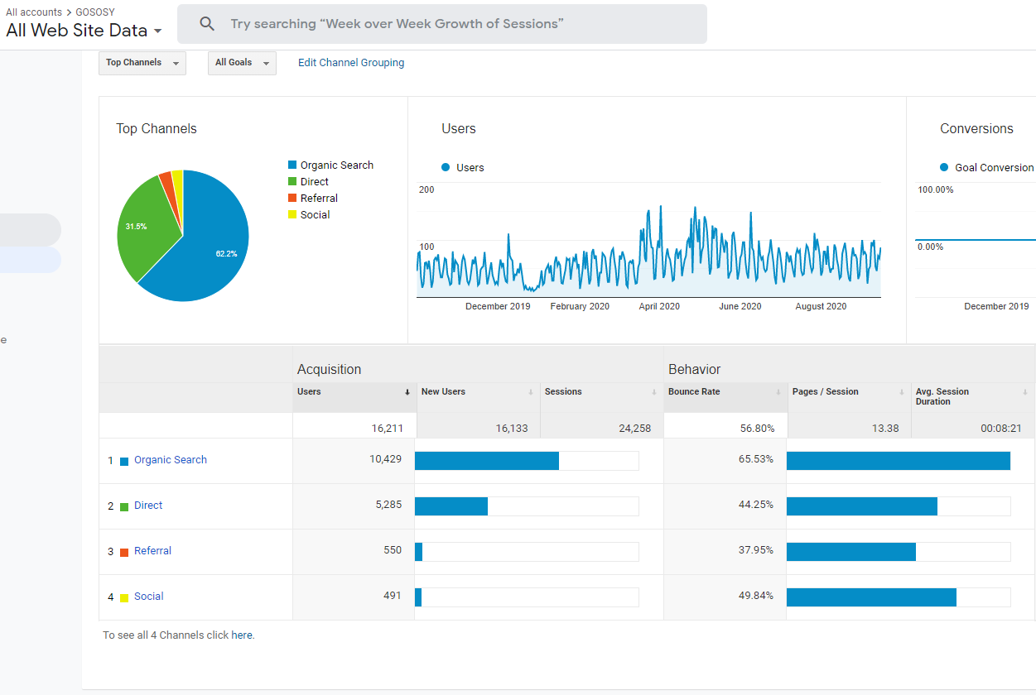
HOW THEY ARE FINDING YOU
www.osymigrant.org

Slide 19
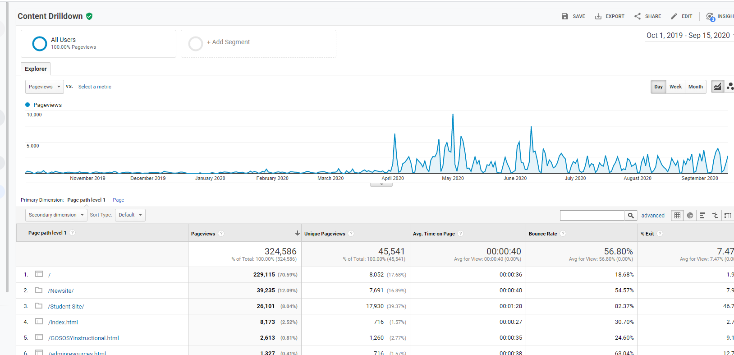
SITE PAGE USE
www.osymigrant.org

Slide 20
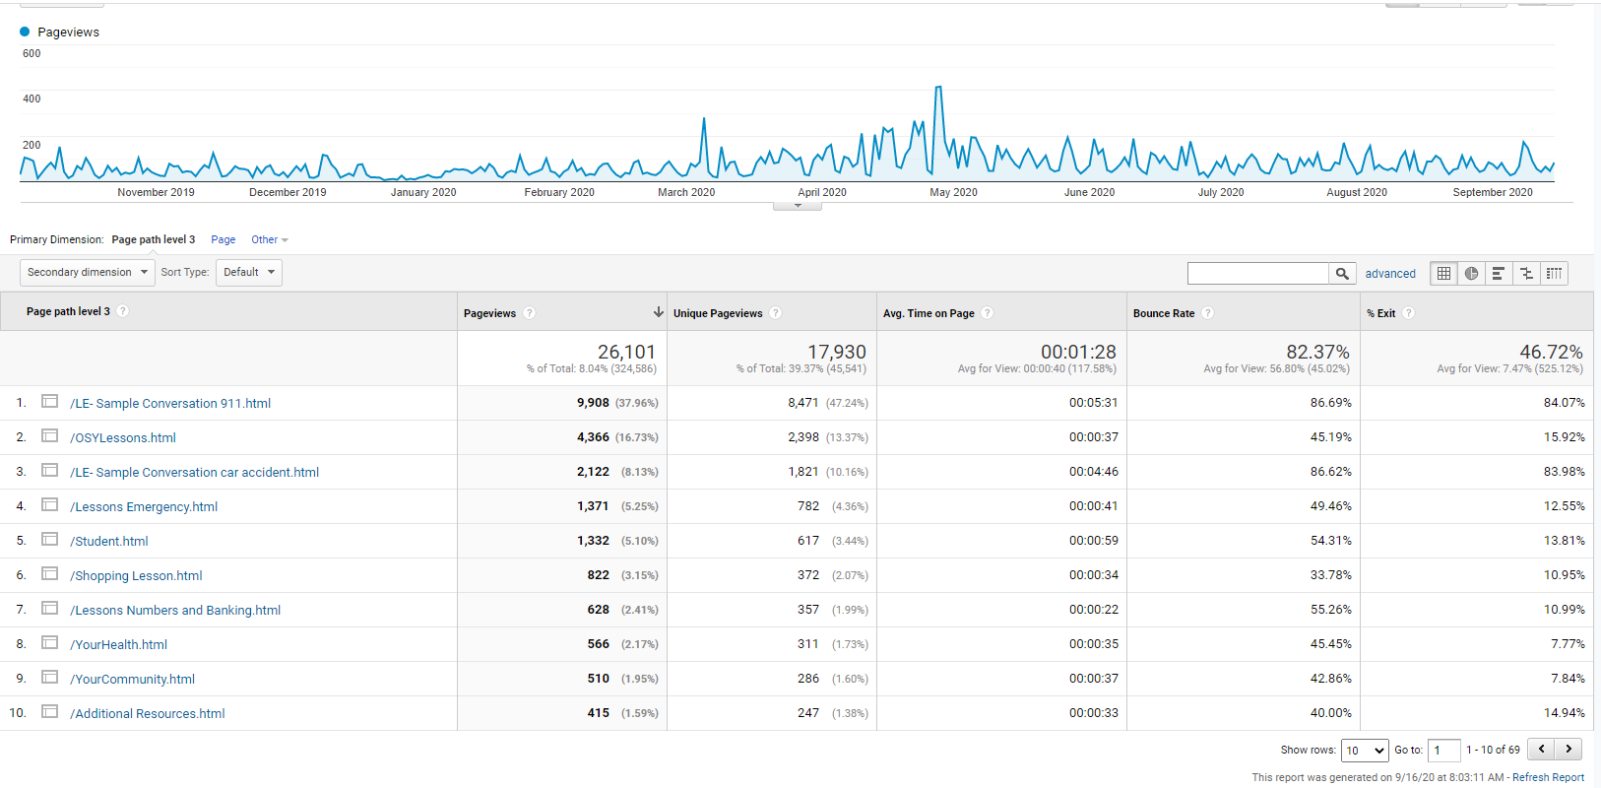
STUDENT SITE PAGES
www.osymigrant.org

Slide 21
STUDENT SITE PAGES
www.osymigrant.org

Slide 22
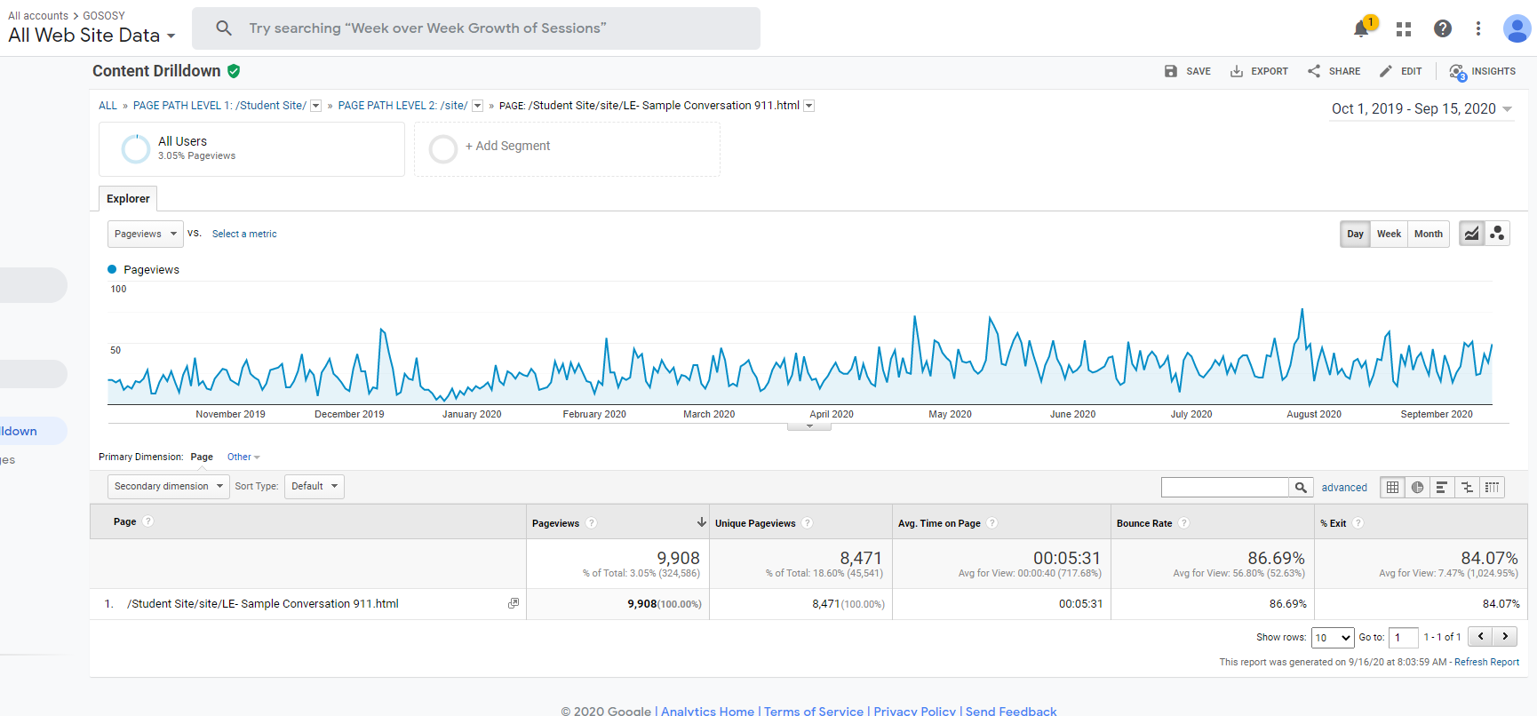
9-1-1 LESSON PAGE STUDENT SITE
www.osymigrant.org

Slide 23
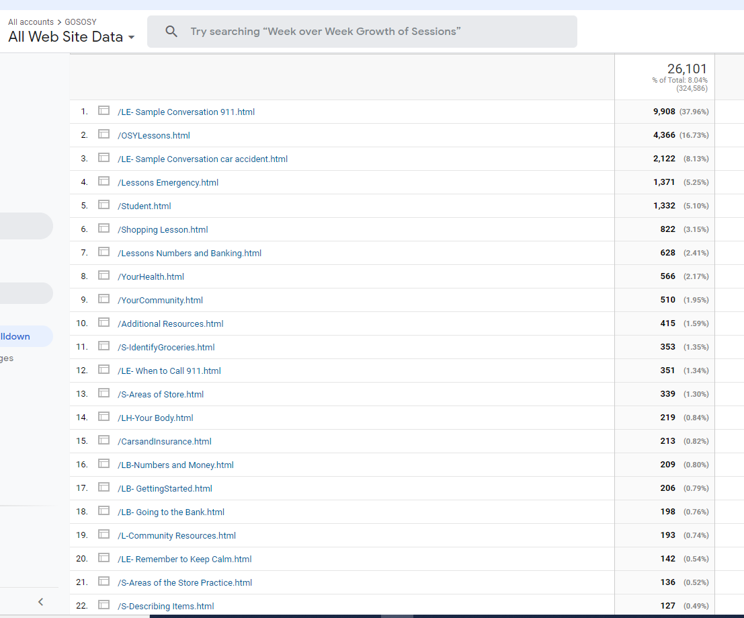
STUDENT PAGES LIST
www.osymigrant.org

Slide 24
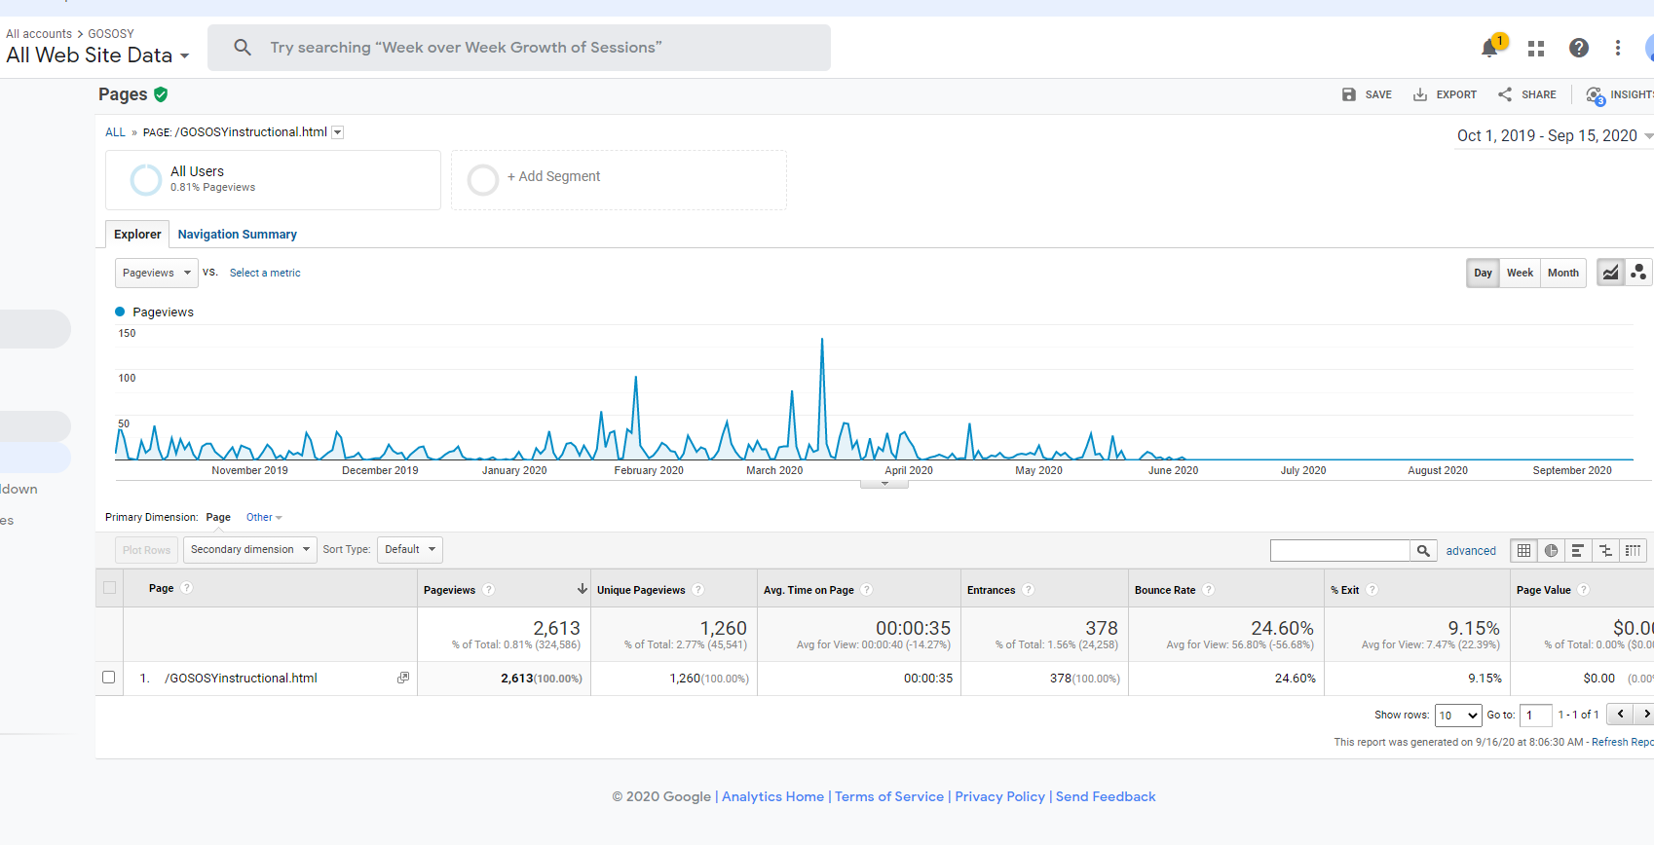
INSTRUCTIONAL
www.osymigrant.org

Slide 25
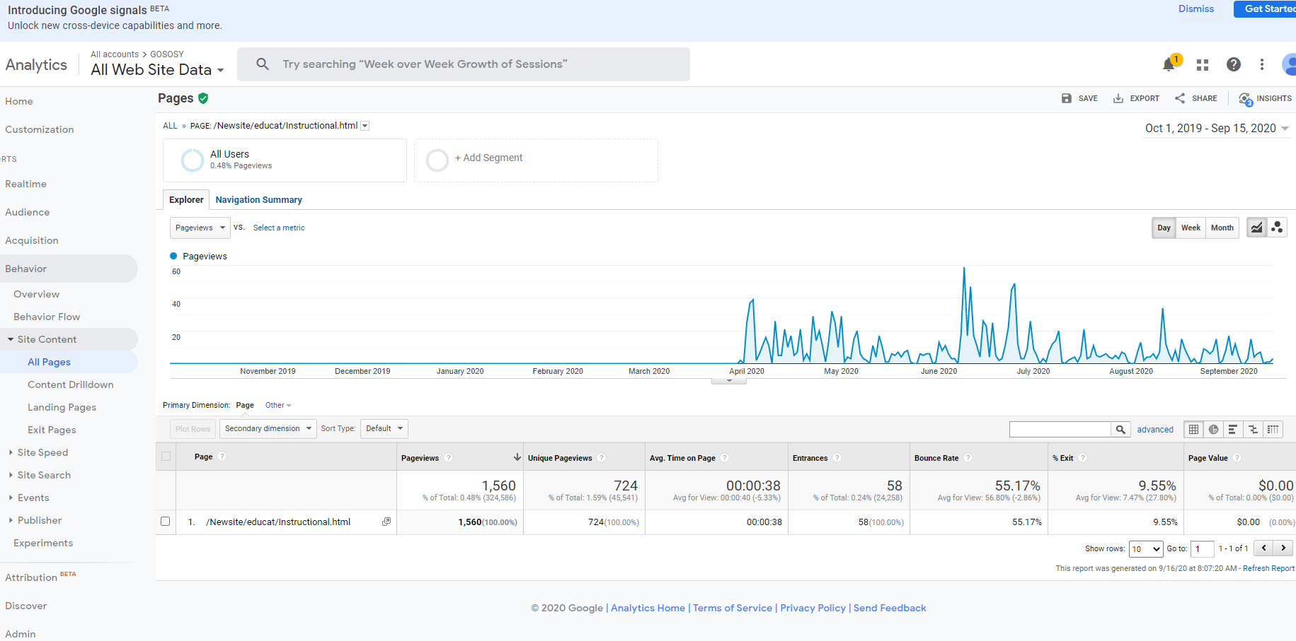
INSTRUCTIONAL
www.osymigrant.org

Slide 26
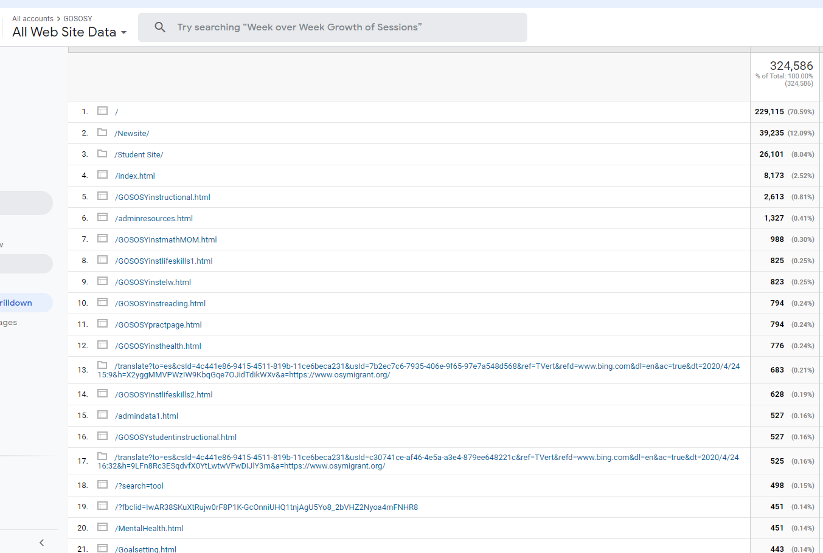
ALL CONTENT – TOP 20 THIS YEAR
www.osymigrant.org

Slide 27
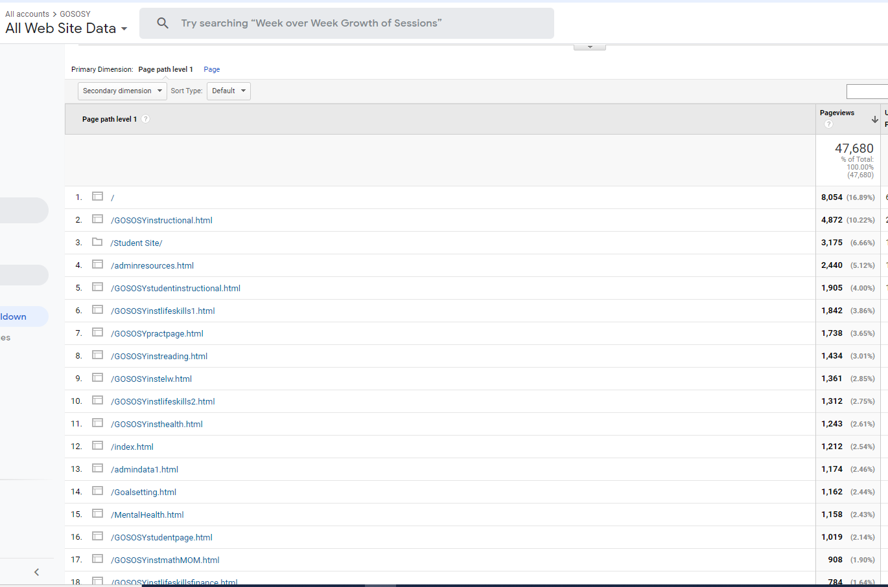
ALL CONTENT – TOP 17 LAST YEAR (2019-20)
www.osymigrant.org

Slide 28
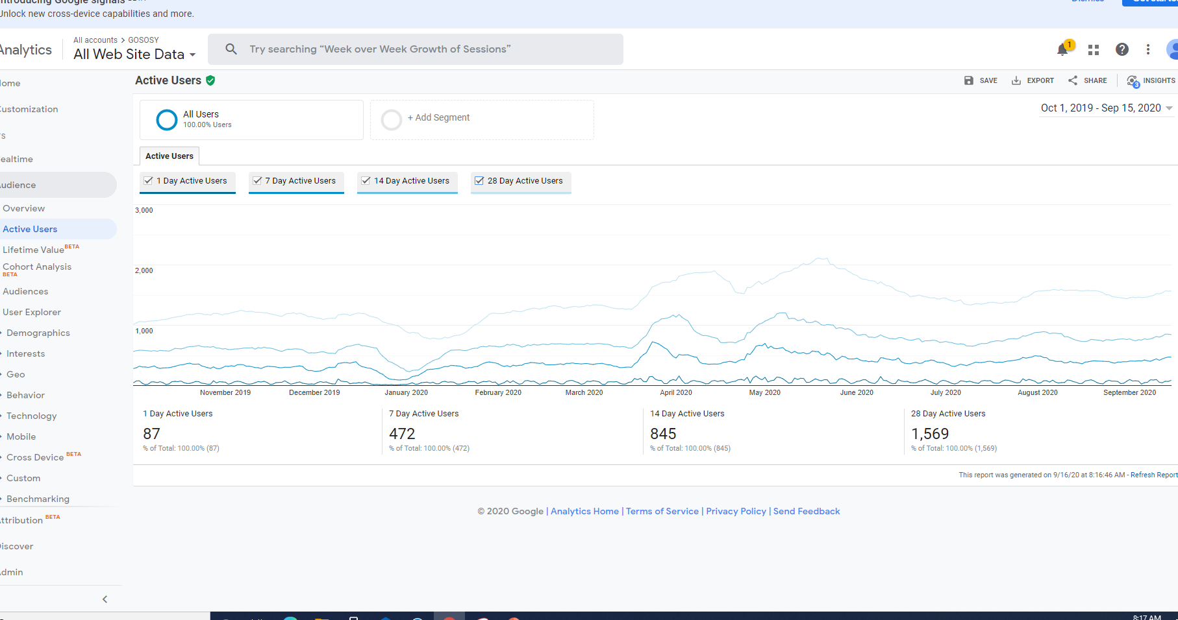
ARE THEY COMING BACK? 2020 YEAR
www.osymigrant.org

Slide 29
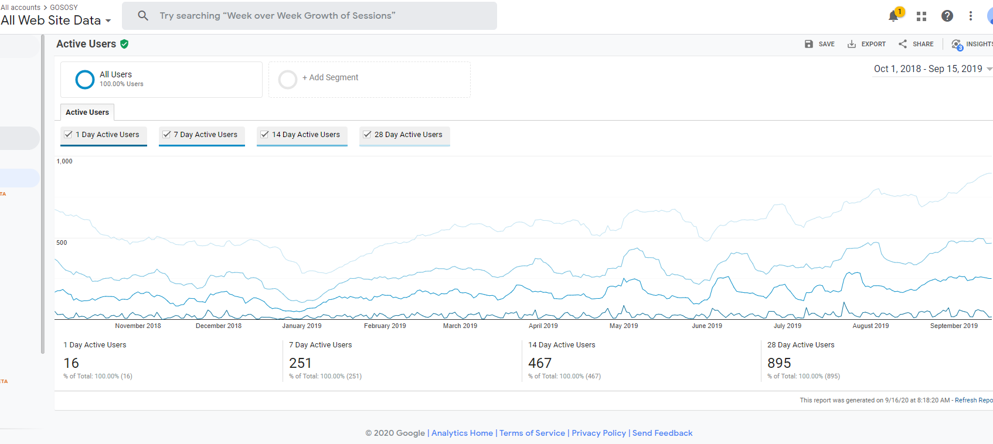
ARE THEY COMING BACK? 2019 YEAR
www.osymigrant.org

Slide 30
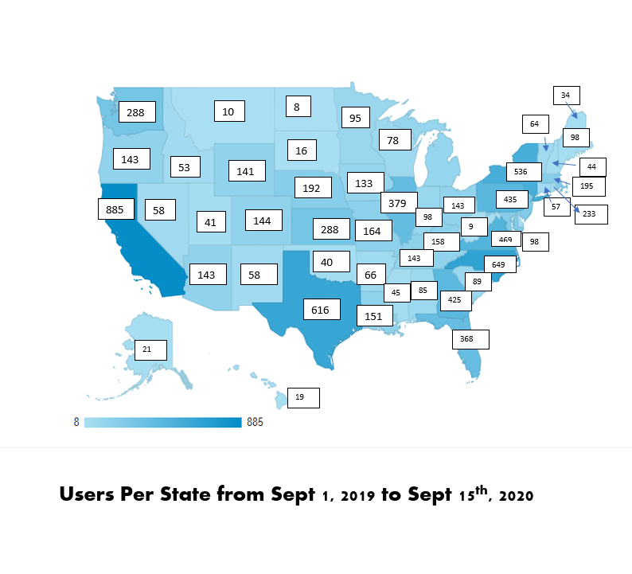
www.osymigrant.org

Slide 31
TST Work Groups
Pathways
FII indicators: 1.6, 1.7, 1.8, and 1.14
1.6 Develop Pathways Guide to HSED and credentials that includes information about prerequisite skills and assessments (instructor version).
1.7 Prepare guide for students on a pathway to HSED exams that includes information about benefits of an HSED, resources, and direction to instruction.
1.8 Prepare guide for students on a pathway to credential programs that includes benefits of various programs (including FSCC programs), resources, and direction to instruction.
1.14 Develop training materials/webinars on pathways to HSED and credentials.
Members:
Emily Hoffman (lead-MA)
Janet Reynolds (KS)
Hunter Ogletree (NC)
John Farrell (KS)
Bruce Lack (MI)
www.osymigrant.org

Slide 32
TST Work Groups
Curriculum
FII indicators: 1.5
1.5 Prepare initial catalog of lessons for wide array of academic backgrounds and identify assessment and instructional materials appropriate for various pathways and methods of instruction including asynchronous, synchronous, and summer.
Finalize English for Daily Life revisions and lesson plans.
Review English Language Screener feedback and make recommendations for revisions.
Develop Life Skills lesson on COVID-19.
Members:
Brenda Pessin (lead- iSOSY)
Veronica Hill (NE)
C. Hope Derry (NC)
Lori Potutschnig (PA)
www.osymigrant.org

Slide 33
TST Work Groups
Mentors Committee
FII indicators: 1.2
1.2 Establish iSOSY mentors and mentoring plan for technical assistance with serving OSY and at-risk secondary students, designing summer services, helping students along pathways, establishing programs for students, identifying at-risk students.
Members:
Tracie Kalic (lead- iSOSY)
www.osymigrant.org

Slide 34
TST Work Groups
Professional Development
FII indicators: 1.16
1.16 Develop training materials for distance education (how to use virtual learning tools for students and service providers).
Members:
Sabrina Rivera-Pineda (lead- GA)
Odilia Coffta (NY)
April Dameron (IA)
www.osymigrant.org

Slide 35
TST Work Groups
Career Awareness and Goal Setting
FII indicators: 1.9
1.9 Develop goal setting and career awareness materials (include materials to assess progress or attainment of lesson objectives).
Members:
Emily Williams (lead- SC)
Joyce Bishop (AL)
Shantella Singleton (PA)
Mary Speyrer (LA)
www.osymigrant.org

Slide 36
TST Work Groups
Personal Wellness
FII indicators: 1.10 and 1.17
1.10 Develop materials to enhance personal wellness (include materials to assess progress or attainment of lesson objectives).
1.17 Develop training materials regarding impact of trauma.
Members:
Lysandra Alexander
(lead- PA)
Lora Thomas (iSOSY)
Susanna Bartee (iSOSY)
Maria Dominguez (IL)
www.osymigrant.org

Slide 37
TST Work Groups
Technology and Student Portal
Andy Wallace (IN)
Travis Williamson (NY)
Sarah Braun-Hamilton (VT)
Michelle Mattson (MI)
Members:
FII indicators: 1.11 and 1.12
1.11 Plan and design student portal with resources that can be used with and without instructional support and options for synchronous and asynchronous instruction.
1.12 Create a plan and processes for transferring Learning Plans state to state.
www.osymigrant.org

Slide 38
Upcoming Meetings
New State Directors Follow Up Meetings
November 5 at 1:30 pm CST/2:30 pm EST/12:30 pm MST
Spring SST meeting TBD
Winter/Spring TST meetings TBD
www.osymigrant.org

