Slide 1

GOSOSY State Steering Team
October 18, 2017
Clearwater, FL
www.osymigrant.org

Slide 2
GOSOSY SST Meeting
Welcome and Introductions
  Alysia Johnston
  Jennifer Quick
Doug Boline, Assistant Director,
MEP State Director
www.osymigrant.org

Slide 3
Agenda
Google Analytics
GOSOSY TST Work Group Progress – Tracie and TST Work Group Leads
  Goal Setting
  OSY Learning Plan
  Professional Development
  Curriculum and Materials Development
  Identification and Recruitment
  ACeS Literature Review
Evaluation Results – Marty Jacobson
Year 2 results in the Annual Performance Report (APR)
Timeline for collection of APR cover sheets
Product Pilot Reviews for Year 3
FII for Year 3 and data collection
Collaboration efforts with other CIGs – Barbie Patch
GOSOSY Dissemination Event Planning
Planning for the Future—Marty Jacobson
GOSOSY Budget
Future meeting dates/times

Slide 4
Member States
Alabama
Florida
Georgia
Illinois
Iowa
Kansas
Kentucky
Massachusetts
Mississippi
Nebraska
New Hampshire
New Jersey
New York
North Carolina
Pennsylvania
South Carolina
Tennessee
Vermont
www.osymigrant.org

Slide 5
Partner States
Alaska
Arkansas
California
Colorado
Idaho
Maryland
Minnesota
Missouri
Montana
Oregon
Washington
Wisconsin
www.osymigrant.org

Slide 6
Technical Support Team
Expectations
Membership
State Director expectations
Requirements
  3 meetings per year
  Conference calls
  Work assignments
  Team Lead meeting
  Collaboration and coordination across groups
Work Norms
Be fully committed to the work and will demonstrate this commitment by meeting agreed upon deadlines, participating/attending meetings and calls until outcomes/goals are fully met.
Leave each meeting with tangible products/achievements synthesizing our meeting outcomes.
Use included reflection time to promote spontaneous, creative discussion.
www.osymigrant.org
Notes:
Purpose- responsibilites
Who to send?
Mentoring Pilot- World Education
Tracie will ask MA, TN, VT, GA, and CA
Mental Health-- KS
Goal Setting – TOT Work Group – Sonja Williams (lead)—Ernesto?
PD- Develop training to certified and non-certified staff – Jessica Castaneda (Lead)
ID&R – in collaboration with IRRC—Jennifer Almeda (lead)
Develop web-accessible lessons- Material Development—Bob Lynch and Brenda Pessin-- leads
With support and guidance from World Ed – Andy Nash
OSY Learning Plan—Emily Hoffman
With Steve Quonn

Slide 7
GOSOSY Updates
OME quarterly monitoring
Fall TST meeting
GOSOSY newsletter
  Fall newsletter published in November
  State articles
  State Spotlight
Google analytics
www.osymigrant.org

Slide 8
OSYMigrant.net
Google Analytics
January 1 – September 14, 2017
www.osymigrant.org

Slide 9
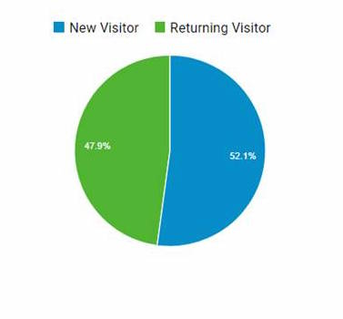
Visitors
2,737 total
www.osymigrant.org

Slide 10
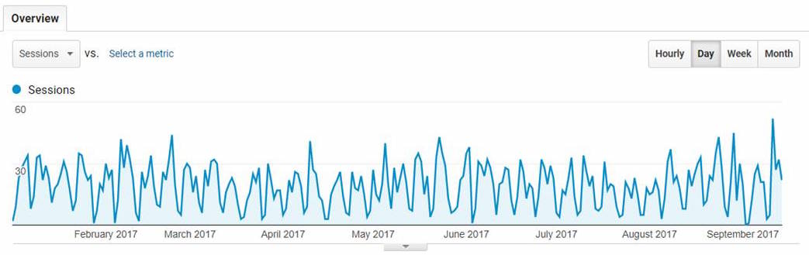
Overview
www.osymigrant.org

Slide 11
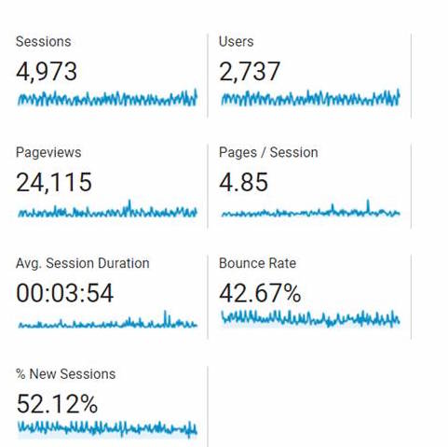
Statistics
www.osymigrant.org

Slide 12
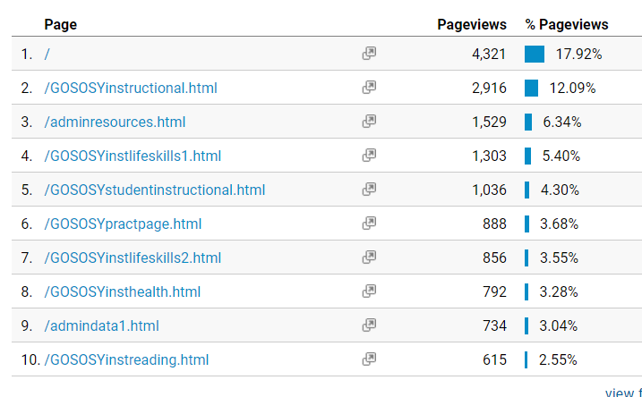
Pages
www.osymigrant.org

Slide 13
Work Groups
  OSY Learning Plan
  Goal Setting
  Professional Development
  Material and Curriculum Development
  Identification and Recruitment
  Literature Review
www.osymigrant.org

Slide 14

OSY Learning Plan
Members
Emily Hoffman (MA-lead)
Margot Di Salvo (FL)
Sarah Braun-Hamilton (VT)
Activities
OSY Learning Plans (Student version and Provider version) were implemented over the summer with more than 300 OSY completing a Learning Plan.
www.osymigrant.org

Slide 15
Goal Setting Workshop
Members
Sonja Williams (NC-lead)
Joyce Bishop (AL)
April Decameron (IA)
Carmen Anderico (MS)
Activities
Goal Setting Implementation Guide was amended per pilot feedback.
Almost 200 OSY were involved in summer the Goal Setting Pilot throughout all 18 member states.
www.osymigrant.org

Slide 16
Professional Development
Members
Kiowa Rogers (NE - lead)
Joan Geraci (NJ – lead)
Sabrina Rivera-Pineda (GA)
Odilia Coffta (NY)
Lysandra Alexander (PA)
Activities
Completed Module 1, Implementing the OSY Action Plan, and released on GOSOSY website.
Completed three Resource Guides to accompany Module 1:
    Strategies for Creating an Effective Learning Environment Resource Guide
    OSY Conversation Starters/Bridges to Academic Instruction Resource Guide
    Young Adult Learning Resource Guide
Began development of five “mini modules” for presentation to TST members in November. To include:
  An Introduction to Out-of-School Youth
  Strategies for One-on-One and Small Group Instruction
  Addressing the Specific Needs of OSY with Limited Formal Schooling
  Using Differentiation Strategies when Working with Various Learning Styles
  Working with Language Learners

Slide 17
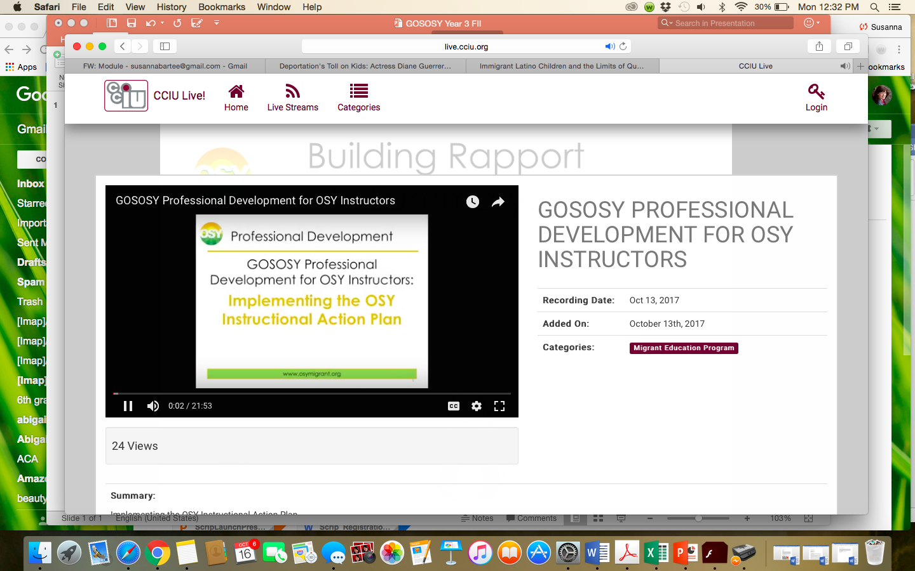
Professional Development Video

Slide 18

Professional Development
GOSOSY Professional Development for OSY Instructors:
Identifying and Addressing the Needs of OSY:
Working with Language Learners
www.osymigrant.org

Slide 19
Acknowledgements
GOSOSY Professional Development Group and Contributors
Lysandra Alexander (PA); Susanna Bartee (KS); Odilia Coffta (NY); Joan Geraci (NJ); Tracie Kalic (GOSOSY); Sabrina Pineda (GA); Kiowa Rogers (NE)
GOSOSY PD Reviewers and Technical Support Team members and the State Steering Support Team
www.osymigrant.org

Slide 20
Statement of Purpose
This module is intended to assist service providers who are tasked with working with OSY who are English Learners (ELs).
www.osymigrant.org
Notes:
Given the understanding that all students are different and learn in a variety of ways and that there is no “magic formula” to working with students; this module is intended to provide a framework for providing support.
Getting to know your students on an individual basis and tailoring your lessons to their specific needs is always the best approach to take when working with any at-risk population.

Slide 21
Learner Characteristics
There are different levels of language ability
Social English may be acquired quickly
Academic English takes years to master
Students learn language at their own pace
ELs need practice in Listening, Speaking, Reading and Writing
The best language learning occurs when students are at ease
www.osymigrant.org
Notes:
Given the understanding that all students are different and learn in a variety of ways and that there is no “magic formula” to working with students; this module is intended to provide a framework for providing support.
Getting to know your students on an individual basis and tailoring your lessons to their specific needs is always the best approach to take when working with any at-risk population.

Slide 22

Learner Characteristics
The Stages of Language Learning are as follows:
  Pre-production (silent period)
  Early Production (low beginner)
  Speech Emergence (high beginner)
  Intermediate Fluency
  Fluent
For detailed information see the Stages of Language Learning chart pictured in the next slide
  For the full document, see Stages of Language Learning document
www.osymigrant.org
Adapted from: http://www.ascd.org/publications/books/108052/chapters/The-Stages-of-Second-Language-Acquisition.aspx
Notes:
Insert new picture once document is updated

Slide 23
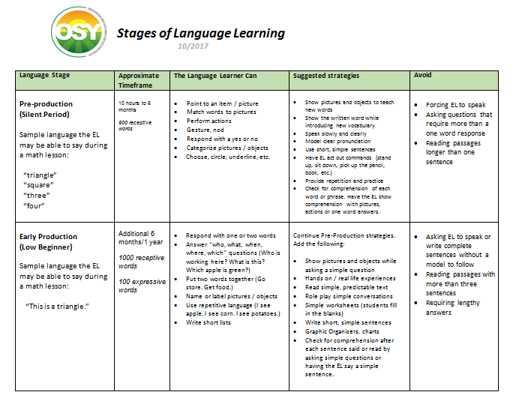
Learner Characteristics
  For the full document, see Stages of Language Learning document
www.osymigrant.org
Adapted from: http://www.ascd.org/publications/books/108052/chapters/The-Stages-of-Second-Language-Acquisition.aspx
Notes:
Insert new picture once document is updated

Slide 24
Working with English Learners:
Before the Lesson
Know the EL’s language level. Utilize a screening tool to determine the language level.
The OSY English Language Screener (linked below) is a good resource.
  http://osymigrant.org/GOSOSYinstorallanguage.html
  This is a basic assessment for beginners. If this screener is too easy for the EL, talk to your supervisor about other assessment options.
Refer to the Stages of Language Learning chart for strategies to implement and avoid at the EL’s language level.
Find out whether the EL is literate in his or her first language. If so, using bilingual materials may be helpful. If not, the following module may be helpful: Addressing the Specific Needs of OSY with Limited Formal Schooling.
  For the full module, see Addressing the Specific Needs of OSY with Limited Formal Schooling
www.osymigrant.org

Slide 25
Working with English Learners:
Before the Lesson
Identify key vocabulary
Prepare visual aids to teach vocabulary:
  Real objects
  Images
  Flashcards
  Dry erase board, markers, sketch pad and pens to draw vocabulary
Think of simple phrases to describe or explain key vocabulary
Plan activities that the EL can do to practice the vocabulary:
  Games
  Simple worksheets
  Conversation starters
  Role plays
www.osymigrant.org

Slide 26
Working with English Learners:
During the Lesson
Help the EL feel at ease:
  Relax
  Show confidence that you can communicate
  Use positive body language (i.e. smile, nod)
Focus on communication rather than grammar or pronunciation:
  Encourage the EL to respond and speak
  Model correct grammar and pronunciation
  Rephrase rather than overtly correcting mistakes
  Use a dictionary or online translation site
Provide opportunities for the EL to interact and show understanding in a variety of ways:
  Through pictures
  Through actions
  Through verbal responses
www.osymigrant.org

Slide 27
Working with English Learners:
During the Lesson
After asking a question, allow plenty of wait time for the EL to respond:
    8 seconds is recommended as a minimum
    Encourage any response, but don’t rush students to respond
Watch the student’s body language. If s/he seems confused (fearful look, blank stare), be ready to modify the way you are presenting the lesson.
Try a different approach if the EL doesn’t respond as expected:
    Present the question in a different manner (rephrase, write, draw)
    Allow the EL to respond non-verbally by:
      Pointing, gesturing, acting out a response
      Selecting from a group of pictures
      Choosing a word card
www.osymigrant.org

Slide 28
Checking for Understanding
Review the vocabulary you taught. Check for understanding by having the OSY:
  Match pictures to words (pre-production, early production)
  Use the word in a sentence (high beginner)
  Do a role play using the vocabulary words (speech emergence, intermediate)
  Describe or explain the words (fluent)
For additional ideas, see the Stages of Language Learning document linked below
  For the full document, see Stages of Language Learning document
www.osymigrant.org

Slide 29
Working with English Learners:
After the Lesson
Learn from your students:
  Reflect on how their responses can help you improve the way you communicate with the EL in the future:
      Which strategies did the EL seem to embrace the most?
      What other topics / vocabulary has the EL expressed interest in?
Reflect on what opportunities you can give the ELs to communicate effectively with you:
      With which response type did they seem most comfortable?
      (drawing, selecting pictures, actions, role play, writing, etc.)
Use student responses and ability to select materials for the next lesson.
Do not hesitate to change/adjust future lessons based on what you observed.
www.osymigrant.org

Slide 30
Participant Feedback
Fill out the GOSOSY online evaluation below:
  https://www.surveymonkey.com/r/PGY5NK5
  Facilitator follow -up questions for group training:
  What did you learn?
  What did you find most helpful or beneficial?
  How will you be using this with your youth?
  What recommendations do you have for future training?
www.osymigrant.org

Slide 31
Materials & Curriculum
Members
Brenda Pessin (IL - lead)
Chris Norton (NY – lead)
Peggy Haveard (AL)
Activities
Four Mental Health Life Skills Lessons were completed and released on the GOSOSY website.
Lesson 5: Let’s Talk About Stress is under final review and will be released this year; will include optional activity on coping plan.
English Language Resource Rubric draft is completed for presentation to TST in November.
Living in America lesson “Using Money” drafted for presentation to TST in November.
www.osymigrant.org

Slide 32
Identification & Recruitment
Members
Jennifer Almeda (SC-lead)
Ray Melecio (FL)
Pedro Santiago (KY)
Barbie Patch (NH)
Deke Showman (PA)
Activities
Field-Based Recruiting and ID&R Tip Sheet both updated and available on GOSOSY website.
2. PREZI resource developed for professional development using recruitment tools on GOSOSY website.
3. Continued collaboration with IRRC on Recruiter Competency Skills Assessment and now developing training with IRRC.
www.osymigrant.org

Slide 33
Literature Review
Members
Jessica Castañeda (lead)
Susanna Bartee
John Farrell
Activities
Continued research into Adverse Childhood Experience (ACEs) study and materials available.
Draft was completed and is under revision for completion this year.
www.osymigrant.org

Slide 34

Adverse Childhood Experiences
ACEs

Slide 35

We need an Understanding of how
Adverse Childhood Experiences
Impact OSY

Slide 36
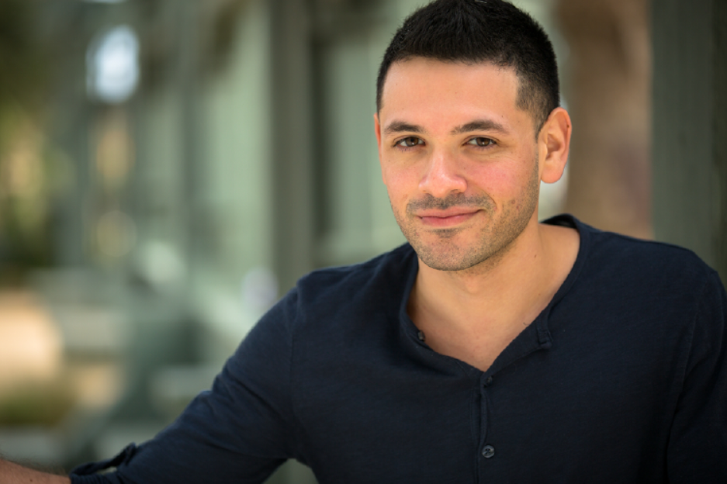


Slide 37

Adverse events or experiences that occur early in childhood can have lifelong consequences for both physical and mental well-being.

Slide 38

Only recently have medical investigators in primary care settings begun to examine associations between childhood abuse and adult health risk behaviors and disease.

Slide 39

Traumatic experiences during childhood, including physical abuse and the adversities that accumulate for children reared in persistent poverty, may disturb the neurobiological systems that guide physiological and behavioral responses to stress, potentially for the remainder of a persons life.

Slide 40
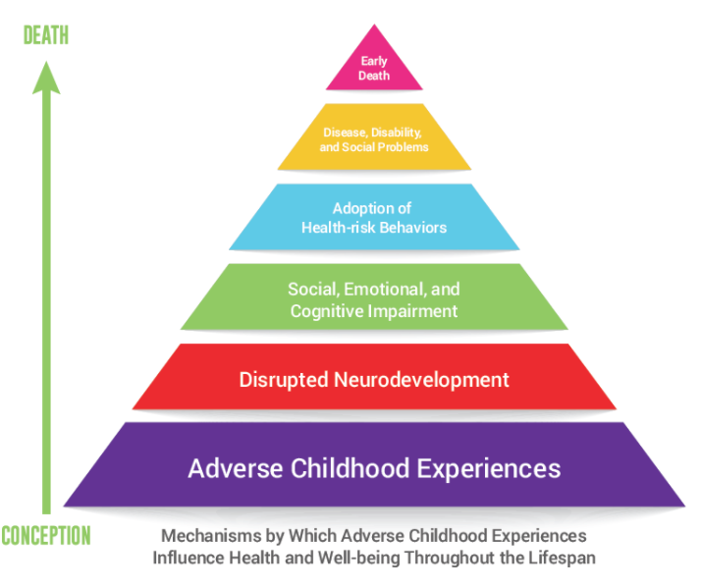

Slide 41

In 1985, Dr. Vincent Felitti, chief of Kaiser Permanente’s revolutionary Department of Preventive Medicine in San Diego, CA, could not figure out why more than half of the people in his obesity clinic dropped out each year for five years straight.

Slide 42

Public health experts, social service workers, educators, therapists, and policy makers commonly regard addiction as a problem. Some, however, are beginning to understand that turning to drugs is an expected response to serious childhood trauma, and that telling people who smoke or overeat or overwork that they should stop because these things are bad for them does not work when those behaviors provide a temporary, but gratifying, solution to a bigger problem.

Slide 43

Kaiser Permanente in San Diego was a perfect place to do a mega-study. More than 50,000 members came through the department each year for a comprehensive medical evaluation.

Slide 44

Anda and Felitti developed a scoring system for ACEs. Each type of adverse childhood experience counted as one point. If a person had none of the events in her or his background, the ACE score was zero. If someone was verbally abused thousands of times during his or her childhood, but no other types of childhood trauma occurred, this counted as one point in the ACE score. If a person experienced verbal abuse, lived with a mentally ill mother and an alcoholic father, his ACE score was three.

Slide 45

Things start getting serious around an ACE score of 4. Compared with people with zero ACEs, those with four categories of ACEs had a 240% greater risk of hepatitis, were 390% more likely to have chronic obstructive pulmonary disease (emphysema or chronic bronchitis), and a 240% higher risk of a sexually-transmitted disease.

Slide 46

People with high ACE scores are more likely to be violent, to have more marriages, more broken bones, more drug prescriptions, more depression, more auto-immune diseases, and more work absences.

Slide 47
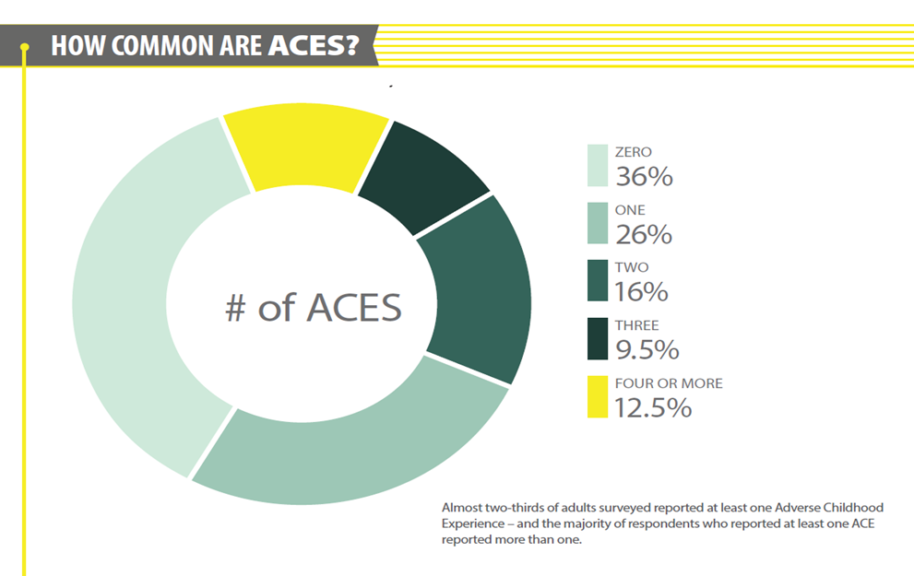

Slide 48
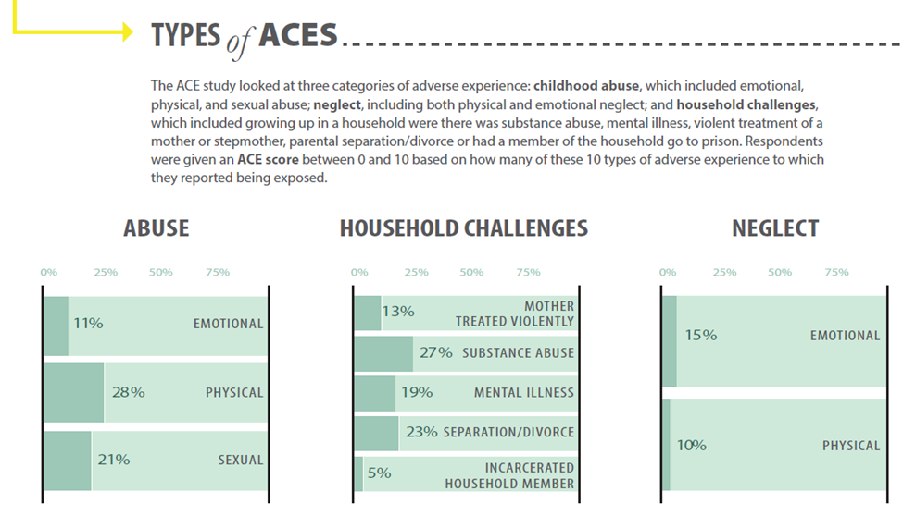

Slide 49
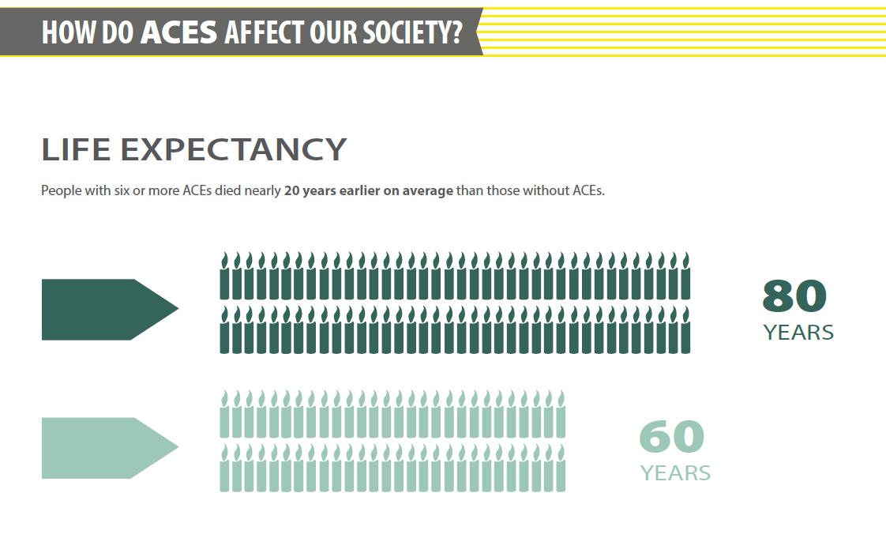

Slide 50

As the number of ACEs increases so does the risk for the following:
Alcoholism and alcohol abuse
Chronic obstructive pulmonary disease
Depression
Fetal death
Health-related quality of life
Illicit drug use
Ischemic heart disease
Liver disease
Poor work performance
Financial stress
Risk for intimate partner violence
Multiple sexual partners
Sexually transmitted diseases
Smoking
Suicide attempts
Unintended pregnancies
Early initiation of smoking
Early initiation of sexual activity
Adolescent pregnancy
Risk for sexual violence
Poor academic achievement

Slide 51
As the number of ACEs increases so does the risk for the following:
Alcoholism and alcohol abuse
Chronic obstructive pulmonary disease
Depression
Fetal death
Health-related quality of life
Illicit drug use
Ischemic heart disease
Liver disease
Poor work performance
Financial stress
Risk for intimate partner violence
Multiple sexual partners
Sexually transmitted diseases
Smoking
Suicide attempts
Unintended pregnancies
Early initiation of smoking
Early initiation of sexual activity
Adolescent pregnancy
Risk for sexual violence
Poor academic achievement

Slide 52
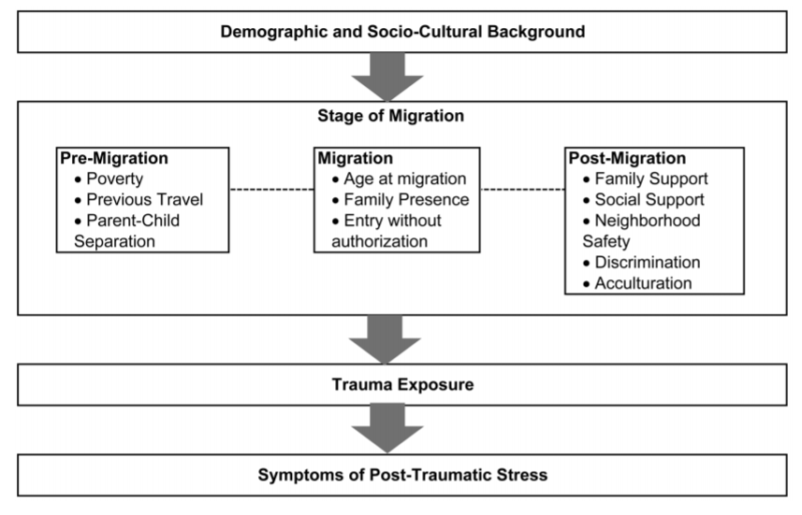

Slide 53
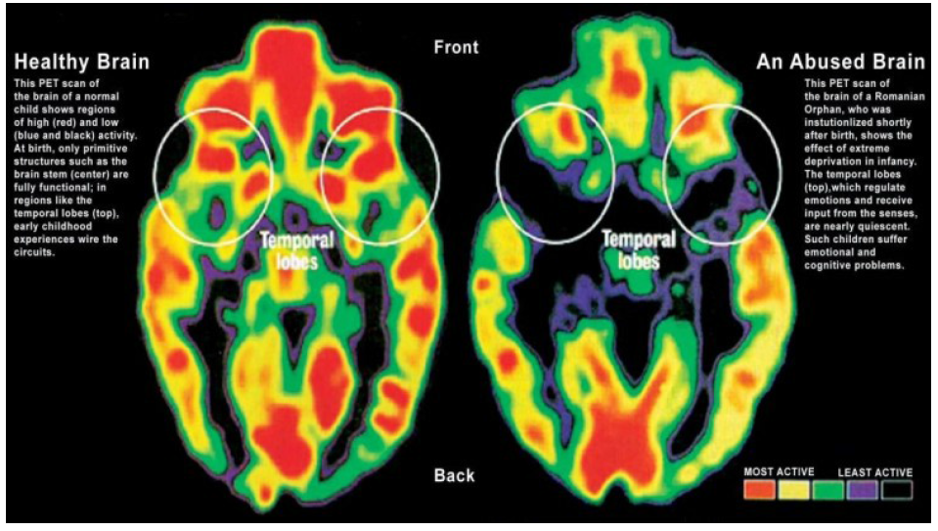

Slide 54
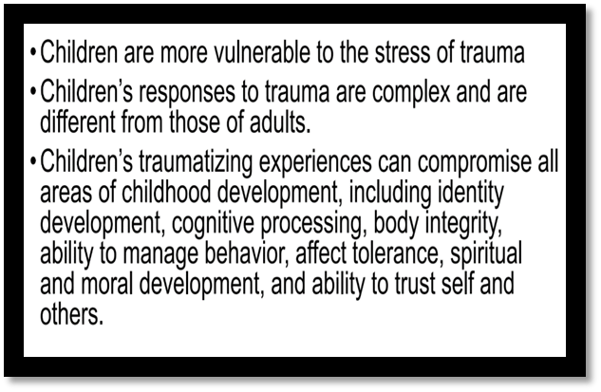

Slide 55

Project Focus
We are working to gather and provide research and tips for practitioners working with OSY that have been affected by ACEs and traumatic stress reactions.

Slide 56
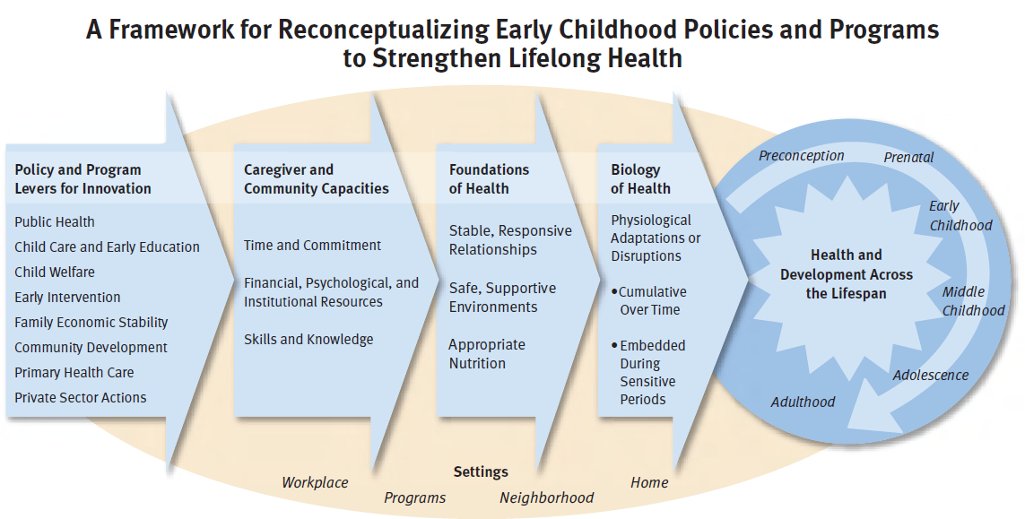

Slide 57

Timeline
We expect to have a draft to share with the TST in November and will also have some visual chapter PowerPoint summaries available on the website later this year.

Slide 58
Dissemination Event Planning
SOSOSY
2014
Dissemination
Event
feedback
and discussion
Even
better
GOSOSY
2018
Dissemination Event
www.osymigrant.org

Slide 59
Dissemination Event Planning
2014
Dissemination Event
Feedback
Overall rating was 4.7 out of 5.
What worked best?
Registration process
Opening session
What needs improvement?
Networking and discussion time
www.osymigrant.org

Slide 60
Ideas We Are Working On
electronic
evaluations
more time for
informal
networking
vendors
record presentations
www.osymigrant.org

Slide 61
Dissemination Event Planning Update
Overall structure-
  Length of GOSOSY portion/number of sessions
  Collaborate with IRRC and PI
  Combined keynote session
  Registration process
    Online process
    Fee
Keynote speaker-
  Potential speakers
OSY participation-
  Leadership institute or strand of sessions/experiences for OSY throughout the event
  Maximize the OSY panel
What is non-negotiable?
Notes:
Dr. Victor Rios
John Quinones
Maria
Stephen Colbert
Dr. Roy Germano

Slide 62
CIG Collaboration
CIG Dissemination Event
Common calendar
Bridging activities
NASDME presentation
www.osymigrant.org

Slide 63
GOSOSY Evaluation Data Collection
Marty Jacobson
META Associates
www.osymigrant.org

Slide 64
Objective 1: Achievement & Learning Plans
Performance Measure | Results
1.1 75% of OSY participating in project-directed instructional services will demonstrate a 20% gain between pre/post | 88% made a 20% gain (4% increase from Year 1) 2% more OSY received services compared to the baseline 18 states and 1,792 OSY used GOSOSY lessons (decreased from Year 1 because of very large decreases in a few states)
www.osymigrant.org
Notes:
The SOSOSY Training Manual has been designed to assist states in the development of systems to support Out-of-School Youth. SOSOSY Training Manual has been created to assist states in creating a system to identify, recruit and provide services to OSY. This document serves as a workbook for states to develop or improve their current services and support programs for OSY. It outlines the steps to gather and analyze OSY data, plan for service delivery, access best practices in curriculum and instruction, as well as create education plans and address advocacy needs of the OSY population.

Slide 65
Objective 1: Achievement & Learning Plans
Performance Measure | Results
1.2 75% of OSY with a Learning Plan (LP) will attain an average of 50% of the learning/achievement objectives | 79% met half of the objectives. Average LP had 4.1 goals and 2.7 were completed.
1.3 Attendance by 54 OSY (consortium wide) at Goal Setting Workshops and attain acceptable or above average score on GSW rubric | 161 attended with acceptable GSW rubric score, which was 83.4% of those attending. 11 states had 3 or more attending.
1.4 Rating 4 or above on 95% of Year 1 FII activities | All activities were fully implemented
www.osymigrant.org
Notes:
The SOSOSY Training Manual has been designed to assist states in the development of systems to support Out-of-School Youth. SOSOSY Training Manual has been created to assist states in creating a system to identify, recruit and provide services to OSY. This document serves as a workbook for states to develop or improve their current services and support programs for OSY. It outlines the steps to gather and analyze OSY data, plan for service delivery, access best practices in curriculum and instruction, as well as create education plans and address advocacy needs of the OSY population.

Slide 66
Objective 2: Professional Development
Performance Measure | Results
2.1 75% of staff completing PD increase skills by 10% between pre- and post-assessment | 77% made a 10% gain (8% decrease) 234 trainings in 18 states 2,862 participants trained (486 increase)
2.2 75% of states average of 5 PD/mentoring collaborations | 100% had 5 or more collaborations
2.3 75% of recruiters tested achieve “proficient” on OSY ID&R skills assessment | 85% were proficient 4 states did not report results for Year 2 (2 of those reported in Year 1)
2.4 Rating 4 or above on 95% of Year 1 FII activities | All activities were fully implemented
www.osymigrant.org
Notes:
The SOSOSY Training Manual has been designed to assist states in the development of systems to support Out-of-School Youth. SOSOSY Training Manual has been created to assist states in creating a system to identify, recruit and provide services to OSY. This document serves as a workbook for states to develop or improve their current services and support programs for OSY. It outlines the steps to gather and analyze OSY data, plan for service delivery, access best practices in curriculum and instruction, as well as create education plans and address advocacy needs of the OSY population.

Slide 67
Objective 3: State Processes
Performance Measure | Results
3.1 Five products developed/ adapted/vetted/adopted by 18 states | Year 3
3.2 GOSOSY Dissemination Event (DE) for 200+ staff is planned, implemented, evaluated | Year 3
3.3 Rating 4 or above on 95% of Year 1 FII activities | All activities were fully implemented
www.osymigrant.org
Notes:
The SOSOSY Training Manual has been designed to assist states in the development of systems to support Out-of-School Youth. SOSOSY Training Manual has been created to assist states in creating a system to identify, recruit and provide services to OSY. This document serves as a workbook for states to develop or improve their current services and support programs for OSY. It outlines the steps to gather and analyze OSY data, plan for service delivery, access best practices in curriculum and instruction, as well as create education plans and address advocacy needs of the OSY population.

Slide 68
Cover Sheets
All states will have a copy of the performance report and cover sheet by 10/27
The only thing states need to complete is the signature and date
Please start the process immediately upon receipt to avoid holiday vacations
Cover sheets should be sent UPS or FedEx to arrive by Friday December 1, 2017
www.osymigrant.org

Slide 69
What’s New in Year 3
New Fidelity of Implementation Index (FII)
1.1g Disseminate lists of ESL materials and provide tips for use
3.1a Disseminate catalog of materials for selection and adoption of 5 products
3.1b disseminate the lit review on OSY research/promising practices
3.2b Carry out logistics for the GOSOSY Dissemination Event
3.2d Participate and present at the GOSOSY Dissemination Event
www.osymigrant.org

Slide 70
Product Pilot Review
Lists all products developed by GOSOSY
States are asked to adopt or adapt 5 by the end of the project
20 possible products are listed on the Pilot Product Review Form
We will send this form to all states in the spring
Each state will submit ONE form
www.osymigrant.org

Slide 71
GOSOSY Year 3 FII

Slide 72
Planning for the Future
New CIG competition in 2018
Reviewing draft objectives today
Call with all interested states to finalize participation expectations, timelines, and objectives in November or December
www.osymigrant.org

Slide 73
Future Meeting Dates
TST Meeting Dates
  November 2-3, 2017 in Louisville, KY
  April 11-12, 2018 in Saratoga Springs, NY
SST Meeting during ADM
www.osymigrant.org

