Slide 1

Professional Learning
Using Differentiation
Strategies when Working with Various
Learning Styles
www.osymigrant.org

Slide 2
Acknowledgements
Professional Development Group and Contributors:
Lysandra Alexander (PA), Susanna Bartee (KS), Odilia Coffta (NY), Joan Geraci (NJ), Tracie Kalic (KS), Sabrina Pineda (GA), Kiowa Rogers (NE)
Professional Development Reviewers and Technical Support Team members and the State Steering Support Team
www.osymigrant.org

Slide 3
Statement of Purpose
This module will teach you how to provide effective lessons when instructing groups of students with varying levels and learning styles.
www.osymigrant.org

Slide 4

Differentiated Instruction:
What is it?
A differentiated lesson is one where all students are learning the same material in different ways.
To create an effective lesson using differentiated instruction, it is important to have a balance between what you are teaching and how the students are learning.
learning
teaching
www.osymigrant.org

Slide 5
Before the Lesson:
Elements to Consider
The student’s level of readiness— How prepared are they to learn specific
information or skills? An informal assessment should be conducted to make this determination.
Interest – What appeals to the student’s interests?
If they are interested in what they are being taught they will be more motivated to learn.
Determine what they like, their hobbies, which sports, places, or food they enjoy.
Learning Profile – How the student approaches learning and learns best:
visual, auditory, kinesthetic, multi-modality
www.osymigrant.org

Slide 6
Before the Lesson:
Elements to Consider
In order to achieve balance for an effective lesson,
the following four elements need to be considered:
Content: What does the student need to learn?
Process: How the student makes sense of the content being taught. Students have
different ways of learning such as:
 Visual – Student learns better by seeing (pictures, photographs, textbooks)
 Auditory – Student learns better by listening (audio books, music, lecture)
 Kinesthetic – Student learns better by using hands-on activities and movement
 Multi-modality – Student learns by a combination of more than one learning style
www.osymigrant.org

Slide 7

Before the Lesson:
Elements to Consider
3. Product: How the student demonstrates what they have learned:
 quizzes/tests
 projects
 activities
 oral reports and/or written reports, etc.
4. Affect: The feelings and attitudes that impact the student’s learning:
Create a safe and supportive environment.
Be respective of the student’s thoughts and feelings.
Lessons should be interesting and challenging.
If the students are interested in the subject matter and feel supported by their teacher and peers, they will be motivated to learn.
www.osymigrant.org

Slide 8


During the Lesson:
Creating Successful Differentiated Group Instruction
Flexible grouping can be used to ensure success. Groups don’t always have to be the same; they can continually change.
Here are some suggestions:
Group according to academic level
Group according to learning styles (visual, auditory or kinesthetic)
Group based on prior knowledge (how much the students know about the topic)
Group according to interests
Group based on English language skills
For more ideas: See One on One and Small Group Instruction
  For the full module, see One on One and Small Group Instruction
www.osymigrant.org

Slide 9
During the Lesson:
Creating Successful Differentiated Group Instruction
A Learning Community is a group of people who share common goals and attitudes. They help foster success among students with different ability levels and learning styles.
Here are some suggestions for building a learning community:
Encourage students to collaborate. Allowing them to share individual strengths can increase productivity in the group as they learn from each other.
Encourage students to have a voice in how the learning community works and take responsibility for solving problems.
Encourage different viewpoints and ideas.
Consider that relationships may already exist between students. Remember that many OSY live and work together and bring their life experience to the learning setting. Understanding and working with these relationships can impact the success of your group.
www.osymigrant.org

Slide 10
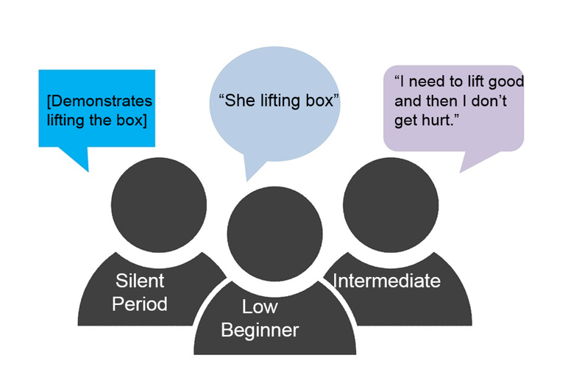
During the Lesson:
Strategy for Differentiation with Language Learners
Example Topic: Protect Your Back While Working
Lesson can be found on the iSOSY website: http://www.osymigrant.org/For%20Your%20Health%20back.pdf
Teacher to student in silent period : “Lift the box.”
Teacher to low beginner: “What is she doing?”
Teacher to Intermediate student: “Why do we need to lift correctly?”
www.osymigrant.org

Slide 11

Strategies for Differentiated Instruction
RAFT – is a writing strategy that can be used in all content areas and offers students a choice in how to focus and complete their writing assignment.
R is for Role – the person or thing that the students will become.
A is for Audience – the person or people who will be reading the finished product.
F is for Format – the way in which the writing will be done. Examples might include letter, brochure, memo, speech, comic or advertisement.
T is for Topic – what the writing will discuss. Students can demonstrate their mastery of content knowledge in this matter.
RAFT allows for differentiated instruction because students get
a choice in their assignment based on their interest and
preferred style of learning.
www.osymigrant.org

Slide 12
An Example of RAFT
Example Topic: A Popular Place
Teacher reads aloud to all students, a paragraph on a popular place they all said they want to visit, sharing important facts about the location.
RAFT activity:
Advanced students - take the role of a travel agent and the format of creating a travel brochure for an audience of tourists.
Intermediate students - take the role of a tourist writing and addressing the format of a postcard to the audience of friends.
Beginner students – take the role of the interesting place creating the format of a poster to encourage the audience of potential tourists to visit.
www.osymigrant.org

Slide 13

An Example of RAFT with iSOSY Lesson
Example Topic: A Healthy Mouth Life Skill Lesson
Lesson can be found: http://osymigrant.org/For%20Your%20Health%20HealthyMouth.pdf
RAFT activity:
Advanced students – take the role of a dentist with the format of writing a small brochure highlighting instructions on proper dental hygiene for an audience of patients.
Intermediate students – take the role of a patient with the format of a written list of questions to be asked of the dentist, their audience.
Beginner students – take the role of the instructor and create the format of a poster with labels of the parts of the mouth to show proper dental hygiene to their roommates or other OSY as their audience.
www.osymigrant.org

Slide 14
Strategies for Differentiated Instruction cont…
Graphic Organizer - uses visual symbols to give information, concepts, thoughts, or ideas and show the relationship between them.
Example:
A Venn diagram is a drawing that shows the relationship between and among sets or groups of objects that share something in common.
www.osymigrant.org

Slide 15
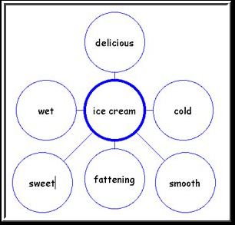
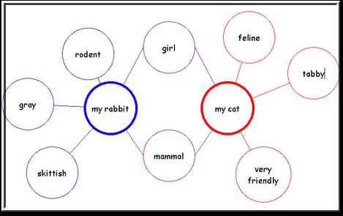
Strategies for Differentiated Instruction cont…
Examples: bubble map, double bubble map
www.osymigrant.org

Slide 16
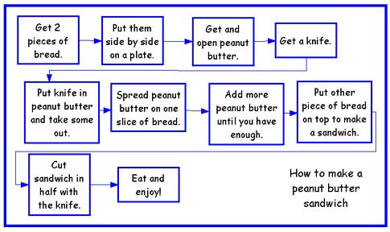
Strategies for Differentiated Instruction cont…
Examples: flow chart
www.osymigrant.org

Slide 17
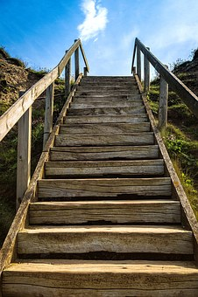
Strategies for Differentiated Instruction cont…
Tiered Instruction:
all students learn the same skills but at different levels.
Teachers make slight adjustments within the same lesson to meet needs of the students.
The activities challenge students at their ability level.
Example: Teacher reads aloud to all students, a paragraph on a popular place they all said they want
to visit, sharing important facts about the location.
 Advanced students – can write a paragraph describing the place, what they found interesting and
surprising and why.
 Intermediate students - can list the facts they found most interesting or
surprising and write a sentence for each fact, stating what they found interesting/
surprising.
 Beginner students – give students a Double Bubble graphic organizer. One bubble is labeled
“interesting” and the other labeled “surprising.” Have students select words from a fact
word bank you have provided and copy the words into the correct bubbles (interesting/surprising), in which they believe the words belong.

Slide 18

Strategies for Differentiated Instruction cont…
Technology – Technology based lessons (iPads, laptops, computers) are useful in teaching
students of various learning styles.
Examples: SAS Curriculum Pathways, Moby Max
Online resources that provides interactive lessons, videos, audio tutorials, and apps for English language arts, mathematics, science, social studies, and Spanish.
Through the various interactive resources students learn, practice skills, and have assessments to email, print, or save.
This information helps teachers continue to group students based on their needs.
https://www.sascurriculumpathways.com
www.mobymax.com
www.osymigrant.org

Slide 19
After the Lesson: Assessment
Providing continual assessment helps you see what information has been learned and where further instruction is needed. Assessments help you plan grouping and activities based on your students’ levels.
Here are some suggestions:
Review assessment results regularly to gauge student progress.
Change instruction as needed based on assessment results.
Use creative ways to help students prepare for assessments:
  Create charts or posters that can be left on display.
  Develop or have students create study guides.
  Leave instructional materials with students (flashcards, games, etc.).
www.osymigrant.org

Slide 20
After the Lesson: Assessment
There are two types of assessment: formal and informal.
Formal assessments that systematically measure learning and can be scored and are given to students individually.
Examples of formal assessments:
Tests and quizzes
May be written, oral, multiple choice, etc.
Formal assessments are available on the iSOSY website.
www.osymigrant.org

Slide 21

After the Lesson: Assessment
Informal assessments enable an instructor to evaluate a student’s performance. They can be interactive, engaging, and hands-on.
Examples of informal assessments:
Thumbs up / thumbs down hand response to questions
Quick write (students write the answer on a whiteboard, note card etc.)
Holding up a Yes / No card
Turn and share with a partner
Role play activities
Oral questions to which the student responds
Be creative and have fun with your informal assessments!
www.osymigrant.org

Slide 22


After the Lesson: Differentiated Assessment
Example Assessment For: Protect Your Back While Working
All students would use the word bank to complete the assessment in the following ways, depending on the level of their language ability.
The teacher’s instructions would be differentiated as follows:
Student in Silent Period: “Match the pictures to the correct words.”
Low Beginner Student: “Write the correct word in the blank.”
___________ a box correctly keeps your back safe.
Intermediate Student: “Write the steps to correctly lift a box.”
Word Bank:
Joint
Lifting
Stretch out
Squat
Pressure
  For the full module, see Working with Language Learners
www.osymigrant.org

Slide 23

Experts in Differentiated Instruction
Recommend:
The teacher’s role in the differentiated classroom is to continually ask him/herself:
“What does this student need at this moment in order to be able to learn and progress with this content?”
“What do I need to do to make that happen?”
Tomlinson and Imbeau (2010)
www.osymigrant.org

Slide 24
Helpful Differentiated Instruction
Websites
https://www.cultofpedagogy.com/starter-kit-differentiated-instruction/
https://www.edutopia.org/stw-differentiated-instruction-replication-tips
www.osymigrant.org

Slide 25
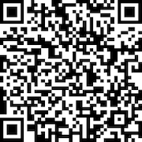
Evaluation
  How will you be using this with your OSY?
  Will it be helpful?
  What would you include?
www.osymigrant.org

