Slide 1

State Steering Team Meeting
March 2, 2020
Washington, DC
www.osymigrant.org

Slide 2
GOSOSY Member States
Alabama
Georgia
Illinois
Iowa
Kansas
Kentucky
Massachusetts
Mississippi
Nebraska
New Hampshire
New Jersey
New York
North Carolina
Pennsylvania
South Carolina
Tennessee
Vermont
www.osymigrant.org

Slide 3
GOSOSY Partner States
Alaska
Arkansas
California
Colorado
Idaho
Maryland
Minnesota
Missouri
Montana
Oregon
Washington
Wisconsin
www.osymigrant.org

Slide 4
Technical Support Team
Expectations
Membership
State Director expectations
Requirements
  2-3 meetings per year
  Conference calls
  Work assignments
  Team Lead meeting
  Collaboration and coordination across groups
Work Norms
Be fully committed to the work and demonstrate this commitment by meeting agreed upon deadlines, participating/attending meetings and calls until outcomes/goals are fully met.
Leave each meeting with tangible products/achievements synthesizing our meeting outcomes.
Use included reflection time to promote spontaneous, creative discussion.
www.osymigrant.org
Notes:
Planning to develop specific protocols and procedures with built in meeting dates (eg the team leads will meet at least two times in between in-person TST meeting
Brainstorming how to use technology more efficiently to cut down on travel

Slide 5
Welcome and Introductions
Welcome and Introductions
Doug Boline, Kansas MEP State Director
GOSOSY Lead State
www.osymigrant.org

Slide 6
Agenda
State responsibilities for Year 5
Evaluation data collection
New CIG direction planning and discussion
Discussion of SST and TST protocols
Future meeting dates
Welcome and Introductions
Overview of agenda and expectations for meeting
Discussion of TST Work Groups tasks, processes, and outcomes
  OSY Engagement and Relationship Building
  Curriculum and Material Development
  Goal Setting and OSY Learning Plan
  Professional Development
  Personal Wellness
  Interstate Collaboration
www.osymigrant.org

Slide 7
GOSOSY Updates
Year 4 Successes
CIG Webinar for Interested States
GOSOSY Web Blasts: In the Field
Trainings at TST
Website Survey and Website Google Analytics
Website redesign
NASDME Proposals
www.osymigrant.org

Slide 8
GOSOSY Year 4 Successes
GOSOSY materials and strategies were implemented in all 18 consortium states with over 2,400 out-of-school youth (OSY).
• 88% of OSY scored 80% or higher on curriculum-based assessments.
• 86% of OSY with a learning plan met target goals on their plans.
• 276 OSY participated successfully in goal-setting workshops.
• Over 200 staff received intensive training in materials.
• 81% of staff surveyed reported using materials and strategies from trainings.
• All states collaborated with other agencies and organizations to provide services.
• States adopted an average of over 15 products and materials from GOSOSY.
• MEP staff in all 18 States used Dissemination Event training materials and products.
www.osymigrant.org

Slide 9
CIG Webinar
for Interested States
Webinar for interested states on February 19
States present: Arizona, Colorado, Ohio, Oklahoma, Michigan, Missouri, New Mexico, (and New York)
Confirmed: New Mexico
Other possible interested states: Indiana, Louisiana, Maine, and Washington
Others?
www.osymigrant.org

Slide 10

GOSOSY Email Blasts
Since June 2019
Seven (7) editions sent
230 connections
Using Constant Contact
Highlighting new materials, success stories, website resources, etc.
www.osymigrant.org

Slide 11
GOSOSY Training at the TST Meeting
  Working with Students with Limited Formal Schooling
  Goal Setting/Learning Plans and Portability Discussion
  OSY Engagement and Relationship Building
  Results from evaluations:

Slide 12
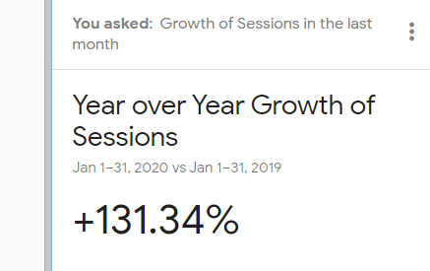

Google Analytics – GOSOSY Year 5
www.osymigrant.org

Slide 13
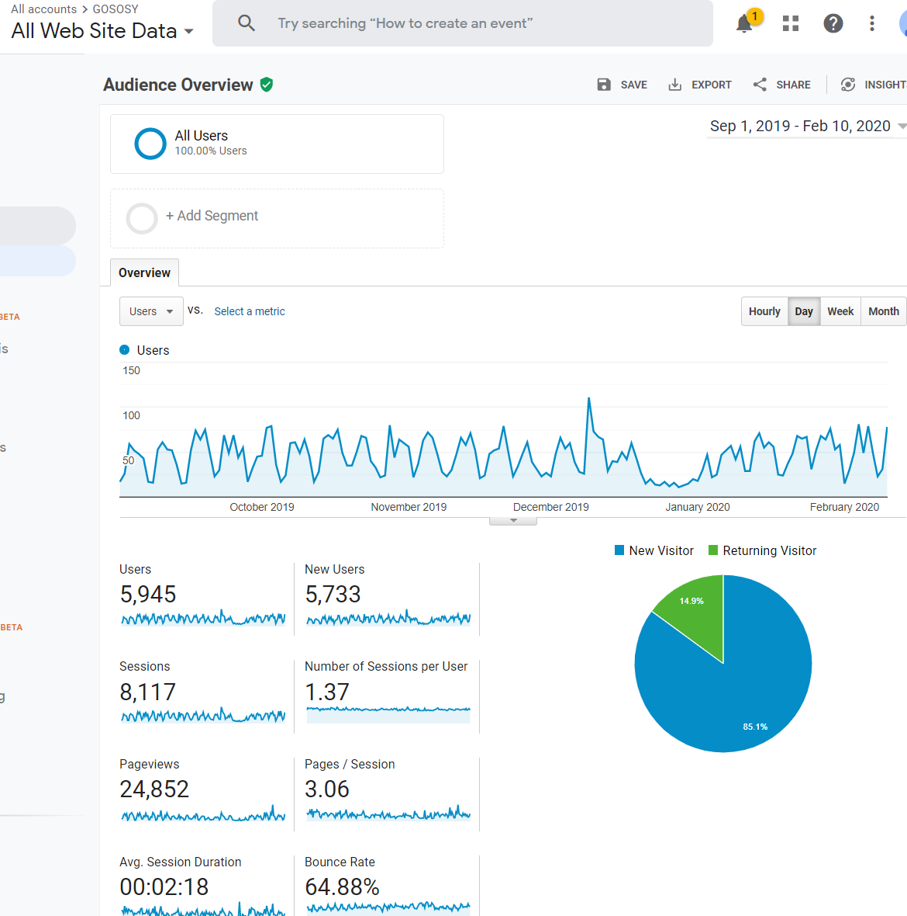

Slide 14
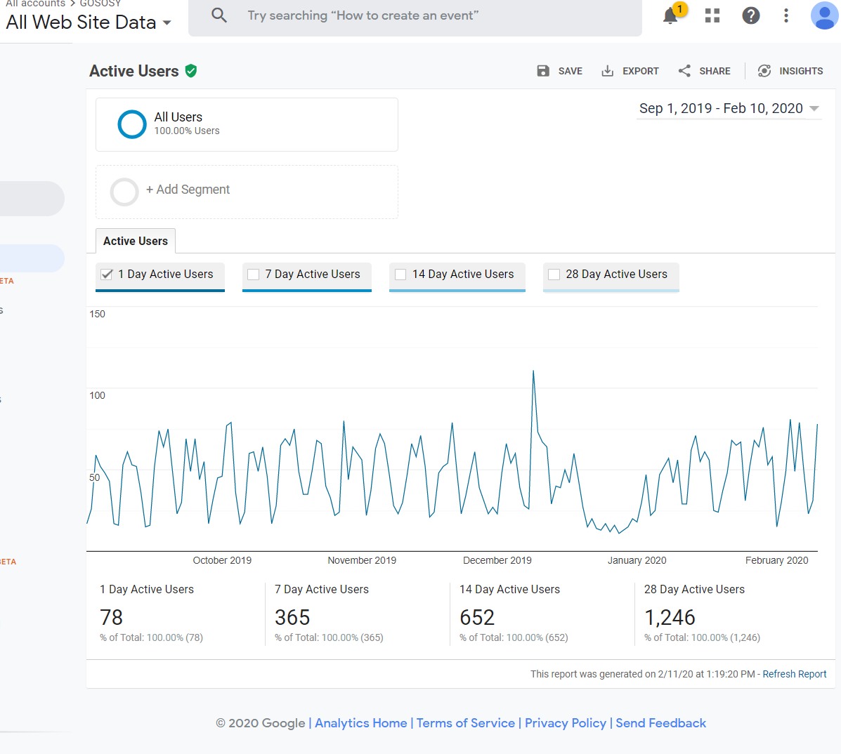

Slide 16
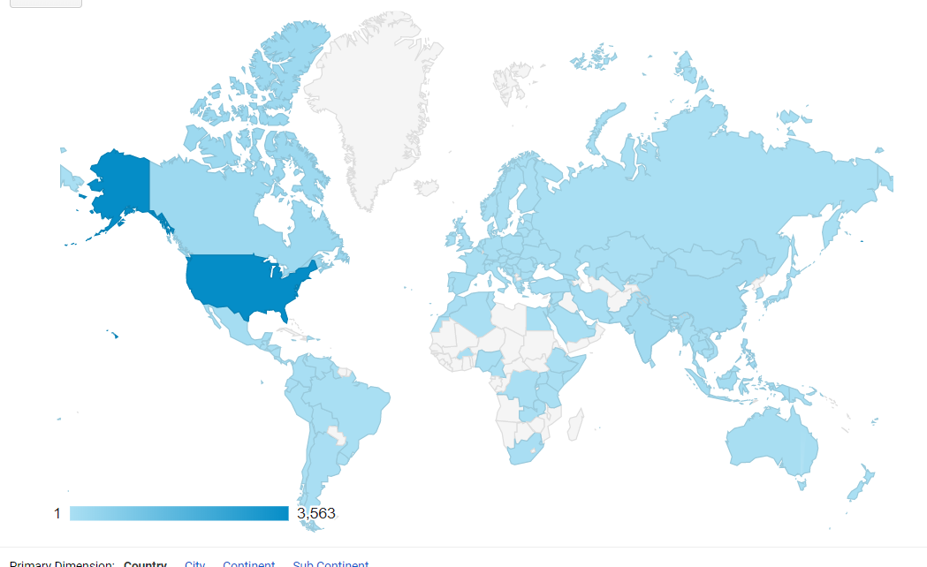

Slide 17
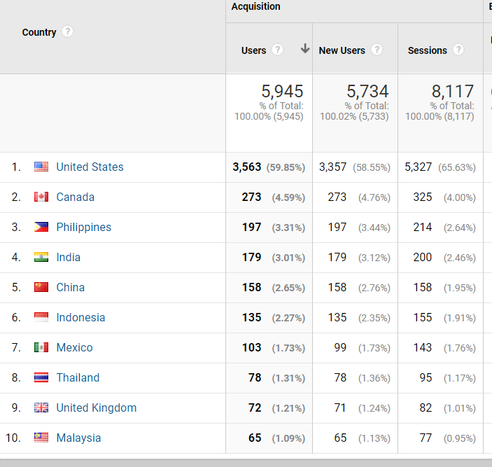

Slide 18
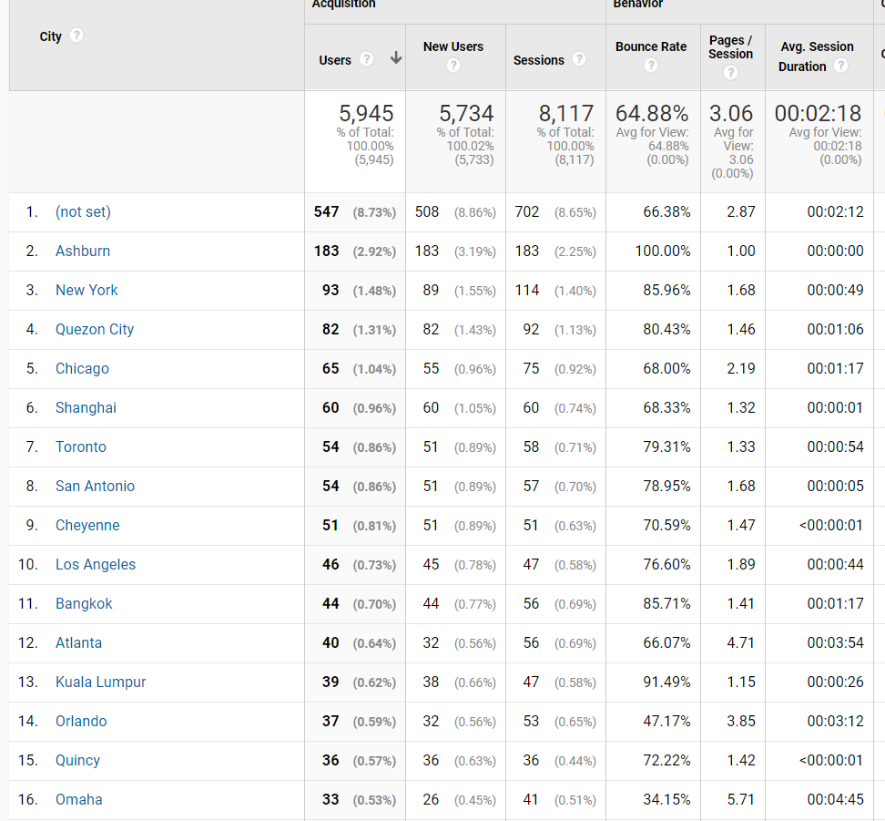

Slide 19
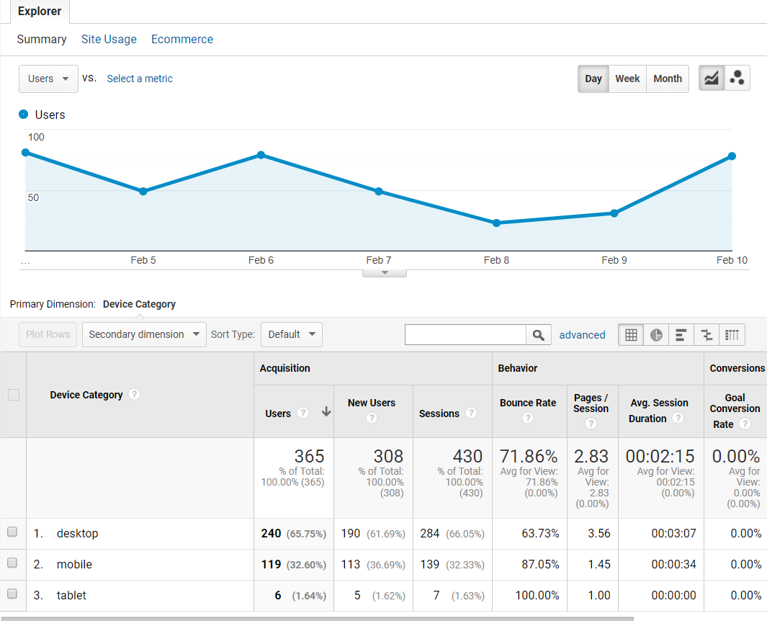

Slide 20
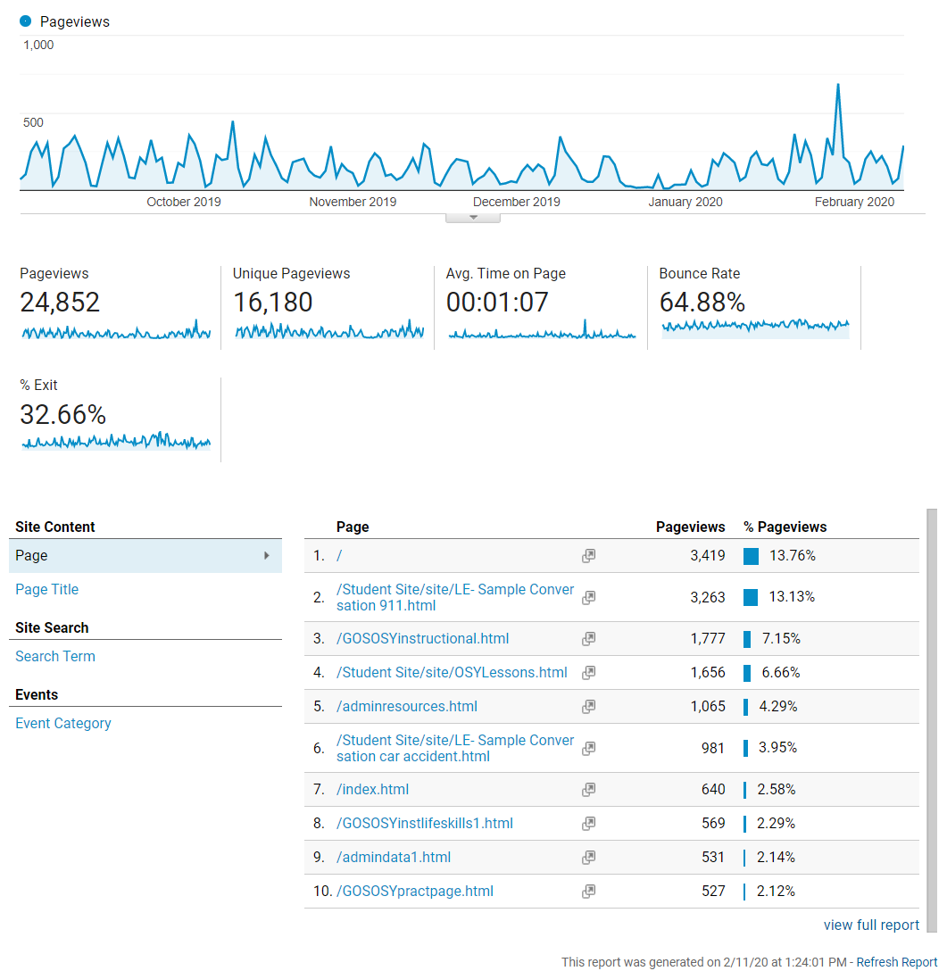

Slide 21
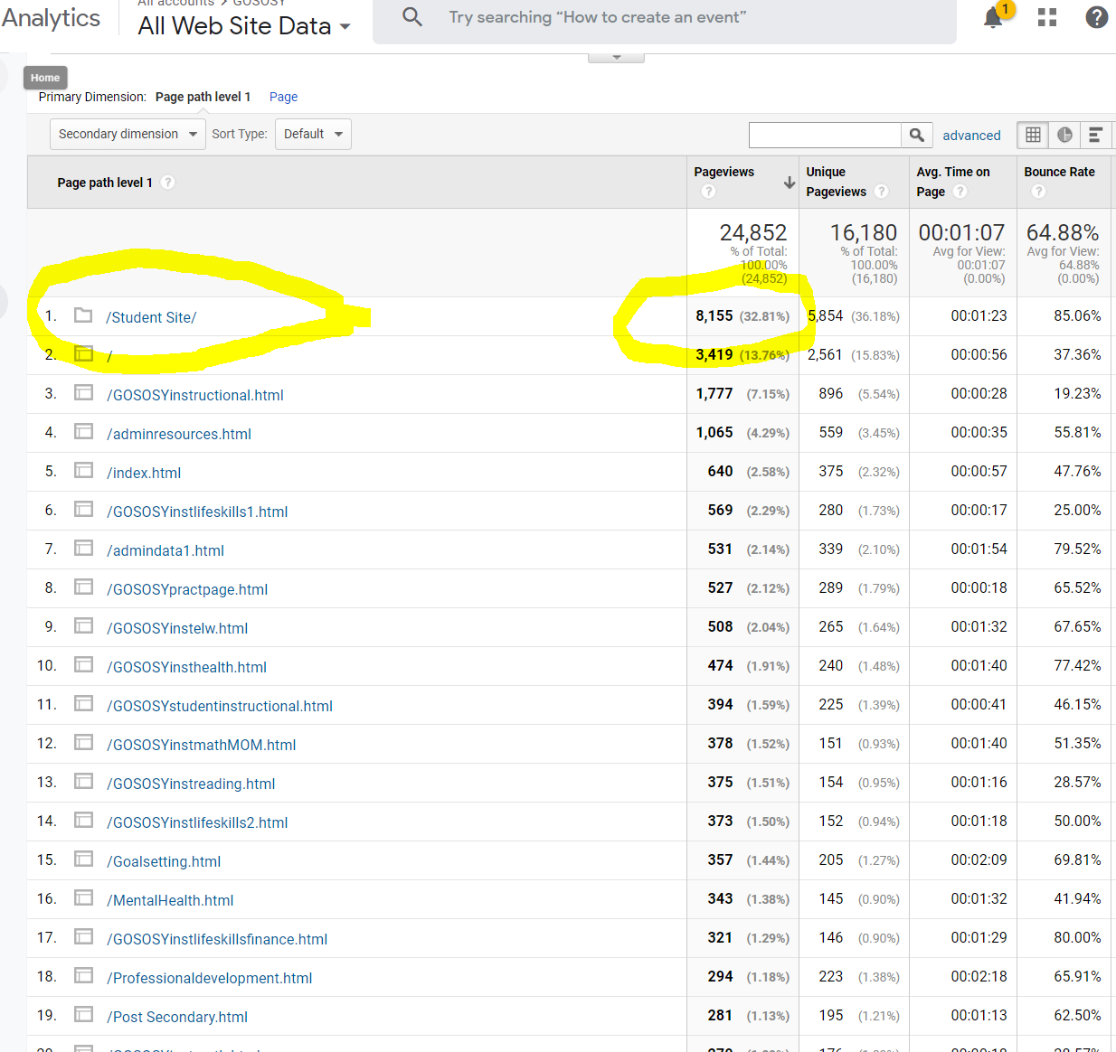

Slide 22
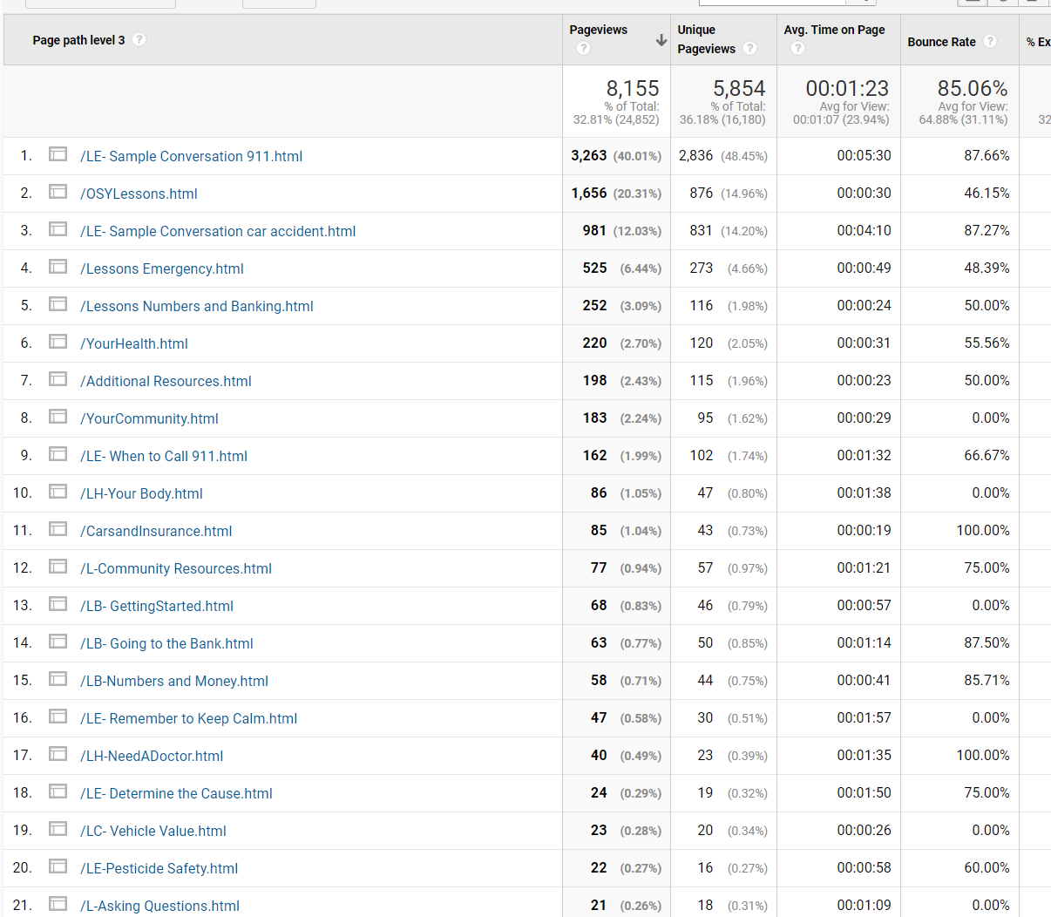

Slide 23
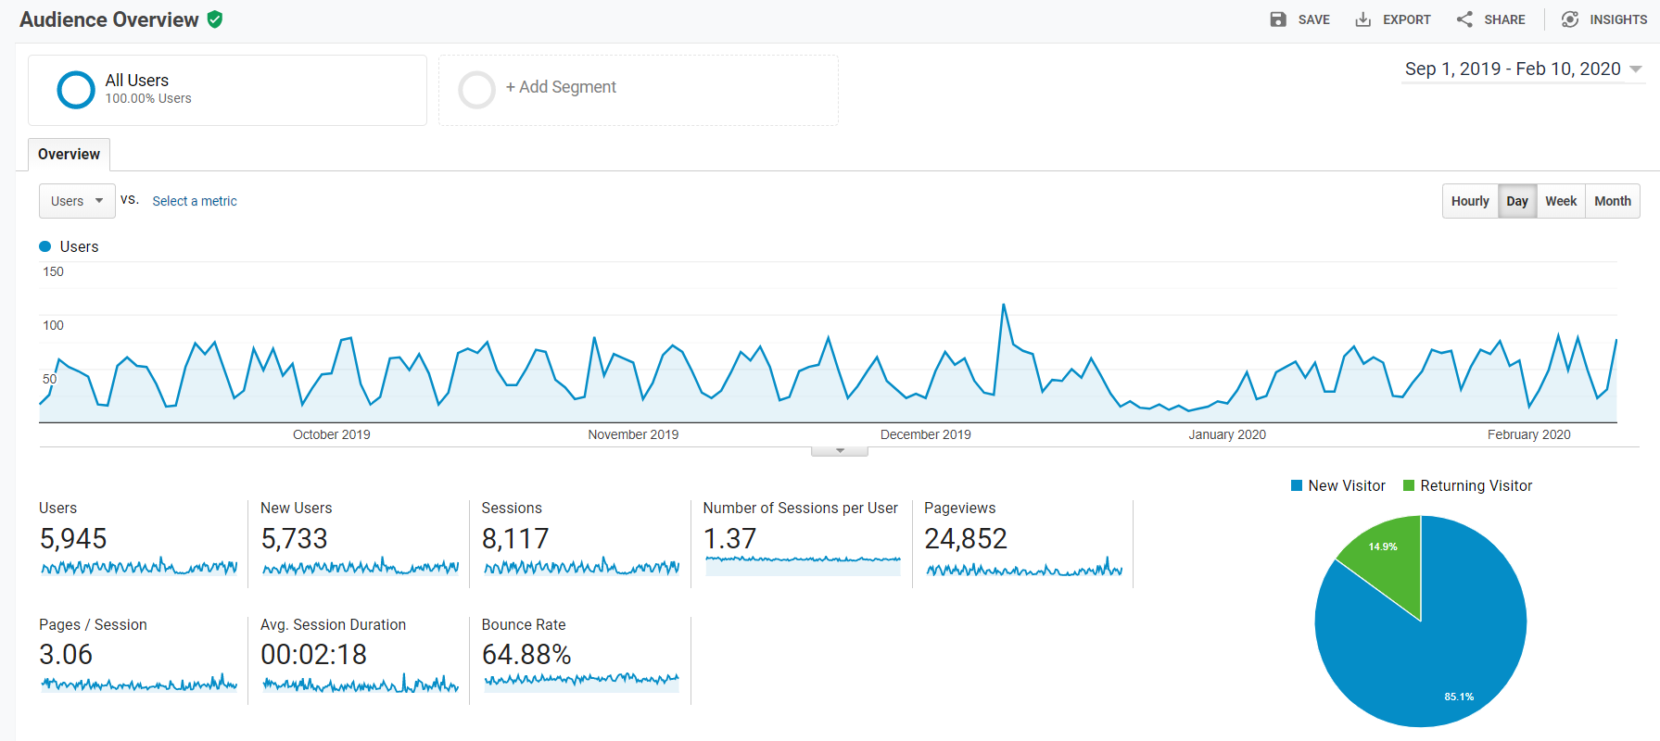

Slide 24
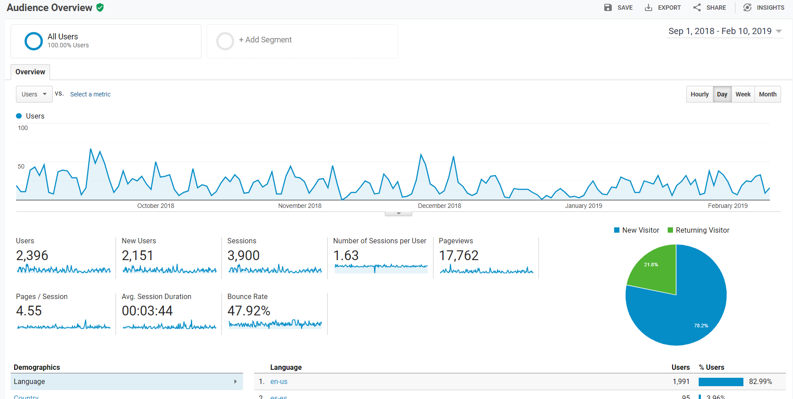

Slide 25
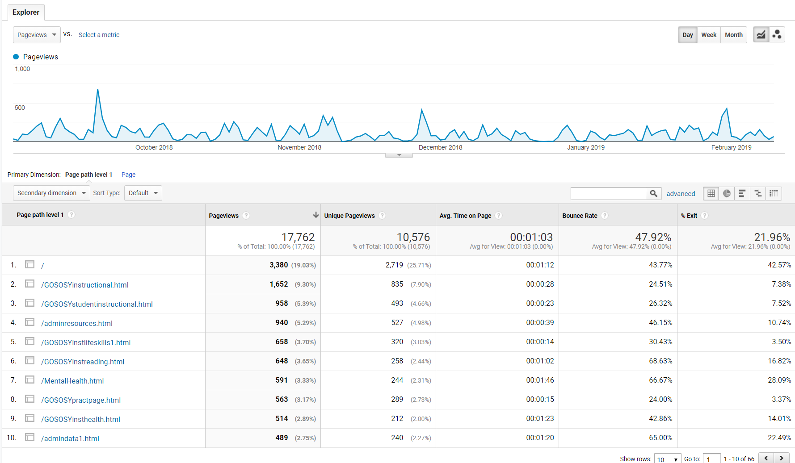

Slide 26
NASDME Presentations
The Growth Mindset: How It Benefits Practitioners and Students
Helping Migrant Students Understand the Journey to College: Preparing for College
Mental Health Is Just as Important as Physical Health: GOSOSY Personal Wellness Manual
How the Practice of Goal Setting Can Help Migrant Students Focus and Progress
www.osymigrant.org

Slide 27
TST Work Groups
  OSY Engagement and Relationship Building
  Curriculum and Material Development
  Goal Setting and OSY Learning Plans
  Professional Development
  Interstate Collaboration
  Mental Health/Trauma
www.osymigrant.org

Slide 28
OSY Engagement and Relationship Building
Emily Hoffman (team lead), Joyce Bishop, and Rachel Beech
FII 2.2c
Develop and finalize materials
Provide training on updated OSY engagement/mentoring toolkit
www.osymigrant.org

Slide 29

OSY Engagement and Relationship Building
Revising OSY Relationship Building materials:
    The Role We Play
    Creating an Inviting Environment
    Building Relationships with OSY
    Cultural Competence + Unconscious Bias
    Questioning Strategies
    Effective Listening
    Effective Communication with OSY
    Effective Advocacy for Migrant Youth
    Engaging Youth and Young Adults
    The Importance of Self-Care
www.osymigrant.org

Slide 31
Curriculum and Material Development
Brenda Pessin (team lead), Peggy Haveard, Rachel Wright-Junio, Jessica Castañeda
1.1f/3.1c/3.1d (in collaboration with GSLP WG)/ Website Redesign
Student Website/Website redesign
English for Daily Life revisions
1.1f Create a list of strategies from the literature with promising evidence for preventing dropouts
3.1d Disseminate tools for portability of GOSOSY materials for highly mobile students
www.osymigrant.org

Slide 32
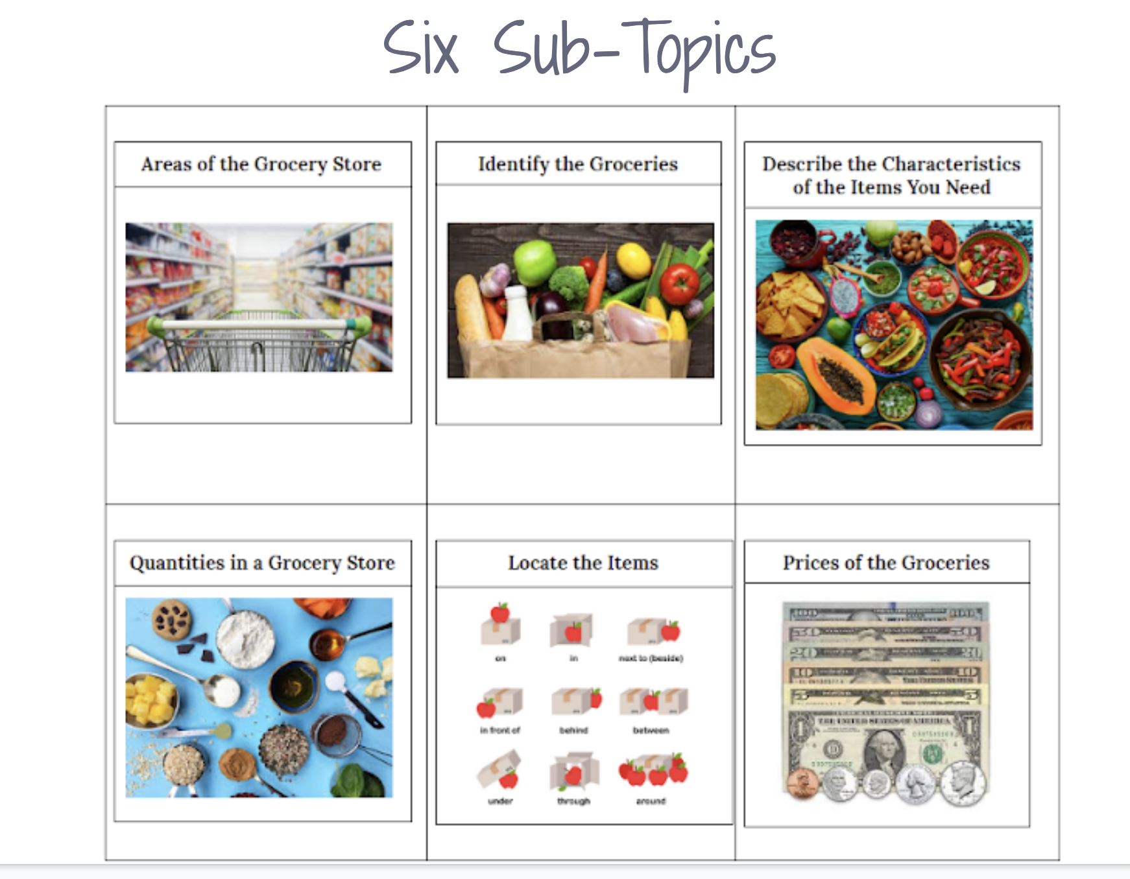

Curriculum and Material Development
Developed new English for Daily Life Lesson: Shopping
Revising Mentor Manual
for Preparing for College
www.osymigrant.org

Slide 33
Preparing for College
www.osymigrant.org

Slide 34
Lesson # | Items to Clarify | Items to Add | Resources Suggested
#1 The Case for College |  | -More discussion about technical/ vocational training and apprenticeships. May be less costly with comparable income potentials.
#3 Considering A Career | -Consider putting lesson #3 before lesson #2 so students can first choose a career, then create relevant goals. | -Include more questioning about careers. | Accuplacer on the College Board website
#4 How Will I Pay for College? | -Differences between subsidized and non-subsidized loans -Check the links. Migrant.net/scholarship does not work. | -Private websites that offer scholarships to non-traditional students. -Include more about parents’ tax returns and how a student with undocumented parents can apply for financial aid.
#7 How to Write the College Essay | -Break down each step in the essay writing process, including benchmarks for specified time frames. --Provide a rubric to assess the essay for use by both students and mentors. | -Add some helpful tips for the mentor such as when the essay should be finalized. Consider including sample essays so students have good examples to review.

Slide 35
General Comments | -Reviewer Pathy Leiva’s name is misspelled. -Provide guidance as to when answers should be in complete sentences and when it’s not necessary. Indicate if expectations relate to specific lessons; i.e. in Lesson 7, Essay Writing, when should the student progress from jotting notes to providing complete sentences? -Include a scoring rubric for the end-of-course assessment for student and mentor use throughout the unit. -Suggest to instructors that they follow the elements of an effective lesson plan (materials, clear objectives, background knowledge, scaffolding strategies, direct instruction action steps, student practice opportunities, and quick assessment). At this time, there are no plans to revise unit content. -Provide guidance re: how to modify the readability of texts, especially the complexity of vocabulary, syntax and background knowledge. | -Provide more specificity re: Lesson Answer Keys. Identify the page #s that have questions. Give advice about how to coach the student—try to eliminate “answers may vary” and provide guidance on types of questions (comprehension and critical thinking) and use of the notes section. Provide reminders that connect the directions from the Introduction and PowerPoint. Mention that many questions are for the student to respond from their own experience. -Provide strategies for scaffolding the reading experience, including bilingual texts. -Consider a comparability study of text difficulty and task characteristics (may need to wait for a unit revision).
#5 College Entrance Exam Strategies #6 Selecting a College #11 The College Interview #12 Becoming an Adult #13 Social Media | These lessons were reported to have been reviewed but no suggestions were offered.

Slide 36
English for Daily Life &
Preparing for College
Shopping
www.osymigrant.org

Slide 37
Professional Development
Sabrina Pineda (team lead), Odillia Cofta, April Dameron,
Veronica Hill
2.1b Provide training and technical assistance on designing services for OSY through the TST and its Workgroups using implementation scenarios
2.1c Create materials for certified and non-certified staff regarding one of the following 1) An Introduction to OSY and 2) Addressing the Needs of OSY with Limited Formal Schooling
www.osymigrant.org

Slide 38
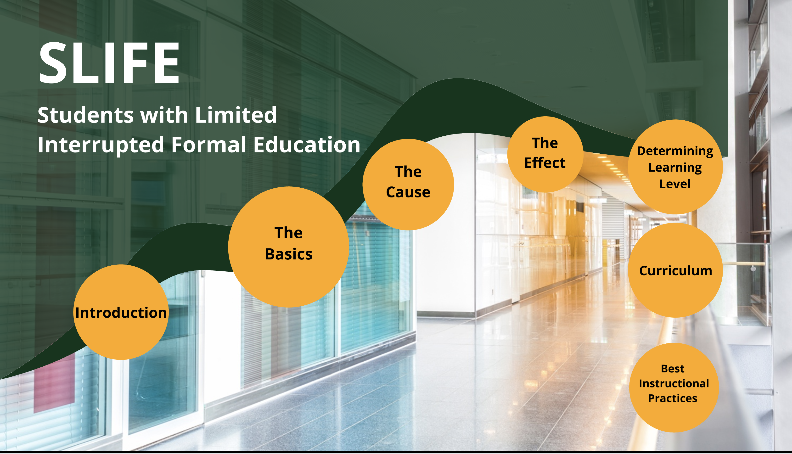
Professional Development
Created new PD Module Prezi: Supporting Students with Limited Interrupted Formal Schooling -SLIFE
www.osymigrant.org

Slide 39
Notes:
https://prezi.com/view/eJRQUCDmeRQFUBsrF4ST/

Slide 40
Interstate Collaboration
Travis Williamson (team lead), Barbie Patch, Deke Showman, and Monika Lorinczova
CIG Collaboration
1.1e Develop a list of common barriers for recruiting and providing services for OSY and possible solutions
2.2a Provide training at TST and training of trainers regarding networking for effective interstate collaboration and interagency collaboration (e.g. HEP, other CIGs)
2.2b Document and report collaboration results
www.osymigrant.org

Slide 41
Interstate Collaboration
Revised OSY Recruitment and Service Providing Tips
Upcoming:
  Schedule a nationwide virtual lesson with live participation across the states
  Coordinate with partner organization(s), including the National PASS Center, to offer webinars for service providers about the best use of online lessons
www.osymigrant.org

Slide 42
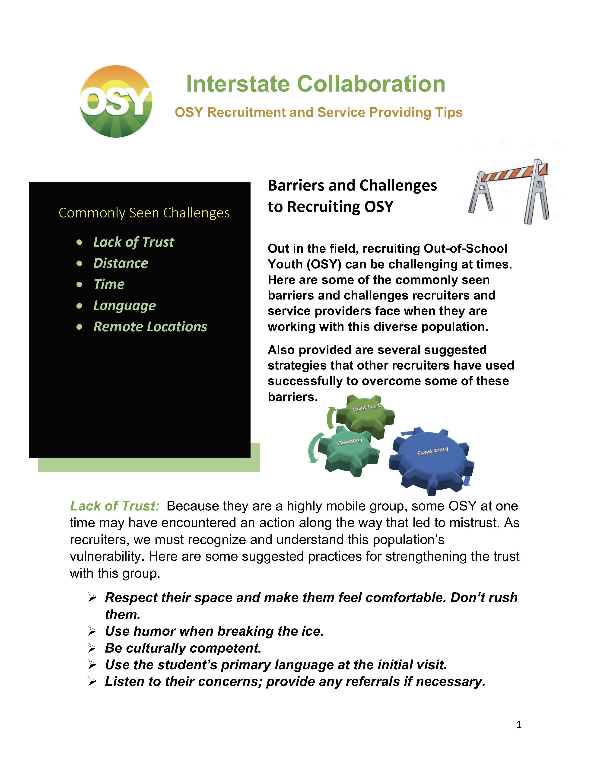

Slide 43

Remote Instruction
- with OSY
www.osymigrant.org

Slide 44

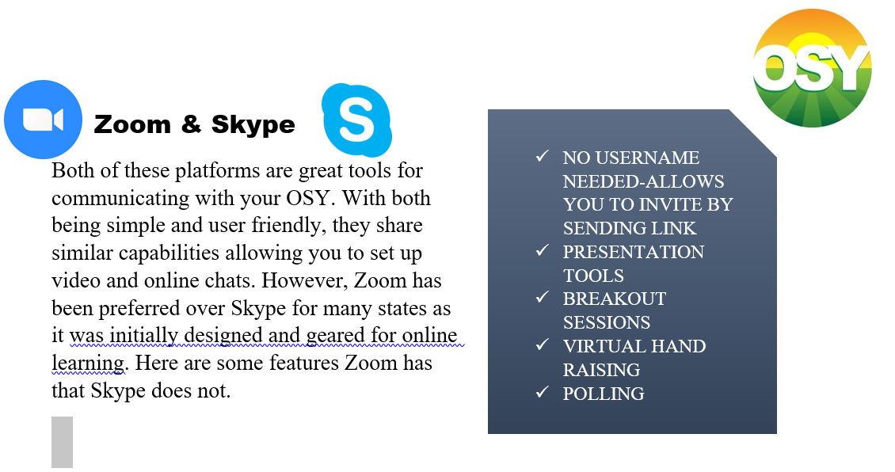
Zoom and Skype
www.osymigrant.org

Slide 45
What Is Needed
You
Student
Computer
Good internet connection
Zoom installed
Pre-planned lesson
Digital handouts
Computer or smartphone
Good internet connection
Email account
Digital handouts or paper materials that were dropped off or mailed ahead of time
Notebook and pencil
www.osymigrant.org

Slide 46
Before you start
Make sure your student has the technology needed
Help your student set up a free email account
Have them write down their new email and password
Help your student download Zoom
Practice in person
Schedule your Zoom lesson
www.osymigrant.org

Slide 47
Goal Setting and Student Learning Plans
Sarah Braun Hamilton (team lead), Justyn Settles, Emily Williams, and
Eugenia Luna
1.2a Create scenarios for best practices in use of the updated OSY Learning Plan templates
1.3a Create scenarios for best practices in the use of updated Goal Setting Workshop (GSW) materials
1.3c Train GSW facilitators based on scenarios
1.3d Conduct GSWs and assess using project-based activity and rubric (design project-based activity and rubric)
3.1d Disseminate tools for portability of GOSOSY materials for highly mobile students
www.osymigrant.org

Slide 48
Goal Setting
www.osymigrant.org
Notes:
Materials included
Warm up- introduce concepts and build rapport
Main activity – chronicles choices based on student preference
Wrap up- links to next lesson
Student handbook in English and Spanish
Inspiration/documentation/ portability
PROVIDERS DO THE ACTIVITIES THEMSELVES BEFOREHAND SO THEY HAVE DIRECT EXPERIENCE AND PERSONAL EXAMPLES TO SHARE WITH OSY

Slide 49
Goal Setting and Student Learning Plans
Revising Goal Setting Rubric (now Goal Setting Assessment and Planning Rubric)
Portability Survey Results:
      72 responses
      91% of surveyed say portability is important
      84.5% say students should benefit most from portability
NASDME Session: How the Practice of Goal-Setting Can Help Migrant Students Focus and Progress
www.osymigrant.org
Notes:
Assessment Guide:
Brief instructions on best practices for assessment of goal setting
Student reflection sheet to guide assessment discussion between provider and student
A one-question, 5-point rubric (replacing the Goal Setting Workshop Rubric) for the instructor to assess if the student has satisfactorily completed the goal setting program and is prepared to set future goals
Add a description of the assessment process to the training scenarios; add the scenarios as an appendix to the Instructor Book and to the training PPT.
After all else is done: Create separate files containing all materials for each of the 6 lessons.

Slide 50
Personal Wellness
Lora Thomas (team lead), Lysandra Alexander, Susanna Bartee, Susana Des Neves, Maria Dominguez, John Farrell
1.1c Incorporate strategies and best practices from the literature review into mental health lessons for OSY
1.1d Develop materials that describe how trauma impact academic performance and strategies for educators
2.2d Prepare training materials to go along with OSY mental health lessons based on staff needs assessment results
3.1b Disseminate materials that describe how trauma impacts academic performance and strategies for educators
www.osymigrant.org

Slide 51
Personal Wellness
Finalizing Personal Wellness (Including Improved Mental Health) Training Manual
  MODULE 1 – Introduction to Training
  MODULE 2 – Adverse Childhood Experiences (ACEs)
  MODULE 3 – Trauma
  MODULE 4 – Cultural Sensitivity
  MODULE 5 – Resiliency
  MODULE 6 – Mindfulness
  MODULE 7 – Self-Care
NASDME Session: Mental Health is Just as Important as Physical Health! Introduction to GOSOSY’s Personal Wellness (Including sections of the improved Mental Health) Manual Training of Trainers
www.osymigrant.org

Slide 52
National Webinar on Supporting the Mental Health Needs of Migrant Students
Kanas School Based Mental Health Initiative and GOSOSY Collaboration
Working with the Mental Health Technology Transfer Center Network (MHTTCN) https://mhttcnetwork.org
SAMHSA funded national network
August 13 at 12:00 pm CDT
Invitations will be sent to all GOSOSY states

Slide 53

2020 Website UPDATES

Slide 54

2020 Website UPDATES

Slide 55

2020 Website UPDATES

Slide 56

Student Page
What are students looking for on the Student Page?
What is the most important academic content for the Student Page?
What is the most important advocacy information for the Student Page?
Should certain “big topics” be highlighted (i.e. Personal Wellness, HSED, etc.)?
How should we include this goal in the new proposal?
www.osymigrant.org

Slide 57
Data Collection
Checklist includes state responsibilities and a list of forms
Form 1: Director/coordinator report (required)
Form 2: Post-training survey (required)
Form 3: Product adoption report (required)
www.osymigrant.org

Slide 58
Performance Measure Change
Performance Measure 3b: By 5/29/20, 75% of staff participating in GOSOSY training of trainers will rate the training as useful for instructing local staff in the implementation of GOSOSY activities with a 4 or above on the 5-point GOSOSY Training of Trainers Rubric.
Change rationale: This new performance measure replaces the performance measure regarding the impact of the Dissemination Event which was completed in Year 4.
www.osymigrant.org

Slide 59
State Responsibilities for Meetings and Trainings
TST participation
Training of Trainers participations (this meeting and NASDME training)
Attend one or more GOSOSY sessions at the NASDME conference
Conduct training regarding use of GOSOSY products
Report training provided on Form 1: Director/Coordinator Report
Use the Form 2: Post-Training Survey after each training
Report at least 5 collaborations on Form 1: Director/Coordinator Report. These may be the same as in previous years.
www.osymigrant.org

Slide 60
State Responsibilities for Use of GOSOSY Products
Adopt at least 2 new GOSOSY products
Assist migratory youth in completing the OSY Personal Learning Plan. (No minimum number is set, but all states must use the product and report results.)
Conduct Goal Setting Workshops with at least 3 students. Results are summarized on Form 1: Director/Coordinator Report. (Note that goal setting may be conducted at the same time as the completion of the personal learning plan.)
Use GOSOSY lessons and conduct post assessments. Report number of students assessed and number earning 80% or more on Form 1: Director/Coordinator Report. (No minimum number is set, but all states must report results.)
Report other activities provided to OSY including post-secondary or career awareness activities and mentoring on Form 1: Director/Coordinator Report. This is not a required activity
www.osymigrant.org

Slide 61
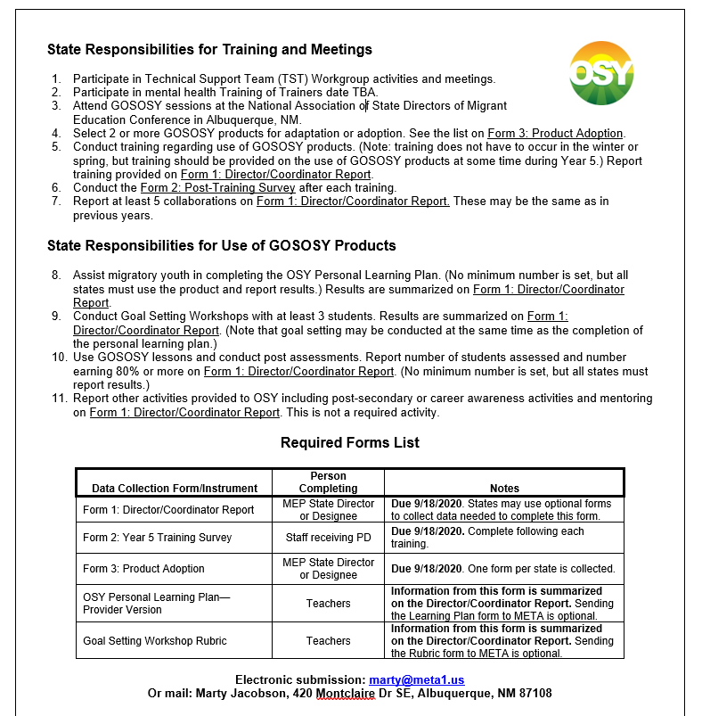
Review Data Checklist
www.osymigrant.org

Slide 62
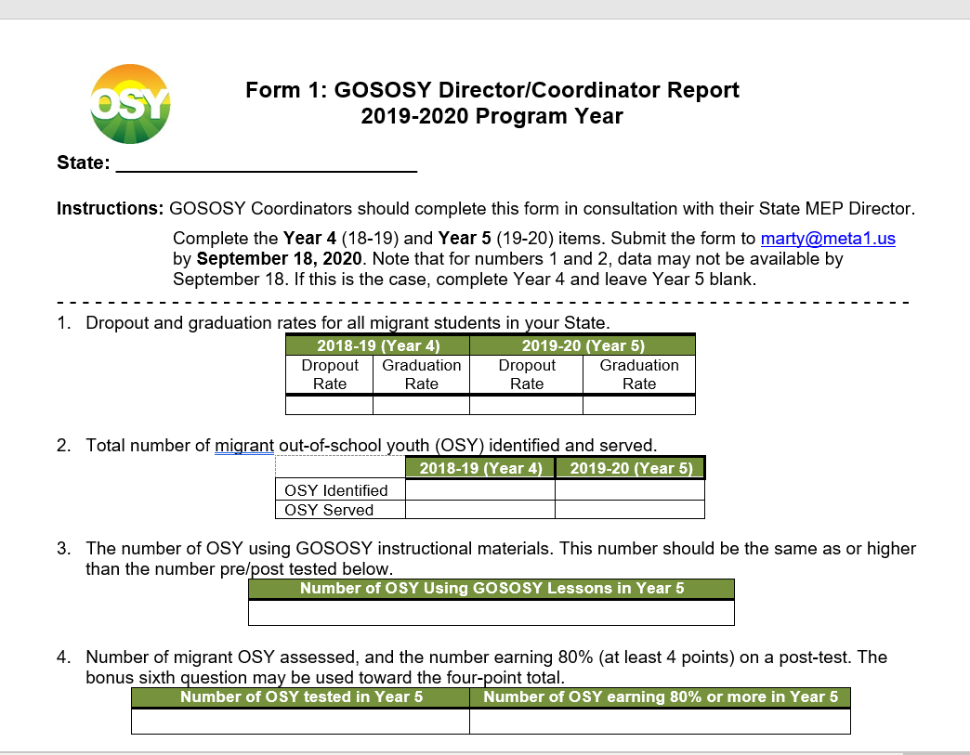
Review Form 1
www.osymigrant.org

Slide 63
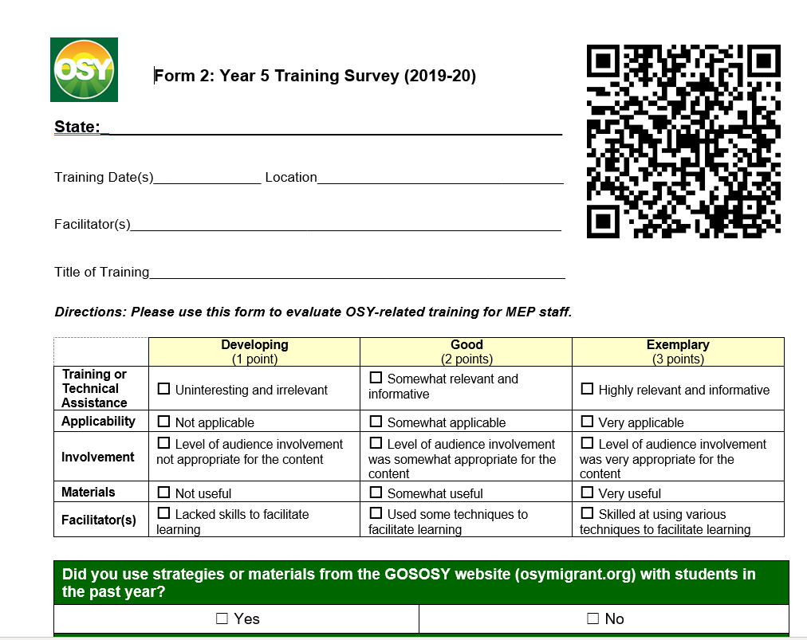
Review Form 2
www.osymigrant.org

Slide 64
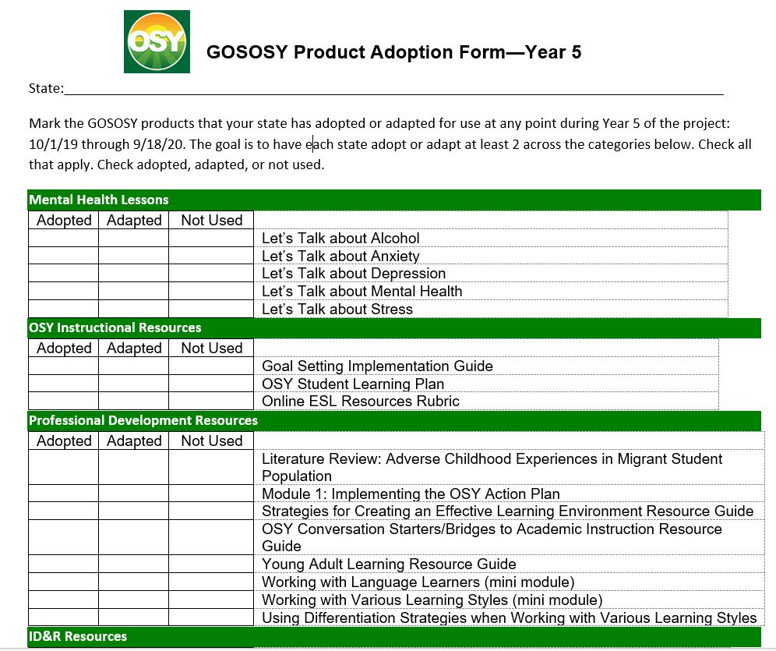
Review Form 3
www.osymigrant.org

Slide 65
Future Planning
Notice Inviting Applications published Monday (2/24)
Applications due 4/27/20 on grants.gov
We’ll know more after the pre-application webinar on Thursday about what each state needs to submit
www.osymigrant.org

Slide 66
Priorities
Absolute Priority 3: Services designed (based on a review of evidence-based research) to improve the educational attainment of out-of-school migratory youth whose education is interrupted.
(The other 2 have to do with ID&R and parent involvement)
www.osymigrant.org

Slide 67
Competitive Preferences (choose 1)
Projects designed to improve student achievement or other educational outcomes in one or more of the following areas: Science, technology, engineering, math, or computer science (as defined in this notice). These projects must address supporting student mastery of key prerequisites (e.g., Algebra I)
Projects must address creating or supporting alternative paths to a regular high school diploma or recognized postsecondary credentials for students whose environments outside of school, disengagement with a traditional curriculum, homelessness, or other challenges make it more difficult for them to complete an educational program
www.osymigrant.org

Slide 68
Future Planning
Process (or program implementation) – Describes aspects of the program that will be implemented to help achieve the intended outcome
Outcome (or performance) – Describes student, staff, or parent outcomes as a result of implementing a prescribed program or activity
www.osymigrant.org

Slide 69
Discussion Questions
What changes have you seen over the last 5 years in the needs of OSY and students at-risk of dropping out?
What materials or activities would best support you in providing instructional services to OSY?
What national organizations should we work with for collaboration or support?
What national leaders should we consult with in the provision of services?
www.osymigrant.org

Slide 70
Measuring Success
What measurements (data collection) would you like to keep from GOSOSY?
What measurements would you like to get rid of?
What measurements would you like to add?
www.osymigrant.org

Slide 71


Instructional Services for Out-of-School and Secondary Youth (ISOSY)
Participating States 2020
Want to have your state highlighted? Contact Tracie Kalic tkalic@embarqmail.com
Planning for the Future
Graduation
The ISOSY consortium will provide materials and training for improving educational outcomes for migratory dropout and secondary youth.
Instruction
Staff Training
Key Activities
Collaboration
Key Benefits
❍ MEP staff help develop materials
❍ States participate in professional development
❍ States provide instruction for dropout and secondary-aged youth
Pathways
❍ Consortium Incentive Grant funding
❍ Tiered support for consortium activity implementation
❍ Increasing instructional services for secondary-aged migratory youth, especially during summer services
❍ Materials for helping migratory youth follow a pathway toward a career, high school diploma or equivalent certificate, or college
❍ Training for identifying and addressing trauma and other barriers to high school graduation
❍ Collaboration with national organizations and educational leaders in the field
Needs Assessment

Slide 72

NEW PROPOSAL – TST Structure
How should the TST be structured to achieve its objectives in the next CIG? One member per state? Multiple members?
What are the ideal qualities for TST WG members and team leads?
How much time is reasonable to expect each TST WG member to devote to achieving WG goals and objectives?
What is the best way to communicate TST efforts and achievements to the SST? Entire organization?
www.osymigrant.org

Slide 73
Future Meetings
Schedule PDWG Webinar on Introduction to OSY module (late spring)
NASDME presentations
Fall SST meeting (IMEC in Kansas City in October)
New States Meeting
Future TST Meetings:
  Fall/late Winter or early Spring
Date Options and Suggested Locations

