Slide 1
State Steering Team Meeting
April 30, 2013
NASDME
Orlando, FL
www.osymigrant.org

Slide 2
Agenda
Welcome and Introductions
Work Group Report(s)
Curriculum and Material Development
Technology
Data Reporting-- Susan Durón
Timeline
New Forms/Forms Checklist
OSY Plan—John Wight
Equity Review Process— Tomás Mejía
Work Group Report
Mentoring
Pilot, Assessments, New Materials
Discussion of process
Work Group Report(s)
Assessment
Training
SOSOSY Professional Networking Site
Budget for Year 2
Year 2 Meetings
Wrap up
www.osymigrant.org

Slide 3
Curriculum and Material Development
Members: Bob Lynch (NPC), Brenda Pessin (IL), Dee Condon (NE), Kiowa Rogers (NE), Peggy Haveard (AL), Stephanie Clark (PA), Patrice Boone (MS)
www.osymigrant.org

Slide 4
Work Group Summary
Review Scope & Sequence of proposed lessons for the Write it Now (writing on the move course) Renamed Write On! Recommendations given to Bob: develop a more generalized writing curriculum that will target the skills needed on the GED essays. The new scope and sequence will be available at the next meeting.
Collaborate with technology group to develop online applications for the materials (curriculum presented in the best way – intended way)
Legal Lesson 4 The draft is done and being revised, about to submitted to NPC for formatting Legal Lesson 5 is just started and development will be determined Healthy House Lessons Storing Your Medicines Safely is done Refrigeration and Clean House Lessons are done at the Center and submitted to the PASS Center Parenting Lessons, 1 and 2 are done, 3 is almost and 4 is in process. There will only be 4.
www.osymigrant.org

Slide 5
Technology Work Group
Members: Kelsey Williams (ID), Marlene Willis (KS), Sabrina Pineda (GA), Alfonso Zepeda-Capistran (WI) and Omar Lopez (GA)
www.osymigrant.org

Slide 6
Work Group Summary
Conduct thorough review of what is available through the website use
Create glossary of types of technology delivery methods currently available with consideration of anticipated needs.
Create IT Assistance Request form for SOSOSY consortium members to request technology assistance.
Disseminate IT Assistance Form to SOSOSY members
Follow up communication with content and assessment teams regarding any needs in completing IT Assistance Form.
Conduct beta-testing of submitted product for dissemination on the SOSOSY website.
Define task assignments among team members according to individual areas of expertise.
www.osymigrant.org

Slide 7
Technical Assistance Form
IT Assistance Form
www.osymigrant.org

Slide 8
Technical Glossary
IT Glossary
www.osymigrant.org

Slide 9
SOSOSY Forms
Activity: Review and comment on the drafts of *
* Form 1-Director/Coordinator Survey
* Form 2-Staff Training and TA Evaluation
Form 3-Student Tracking Form
* Form 4-Product Pilot Review Form
Mentoring Rubric
Student Profile (English and Spanish)
OSY Planning Template

Slide 10
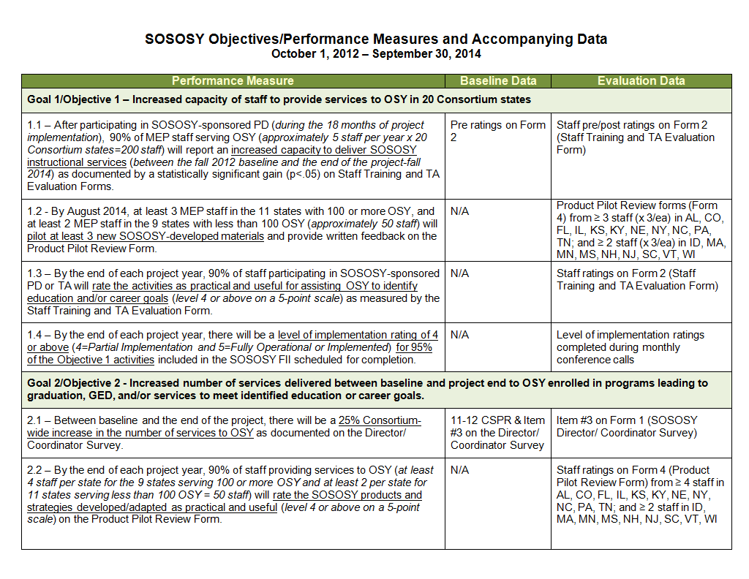

Slide 11
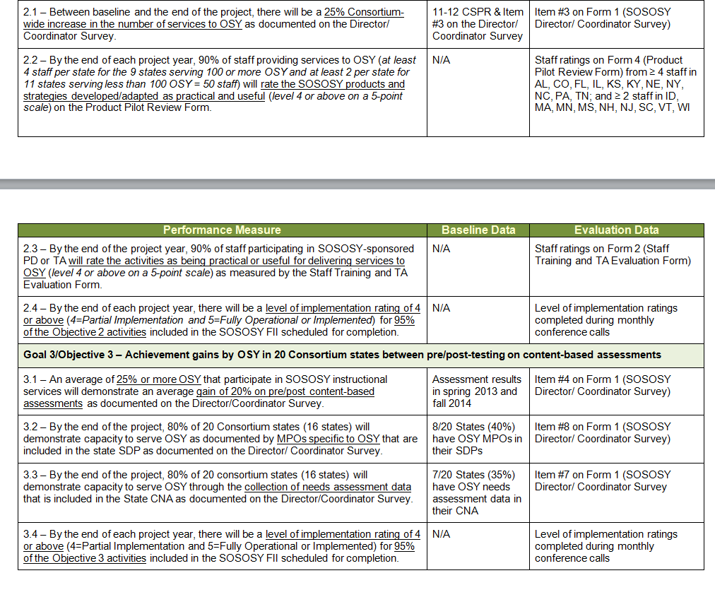

Slide 14
Form 1
Director/Coordinator Survey
Feedback:

Slide 15
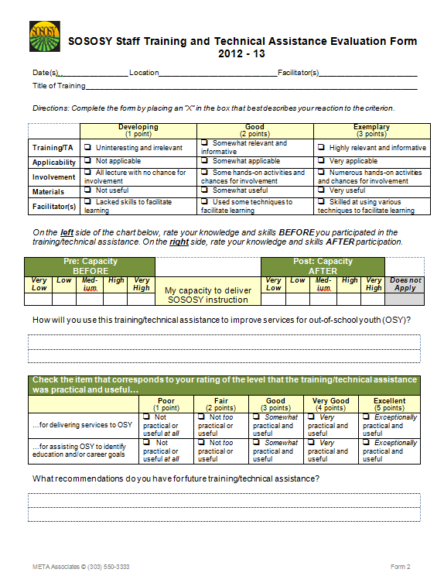
Form 2
Staff Training & TA Evaluation
Feedback:

Slide 16
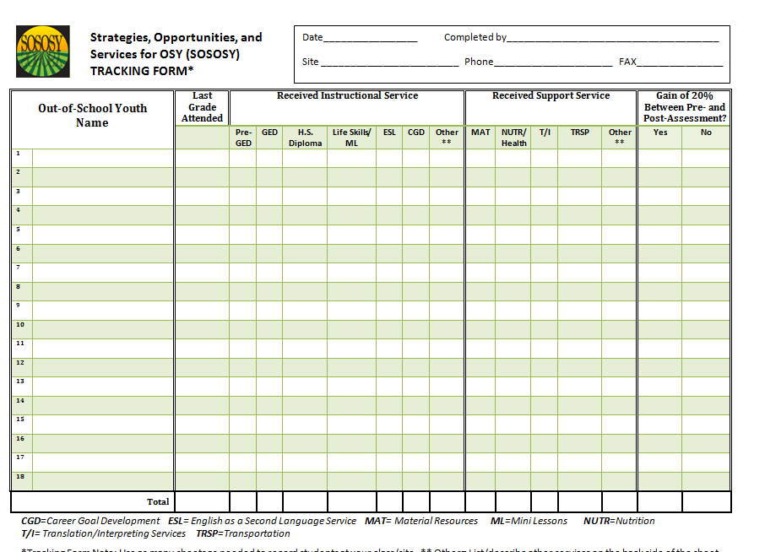
Form 3 – Student Tracking Form

Slide 17
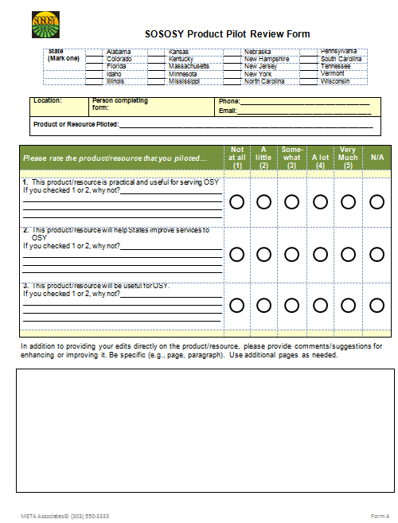
Form 4
Product Pilot Review Form
Feedback:

Slide 18
Pilot Process
3 materials to pilot
Assessments and instructional materials
www.osymigrant.org

Slide 19
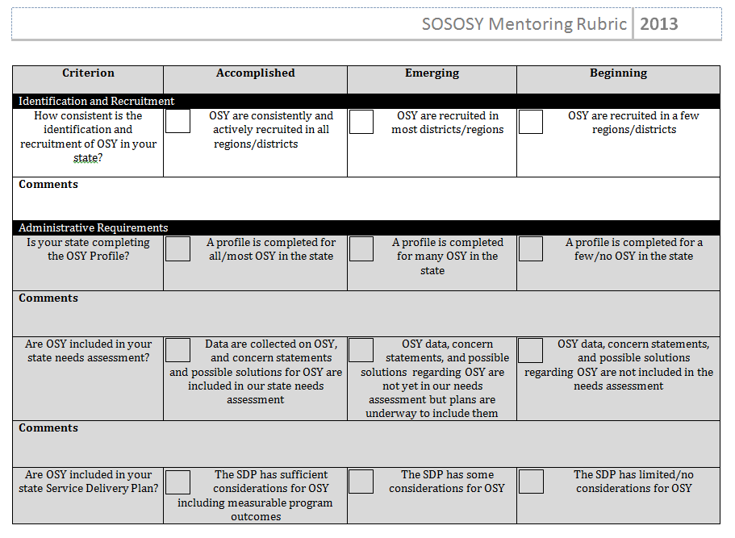

Slide 20
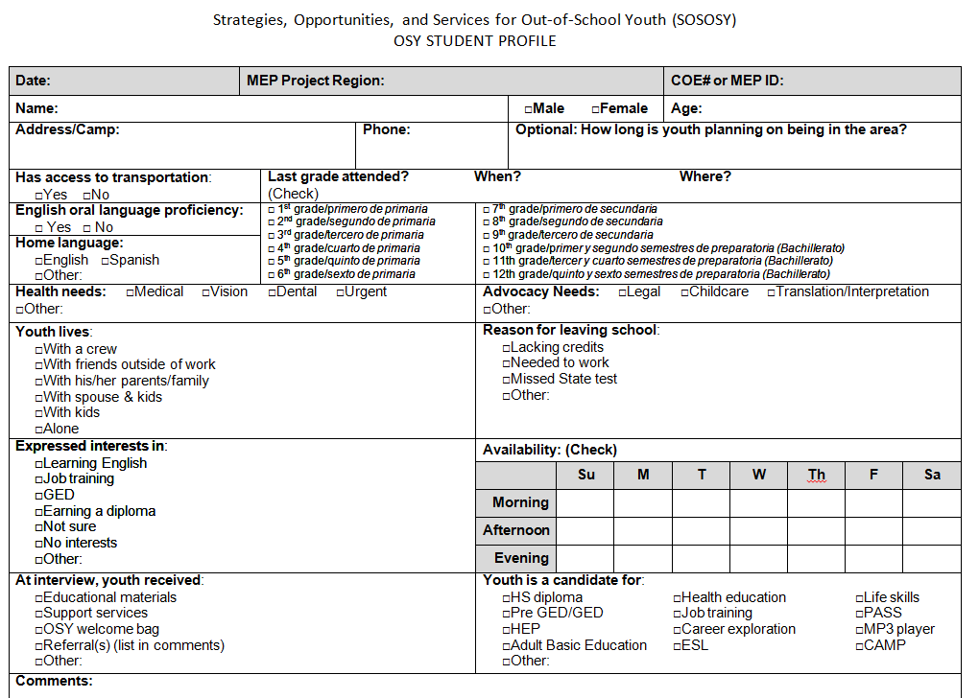

Slide 22
Georgia’s OSY State Plan
GA piloted the use of the OSY State Plan form
How was the form used
Describe the process
Discuss successes and challenges
www.osymigrant.org

Slide 23
Mentoring Work Group
Members: Jessica Castaneda (TN), Barbie Patch (NH), John Farrell (KS), Ray Melecio (FL), Lysandra Lopez-Medina (PA), and Michael Maye (NY)
www.osymigrant.org

Slide 24
Work Group Summary
Build rubric to observe & assess capacity to deliver services to OSY
Meet with new state directors to administer rubric
Identify needs, trends; identify potential mentors
Train mentors to interpret rubric, CSPR, profile, etc.
Reworked rubric to include specific questions that will guide the mentoring visits
Contacted initial states for mentoring visits
Brainstorm ideas for using technology to create a Welcome to SOSOSY course for brand new staff or states in the Consortium. Develop set of protocols for mentoring visits and draft a letter explaining the purpose

Slide 25
Assessment Work Group
Members: Erin Shea (VT), Christine Deines (CO), Taylor Dearman (MS), Jennifer Almeda (NC) and Frank Crossman (KY)
www.osymigrant.org

Slide 26
Work Group Summary
Complete rubric and instruction sheet
Develop state data collection tool. Follow up with Susan Duron and Tracie Kalic on this to ensure alignment with SOSOSY reporting forms
Discuss development of webinar and begin planning webinar to introduce assessments to Consortium states
Coordinate with curriculum group to ensure alignment with assessment creation/coding
www.osymigrant.org

Slide 27
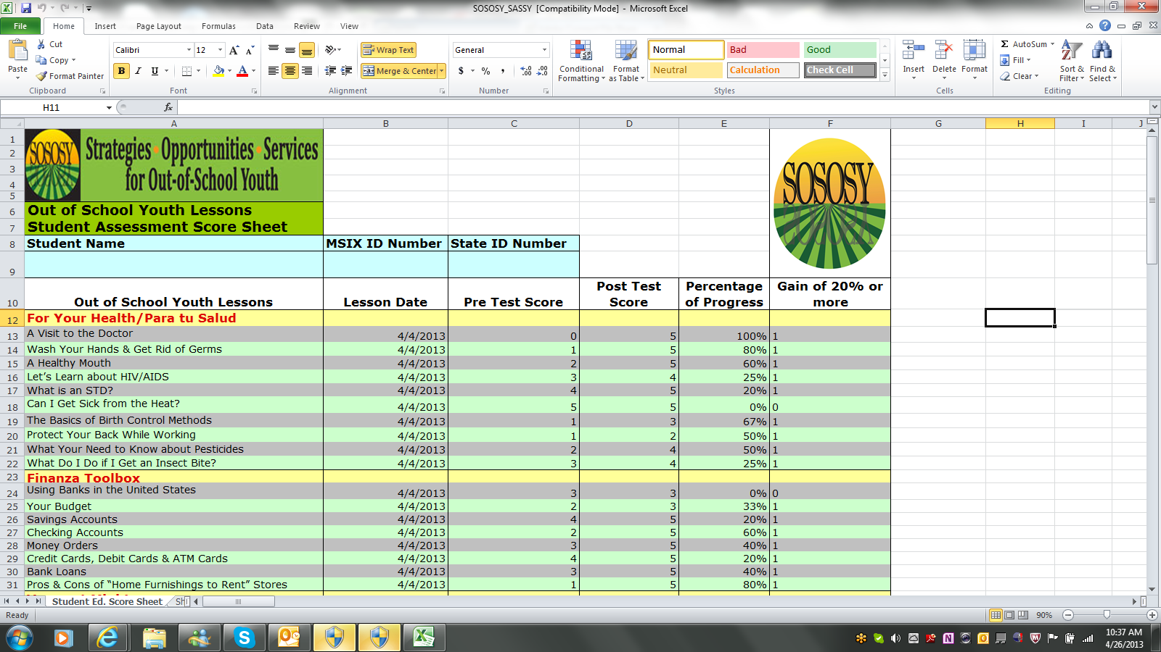

Slide 28
Training Work Group
Members: Emily Hoffman (MA), Sonja Williams (NC), Jorge Echegaray (FL), Novelette Seroyer (AL), Brenda Meyer (CO) and Kathleen Bibus (MN)
www.osymigrant.org

Slide 29
Work Group Summary
Preparation of additional TOT materials (2 modules and supportive documents) and editing of the current TOT Manual
Implementing a three day TOT for new trainers and current trainers. We will be bringing people who did not participate in the 2012 TOT (new states and open positions due to attrition) for a 2 day TOT and bring all trainers together for the third day of the TOT and train on the two new modules.
Continued support/training for SOSOSY trainers through webinars
Development of a sustainability plan for training materials (for future use by states not participating in the OSY-CIG and for participating states to use with additional staff)
www.osymigrant.org

Slide 30
Trainer Survey Questions
Preparedness
Clarity and Usefulness of Materials
Participant Involvement
Material Modification
Relevance to Participants’ Needs
Additional Questions:
Describe support you would like from SOSOSY in order to achieve your training goals.
Describe support you would like from your state MEP in order to complete your training goals.
www.osymigrant.org

Slide 31
How Many Trainings Have Held Since September 2011?

Slide 32
How Many People Have Been Trained?

Slide 33
Does Your State Have a Training Plan?

Slide 34
SOSOSY Professional Networking
http://osymigrant.ning.com
designed to be a professional networking site; a venue for MEP staff from across the country to share best practices, generate forum conversations
work together to improve efforts to identify, recruit, and provide exceptional services to OSY throughout the country.
The site currently has 20 members, all of whom have been recommended either by State Directors, ID&R Coordinators, or another administrator. Most members either work directly with OSY, or oversee the identification and recruitment, and/or service provision initiatives to the OSY in their state. We have representation from 12 states on the site.
www.osymigrant.org

Slide 35
Meetings for Next Year
Fall and Spring
Time and Date
Locations?
www.osymigrant.org

