Slide 1
GOSOSY State Steering Team
March 5, 2017
Washington, DC
www.osymigrant.org

Slide 2
Agenda– March 5
Lead State Welcome and Introductions
GOSOSY Updates
TST Work Groups
Identification and Recruitment
Curriculum and Material Development
Professional Development
OSY Learning Plan
Goal Setting
OSY Literature Review
GOSOSY Dissemination Event Planning
GOSOSY FII and Requirements for State Directors
Timeline
Collaboration efforts with other CIGs – Barbie Patch
Networking discussion
Future meeting dates/times
www.osymigrant.org

Slide 3
Welcome to State Directors
Doug Boline, State MEP Director, Kansas
Lindsay Booth, Program Office, OME
www.osymigrant.org

Slide 4
Member States
Alabama
Florida
Georgia
Illinois
Iowa
Kansas
Kentucky
Massachusetts
Mississippi
Nebraska
New Hampshire
New Jersey
New York
North Carolina
Pennsylvania
South Carolina
Tennessee
Vermont
www.osymigrant.org

Slide 5
Partner States
Alaska
Arkansas
California
Colorado
Idaho
Maryland
Minnesota
Missouri
Montana
Oregon
Washington
Wisconsin
www.osymigrant.org

Slide 6
GOSOSY Updates
ACReS Lessons in French– Thank you to Illinois!
OME Monitoring– February 14, 2017
ADM Participation
NASDME presentations
GOSOSY Website Updates
Google Analytics
Discussion of student site
www.osymigrant.org

Slide 7
Google Analytics
A review of the GOSOSY site between November to January 2017
www.osymigrant.org

Slide 8
Overview of Sessions & Users on GOSOSY site

Slide 9
What countries are people from that are visiting the site….

Slide 10
Active Users

Slide 11
Demographics

Slide 12
Engagement

Slide 13
Devices

Slide 14
Where they are going to on the site

Slide 15
Where they are going to on the site

Slide 16
Technical Support Team
Expectations
Membership
State Director expectations
Requirements
3 meetings per year
Conference calls
Work assignments
Team Lead meeting
Collaboration and coordination across groups
Work Norms
Be fully committed to the work and will demonstrate this commitment by meeting agreed upon deadlines, participating/attending meetings and calls until outcomes/goals are fully met.
Leave each meeting with tangible products/achievements synthesizing our meeting outcomes.
Use included reflection time to promote spontaneous, creative discussion.
www.osymigrant.org
Notes:
Purpose- responsibilites
Who to send?
Mentoring Pilot- World Education
Tracie will ask MA, TN, VT, GA, and CA
Mental Health-- KS
Goal Setting – TOT Work Group – Sonja Williams (lead)—Ernesto?
PD- Develop training to certified and non-certified staff – Jessica Castaneda (Lead)
ID&R – in collaboration with IRRC—Jennifer Almeda (lead)
Develop web-accessible lessons- Material Development—Bob Lynch and Brenda Pessin-- leads
With support and guidance from World Ed – Andy Nash
OSY Learning Plan—Emily Hoffman
With Steve Quonn

Slide 17
Work Groups
Identification and Recruitment
Material and Curriculum Development
Professional Development
OSY Literature Review
OSY Learning Plan
Goal Setting
www.osymigrant.org
www.osymigrant.org

Slide 18
TST Work Groups
Identification & Recruitment
Tasked with collaborating with Identification & Recruitment Rapid Response (IRRC) Consortium to develop, pilot, and implement the Recruiter Assessment Tool; tasked with updating GOSOSY recruiter resources.
LEAD Jennifer Almeda – SC
Ray Melecio – FL
Barbie Patch – NH
Pedro Santiago – KY
Deke Showman - PA
www.osymigrant.org

Slide 19
Identification & Recruitment
Recruiter Assessment Tool (with IRRC)
Link to assessment tool will be available to all states on osymigrant.org.
Assessment tool will be used by GOSOSY states
www.osymigrant.org

Slide 20
Identification & Recruitment
In-the-Field Recruiter Training (with IRRC)
Prezi/video created in collaboration with IRRC.
IRRC will present training on Mapping and H2A at April GOSOSY TST meeting.
www.osymigrant.org

Slide 21
TST Work Groups
Material & Curriculum
Tasked with finalizing, piloting, and implementing the five new Mental Health Life Skills Lessons; tasked with updating the Living in America curriculum.
LEAD Brenda Pessin – IL
LEAD Chris Norton – National PASS Center
Peggy Haveard - AL
www.osymigrant.org

Slide 22
Materials & Curriculum
Mental Health Life Skills Lessons
Let’s Talk About Alcohol
Let’s Talk About Anxiety
Let’s Talk About Depression
Let’s Talk About Mental Health
Let’s Talk About Stress
*audio enhancements in production with ALRC
www.osymigrant.org

Slide 23
Materials & Curriculum
Living in America*
10 lessons to be updated:
Formatting
ESL enhancements
Removal of pre- and post-assessments
General language acquisition categories aligned with numerical scores
*Curriculum now available at no cost online at migrant.net and osymigrant.org.
www.osymigrant.org

Slide 24
Materials & Curriculum
Living in America
“Using Money” lesson
Will be updated for review at April TST meeting
Will be piloted by several states in Summer 2017
Will serve as template for other lesson updates
*
www.osymigrant.org

Slide 25
TST Work Groups
Professional Development
Tasked with designing, piloting, and implementing professional development for MEP practitioners – to include materials, training, and video supplement.
LEAD Joan Geraci – NJ
LEAD Kiowa Rogers – NE
Lysandra Alexander – PA
Odilia Coffta – NY
Sabrina Rivera-Pineda - GA
www.osymigrant.org

Slide 26
Professional Development
GOSOSY Professional Development for OSY Instructors:
Implementing the OSY Instructional Action Plan
www.osymigrant.org

Slide 27
Acknowledgements
GOSOSY Professional Development Group and Contributors
Lysandra Alexander (PA); Susanna Bartee (KS); Joan Geraci (NJ); Lori Houck (KS); Lindsay Ickes (NE); Tracie Kalic (KS); Hillary Maitlen (TN); Sabrina Pineda (GA); Kiowa Rogers (NE), Odilia Coffta (NY)
Kansas MEP: John Farrell, Paige Inman and John Fink.
GOSOSY PD Reviewers and Technical Support Team members and the State Steering Team
www.osymigrant.org

Slide 28
Introduction to the OSY Instructional Action Plan
www.osymigrant.org

Slide 29
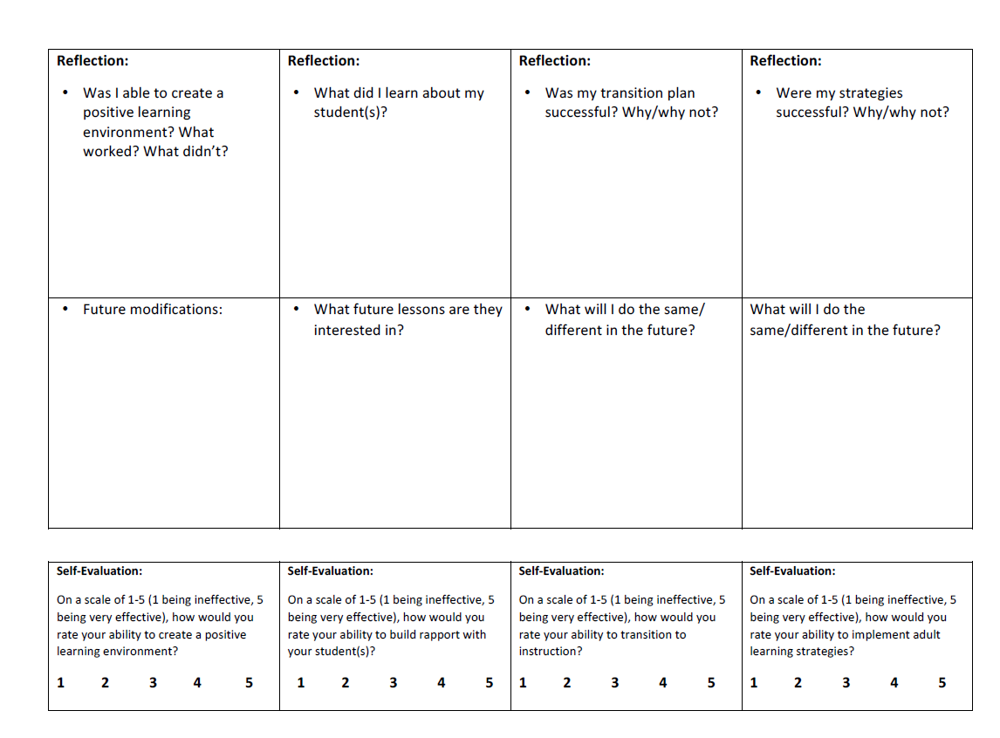
Introduction to the OSY Instructional Action Plan Continued
www.osymigrant.org

Slide 30
Student Scenario: Introducing Paw
Paw is a 17-year-old OSY. She moved here with her boyfriend who worked in a feedlot a year ago. Not long after moving, she found out she was pregnant. She and her boyfriend are no longer together and her family lives in a different state. She completed her freshmen year of high school and then dropped out. Her English proficiency is Intermediate. She is unfamiliar with the area and needs medical services during her pregnancy. After her pregnancy, she will need childcare as she is planning on going back to her job in a dairy and has also expressed a desire in obtaining her GED.
www.osymigrant.org

Slide 31
Student Scenario: Introducing Yordano
Yordano is an 18-year-old OSY. He just recently moved out of his parents’ house and is working for a local farmer. Money is very tight in his household and therefore he cannot afford a car. He attended school all the way up to the first semester of 12th grade. He is proficient in English. He dropped out because he missed the state test and was not going to be on track to graduate. Because of the lack of transportation, he is unable to have a stable means of transportation to get to and from a school.
www.osymigrant.org

Slide 32
Main Components OSY Instructional Action Plan
STEP 1
Creating an Effective Learning Environment
STEP 2
Building Rapport
STEP 3
Transition to Instruction
STEP 4
Young Adult Learning Strategies
www.osymigrant.org

Slide 33
Step 1
www.osymigrant.org
Notes:
Change fillable form to effective
Introduce the concept of actively participating… refer to OSY Instructional Action Plan
Explain Stop and Do.

Slide 34
Step 1: Creating an Effective Learning Environment
Guiding Questions: | Tips:
Where may you conduct the lesson? What distractions or challenges may you encounter? How will you address these? | Find an effective location Minimize distractions (turn off TV, phones, radio, etc.) Have supplies readily available for use Ensure there is proper lighting
www.osymigrant.org

Slide 35
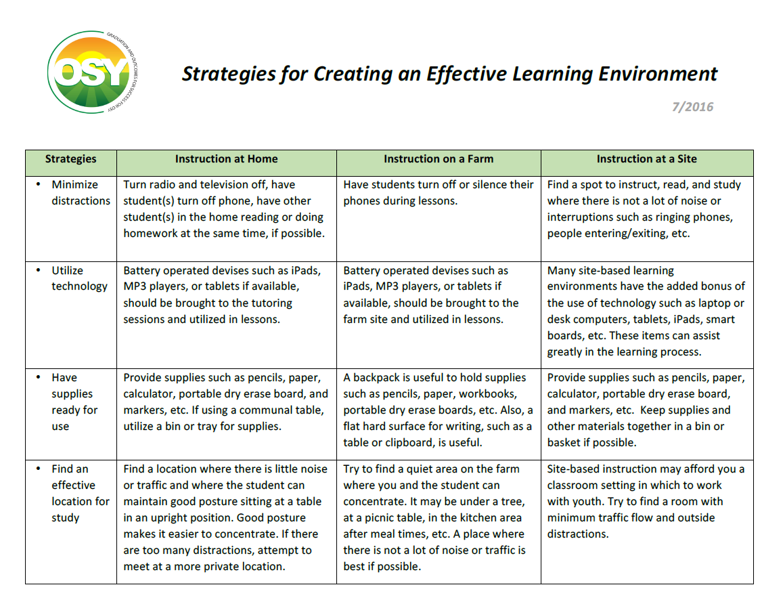
Step 1: Creating an Effective Learning Environment
For the full document, see Strategies for Creating an Effective Learning Environment Resource Guide
www.osymigrant.org
Notes:
In Voiceover, point out that this is a screenshot of the resource guide for Step 1: Creating an Effective Learning Environment

Slide 37
Stop-and-Do: Step 1
Describe what you would do to create an effective learning environment for Yordano on the farm where he works and lives:
Where may you conduct the lesson?
What distractions or challenges may you encounter?
How will you address these?
www.osymigrant.org
Notes:
Explain pencil?

Slide 38
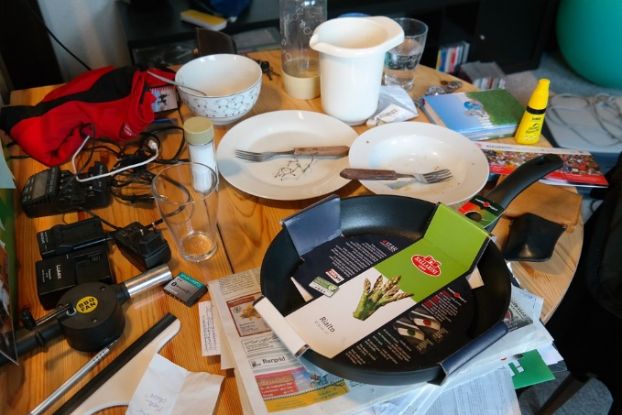
Effective Learning Environment In Summary…
Minimize Clutter
Minimize Distractions
Have Supplies
Ready for Use
Ensure Proper Lighting
Utilize Technology
www.osymigrant.org
Ensure Proper Lighting

Slide 39
Step 2
www.osymigrant.org
Notes:
Change fillable form to effective

Slide 40
Step 2: Building Rapport
Guiding Questions: | Tips:
What conversation starters/questions will you use to build rapport with OSY? What are specific lessons that would be helpful/applicable for the OSY? | Ask student(s): What is something you would like to learn more about? Why? What is an activity or subject that you never get tired of talking about? If you have time and resources to achieve your dreams, what would your dreams be?
www.osymigrant.org

Slide 41
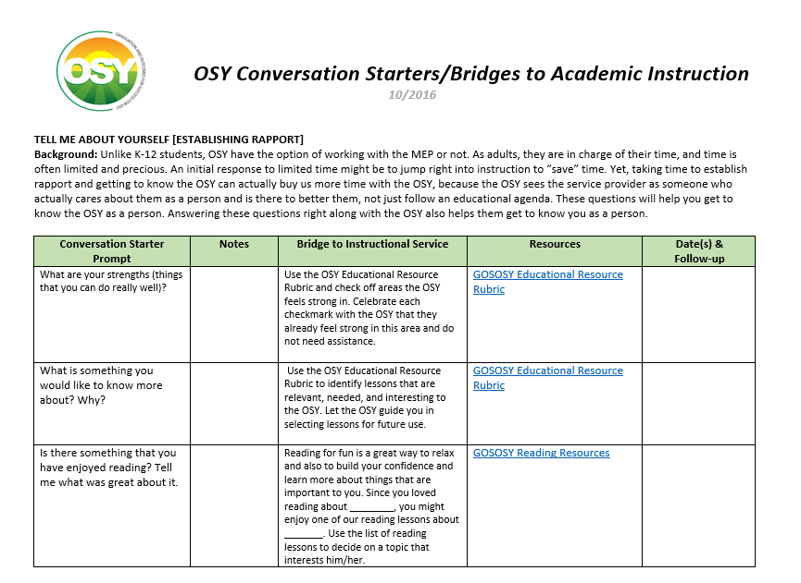
Step 2: Building Rapport
For more information, see OSY Conversation Starters/Bridges to Academic Instruction Resource Guide
www.osymigrant.org
Notes:
Explain that step 2 is all about conversation starters and will lead to bridge to instructional services in step 3

Slide 43
Stop and Do: Step 2
Describe what you would do to build rapport with Yordano prior to instruction, knowing that he has limited availability in his schedule:
What conversation starters/questions will you use to build rapport with OSY?
Use this time to determine if there are specific lessons that would be helpful/applicable.
www.osymigrant.org

Slide 44
Building Rapport In Summary…
What is something you would like to learn about?
What are your dreams for the future?
?
?
?
What interests you?
www.osymigrant.org
Ensure Proper Lighting

Slide 45
Step 3
www.osymigrant.org
Notes:
Change fillable form to effective

Slide 46
Step 3: Transition to Instruction
Guiding Questions: | Tips:
How will you transition from the rapport building to the instructional lesson? | Review material from previous lesson Relate lesson to the interest expressed in previous conversations Create interest and enthusiasm in the topic you’re about to present
For more information, see OSY Conversation Starters/Bridges to Academic Instruction Resource Guide
www.osymigrant.org

Slide 47
Step 3: Transition to Instruction
For more information, see OSY Conversation Starters/Bridges to Academic Instruction Resource Guide
www.osymigrant.org
Notes:
Explain that step 2 is all about conversation starters and will lead to bridge to instructional services in step 3

Slide 49
Stop-and-Do: Step 3
Describe what you would do to transition from building rapport to instruction with Yordano, knowing that his goal is to complete high school and that he was very close to doing so:
How will you redirect the conversation from being informal to introduce and begin your lesson?
www.osymigrant.org

Slide 50
Transition to Instruction In Summary…
instruction
Create interest and enthusiasm
Review content
interests
Relate to interests
www.osymigrant.org
Ensure Proper Lighting

Slide 51
Step 4
www.osymigrant.org
Notes:
Change fillable form to effective

Slide 52
Step 4: Young Adult Learning Strategies
Young Adults Learn: | Tips:
When they want to or feel a need to learn When learning is practical and related to real life By doing/experiencing In a variety of ways | Make sure the lesson is relevant and useful to the student Provide immediate practice and feedback Adjust learning to the student’s needs/level Incorporate as many senses as possible
www.osymigrant.org
Notes:
Give examples of senses in voiceover–
Young Adults Learn:
Tips:
In a variety of ways
Visual (through looking at materials)
Auditory (through hearing)
Kinetic (through movement)
Present ideas in different ways
Some repetition is OK
Incorporate as many senses as possible in a lesson (e.g. looking, hearing, using hands-on materials)
Encourage interaction
Incorporate Technology, when possible (tablet, smartphone, etc.)
By Doing
If youth are actively involved in the process, they:
Learn quicker
Retain the information
Relate learning to what they know
Provide immediate practice and feedback
Use graphic organizers and other visuals
Use frequent comprehension checks
Adjust learning to the student’s needs/level

Slide 53
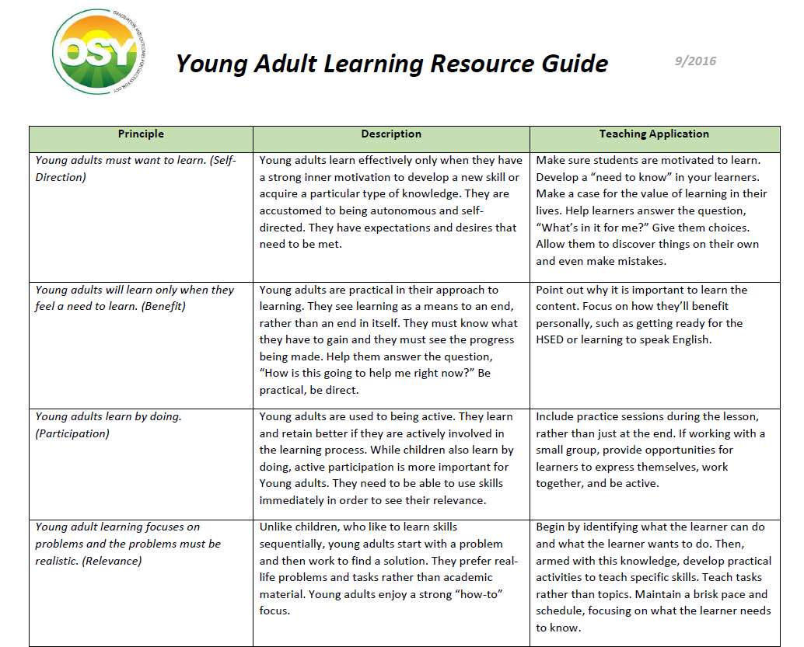
Step 4: Young Adult Learning Resource Guide
For the full document, see Young Adult Learning Resource Guide
www.osymigrant.org
Notes:
Explain that step 2 is all about conversation starters and will lead to bridge to instructional services in step 3

Slide 55
Stop-and-Do: Step 4
Describe what young adult learning strategies you would use with Yordano, knowing obtaining his diploma may lead to better opportunities:
Identify the specific learning strategies you plan to use.
Where and how will you implement these strategies?
www.osymigrant.org

Slide 56
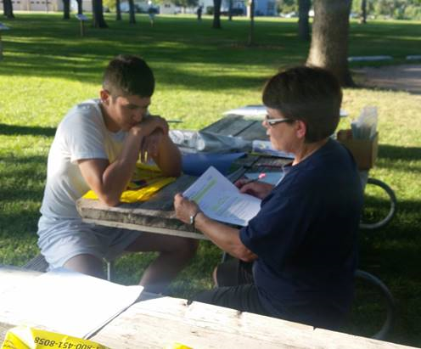
Learning Strategies In Summary…
Relevant and Useful
Adjust to meet needs
instruction
Incorporate many senses
Practice and Feedback
interests
www.osymigrant.org
Ensure Proper Lighting

Slide 57
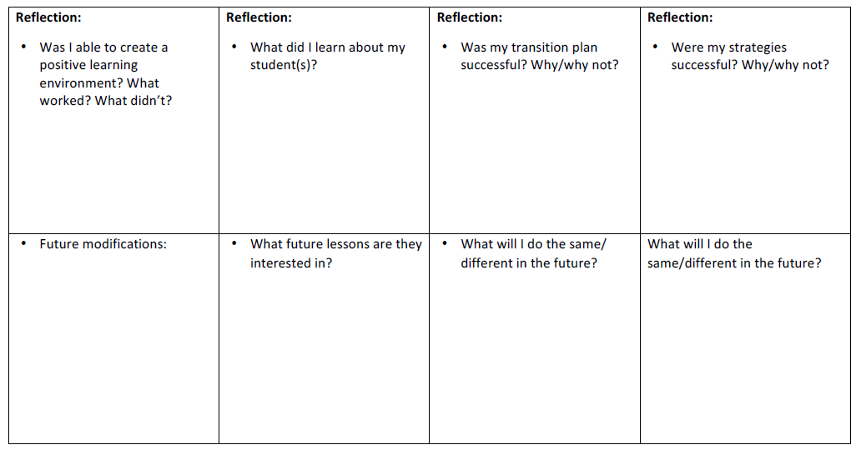
OSY Instructional Action Plan Reflection
Review the questions in the reflection section to evaluate the success of your lesson and determine future modifications.
www.osymigrant.org

Slide 58
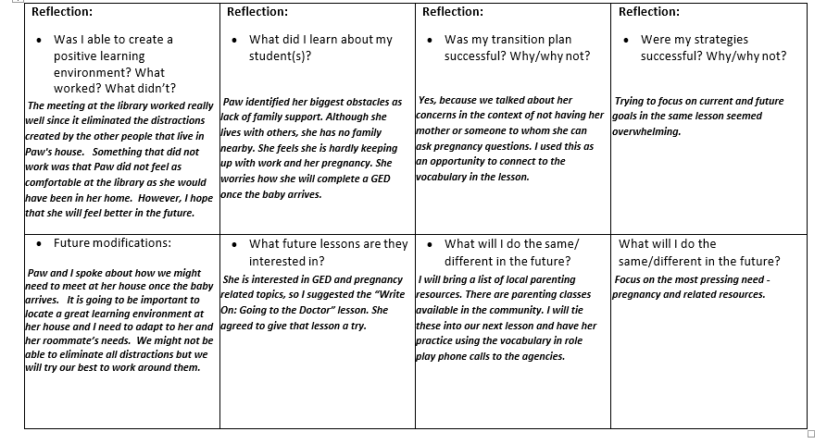
Sample OSY Instructional Action Plan: Paw
www.osymigrant.org

Slide 59
Stop-and-Do: Reflection
Take a few moments to consider these components of reflection:
Reflection is critical. It enables you to construct valuable future lessons.
Use your reflection to set goals for yourself.
Reach out for help from a supervisor, trusted colleague, or utilize community resources.
Be flexible - don’t hesitate to change your future lesson plan based on the OSY’s response.
Reflection is vital to your rapport with the OSY, as it enables you to stay in tune with their changing needs.
www.osymigrant.org

Slide 60
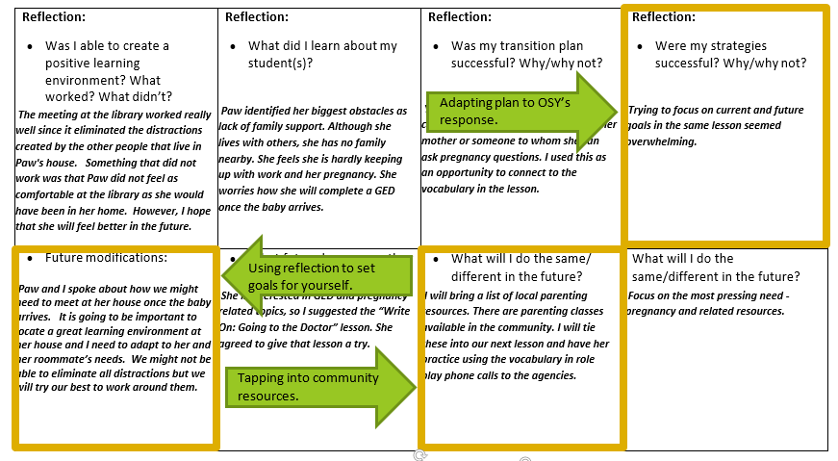
Stop-and-Do: Reflection
Now take a moment to note these components on Paw’s Learning Plan Reflection:
www.osymigrant.org

Slide 61
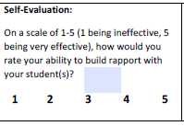
OSY Instructional Action Plan Evaluation
Self Evaluation:
On a scale of 1-5, how would you rate your ability to…
Create a positive learning environment?
Build rapport with your student(s)?
Transition to instruction?
Implement young adult learning strategies?
www.osymigrant.org
Notes:
Explanation of scale 1 being…

Slide 62
Sample OSY Instructional Action Plan Evaluation: Paw
Be honest in the evaluation process; learn from what didn’t work and build on what worked!
While working at the library was great in theory, Paw did not feel comfortable there.
Incorporating my personal story really helped put Paw at ease with me and open up about her own family situation.
I was able to easily transition into the lesson I had planned since we had such a great conversation about her needs.
I planned too many strategies for this particular lesson. I will need to revisit the second strategy at a later time.
www.osymigrant.org
Notes:
Explanation of scale 1 being…

Slide 63
Closing: OSY Instructional Action Plan
For more information, see Sample OSY Action Plan
www.osymigrant.org
Notes:
Now that you’ve completed the action plan…select a student with whom you’ve been working and develop an action plan.

Slide 64
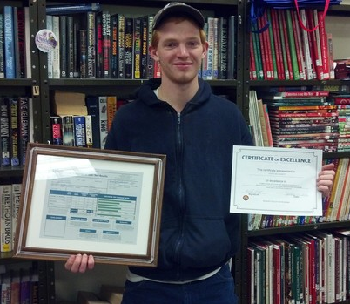
Success in Action
“Every new lesson offers another step to success”
- Terry Mark
www.osymigrant.org

Slide 65
TST Work Groups
OSY Learning Plan
Tasked with designing, piloting, and implementing the OSY Student Learning Plan for both students and practitioners.
LEAD Emily Hoffman – MA
Sarah Braun-Hamilton – VT
Margot DiSalvo – FL
Mike Reho – NY
www.osymigrant.org

Slide 66
OSY Learning Plan
www.osymigrant.org

Slide 67
TST Work Groups
Goal Setting
Tasked with designing, piloting, and implementing the Goal Setting for OSY training and workshops.
LEAD Sonja Williams – NC
Carmen Anderico – MS
Joyce Bishop – AL
April Dameron – IA
Denise Rocha – TN
www.osymigrant.org

Slide 68
Goal Setting
Staff participants will be able to work with OSY to develop potential educational and/or life pathways for the youth using:
networking
advocacy
OSY Student Profile data
appropriate educational materials into step-by-step action plan
OSY Student Learning Plan
Student participants will learn to identify and articulate their own goals and use hands-on activities to develop both short- and long-term plans to reach those goals.
www.osymigrant.org

Slide 69
TST Work Groups
Literature Review
Tasked with creating new GOSOSY Lit Review focused on Mental Health in Migrant Students, with emphasis on the Adverse Childhood Experiences (ACEs) studies and resources and their potential uses with OSY.
LEAD Jessica Castañeda - GOSOSY
Susanna Bartee - GOSOSY
John Farrell – GOSOSY
www.osymigrant.org

Slide 70
The Adverse Effects of Childhood Trauma
www.osymigrant.org

Slide 71
Traumatic Events
Each year in the United States:
over 3 million children and adolescents experience some form of traumatic event
trauma in childhood and adolescence can lead to future disorders
www.osymigrant.org
Notes:
We are looking into how this directly affects migrant youth.

Slide 72
Understanding Trauma’s Effect
When a child grows up afraid or under constant or extreme stress, the immune system and body’s stress response systems may not develop normally.
When the child or adult is later exposed to even ordinary levels of stress, these systems may automatically respond as if the individual is under extreme stress.
www.osymigrant.org
Notes:
From infancy through adolescence, the body’s biology develops. Normal biological function is partly determined by environment.

Slide 73
Long Term Health Consequences
The Adverse Childhood Experiences (ACE) Study includes over 17,000 participants ranging in age from 19 to 90.
Results:
indicated nearly 64% of participants experienced at least one exposure, and of those, 69% reported two or more incidents of childhood trauma.
demonstrated the connection between childhood trauma exposure, high-risk behaviors (e.g., smoking, unprotected sex), chronic illness such as heart disease and cancer, and early death.
www.osymigrant.org
Notes:
Traumatic experiences in childhood have been linked to increased medical conditions throughout the individuals’ lives. The Adverse Childhood Experiences (ACE) Study is a longitudinal study that explores the long-lasting impact of childhood trauma into adulthood. Researchers gathered medical histories over time while also collecting data on the subjects’ childhood exposure to abuse, violence, and impaired caregivers.

Slide 74
Migration & Trauma
Many of our migrant families and youth came to the United States from another country.
Many have experienced traumatic exposure in their homelands (war, torture, terrorism, natural disasters, famine) which prompt the decision to emigrate in the first place.
The path to immigration is filled with risks and stressors that are unique to immigrants, both prior and after their arrival.
Added stressors from the process of immigration itself can lead to increased risk for emotional disturbance in newer immigrants.
www.osymigrant.org

Slide 75
Cycle of Poverty
The majority of migrants have low levels of education and job skills
Families survive neighborhoods that are often unsafe. Children may live in an atmosphere of risk of crime and violence, which undermines social cohesion.
The cycle of poverty, coupled with inferior levels of education, threatens to create a downward spiral of declining financial opportunity for immigrants.
www.osymigrant.org

Slide 76
Major Stressors
Discrimination and prejudice
Children (especially adolescents) experience discrimination and prejudice from their peers in school and social settings, with more intense expression of what is sometimes subtle amongst adult counterparts.
Discrimination is increasingly recognized as an adverse mental health risk (Finch, Kolody, & Vega, 2000).
www.osymigrant.org
Notes:
Discrimination and prejudice are other major stressors that come into prominence once the immigrant is better established and oriented to the mainstream culture. This is experienced not only as originating from mainstream culture Americans, but often from other earlier-arriving immigrants, even from their nation or culture of origin, who may feel threat of displacement as far as job security and access to resources and opportunity.

Slide 77
Alternative coping
Alternative routes for coping with cultural changes and stress induced by immigration:
neurotic marginality (anxiously trying to meet the demands of both cultures)
deviant marginality (isolated as a result of ignoring the norms of both cultures)
traditionalism (withdrawal into nostalgia for the old culture)
over-acculturation (abandoning the culture of origin)
biculturality (integrating the best of both cultures)
Lin, Masuda, & Tazuma (1982)
www.osymigrant.org
Notes:
As a result of the many traumas and stressors faced by immigrants and refugees during their physical and psychological odyssey, they have been found to generally be at high risk for mental health problems (Keyes, 2000).

Slide 78
Mental Health
Some studies, like those of Mexican-born immigrants, have found that they have better mental health profiles than subsequent generations despite significant socioeconomic disadvantages.
Possible explanations include greater use of protective traditional family networks, a lower set of expectations for ‘‘success’’ in America, and lower substance abuse (Escobar, Nervi, & Gara, 2000).
www.osymigrant.org
Notes:
These disorders have been correlated to exposure and proximity to pre-migration and post-migration traumatizing events (Fenta, Yman, & Noh, 2004). Other risk factors that affect the degree of symptomatology and impairment include poverty, education, subsequent unemployment, low self-esteem, and poor physical health (Hermansson et al., 2002; Hsu, Davies, & Hansen, 2004; Weine et al., 2000).

Slide 79
Youth Suffer
Immigrant children and youth suffer from similar conditions as described for adults:
anxiety disorders
depression
posttraumatic stress disorders
Such disorders can significantly impair academic functioning for these children. Factors such as parental emotional well-being and peer relationships can mitigate or aggravate the symptomatic and functional impact of such disorders.
www.osymigrant.org
Notes:
(Fox, Burns, Popovich, Belknap, & FrankStromborg 2004; McKelvey et al., 2002). (Fox et al., 2004). Almquist & Broberg, 1999)

Slide 80
In Summary
We are compiling research in a literature review regarding how adverse childhood experiences (ACEs) directly affect our migrant students.
Included in this review will be direct interventions that have proven helpful in overcoming the effects of childhood trauma.
www.osymigrant.org

Slide 81
Year 2 Fidelity Implementation Index
www.osymigrant.org

Slide 82
Objective 1: Achievement & Learning Plans
Outcome | Measurement Tool | Timeline
1.1 75% of OSY participating in project-directed instructional services will demonstrate a 20% average gain between pre/post | Student Assessment Score Sheet (SASS) available on osymigrant.org | Annually, Year 1 data due in September 2016
1.2 75% of OSY with a Learning Plan will attain an average of 50% of the learning/achievement objectives | Learning Plan Templates will be available by 5/15/16 on osymigrant.org | Annually, Year 1 data due in September 2016
1.3 Attendance by 54 OSY (consortium wide) at Goal Setting Workshops and attain acceptable or above average score on GSW rubric | Verified Attendance Rosters; Goal Setting Workshop Rubric available by 6/15/16 on osymigrant.org | Annually, Year 1 data due in September 2016
www.osymigrant.org
Notes:
The SOSOSY Training Manual has been designed to assist states in the development of systems to support Out-of-School Youth. SOSOSY Training Manual has been created to assist states in creating a system to identify, recruit and provide services to OSY. This document serves as a workbook for states to develop or improve their current services and support programs for OSY. It outlines the steps to gather and analyze OSY data, plan for service delivery, access best practices in curriculum and instruction, as well as create education plans and address advocacy needs of the OSY population.

Slide 83
Objective 2: Professional Development
Outcome | Measurement Tool | Timeline
2.1 75% of staff completing PD increase skills by 10% between pre- and post-assessment | Staff Skills Assessment available on osymigrant.org by 1/30/16 | Annually, Year 1 data due in September 2016
2.2 75% of states average of 5 PD/mentoring collaborations | Director/Coordinator Form on osymigrant.org | Annually, Year 1 data due in September 2016
2.3 75% of recruiters tested achieve “proficient” on OSY ID&R skills assessment | ID&R Skills Test developed in collaboration with ID&R consortium | Annually, Year 1 data due in September 2016
www.osymigrant.org
Notes:
The SOSOSY Training Manual has been designed to assist states in the development of systems to support Out-of-School Youth. SOSOSY Training Manual has been created to assist states in creating a system to identify, recruit and provide services to OSY. This document serves as a workbook for states to develop or improve their current services and support programs for OSY. It outlines the steps to gather and analyze OSY data, plan for service delivery, access best practices in curriculum and instruction, as well as create education plans and address advocacy needs of the OSY population.

Slide 84
Objective 3: State Processes
Outcome | Measurement Tool | Timeline
3.1 Five products developed/ adapted/vetted/adopted by 18 states | Quality of Implementation Tool available by 9/30/2017 | Year 3, QI due by 9/30/2018
3.2 GOSOSY Dissemination Event (DE) for 200+ staff is planned, implemented, evaluated | Dissemination Event survey in Year 3 | End of Year 3
www.osymigrant.org
Notes:
The SOSOSY Training Manual has been designed to assist states in the development of systems to support Out-of-School Youth. SOSOSY Training Manual has been created to assist states in creating a system to identify, recruit and provide services to OSY. This document serves as a workbook for states to develop or improve their current services and support programs for OSY. It outlines the steps to gather and analyze OSY data, plan for service delivery, access best practices in curriculum and instruction, as well as create education plans and address advocacy needs of the OSY population.

Slide 85
APR Highlights
71% of OSY received services (5% increase)
835 OSY demonstrated a 20% gain on post assessments (84.5%)
184 training sessions to service providers and staff (2366 participants- duplicated count)
www.osymigrant.org

Slide 86
Dissemination Event Updates
FL, IL, KS, KY, MA, NE, NH, NJ, NC, TN
Meeting with IRRC and PI
Working on registration process
Fee
Keynote
Structure and logistics
www.osymigrant.org

Slide 87
Networking Discussion
GOSOSY Questions:
GOSOSY states offer a variety of services designed to meet the needs of migrant students such as learning and career plans, goal development, language instruction, assessments, and credit recovery options. How has your state structured and delivered instruction for OSY?
Another goal of GOSOSY is to increase collaboration with other groups and agencies in order to reduce duplication of efforts and ensure best possible services. What were the most successful collaborations in your state and what made them successful?
www.osymigrant.org

Slide 88
Networking Questions
Current Trends in ID&R, Partnerships, and Service Delivery:
What is currently affecting recruitment, instruction and support services to OSY within your state?
What are some current needs that OSY are bringing to your attention?
How are you addressing those needs (either through direct support to OSY and/or staff who interact with them)?
What resources have you found available to address these needs?
What types of state and local agencies are you partnering with to provide services, meet needs, and remove barriers? What’s going well with those partnerships, and what do they need to flourish?
www.osymigrant.org

Slide 89
Future Meeting Dates
Future SST Meetings:
Webinar to review data collection via the Director’s Report due September 20, 2017- TBA
October 17, 2017 at the IMEC Symposium in Clearwater, FL
Prior to the ADM
Future TST Meetings:
Spring meeting: April 5-6, 2017, Chicago, IL
Team Lead Conference Calls: scheduled prior to next meeting
Next year- Fall and spring meetings
www.osymigrant.org

