Slide 1
iSOSY Personal Wellness
Resilience
The process of adapting well in the face of
adversity, trauma, or significant stress
Presenter, title, organization
www.osymigrant.org
Notes:
This module focuses on resilience—the process of adapting well in the face of adversity, trauma, tragedy, threat, or overwhelming amounts of stress. Resilient individuals are better equipped to handle adversity and rebuild their lives after a disappointment, failure, or tragedy. Let’s help our students become more resilient; it’s a skill that will benefit them throughout their lives.
Adversity can include family and relationship problems, serious health problems, workplace/financial stresses, or unanticipated tragedy.
It is important to realize that someone who experiences a traumatic event will not retain all of the same outlooks and opinions after that experience. However, that change can actually be seen as growth—moving forward and creating a better fit.
Resilience is much more than an optimistic outlook and bouncing back. Resilience is a skill that can be honed to help you: -never give up, even when times get tough
-keep trying even if you’re not sure you’ll succeed
-have the courage to come back from a failure
-get back up when you’ve been knocked down
Resilience offers the psychological strength to cope with stress and hardship without falling apart.

Slide 2
www.osymigrant.org
Notes:
We all face trauma, adversity, and other stresses.
The goal is to be resilient people who can adapt to life-changing situations and emerge even stronger than before.
There are many aspects of life you can control, even when life throws you challenges.
Becoming more resilient not only helps you get through difficult circumstances, but it also empowers you to grow and even improve your life along the way.
It’s important to remember and communicate that increasing your resilience takes time and intentionality.

Slide 3
Resilience
Resilience
Characterized by:
Defined as:
making plans and carrying them out
a positive view of self
self-management skills
a sense of autonomy
optimism
emotional intelligence
meaning and purpose
altruism
character and curiosity
a sense of balance
social competence
adaptability
spirituality
a process of adapting well to adversity, trauma, tragedy, threats, significant stress
“bouncing back”
personal growth
ordinary, not extraordinary
American Psychological Association
Schiraldi, G. 2017
Positivepsychology.com
www.osymigrant.org
Notes:
Psychologists define resilience as the process of adapting well in the face of adversity, trauma, tragedy, threats, or significant sources of stress.
Resilience empowers you to grow and even improve your life along the way.
“Resilience is that ineffable quality that allows some people to be knocked down by life and come back stronger than ever. Rather than letting failure overcome them and drain their resolve, they find a way to rise from the ashes.” Psychology Today. The American Psychological Association Help Center’s article on resilience states, “Research has shown that resilience is ordinary, not extraordinary. People commonly demonstrate resilience.”
When you think about it in those terms, it’s easy to see that everyone displays some degree of resilience. Some of us are more resilient than others, but everyone has been knocked down, defeated, and despondent at some point; however, if we kept going and are here today, we are undoubtedly stronger from the experience.
So what does it look like to demonstrate resilience?
The APA outlines a number of factors that contribute to and act as markers of resilience including:
-The capacity to make realistic plans and take steps to carry them out
-A positive view of yourself and confidence in your strengths and abilities
-Skills in communication and problem-solving
-The capacity to manage strong feelings and impulses
Author and resilience expert Glenn Schiraldi (2017) provides even more examples and characteristics of resilient people, listing strengths, traits, and coping mechanisms that are highly correlated with resilience:
-Sense of autonomy (having appropriate separation or independence from family dysfunction; being self-sufficient; being determined to be different—perhaps leaving an abusive home; being self- protecting; having goals to build a better life)
-Calm under pressure (equanimity, the ability to regulate stress levels)
-Rational thought process
-Self-esteem
-Optimism
-Happiness and emotional intelligence
-Meaning and purpose (believing your life matters)
-Humor
-Altruism (learned helpfulness), love, and compassion
-Character (integrity, moral strength)
-Curiosity (which is related to focus and interested engagement)
-Balance (engagement in a wide range of activities such as hobbies, educational pursuits, jobs, social and cultural pastimes)
-Sociability and social competence (getting along, using bonding skills, being willing to seek out and commit to relationships, enjoying interdependence)
-Adaptability (having persistence, confidence, and flexibility; accepting what can’t be controlled; using creative problem-solving skills and active coping strategies)
-Intrinsic religious faith
-A long view of suffering
-Good health habits (getting sufficient sleep, nutrition, and exercise; not using alcohol or other substances immoderately; not using tobacco at all; maintaining good personal appearance and hygiene)
To summarize, a resilient person has awareness (both of the self and of the environment around them), manages their feelings effectively, keeps a handle on their thoughts, emotions, and behaviors, and understands that life has its inevitable ups and downs.

Slide 4
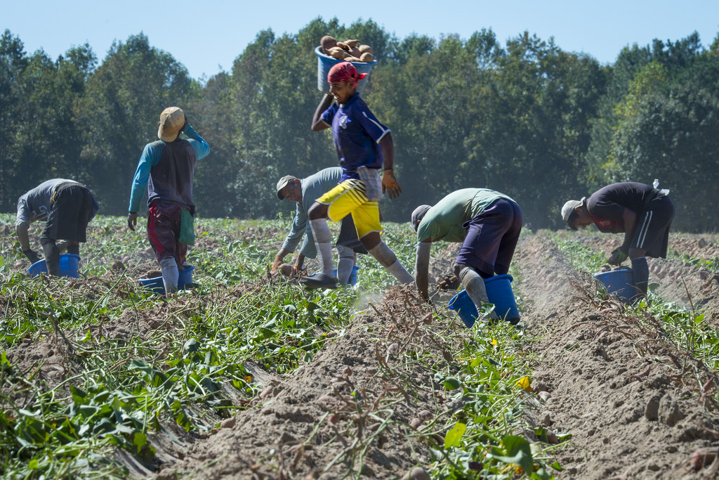
Resilience
Based on these definitions, how do you see resilience displayed by the migratory students you serve?
www.osymigrant.org
Notes:
Ask the participants to share examples from their own experiences with migratory students.

Slide 5
Resilience
Help Students Think Resilience!
Embrace Challenges – Resilient people view a difficulty as a challenge, not as a paralyzing event.
Commitment – Resilient people are committed to their lives and their goals, and they have a compelling reason to get out of bed in the morning.
Personal Control – Resilient people spend their time and energy focusing on situations and events that they have control over.
www.osymigrant.org
Notes:
Resilient people look at their failures, mistakes, or tragedies as lessons to be learned and as opportunities for growth.
They don't view them as a negative reflection on themselves, their abilities, or self-worth.
What does this mean for the students with whom we work?
Their commitments should not be solely restricted to their work – resilient people commit to their relationships, their friendships, the causes they care about, and their religious or spiritual beliefs.
Those who put their efforts where they can have the most impact feel empowered and confident. While those who spend time worrying about uncontrollable events often feel lost, helpless, and powerless to take action.

Slide 6
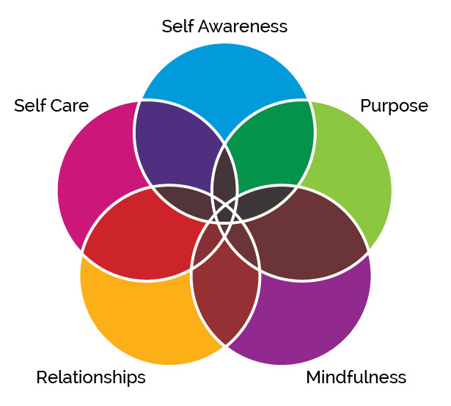
Resilience
Pillars that
Build Resilience
www.osymigrant.org
Notes:
There are many ways to support and strengthen our students’ abilities to become more resilient. Focusing activities on the following “pillars” will build a strong foundation for that growth:
Teach and practice self awareness – Help students have or develop a clear perception of their own personality and know who they are. Help them assess their strengths, weaknesses, thoughts, beliefs, motivation, and emotions. Keen self-analysis and awareness allows people to understand how they are perceived and how you can work together to strengthen or modify those perceptions.
Help students define their purpose and have confidence that they are here for a reason and that their efforts make a difference. This comes from using their strengths to support their vision in all aspects of their lives, from work to relationships to future goals.
Help students become mindful. This is the invaluable ability to intentionally focus on the present moment without judgment. It includes the practice of regulating one’s attention “with an attitude of curiosity, openness, and acceptance.” It helps students calm and soothe themselves by shifting focus from the effects of stress to the present moment. (Mindfulness is addressed in detail in Module 5.)
Relationships are the vital support that every human needs. Healthy relationships make all the difference in experiencing and overcoming everything from minor challenges to intense trauma. Help students focus on healthy relationships and making each relationship better.
Help students recognize that that taking care of themselves is, in fact, a gift to others. It’s only when we balance our own personal wellness with the needs of others that we can fully give support to those around us. (This concept is more fully addressed in Module 6.)
To increase your capacity for resilience to weather and grow from difficulties or stresses, focus on these pillars. Be sure to focus on your strengths and then identify weaknesses that you want to work on.
Bouncebackproject.org

Slide 7
Resilience
Strategies to Increase Resilience
Build Connections
Foster Wellness
Find Purpose
Embrace Healthy Thoughts
www.osymigrant.org
Notes:
The following slides will highlight four strategies for increasing resilience.

Slide 8
Resilience
Strategy 1: Help Students Build Connections
Prioritize relationships
Connect with empathetic, trustworthy people who support you and your vision.
Join groups
Being active in something you care about focuses on HOPE for the future.
www.osymigrant.org
Notes:
Strategy 1 -
Relationships: One of the most profound experiences we all have in our lives is our connections with other human beings. They’re the people who support and care for us — and we care for them. Positive and supportive relationships help us feel healthier, happier, and more fulfilled and satisfied with our lives. Urge students to identify and assess their relationships and determine how they can strengthen those relationships and build new ones.
Help students identify interests and groups that can support those interests. Social opportunities, even education-based opportunities, provide hope for the future.

Slide 9
Resilience
Strategy 2: Foster Wellness
Take care of your body
Practice mindfulness
Avoid negative outlets
www.osymigrant.org
Notes:
Strategy 2: Foster Wellness
In its simplest form, self-care refers to our ability to function effectively in the world while meeting the multiple challenges of life with a sense of energy, vitality, and confidence. It means prioritizing ourselves and creating a healthy balance between physical, emotional, and work/life balance.
Self-care is initiated and maintained by us as individuals and requires active engagement.
Self-care sounds like a buzzword, but our students need to know that stress is just as much physical as it is emotional. Work with students to encourage physical lifestyle factors like proper nutrition, ample sleep, hydration, and regular exercise. Anything they can do to strengthen their bodies will help them adapt to stress and reduce the toll of stressful emotions like anxiety or depression.
Mindfulness is a state of active, open attention to the present. It is living in the moment and being open to new experiences.
It’s not thinking ahead about the “what if”s of life, and it’s not dwelling on the past and what used to be or what could have been.
Helpful mindfulness activities include journaling, yoga, or meditation.
Help students develop skills to manage stress instead of trying to eliminate those negative feelings.
It’s all too easy to self-medicate with alcohol, drugs, or other substances. Help them build skills and resist the urge.

Slide 10
Resilience
Strategy 3: Help Students Find Purpose
Help others
Be proactive
Move toward your goals
Look for opportunities for self-discovery
www.osymigrant.org
Notes:
Strategy 3:
There are many different ways in general to find purpose, but be mindful about how migratory students specifically can find purpose.
Can they better connect with or help other migratory students?
Can they support each other in new endeavors that will help them learn more about themselves and their goals?
Encourage students to be proactive by asking, “What can I do about this problem in my life?”
If the problem seems too big, help them break it down into manageable pieces.
Help each student develop goals and a plan to consistently make choices that move them toward those goals.
Encourage students to look for and use opportunities to grow.

Slide 11
Resilience
Strategy 4: Help Students Embrace Healthy Thoughts
No one is helpless - use your strengths
Focus energy on all that you can alter or control
Focus on positive change
Move toward your goals
www.osymigrant.org
Notes:
Strategy 4:
It is easy to revert to thinking about “What if?” when faced with difficult challenges.
Instead, help students work on accepting the current circumstances as they are at the moment and remind them that they are not helpless. Help them call on all of their strengths to identify and respond to challenges that they can control. Change is a part of everyone’s life.
Help students learn to visualize what they want and develop strategies that can help them move toward those goals that are within their control..
And above all, encourage them to seek help when needed. The strategies we’ve covered will help, but if they get stuck or need help making progress, professional help from someone like a coach, a counselor, or a support group may be exactly the boost that they need.

Slide 12
Resilience
Why is Resilience Important for Migratory Families?
Higher resilience contributes to:
reduced risk-taking behaviors (excessive drinking, smoking, drugs)
lower absences from school/work due to illness
lower rate of mortality and increased physical health overall
improved learning and academic achievement
more involvement in community and family activities
www.osymigrant.org
Notes:
Resilience does not eliminate stress or erase life's difficulties.
And most certainly people who possess resilience don’t see life through rose-colored lenses.
Instead, they understand that setbacks happen and that life can at times be hard and painful.
They still experience the emotional pain, grief, and sense of loss that comes following a loss or a tragedy, but their mental outlook allows them to work through such feelings and bounce back a little more quickly than others.

Slide 13
Resilience
Factors That Support Resilience
Personal strengths
Realistic planning
Communication/problem-solving skills
Attitude – no victims allowed
High emotional intelligence – ability to manage
impulses and emotions
www.osymigrant.org
Notes:
Strengths - knowing and utilizing personal strengths and abilities
Planning - having a thought-out realistic plan and the where-with-all to stick to it
Communication and problem-solving skills – knowing how to express what one both wants and needs when faced with a challenge
In control - viewing themselves as fighters rather than victims
High emotional intelligence - managing impulses and emotions effectively

Slide 14
Resilience
www.osymigrant.org
Notes:
Encourage each student to:
1. Accept change. Help students find ways to become more comfortable with change.
2. Learn continuously. Encourage students to learn new skills, gain new understandings, and apply them during times of change.
3. Take charge. Help students embrace self-empowerment. Encourage them to take charge of their own futures and develop new understandings and apply them during times of change.
4. Define purpose. Help students develop a “personal why” that gives their life meaning and helps them put it into a larger context.
5. Create balance. Help students form their identity apart from their job as a migratory worker.
6. Cultivate relationships. Help students develop a plan to nurture a broad network of relationships.
7. Reflection fosters learning, new perspectives, and a degree of self-awareness that can enhance resilience. Help students routinely reflect on their feelings, their hopes, and dreams.
8. Reframe skills. Help students define themselves and their skills. It may give them new paths to consider as they work to meet their goals.

Slide 15
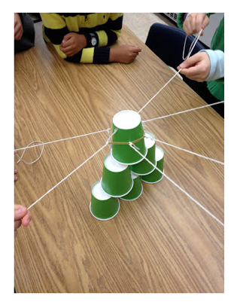
Resilience
ACTIVITY: Teamwork Cup Stack
Objective:
Engage in teamwork and communication activity to learn about individual and collective resilience.
www.osymigrant.org
Notes:
Divide into groups of six.
Tie six equally spaced strings (about 1-2 feet long) around a single rubber band and give each group the string/rubber band device and six paper cups.
Challenge the group to build a pyramid out of the paper cups (three on the bottom, two in the middle, one on the top).
**Group members cannot touch the cups with their hands or any other part of their bodies, even if a cup falls over or on the floor. Each person holds onto one of the strings that are attached to the rubber band and they use this device to pick up the cups and place them on top of each other (by pulling the rubber band apart and then bringing it back together over the cups).
Discuss the experience with a focus on connections, teamwork, and what participants learned about themselves.
Was anyone frustrated at all during the activity? If so, how was it handled?
What did you learn about yourself or others?
Why was teamwork so important for this activity?
What is so hard about teamwork?
What did you do today to contribute to the teamwork on your team?
What are some skills needed to be good at teamwork?
Are you ever in a situation where you must use teamwork? Is this always easy for you? Why or why not?
How can we use what we learned through this experience in situations outside the game?

Slide 16
Resilience
Let’s Learn and Teach Resilience
Authenticity - show up as your real self
Manage stress and avoid burnout
Manage change and setbacks
Engage respectfully with others by communicating supportively and being an effective listener
www.osymigrant.org
Notes:
As you can see from the next three slides, there are lots of ways to practice building resilience.
This module provides a lot of opportunities to learn about resilience and strategies that can help us improve our resilience, but it is also designed to help us focus on teaching these strategies to migratory students. Be sure to support their efforts in building resilience; each individual’s journey will be different. However, the lesson remains the same. We all need to be true to ourselves, take care of ourselves, and treat each other with equal respect.

Slide 17
Resilience
Let’s Learn And Teach Resilience
Facilitate another person’s success with guidance, recognition, and support
Build trust
Seek support to help you build positivity
Have moments of play
Stay inspired
www.osymigrant.org
Notes:
Remind yourself and your students often:
-positive relationship are established by focusing on others and building up trust with them
-part of self-care is enjoying life and finding new ways to be inspired

Slide 18
Resilience
Let’s Learn and Teach Resilience
Develop quality relationships
Spend face-to-face time with loved ones
Practice gratitude daily
Gain perspective by stepping out of your own box
Reframe your thoughts (positive mindset)
Focus on what you can control – take small steps
www.osymigrant.org
Notes:
Don’t underestimate how important it is to practice these ways to resilience on a daily basis.
Focusing on what you can control helps you build and maintain a positive mindset.

Slide 19
Resilience
ACTIVITY:
Nicholson McBride Resilience Questionnaire (NMRQ).
Resilience Questionnaire | Score
1. In a difficult spot, I turn at once to what can be done to put things right.
2. I influence where I can, rather than worrying about what I cannot influence.
3. I do not take criticism personally.
4. I generally manage to keep things in perspective.
5. I am calm in a crisis.
6. I am good at finding solutions to problems.
7. I would not describe myself as an anxious person.
8. I do not tend to avoid conflict.
9. I try to control events rather than being a victim of circumstances.
10. I trust my intuition.
11. I manage my stress levels well.
12. I feel confident and secure in my position.
TOTAL
Objective:
Assess current level of resilience and quickly identify tips to increase resilience.
www.osymigrant.org
Notes:
Pass out a copy of the abbreviated Nicholson McBride Resilience Questionnaire for each participant to take.
Use the worksheet to assess resilience score, set a goal to increase score, and identify strategies to support goals.
Have participants discuss the results in their table groups.
Discuss:
What did you learn?
Were there any surprises?
How would you use this assessment with students?

Slide 20
Resilience
10 Steps to Resilience
1. Visualize success
2. Boost your self-esteem
3. Enhance your efficacy, take control
4. Become more optimistic
5. Manage stress
6. Improve decision-making
7. Ask for help
8. Deal with conflict
9. Learn
10. Be yourself
www.osymigrant.org
Notes:
The following 10 steps will help you become more resilient.
1. Visualize success
2. Boost your self – esteem
3. Enhance your efficacy, take control
4. Become more optimistic
5. Manage stress
6. Improve decision – making
7. Ask for help
8. Deal with conflict
9. Learn
10. Be yourself

Slide 21
Resilience
ACTIVITY:
Challenge Your Brain to Think in Different Ways
Do not read the words… rather say the colors of the following words. For example, if the word BLUE is printed in a red color, you should say RED.
Say the colors as fast as you can.
It is not as easy as you think… Ready?
Red
Blue
Yellow
www.osymigrant.org
Notes:
Sometimes the key to improving our own resilience is to challenge our brains to think in new and different ways. After all, while it’s easy to say become more optimistic, our brains don’t always listen to the instruction and automatically respond. Instead, we have to train our brains to become more optimistic over a period of time. It may not be our natural way of thinking, but we can change the way our brains react and respond to new concepts.
Objectives:
Engage in activities that challenge the brain to think in different ways.
Expand knowledge of how minds work and understand how brains can be trained to think in new ways.

Slide 22
Resilience
State the color of each word.
The words are in the corresponding color.
Blue
Yellow
Red
Purple
Black
www.osymigrant.org
Notes:
Have the participants state the color of each word in the first graphic—in which the color and the word correspond.

Slide 23
Resilience
Now try stating the color of each word.
The words are NOT in the corresponding color.
Blue
Yellow
Red
Purple
Black
www.osymigrant.org
Notes:
Next have participants state the color of each word in the second graphic—in which the colors and the words do not correspond.
Discuss:
How did you feel?
Was this confusing for you?
Was it frustrating?

Slide 24
Resilience
Tree of Resilience
Take a moment and draw:
Roots- current risk and protective factors
Trunk- existing belief system
Branches- present support system
Leaves- personal strengths
Fruit- small moments of joy
Flowers- hopes for the future
www.osymigrant.org
Notes:
Objective:
Provide participants with a visual tool for considering and accessing assets. Identified assets can be used to assist participants during times of challenge and enhance successes.
Steps:
Pass out the Resilience Tree handout and have participants draw their own tree after explaining the following:
Roots: Roots are your foundation, representative of the present and influenced by your past. Consider the risk and protective factors that are present in your life currently and when you were younger. These may include external risk and protective factors such as neighborhood, family support and communication, faith, expectations, other adult relationships, and environmental factors. Consider your current physical and mental health, the health of family, family dynamics, faith, expectations, hobbies, your home, etc. These risk and protective factors often represent situations that have shaped our identity, highlight ways in which we have bounced back and moved forward after adversity, and are important considerations for self-awareness.
Trunk: The trunk of the tree represents your belief system, the personal “code” by which you live. This may be a phrase, a set of values or beliefs, faith, or spirituality that you rely on for support and guidance. Values, faith, etc. are strengths that can increase feelings of autonomy, self-efficacy, safety, and security.
Branches: Branches signify your support system/your team. Consider who your strong supporters are, the people providing you with support and care and those you care and support. Your support system may be a combination of people inside and outside your home. You are invited to create many branches. Strong social support is a protective factor for overcoming adversity and increases overall well-being.
Leaves: Leaves represent your strengths, your skills, and assets. Your leaves are skills and talents and internal assets such as humor, positive decision making, sense of purpose, hopefulness, and kindness. Assets are often positive coping techniques or strategies for navigating life. Utilizing assets that have worked in the past may be effective when applied to new situations and challenges.
Fruit: Fruit on your resilience tree signifies the things that bring you joy. Your fruit might be small pleasures and fun things you might be curious to try, in addition to other sources of joy. Practicing gratitude and identifying things that create pleasure may enhance and increase resilience.
Flowers: Flowers represent hopes and dreams for the future. Your flowers may be goals, wishes, aspirations, or something to which you are looking forward. Identifying positive conditions for the future may increase the ability to cope with and grow through adversity.
Discuss:
What did you learn about yourself?
How would you use this in the future when you face adversity?
How would you use with your students?

Slide 25
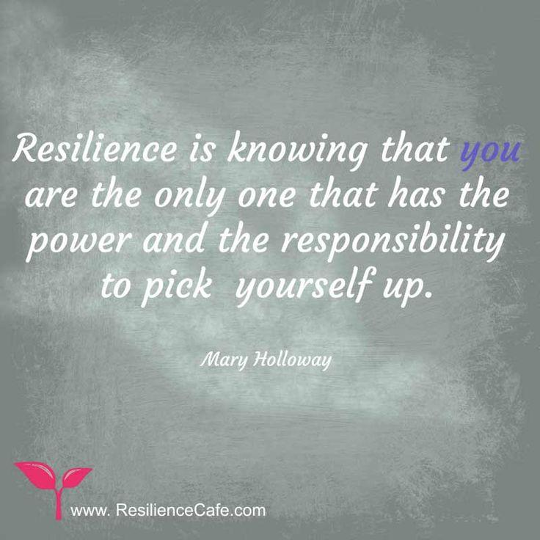
Resilience
You can improve your resilience!
www.osymigrant.org
Notes:
Remember:
Self awareness
Mindfulness
Self care
Positive relationships
Purpose

Slide 26
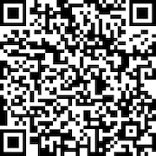
Resilience
Please use the link to fill out an evaluation. Thank you!
www.osymigrant.org
Notes:
We appreciate your time and attention to this presentation about the importance of ACEs in the lives of migratory students. Your honest feedback is vital to our focus and efforts as iSOSY continues to move forward in the area of personal wellness and mental health. Please take just a moment to use the QR code on the screen to access a brief evaluation. Thank you.

Slide 27
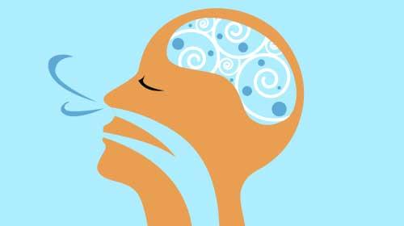
Resilience
Presenter name
Email
Phone
www.osymigrant.org
Notes:
Thank you so much for your time and attention. Any questions/comments?

