Slide 1
Introduction to Mapping with Google Platforms
Presented by South Carolina MEP
IRRC TST Meeting
January 2017

Slide 2
Mapping with Google Earth
Demonstrate basics of Google Earth
Why maps?
How they can appear
Practical applications
Hands on Mapping Points of Interest and Importing Data
Break out 1: Practice in Groups
Converting maps onto a GPS
Discuss other platforms for mapping
Review of Resources

Slide 3
Why should we utilize mapping for ID&R?
Compliance with the Non-Reg Guidance and OME Monitoring Instrument:
Chapter III, (A4): “In implementing an active statewide ID&R process, the SEA should: Implement a formal process to map all of the areas within the State where migrant families are likely to reside.”
Organization, New Recruiters/Seasonal Turn-over
You might think, “I already know my region!!”- OK, but what happens when you are gone?

Slide 4
What can maps look like? What can you do?
https://drive.google.com/open?id=1an0VQH_3wuRUmpe-lE6iBteQP4o&usp=sharing

Slide 5
Adding Folders
You will need a new folder for every area you are identifying (town,region,center, etc.)
After creating a new folder, always save it to my places. Files not saved here will be in your temporary places and be lost when closing out program.
* You may move these sub-folders to your desired region

Slide 6
Points of Interest (POI)
Type in address you are looking for and hit search/enter.
You may also type in key words such as “fruit farms in Athens,GA”. *By inserting the word farm, you will need to ignore businesses with the word containing farm; such as State Farm.

Slide 7
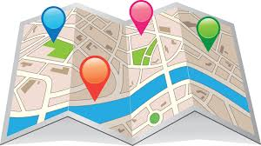
Pinpointing POIs
Once the address is inserted, it will pinpoint to where the place is via satellite view.
Click on the yellow thumbtack in the tool bar above.
Name the location according to the farm list/directory. In this section, you are also able to include any links,images and details about the location.

Slide 9
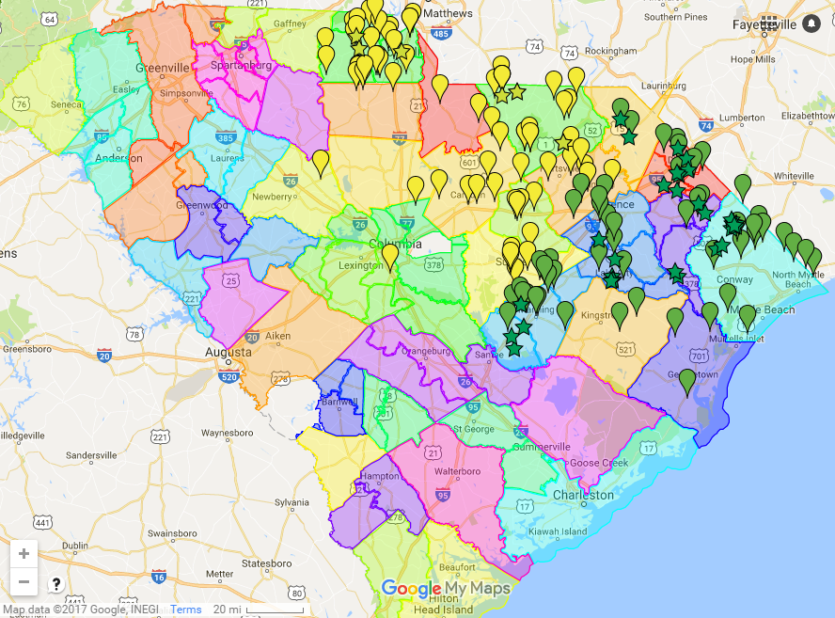
Pinpointing Tacks
Under styles you can also color code each region to show the different areas such as type of farm, region itself, or school district, etc.
Under description, you can also insert any key notes or even the exact address for future use.

Slide 10
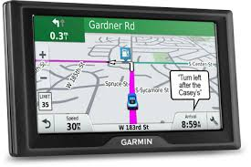
Importing to a Garmin GPS
Under the new folders you have created, right click and save place as
- This file should be a kmz file not a a kml
Prior to importing it to the GPS, Save it to desktop so they are easier to locate.

Slide 11
Converting to a GPX file
Go to http://www.gpsvisualizer.com
In the green box, select the file you are wanting to convert. Next in the drop box below, drag down to GPX file and then select convert it.
Download the newly created GPX file and save it to your hard drive.
Connect your GPS to your computer using a USB cord.
Send the file to your GPS. This file will be found in your favorites section of the GPS.

Slide 13
Google Earth and Smart Phones

Slide 14
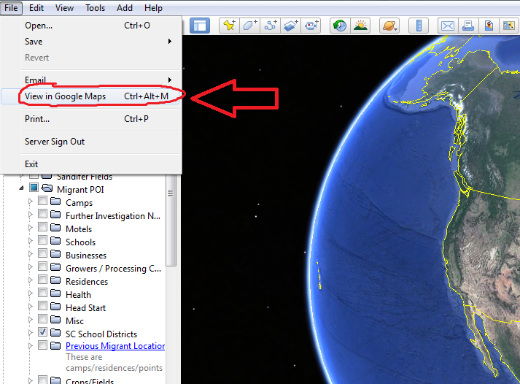
Google Maps
Once you have the files developed in Google Earth, you will also be able view them in Google Maps.
You will be able to invite parties via email to view the map on their smartphone/computer in the Google Maps app.

Slide 15
Heads Up
1
2
3
4
5

Slide 16
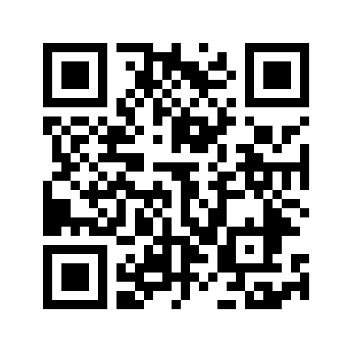
Contact Info/ Resources
Travis Williamson
Twilliamson@ed.sc.gov
803-394-8478
315-842-0980
Zach Taylor
Ztaylor@ed.sc.gov
803-391-9393
843-592-8782
All Resources & Powerpoint File Available HERE!
http://padlet.com/stateidr/gososychicago

