Slide 1
iSOSY Personal Wellness
Trauma
Presenter, title, organization
www.osymigrant.org
Notes:
This framework for understanding trauma was developed by a working group of researchers, practitioners, trauma survivors, and family members convened by Substance Abuse and Mental Health Services Administration (SAMHSA). It is important because it offers a way to understand the complex nature of trauma. Some people prefer to use a simple definition of trauma like “trauma is anything that overwhelms a person’s ability to cope”.
It’s fine to use a shorthand definition like this for ease of communication.

Slide 2
Trauma
“Individual trauma results from an event,
series of events, or set of circumstances that is experienced by an individual as physically or emotionally harmful or life threatening and that has lasting adverse effects on the individual’s functioning and mental, physical, social, emotional, or spiritual well-being.”
Substance Abuse and Mental Health Services Administration (SAMHSA)
www.osymigrant.org
Notes:
Read the quote aloud.

Slide 3
Trauma
Today you will learn to:
Understand the short-term and long-term effects of trauma.
Understand the different types of trauma.
Understand the importance of trauma-informed care.
www.osymigrant.org
Notes:
The objectives of this module are:
Understand the short-term and long-term effects of trauma.
Understand the different types of trauma.
Understand the importance of trauma-informed care

Slide 4
Trauma
Lifelong Impact
of
ACEs
www.osymigrant.org
Notes:
Trauma, especially when it occurs in childhood, has lasting lifelong impact.
Early childhood and adolescence are critical times for human brain development.
Short periods of low-level stress are a normal and healthy part of growing up, but chronic and severe stress during childhood can be toxic to the developing brain.
You are likely familiar with the Adverse Childhood Experience (ACEs) study that measures childhood exposure to abuse, neglect, and household dysfunction.
As exposure to ACEs-related toxic stress increases, so does the risk of a wide variety of outcomes with long-term negative effects, including some you might not always think about being related to trauma:
Depression
Obesity
Alcohol or drug abuse
Chronic obstructive pulmonary disease (COPD)
Smoking
Heart disease

Slide 5
Trauma
Trauma-informed care shifts the focus from:
What happened to you?
to
What is wrong with you?
www.osymigrant.org
Notes:
Learning more about trauma includes making a major shift in language and thinking.
Trauma-informed care helps individuals learn resilience and reclaim their lives by underscoring that they are not at fault for the trauma.
Current trauma-informed care thinking focuses on asking, “What happened to you?”
This is in contrast to a traditional question that places blame, “What’s wrong with you?
The focus on events that occurred places the emphasis on the environment, not on some defect of the individual who was affected.
This important principle underlies the basic credo of trauma-informed approaches: “It’s not what’s wrong with you, but what happened to you.”

Slide 6
Trauma
Trauma
Definition: 3 Es
Events
Experiences
Effects
www.osymigrant.org
Notes:
Individual trauma results from an event, series of events, or set of circumstances that are experienced by an individual as overwhelming or life-changing and that has profound effects on the individuals’ psychological development or well-being.
Trauma is when we have encountered an out-of-control, frightening experience that has disconnected us from all sense of resourcefulness, safety, coping, or love.
It’s important to realize that we can all experience the same event, but that some will experience it so profoundly that their brain literally changes.Under stress, a brain goes to “fight, flight, or freeze mode” and the ability to respond, learn, and process is severely compromised.
The effects of trauma may be likened to “the elephant in the room.” Think of what can be pent up inside of people who have been traumatized: anger, fear, defiance, guilt, shame, mistrust, grief, aggression, low self-esteem… and the list goes on.
When trauma is experienced in childhood, there are few tools to use and rely on. Children go into survival mode.
When they are in survival mode or under chronic stress, symptoms often make it hard for them to think in any logical way, to remember things, or learn any kind of new information.
Think about what that means for education.
It literally becomes the elephant in the room. You may not actually see it, but you know that it’s there!
What are they thinking? Who did they bring into the room this morning? Is it their parents – who had a huge argument last night? Is it their grandma who is sick and perhaps dying? Is it their friend who suddenly turned on them and started bullying them for no apparent reason? It’s a huge task to always consider who is in the room with the student or family with whom you’re working. But the ability to consider what each student is carrying holds many keys to understanding behaviors and offering appropriate trauma-informed responses.

Slide 7
Trauma
Types of Trauma
Acute/single, isolated event
Chronic/repeated and prolonged
Complex
Historical and Racial
www.osymigrant.org
Notes:
Discuss examples of the different types of trauma:
1. Acute – accident / natural disaster / single act of violence or terrorism / sudden unexpected loss
2. Chronic – traumatic experiences that are repeated and prolonged / prolonged family or community violence / long-term illness / chronic bullying / chronic poverty and related stressors / exposure to war, torture or force displacement
3. Complex – early age trauma / physical or sexual abuse / neglect / witnessing domestic violence
4. Historical & Racial – systemic oppression of population groups across generations / racism / discrimination / harassment

Slide 8
Trauma
Migratory Students:
Cultural, Historical, and Gender Issues
Context of learning
Education disruption
Language barriers
Family disruption
Balancing work, home life, and schools
Acculturation
Other including family separation/social status/discrimination
www.osymigrant.org
Notes:
Historical & Racial trauma is obviously at play with our migratory student population.
This level of exposure to trauma often leads to several issues that affect education and career paths.

Slide 9
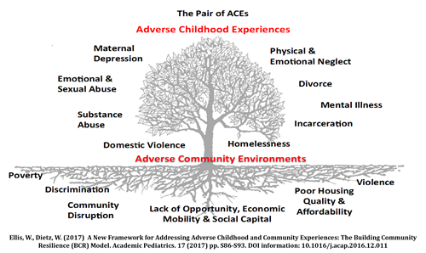
Trauma
www.osymigrant.org
Notes:
Adversity within a family and adversity within a community can create a double impact. The leaves on the tree represent the ‘symptoms’ of ACEs that are usually recognized in clinical, educational and social service settings.
When the tree is planted in poor soil that is steeped in systemic inequities, it’s robbed of vital nutrients necessary to support a thriving community.
Adverse community environments such as a lack of affordable and safe housing, community violence, systemic discrimination, and limited access to social and economic mobility compound one another, creating a negative cycle of ever worsening soil that results in withering leaves on the tree.
That’s why it’s important to think holistically and build a sense of community and coalitions that work together to support children and families.

Slide 10
Trauma
Why Trauma-Informed Care for Students?
“Trauma affects the way people approach all relationships, even those that may be helpful. These same ways of coping may make it more difficult for survivors to feel the safety and trust necessary to form helpful relationships.”
Be patient
Be compassionate
Listen / Build connections
www.osymigrant.org
Notes:
For survivors of trauma, building relationships may be very difficult.
Survivors do not trust easily and may have a difficult time building – and maintaining - any type of relationship.
Being vigilant and suspicious are often important and understandable self-protective mechanisms in coping with trauma exposure.
It is very important to listen and build connection – no matter how long it takes.
You might be the only person with whom they feel comfortable.
You don’t have to be an expert – just someone who cares and listens.
This point is reiterated to help you to remember that doing something is better than doing nothing.
Be compassionate.
https://www.healthcare.uiowa.edu/icmh/documents/CCTICSelf-AssessmentandPlanningProtocol0709.pdf

Slide 11
Trauma
Trauma-Informed Care
and Organizational Approach
“An organizational approach to trauma means recognizing the signs and symptoms of trauma and responding by fully integrating knowledge about trauma into policies, professional learning, procedures and practices. The goals of trauma-informed care are to recognize the presence and onset of trauma, resist the recurrence of trauma, and promote resiliency tailored to each individual’s culture.”
www.osymigrant.org
Notes:
An individual approach – working one-on-one with students – is important, but an organizational approach yields more benefits and helps all staff learn to build skills and lay a consistent foundation for all students.
How to do that?
Learn about trauma.
Assess what it means within the framework of your program.
Resist / minimize recurrence.
Promote resilience.
Trauma-informed care is all about collaboration, building relationships, and understanding.
We can provide trauma-informed care by educating ourselves, listening, and offering safe spaces, to name just a few best practices.
Are there other ways of offering trauma-informed care to students and families?

Slide 12
Trauma
Supporting Students: Impact of Trauma
Physical symptoms such as headaches, stomachaches, poor appetite, and decline in self-care
Intense feelings of fear, anxiety, and concern for their safety
Difficulty identifying how they are feeling and controlling their emotional reactions
Angry or aggressive outbursts
A desire to withdraw from peers and adults
A tendency to engage in risk-taking behaviors
Trouble trusting adults and peers, reading social cues, and building relationships
www.osymigrant.org
Notes:
In these days of COVID isolation, there may be more trauma occurring than ever before.
Things are very different during the pandemic, so it is important to monitor and re-consider habits and ways of work.
While you can’t always control your environment, trauma-informed care offers basic principles that are beneficial for all of your work.
Whether in-person or virtual, it is more important than ever to check in with those with whom you work with and those you serve.
You can help create for them a safe, calm, and secure environment with support (physical safety / psychological safety).

Slide 13
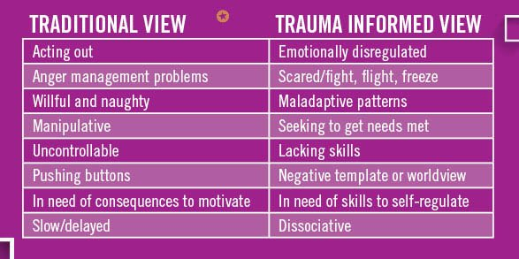
Trauma
www.osymigrant.org
Notes:
It is extremely common to fall back on our traditional instincts and observations.
Here is an example of how a trauma-informed approach to a troubled student can look.
By changing our language, we are able to view situations differently - therefore empowering a student instead of victimizing them.
A trauma-informed view provides a path to help students develop skills to consistently view behaviors through a different lens.

Slide 14
Trauma
Demonstrate
Trauma-
Informed
Care
www.osymigrant.org
Notes:
What does trauma-informed care look like?
Very simply, it’s all about relationships.
Healing happens in relationships.
Often we must work hard to understand where the other person is coming from.
Promote safety.
Really listen and validate what people say.
Earn their trust. (This can take time. Be patient and be consistent.)
Embrace diversity. We are all different and unique in who we are and how we think. We process things in our own way in our own time. Take time to learn about the individual you’re working with and appreciate their views.
Holistic Care is important to understand and will help to understand the whole person, their mind/body/spirit, as well as their environment.
Respect their rights as a person by giving them a safe space to express and explain their ideals.
Pursue the person’s strengths and autonomy. Find what makes them happy. Focus on the positive, not the negative or their past history.
Remind them, “We are in this together” “You know more about your life than anyone.” “I’m here to help and support you.”
Communicate with compassion, understanding that verbal and non-verbal cues are important.

Slide 15
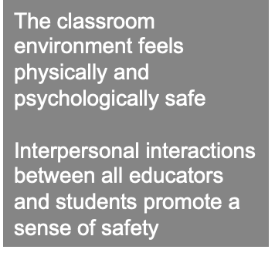
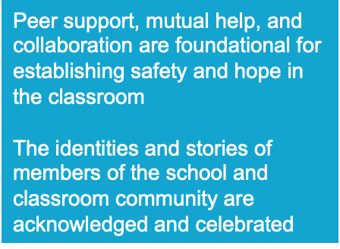
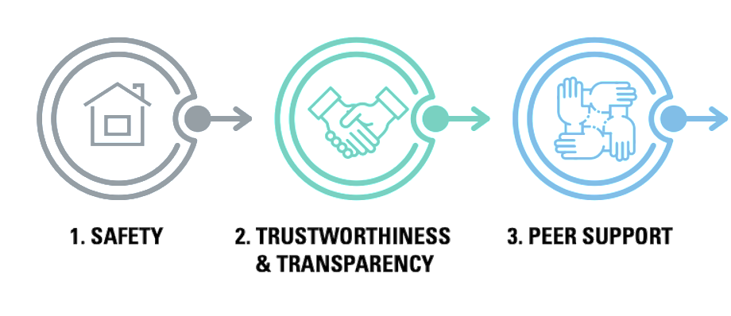
Trauma
CDC’s Six Guiding Principles to a Trauma-Informed Approach
www.osymigrant.org
Notes:
These are the core principles of trauma informed care. As you see, you don’t have to be a specialist in this field to be a helper. Try to remember these key principles when working with families and students.
Safety: Understanding safety as defined by those served is a high priority.
Trustworthiness and Transparency is vital at every level of operations:
The goals of building and maintaining trust must be considered at every level, whether working with students, family members, among staff and colleagues, and others involved in your work.
Peer/Family Support: Peer support and mutual self-help are key vehicles for establishing safety and hope. Both peer and family supports have unique – extremely powerful – influence in everyone’s life. Remember: Peer and family supports can be positive – or negative – always lead with strong, positive influences that can help build trust.

Slide 16
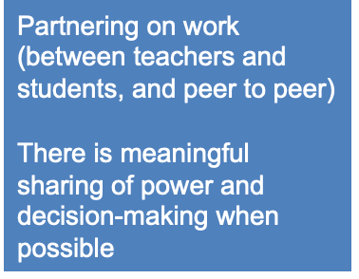
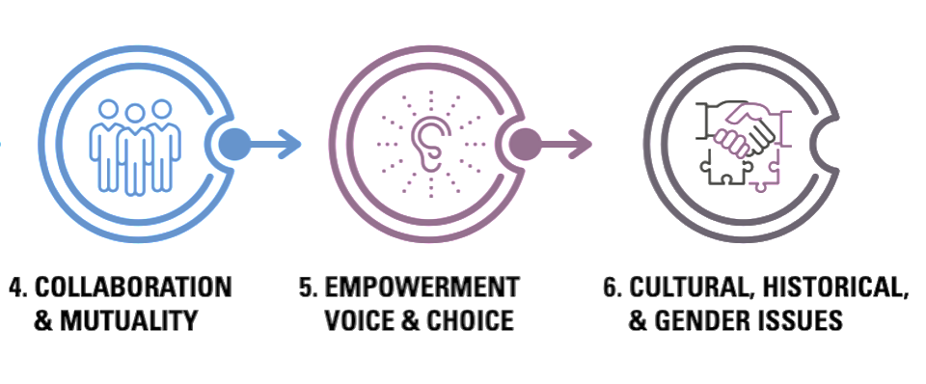
Trauma
CDC’s Six Guiding Principles to a Trauma-Informed Approach
www.osymigrant.org
Notes:
To build trust, ensure that you are working to enhance collaboration. Whenever possible utilize their stories and their own lived experience to support individuals and promote recovery and healing.
Collaboration and Mutuality:
Everyone has a role to play in a trauma-informed approach. As one expert stated: “one does not have to be a therapist to be therapeutic.” That’s good! Since we are not therapists, we simply need to approach individuals with the goal of listening and developing relationships that can be trusted.
Empowerment, Voice and Choice
Trauma-informed care ensures that individuals and families are supported in shared decision-making, choice, and goal setting to determine their own plan of action that will help them heal and move forward. In many cases, they must be taught self-advocacy skills, then encouraged and supported as they learn to use them.
Cultural, Historical, and Gender Issues:
Implementing TIC means that individuals and organization must actively move past cultural stereotypes and biases that are often based on race, ethnicity, sexual orientation, age, religion, gender-identity, geography or any other issues at hand.
https://www.cdc.gov/cpr/infographics/6_principles_trauma_info.htm

Slide 17
Trauma
Reflection
Think about the trauma-informed framework. What are some principles you would like to be more intentional about with your students?
www.osymigrant.org
Notes:
Ask the participants to offer:
Principles they already (even unintentionally) offer trauma-informed care with their students.
Principles they believe would be the most useful in their situations.
Stories – both successful and not successful – about trauma-affected students and trauma-informed care.

Slide 18
Trauma
A Trauma-Informed Approach (the 4 Rs):
1. Realizes the widespread impact of trauma and understands potential paths for recovery.
2. Recognizes the signs and symptoms of trauma in clients, families, staff, and others involved with the system.
3. Responds by fully integrating knowledge about trauma into policies, procedures, and practices.
4. Resists re-traumatization.
www.osymigrant.org
Notes:
SAMHSA Resource about Trauma and Trauma-Informed Care. Organizationally, you and your staff must: 1. Realize the widespread impact of trauma and understand potential paths for recovery.
2. Recognize the signs and symptoms of trauma in clients, families, staff, and others involved with the system.
3. Respond by fully integrating knowledge about trauma into policies, procedures, and practices.
4. Resist re-traumatization.
Reminders of the trauma can trigger trauma instantly.
Re-traumatization comes through our senses:
We see something or someone…
We hear something, whispers, taunts or an argument
We touch something / or someone touches us
We smell something that takes us back to the initial trauma… perfume, smoke, fruit
We taste something that reminds us of someone/something

Slide 19
Trauma
Supporting Staff, Students, and Families
Substance abuse
Mental health history in family
Parental characteristics including young age, education, single parenthood, large number of dependent children, low income
Nonbiological, transient caregivers in the home
Immigration issues/migratory status
Family support
Children with special needs that increase caregiver burden
www.osymigrant.org
Notes:
Know the risk factors of the students with whom you work:
(read three or four examples from the list)
Create relationships with students so they will feel safe discussing any/all of the risks involved in their lives.
Remember that these are hard discussions, and they will evolve along the way.
Be patient.

Slide 20
Trauma
The Challenge of Assumptions
We do not know what kinds of experiences students and families have had so we need to approach them in a sensitive manner.
Do not assume!
If we assume that their behavior or crisis is not related to trauma, then we miss a great opportunity to help.
If we assume trauma may be playing a role, then we begin to pay attention to signs of trauma and ask the right questions.
The steps we take to create a safe and trusting relationship and environment benefits everyone.
www.osymigrant.org
Notes:
Assuming things we think we know or don’t know can present harmful outcomes.
Not every individual will respond to the same trauma in the same way.
Something that may seem inconsequential to one person may be very devastating to another.
Conversely, a student who has experienced something that you see as horribly traumatic may be less affected than you assume.
You must allow the student to express how they feel instead of projecting your own ideas and assumptions.
National Council for Behavioral Health

Slide 21
Trauma
Tips for supporting those who have been traumatized:
Recognize those who may have been traumatized.
Let them know you believe in them and support their efforts.
Understand the meaning each student gives to their trauma from their own cultural perspective.
www.osymigrant.org
Notes:
Trauma-informed care boils down to a few key points:
Create a safe environment by building a relationship within which the student feels comfortable enough to share.
Listen, listen, listen. Your job is to give them a place to express their feelings without worry about judgment or assumptions.
Offer appropriate support. This may include simply the ability to talk to you whenever they feel the need, or it may include helping the student connect with the correct professional resources to address the effects of trauma in their lives.

Slide 22
Trauma
Remember!
Stressed brains cannot:
Respond
Learn
Process information and emotions effectively
Take time to breathe and reset.
www.osymigrant.org
Notes:
Remember that a tired, stressed, traumatized brain will not function properly.
While the brain is in stress mode, the major parts that are used for everyday functioning often shut down.
Take whatever time is needed to de-escalate and ground yourself so you can help others to do the same.

Slide 23
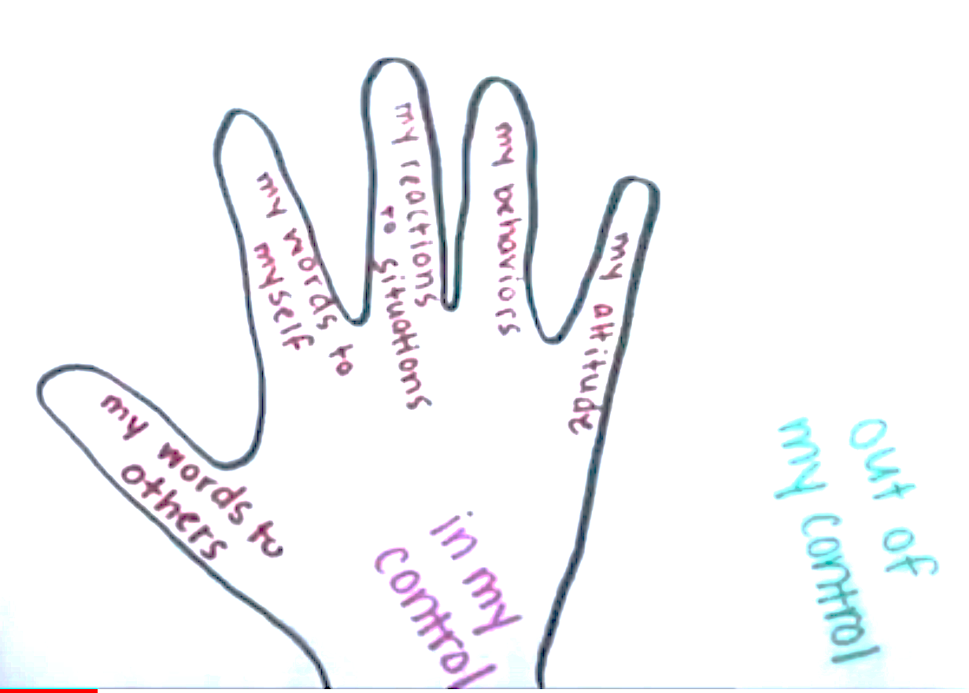
Trauma
ACTIVITY: In or Out of Control
Objective:
Help participants understand that they are not in control of, or responsible for, the behavior of others and must focus on what they can control.
www.osymigrant.org
Notes:
Help participants understand that they are not in control of, or responsible for, the behavior of others and must focus on what they can control. It is good to talk about both what is in and out of our control in order to help participants focus on positive outcomes instead of the trauma that they have suffered.
Watch the video for an example: https://youtu.be/nxacynVqWd8
Steps:
Pass out paper and writing utensils to all participants.
Participants begin by tracing their hands onto the paper.
On the inside of the hand write, “In my control.” On the outside of the hand write, “Out of my control.”
Guide participants to write or draw the things that are in their control on the inside of the hand. They could write things like my behavior, my thoughts, the words I choose to say, the words I choose to keep to myself, the way I react to others, etc. On the outside of the hand, they will write things that are not in their control. These could be things like my parent’s job, my parents’ divorce, the weather, my teacher’s voice, the lunch my peer brings to school, etc.
Discuss the following:
“The hand is an important visual reminder of control. If something is in our hands, we are in control of it. For a concrete example, if you are holding a wadded-up candy wrapper in your hand, you are in control of the wrapper. You can choose to hold the wrapper, roll it in your hands, toss it in the trash can, throw it at someone, etc. If something is not in your hand, you are not in control of it. If the candy wrapper is on a table across the room, you cannot control what happens with the candy wrapper.”
If you want to take it further, introduce a visualization in which the things they want to control, but are actually out of their control, are falling through their fingers. For example, if you have a participant who needs to relocate, they can create a visual representation of their impending move. Help the participant to create a narrative: “I cannot control my relocation. I CAN control my actions. I can choose to notice things that make me happy each day. I can control my actions.”
Trying to hold on to something tightly that is truly outside of their control can leave them feeling overwhelmed and exhausted. It is hard to hold on to something that we have no control over. Visualizing themselves opening their grasp and releasing whatever that thing is can be a powerful way to relinquish the tension and focus on the things that are actually within their control.
For example:
I can control my breathing.
I can control my thoughts.
I can control my words to myself.
I can control my words to others.
I can control my body.

Slide 24
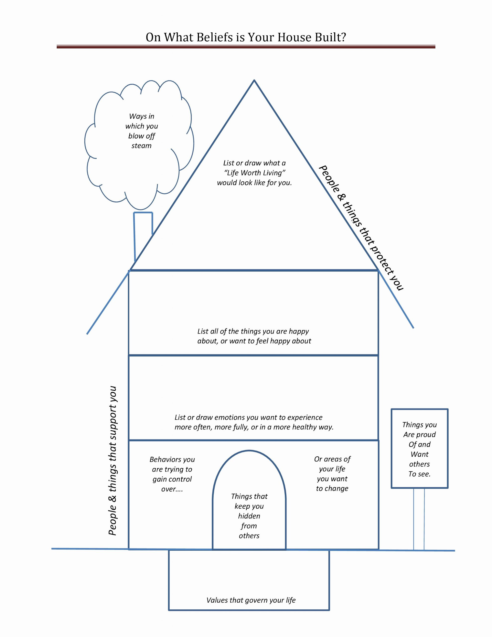
ACTIVITY:
House of Beliefs
Objective:
Recognize personal strengths, ways of coping, support systems, and values through this mindfulness activity.
Notes:
Objectives:
Recognize personal strengths, ways of coping, support systems, and values through this mindfulness activity.
Steps:
Pass out the House of Beliefs Worksheet and writing utensils to each participant.
Explain, “This is your house. There is no right or wrong way to make it. You can use the worksheet or draw your own four-story house. Be sure to include the chimney, welcome sign, and door.”
Ask participants to follow the instructions on the instruction page and add words, symbols, and pictures that describe the different parts of their life.

Slide 25
OBJECTIVE:
An iceberg is a powerful visual to help participants think about what it means to live "above the water line," and stop hiding who they really are.
ACTIVITY:
“If You Really Knew Me”
Notes:
Objective:
An iceberg is a powerful visual to help participants think about what it means to live "above the water line," and stop hiding who they really are.
This is a good relationship-building activity for participants and families.
Steps:
Ask participants to draw their own iceberg and write what other people see (top of the iceberg) and what they hide (bottom of the iceberg).
Provide time for participants to self-reflect.

Slide 26
Trauma
Show Up and Create a Culture.
“If we want people to fully show up, to bring their whole selves including their unarmored, whole hearts – so that we can innovate, solve problems, and serve people – we have to be vigilant about creating a culture in which people feel safe, seen, heard, and respected.”
-Brené Brown
www.osymigrant.org
Notes:
Set the stage. Reach out, engage, be positive, supportive, and work hard to make people feel safe. seen, heard. and respected.
Those basic needs are the foundation of strong, healthy relationships.
You can model behaviors that not only support those principles, but teach your students the skills needed to strengthen them as well.
Everyone benefits by practicing the skills needed to develop new relationships and improve old ones.
As Maya Angelou said, “I’ve learned that people will forget what you said, people will forget what you did, but they will never forget how you made them feel.”
Be energized in creating a safe, trauma-informed culture – one that is welcoming, healing, and empowering for all.

Slide 27
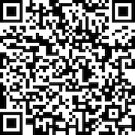
Trauma
Please use the link to fill out an evaluation. Thank you!
www.osymigrant.org
Notes:
We appreciate your time and attention to this presentation about the role of trauma in the lives of migratory students. Your honest feedback is vital to our focus and efforts as iSOSY continues to move forward in the area of personal wellness and mental health. Please take just a moment to use the QR code on the screen to access a brief evaluation. Thank you.

Slide 28
Trauma
Presenter name
Email
Phone
www.osymigrant.org
Notes:
Thank you so much for your time and attention. Any questions/comments?

