Slide 1
State Steering Team Meeting
October 16, 2019
Clearwater, FL
www.osymigrant.org

Slide 2
Member States
Alabama
Georgia
Illinois
Iowa
Kansas
Kentucky
Massachusetts
Mississippi
Nebraska
New Hampshire
New Jersey
New York
North Carolina
Pennsylvania
South Carolina
Tennessee
Vermont
www.osymigrant.org

Slide 3
Partner States
Alaska
Arkansas
California
Colorado
Idaho
Maryland
Minnesota
Missouri
Montana
Oregon
Washington
Wisconsin
www.osymigrant.org

Slide 4
Welcome and Introductions
Welcome and Introductions
Doug Boling, KS MEP Director,
GOSOSY Lead State
Special Guests:
Alysia Johnston, FSCC President
Janet Fancher, Vice President of Students
www.osymigrant.org

Slide 5
Agenda
Welcome and introductions (Doug Boline)
Overview of agenda and expectations for meeting
Discussion of TST Work Groups tasks, processes, and outcomes:
OSY Engagement and Relationship Building
Curriculum and Material Development
Goal Setting and OSY Learning Plans
Professional Development
Interstate Collaboration
Mental Health/Trauma
Preparing for College (Brenda Pessin)
Dissemination Event Evaluation follow up (Marty Jacobson)
Review of the Annual Performance Report results and outstanding data needs
Year 5 extension work items and changes to the FII
Year 5 changes to performance measures
Data collection for Year 5
State prompts and discussion
Budget
Future meeting dates/times

Slide 6
GOSOSY Updates
TST meeting– November 15-16
GOSOSY Fall 2019 Newsletter
GOSOSY Web Blasts: In the Field
Website Survey and Website Google Analytics
Website redesign
www.osymigrant.org

Slide 7
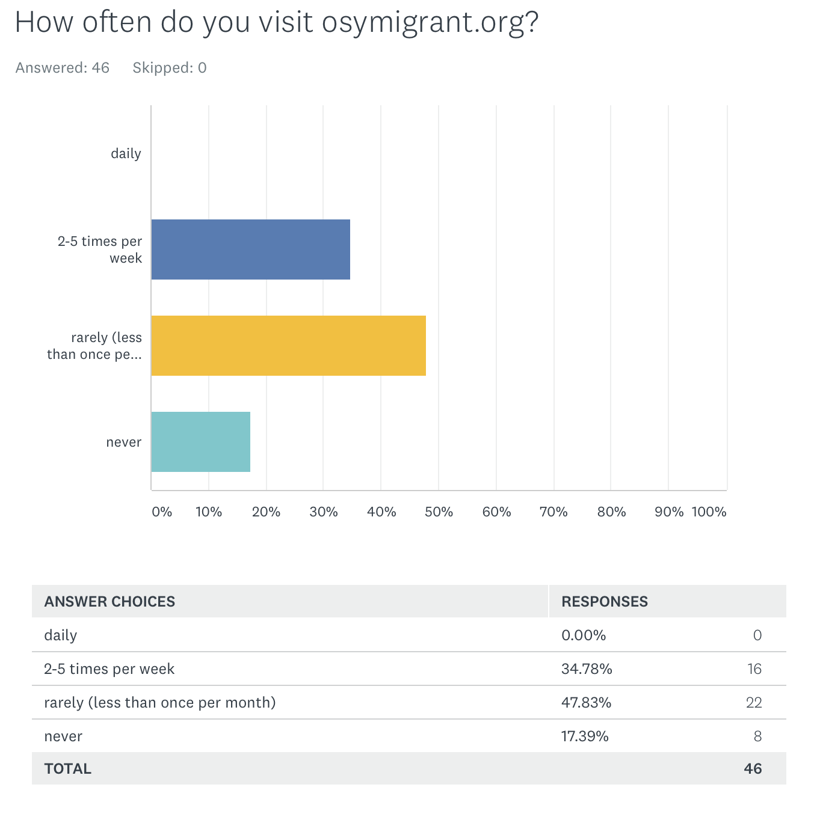
TITLE
GOSOSY Website User Survey
www.osymigrant.org

Slide 8
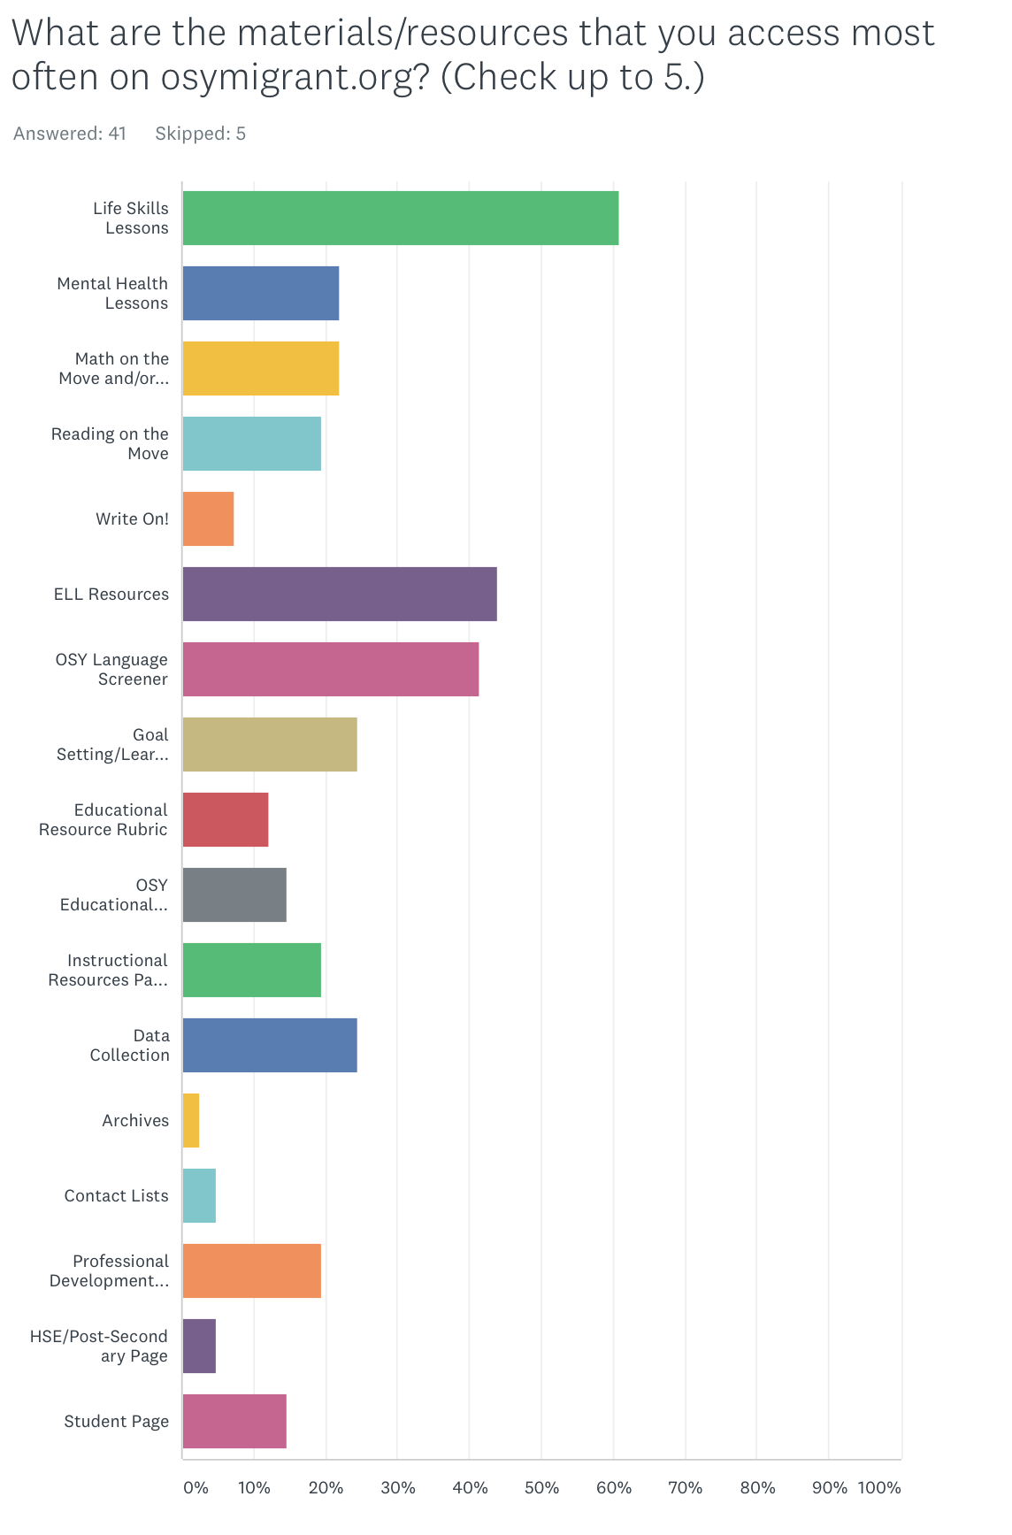
GOSOSY Website User Survey

Slide 9
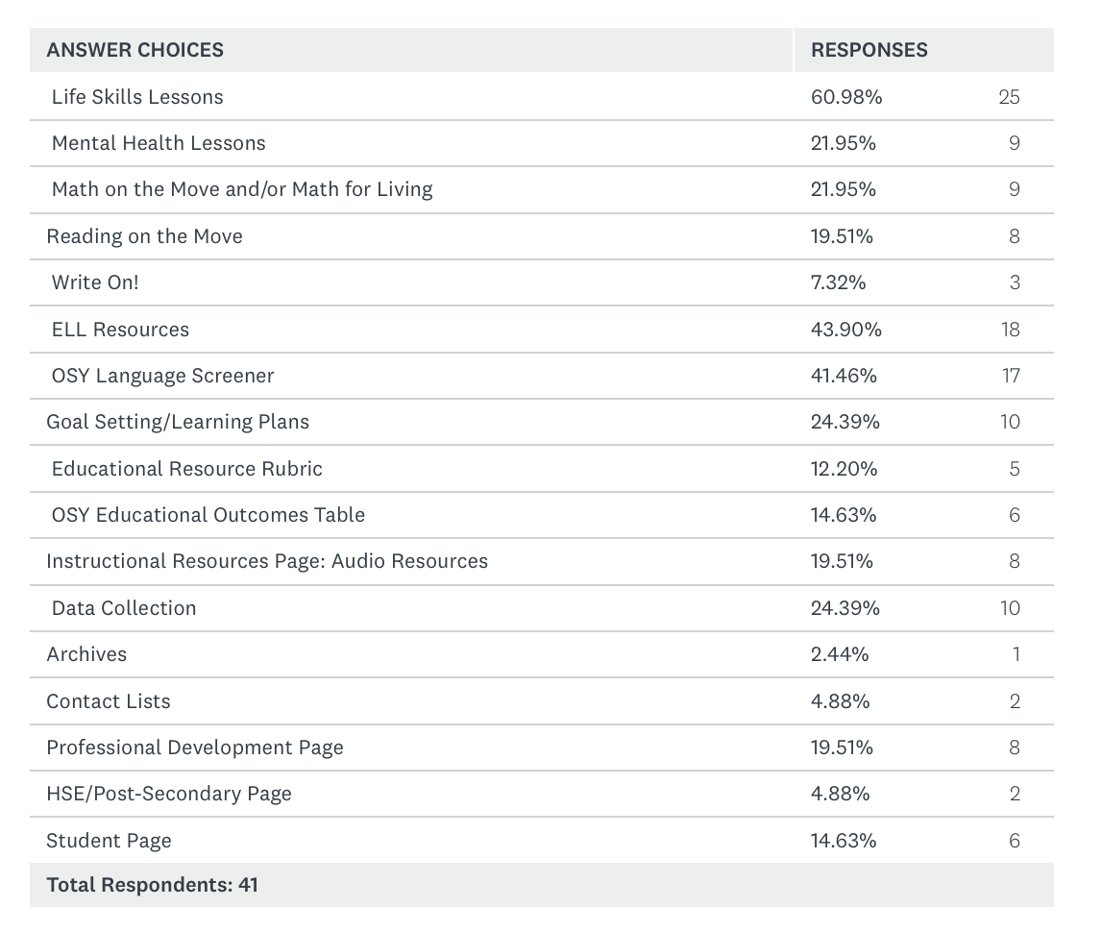
TITLE
GOSOSY Website User Survey
www.osymigrant.org

Slide 10
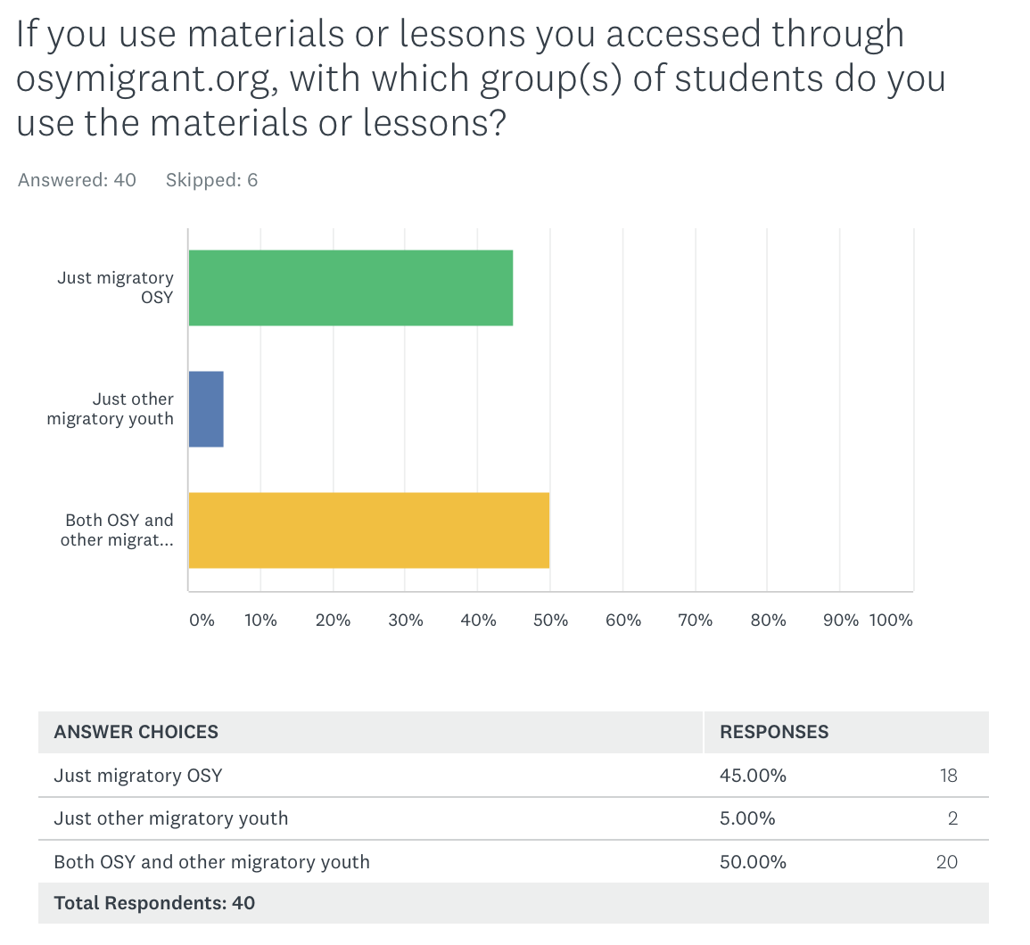
TITLE
GOSOSY Website User Survey

Slide 11
Google Analytics
GOSOSY Site
www.osymigrant.org

Slide 12
GOSOSY Website Update
www.osymigrant.org

Slide 13
GOSOSY Website Update
www.osymigrant.org

Slide 14
GOSOSY Website Update
www.osymigrant.org

Slide 15
GOSOSY Website Update
www.osymigrant.org

Slide 16
GOSOSY Website Update
www.osymigrant.org

Slide 17
GOSOSY Website Update
www.osymigrant.org

Slide 18
Technical Support Team
Expectations
Membership
State Director expectations
Requirements
2-3 meetings per year
Conference calls
Work assignments
Team Lead meeting
Collaboration and coordination across groups
Work Norms
Be fully committed to the work and demonstrate this commitment by meeting agreed upon deadlines, participating/attending meetings and calls until outcomes/goals are fully met.
Leave each meeting with tangible products/achievements synthesizing our meeting outcomes.
Use included reflection time to promote spontaneous, creative discussion.
www.osymigrant.org
Notes:
Purpose- responsibilites
Who to send?
Mentoring Pilot- World Education
Tracie will ask MA, TN, VT, GA, and CA
Mental Health-- KS
Goal Setting – TOT Work Group – Sonja Williams (lead)—Ernesto?
PD- Develop training to certified and non-certified staff – Jessica Castaneda (Lead)
ID&R – in collaboration with IRRC—Jennifer Almeda (lead)
Develop web-accessible lessons- Material Development—Bob Lynch and Brenda Pessin-- leads
With support and guidance from World Ed – Andy Nash
OSY Learning Plan—Emily Hoffman
With Steve Quonn

Slide 19
TST Work Groups
OSY Engagement and Relationship Building
Curriculum and Material Development
Goal Setting and OSY Learning Plans
Professional Development
Interstate Collaboration
Mental Health/Trauma
www.osymigrant.org

Slide 20
OSY Engagement and Relationship Building
Emily Hoffman (team lead), Rachel Beech,
Joyce Bishop
FII 2.2c
Develop and finalize materials
Provide training on updated OSY engagement/mentoring toolkit
www.osymigrant.org

Slide 21
Curriculum and Material Development
Brenda Pessin (team lead), Peggy Haveard, Rachel Wright-Junio, Jessica Castañeda
1.1f/3.1c/3.1d (in collaboration with GSLP WG)/ Website Redesign
Student Website/Website redesign
English for Daily Life revisions
1.1f Create a list of strategies from the literature with promising evidence for preventing dropouts
3.1d Disseminate tools for portability of GOSOSY materials for highly mobile students
www.osymigrant.org

Slide 22
Professional Development
Sabrina Pineda (team lead), Odillia Cofta, April Dameron, Veronica Hill
2.1b Provide training and technical assistance on designing services for OSY through the TST and its Workgroups using implementation scenarios
2.1c Create materials for certified and non-certified staff regarding one of the following 1) An Introduction to OSY and 2) Addressing the Needs of OSY with Limited Formal Schooling
www.osymigrant.org

Slide 23
Interstate Collaboration
Travis Williamson (team lead), Barbie Patch, Deke Showman
CIG Collaboration
1.1e Develop a list of common barriers for recruiting and providing services for OSY and possible solutions
2.2a Provide training at TST and training of trainers regarding networking for effective interstate collaboration and interagency collaboration (e.g. HEP, other CIGs)
2.2b Document and report collaboration results
www.osymigrant.org

Slide 24
Goal Setting and Student Learning Plans
Sarah Braun Hamilton (team lead), Monika Lorinczova, Justyn Settles, Emily Williams
1.2a Create scenarios for best practices in use of the updated OSY Learning Plan templates
1.3a Create scenarios for best practices in the use of updated Goal Setting Workshop (GSW) materials
1.3c Train GSW facilitators based on scenarios
1.3d Conduct GSWs and assess using project-based activity and rubric (design project-based activity and rubric)
3.1d Disseminate tools for portability of GOSOSY materials for highly mobile students
www.osymigrant.org

Slide 25
Mental Health/Trauma
Lora Thomas (team lead), Lysandra Alexander, Susanna Bartee, Susana Des Neves, Maria Dominguez, John Farrell
1.1c Incorporate strategies and best practices from the literature review into mental health lessons for OSY
1.1d Develop materials that describe how trauma impact academic performance and strategies for educators
2.2d Prepare training materials to go along with OSY mental health lessons based on staff needs assessment results
3.1b Disseminate materials that describe how trauma impacts academic performance and strategies for educators
www.osymigrant.org

Slide 26
Additional Work - Professional Development
Multiple Work Groups:
3.2a Conduct a training of trainers regarding implementation of updated and newly created GOSOSY materials and strategies including scenarios for implementation, addressing the impact of trauma on OSY, and portability solutions for highly mobile students
3.2b Create a GOSOSY Training of Trainers rubric for participants at the training of trainers
www.osymigrant.org

Slide 27
Preparing for College
Prepared by the National PASS Center
In Collaboration with the Illinois Migrant Education Resource Project
Geneseo Migrant Center
Leichester, NY
(May be used independently or as an option to replace Unit 5 of the PASS Language Arts III and IV courses)
www.osymigrant.org

Slide 28
Preparing for College Background
Preparing for College was first prepared in 2008 by the National PASS Center in collaboration with the Illinois Migrant Education Program.
To accommodate the many changes in our educational system and the vast amount of material now available online, a re-write of Preparing for College was initiated in 2017 and completed in 2018.
Its purpose remains the same:
To inspire students to graduate from high school and go on to receive some form of post-secondary education, and
To provide students with the information and tools necessary to achieve their education and career goals.

Slide 29
Preparing for College
What are the most important topics to
cover in helping students prepare for
and plan for college?
www.osymigrant.org

Slide 30
Topics Covered in Preparing for College
The Case for College
Goal Setting
Considering a Career
How Will I Pay for College?
College Entrance Exam Strategies
Selecting a College
How to Write a College Essay
The College Visit
College Application
Writing a Personal Resume
The College Interview
Becoming an Adult
Social Media
Review
www.osymigrant.org

Slide 31
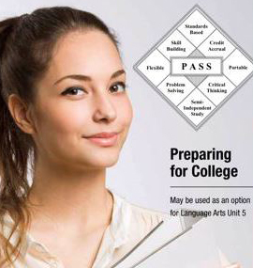
Accessing Preparing for College via the GOSOSY Website
HSE/ Post Secondary Resources
Preparing for College Powerpoint Training for Instructors
Preparing for College Mentor Manual
Preparing for College Course Materials
Preparing for College Pre and Final Tests (password protected)
www.osymigrant.org

Slide 32
Key Features (Patterned After a PASS Unit)
14 lessons including:
Helpful web links
Activities and organizers
Useful vocabulary words and glossary
Comprehension and critical thinking questions
Pre and post tests with answer keys
Mentor Manual
Easy-to-read format with lots of pictures and graphics along with white space for note taking and highlighting questions for the student’s mentor.
Journal writing in each lesson with prompts connected to specific information presented.
Designed with English Learners in mind.
www.osymigrant.org

Slide 33
Preparing for College: Easy to Use
One-on-one or in a group setting.
Accessed online or printed.
Internet access strongly suggested.
Links to important web sites included in many lessons.
Used sequentially as an entire unit or lesson-by-lesson according to the specific needs and interests of students.
www.osymigrant.org

Slide 34
Preparing for College: Unpacking the Course
Lessons 1 - 6 Focus on Getting Ready to Apply for College
Why college is important
Setting goals for success
Thinking about careers
Paying for college
Preparing for college exams
Deciding what colleges might be best
www.osymigrant.org

Slide 35
Preparing for College: Unpacking the Course
Lessons 7 - 11 Focus on Applying for College and Being Successful in College
Writing the college essay
Making the most of a college visit
Completing a college application
Writing a personal resume
Preparing for a college interview
www.osymigrant.org

Slide 36
Preparing for College: Unpacking the Course
Lessons 12 - 13 Focus on Preparing for Adulthood
Taking personal responsibility
Making safe and effective use of online resources
Lesson 14 Is a Review including a reflective journey
Pre and Post Exams with answer keys
Glossary
Appendix
College Checklist by Year of High School
Websites Cited in the Document
www.osymigrant.org

Slide 37
Preparing for College: Taking a Look at Some of the Lessons
The lessons can be a journey of self-discovery, as students learn more about who they are as a person, their likes, dislikes, and what makes them stand out from everyone else.
This information may help in choosing a career that fits a student’s personality and skill set and identifying the right educational path to reach that career goal.
www.osymigrant.org

Slide 38
Preparing for College: The Case for College
This first lesson is designed to motivate students to finish high school and find a fulfilling career.
Unemployment rates and earnings by educational attainment data are shared.
The prevailing message is:
A student who has the desire to go to college can find a way!
www.osymigrant.org

Slide 39
Preparing for College: First in the Family
The curriculum recognizes that many migrant students will be the first in their family to go to college.
This can be scary for the student since no one at home can guide them through this process.
There is a website for First Generation Students with lots of information to help them through the college process.
http://www.firstinthefamily.org/highschool/index.html
www.osymigrant.org

Slide 40
Preparing for College: Goal Setting
www.osymigrant.org

Slide 41
Preparing for College: Considering a Career
www.osymigrant.org

Slide 42
Preparing for College: Career One Stop and My Majors
https://www.careeronestop.org/
Free website that can be used in English or Spanish.
Provides self, career and skill assessments as well as career exploration, ways to find job training, and ways to find jobs.
www.MyMajors.com
Links the kind of training needed to obtain a job in a particular career field.
Provides an opportunity to explore different college careers to see what best fits a career choice.
www.osymigrant.org

Slide 43
Preparing for College: Career One Stop and My Majors
https://www.careeronestop.org/
Free website that can be used in English or Spanish.
Provides self, career and skill assessments as well as career exploration, ways to find job training, and ways to find jobs.
www.MyMajors.com
Links the kind of training needed to obtain a job in a particular career field.
Provides an opportunity to explore different college careers to see what best fits a career choice.
www.osymigrant.org

Slide 44
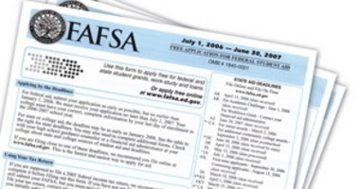
Preparing for College: Paying for College
Types and sources of scholarships and financial aid
Beginning with the FAFSA (Free Application for Federal Student Aid)
Create a Federal Student Aid ID
Gather important documents
Practice filling out an application
Comparing financial aid packages
Timelines
www.osymigrant.org

Slide 45
Preparing for College: College Green Light
https://www.collegegreenlight.com/
Website designed to aid first generation or minority students in their quest to go to college.
Can be used to search for colleges and scholarships.
An entire section on scholarships for undocumented students.
Also the MALDEF scholarship resource guide for DACA and undocumented students:
www.Maldef.org/leadership/scholarships
www.osymigrant.org

Slide 46
Preparing for College: College Entrance Exams
ACT and SAT
General test-taking skills
Skills for specific tests
PSAT/NMSQT
SAT
ACT
Sample writing prompt
www.osymigrant.org

Slide 47
Preparing for College: Selecting a College
Clarifies the options available and the differences between trade/vocational schools, community colleges, public and private universities.
Explains the differences between certificates, associate’s degrees, bachelor’s degrees, graduate and professional degrees.
Provides organizational tools for documenting the student’s research on schools
www.osymigrant.org

Slide 48
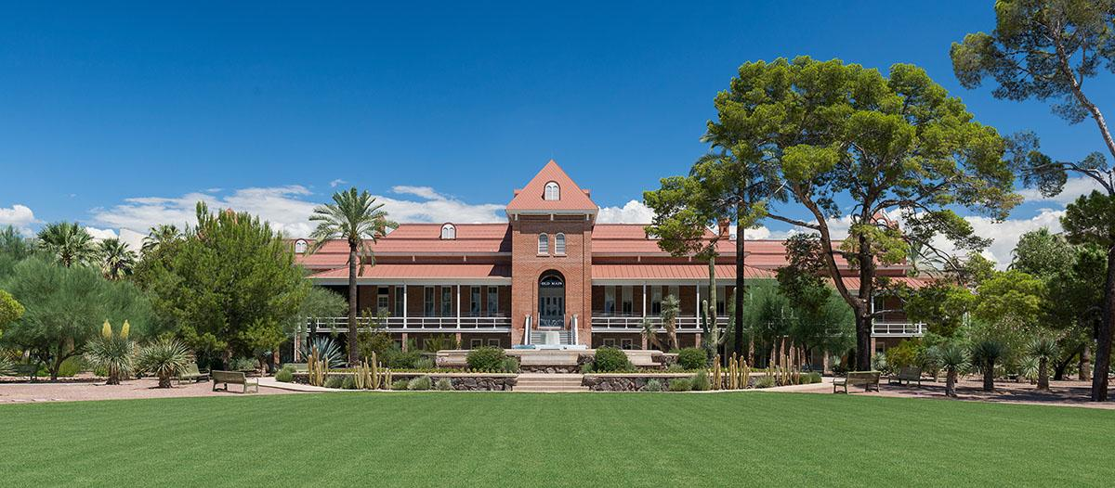
Preparing for College: Big Future through College Board
https://bigfuture.collegeboard.org/
Part of the College Board website.
Specifically designed to help students search for colleges, explore careers and majors as well as search for scholarships
A good tool for students to use to create their own road map to college.
www.osymigrant.org

Slide 49
Preparing for College: Writing the College Essay
Encourages authenticity and references the journals students have been keeping to identify their strengths/weaknesses, likes/dislikes, what’s important to them, what they have been involved with, and what they want to do with their lives.
Reviews the Writing Process.
Provides tips for writing an effective essay.
Can easily be used as a stand-alone lesson in tutorial sessions or summer programming.
www.osymigrant.org

Slide 50
Preparing for College: The Common Application
Filling out the Common Application—PRACTICE with the paper copy provided.
Tips for completing.
Importance of letters of recommendation.
Additional information requested by specific colleges.
A word about rejection and alternatives.
www.osymigrant.org

Slide 51
Preparing for College: The Resume
Types of information to include and why it’s important.
Organizing the information.
A potential stand-alone lesson for use with all secondary and OSY students to help with applying for jobs, colleges, scholarships, etc.
www.osymigrant.org

Slide 52
Preparing for College: Campus Visits
Using internet sites, virtual tours, emails, etc., to narrow down the campuses to visit.
Types of campus visits.
College visit checklist with key steps to prepare for the visit, explore the facilities, make connections and ask questions, take notes and reflect.
Types of questions the interviewer might ask.
Tips for the interview.
Suggested follow-up steps.
www.osymigrant.org

Slide 53
Preparing for College
For more information, please contact:
Brenda Pessin
Consultant
Brenda_pessin@msn.com
Tracie Kalic
GOSOSY Director
tkalic@embarqmail.com
www.osymigrant.org

Slide 54
Future Meeting Dates
State Steering Team Meeting dates:
During or prior to OME ADM
TST Meeting date:
February 25-26, 2020
www.osymigrant.org

